Slide 1
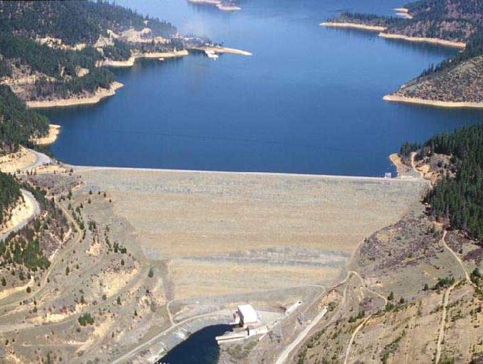
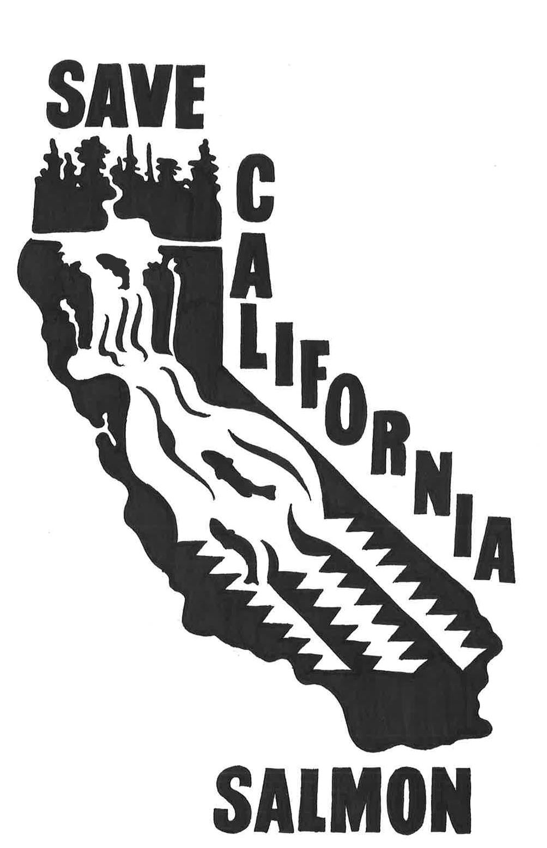
Threats to the Trinity River Water Protection Speaker’s Series, June 12, 2019
“Provided, That the
Secretary is authorized
and directed to adopt
appropriate measures to
insure the preservation
and propagation of fish
and wildlife, including,
but not limited to,
the maintenance of the
flow of the Trinity River
below the diversion point…”
1955 Trinity River Act
Tom Stokely, Save California Salmon
530-524-0315
tstokely@att.net

Slide 2
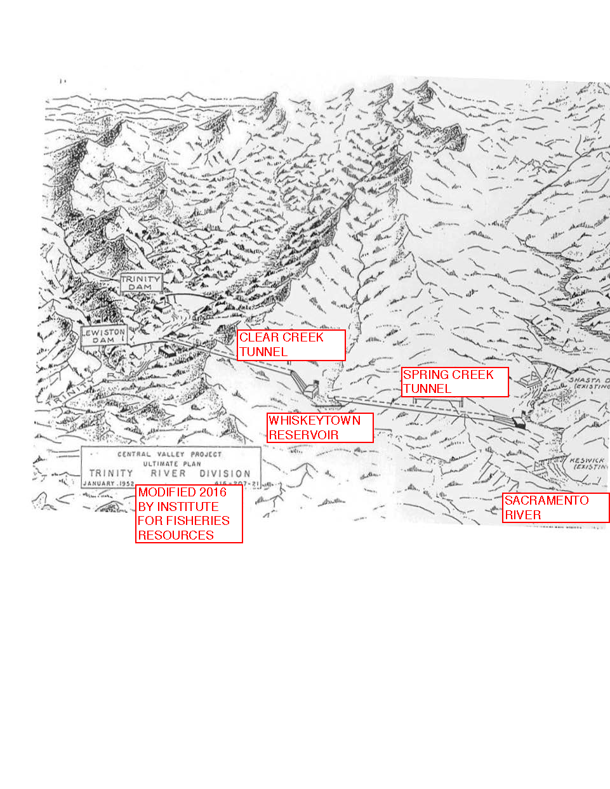
ULTIMATE PLAN
FOR TRINITY RIVER
DIVISION, USBR,
1952, MODIFIED BY
IFR, 2016

Slide 4
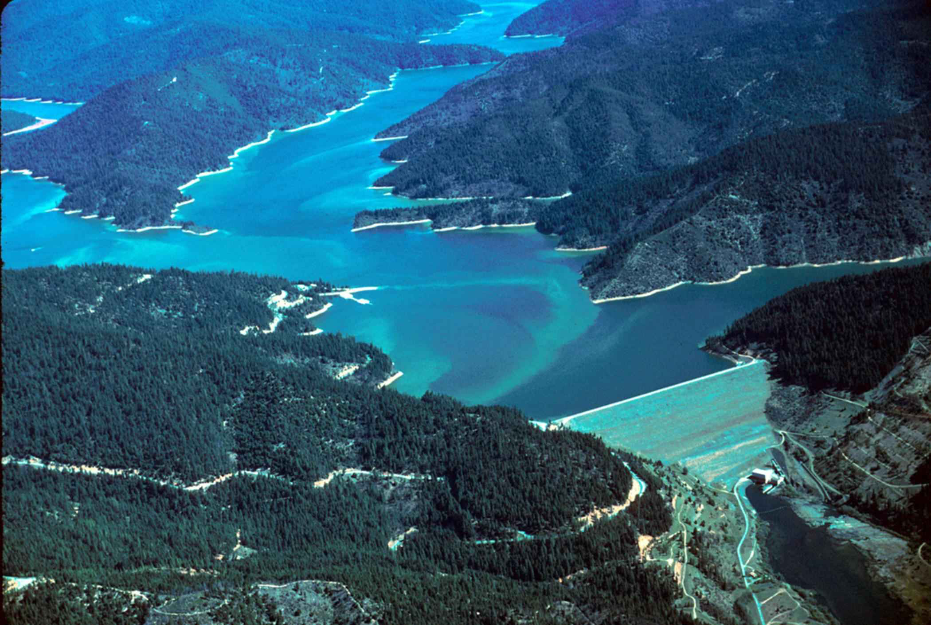
TRINITY DAM
& RESERVOIR
Photo: Tupper Ansel Blake, USFWS, Wikipedia

Slide 5
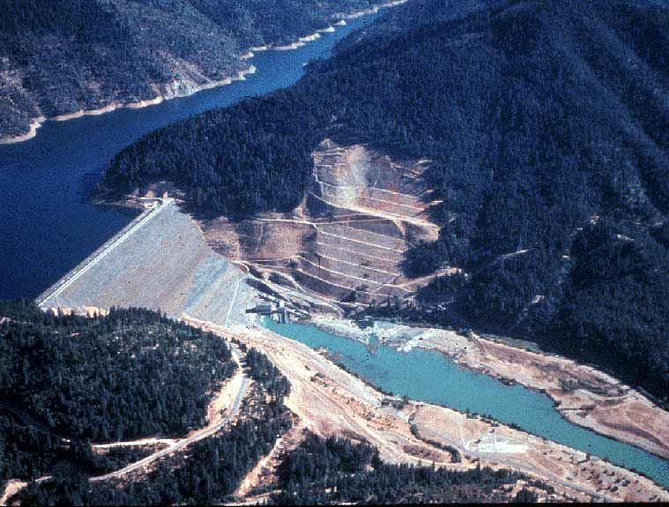
Photo: Krisweb

Slide 6
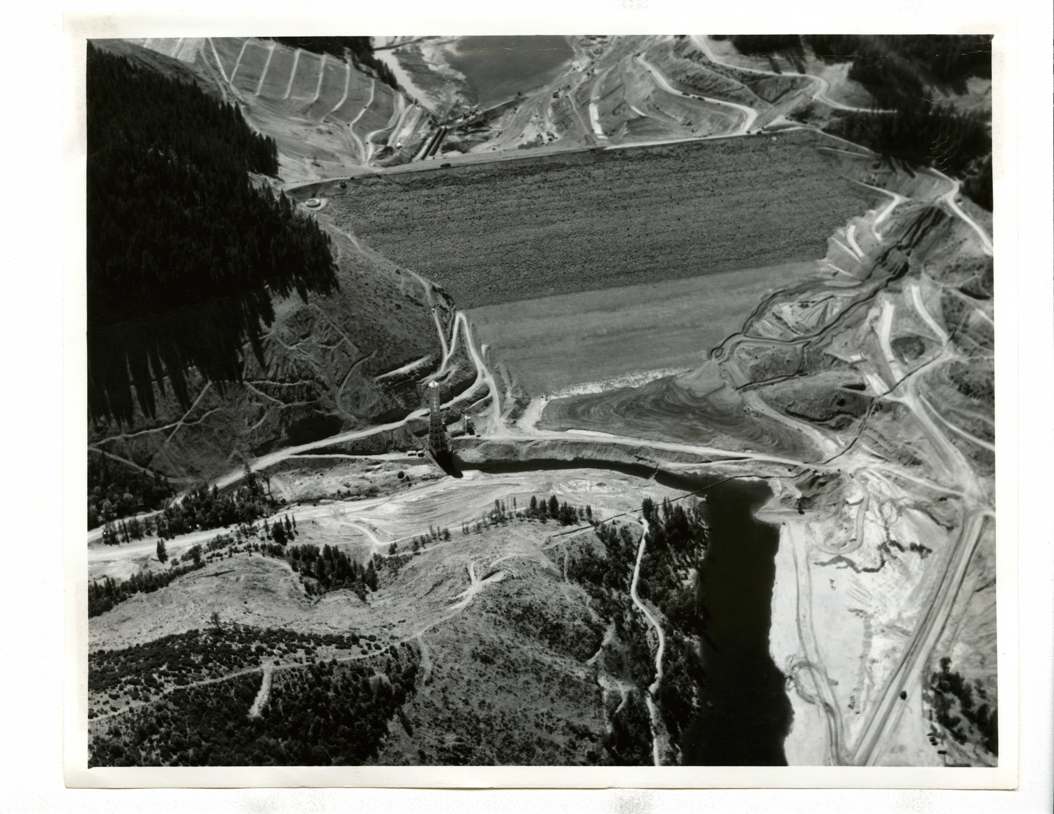
Photo: USBR

Slide 7
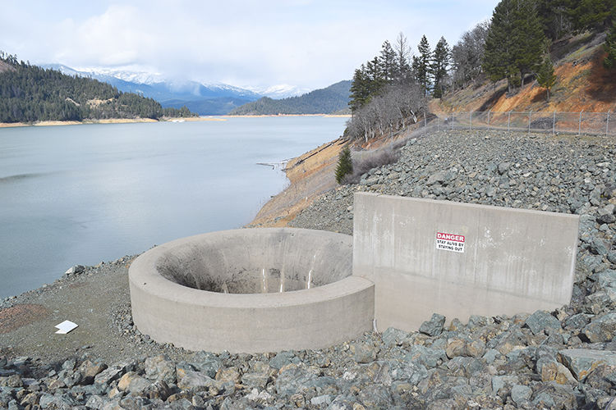
TRINITY DAM GLORY HOLE Photo: Trinity Journal

Slide 8
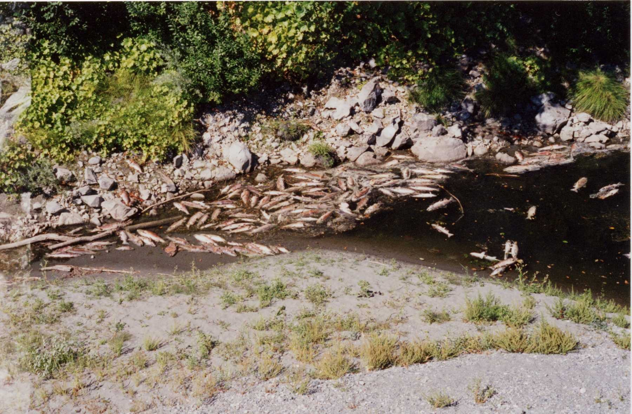
1970’s: Damage to Trinity River Fisheries is severe Trinity River Task Force is formed
1975: Experiments with increased flows begin
1977: Driest year on record in California, Trinity Lake drained to approximately 10% of its capacity (224,000 af)- cold water pool nearly exhausted, but Powerplant remains in operation
1977: Trinity River Hatchery Fish Die because Reclamation refuses to bypass the Powerplant to provide cold water to the fish until September 9, 1977

Slide 9
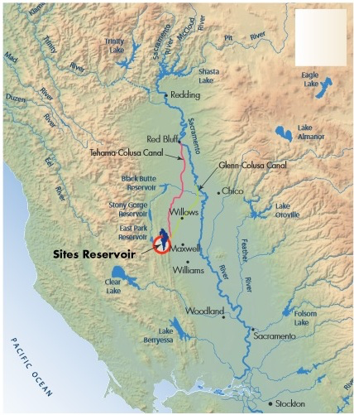

Slide 10
SITES IMPACTS TO TRINITY RIVER AND HUMBOLDT COUNTY PER KAMMAN HYDROLOGY REPORT:*
MODELING DOES NOT INCLUDE HUMBOLDT COUNTY’S 50,000 ACRE FOOT CONTRACT OR LOWER KLAMATH RECORD OF DECISION
CHANGES IN TIMING OF DIVERSIONS TO SACRAMENTO RIVER FROM FALL MONTH TO WINTER INCREASES RIVER TEMPERATURES DURING FALL SPAWNING PERIOD BUT IMPACT NOT DISCLOSED
DECREASES IN WINTER TRINITY RIVER FLOWS
PROPOSED 5,000 CUBIC FEET PER SECOND MINIMUM BYPASS FLOW IN SACRAMENTO RIVER IS INADEQUATE TO PROTECT SACRAMENTO RIVER SALMON, AN IMPORTANT COMPONENT OF NORTH COAST OCEAN SALMON FISHING (NOT MENTIONED IN KAMMAN REPORT)*

Slide 11
TRUMP WATER PLAN= TRINITY LAKE UP TO 350,000 AF LOWER THAN MODEL RESULTS=DEAD FISH IN TRINITY AND LOWER KLAMATH RIVERS!

Slide 12
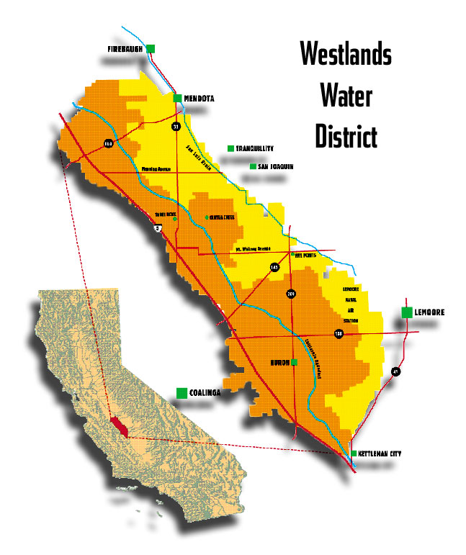
1953: Westlands Water District joins the fight in promoting legislation to dam the Trinity River
For a history of ”How the Trinity Lost It’s Water” to Westlands, see http://trinity-lake.com/water/HowTrinityRiveLostItsWater.pdf
Congressman Clair Engle and the “California Committee for Trinity River Development” promise that the Trinity project “does not contemplate diversion of one bucketful of water which is necessary in this basin” and “the argument that it will ruin fishing is absolute nonsense”
Image Courtesy of Westlands Water District Website

Slide 14
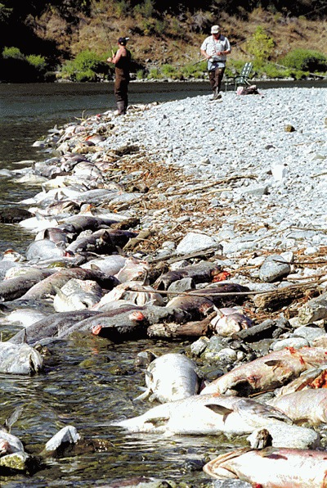
FUTURE CONDITION KLAMATH/TRINITY RIVER FISHERIES?
Central Valley fall-run Chinook salmon in the Yuba River. Photo: Jacob Katz
Lower Klamath River 2002. Photo: California Department of Fish and Wildlife

Slide 16
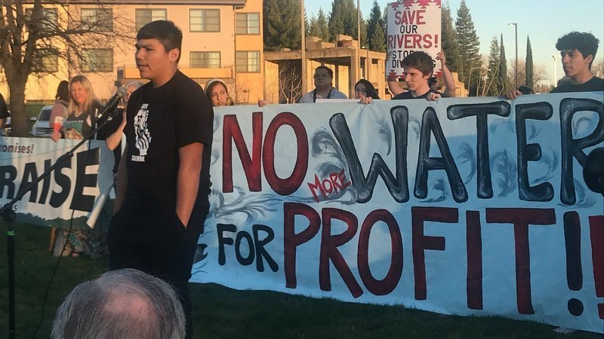
THANK YOU WATER PROTECTORS!

