Slide 1
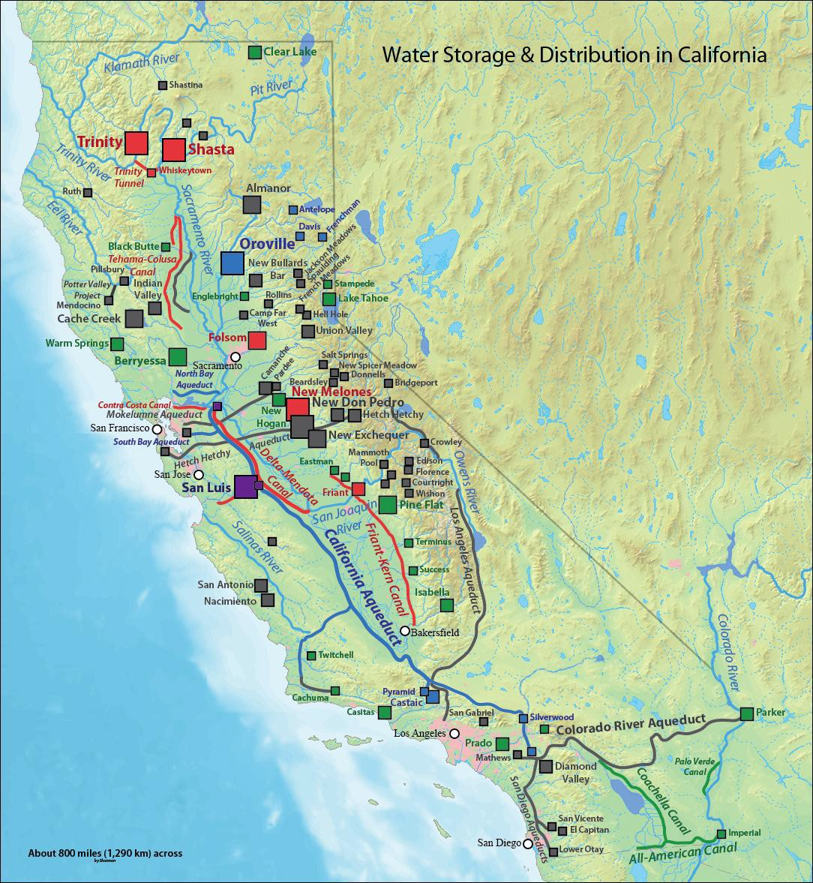
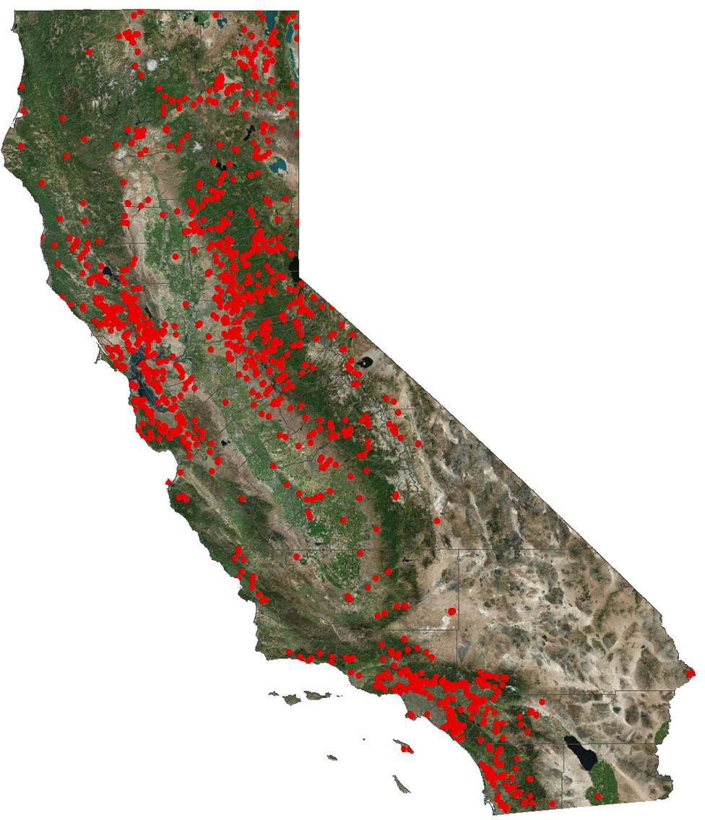
The Bay Delta is a heavily impacted watershed. There are over 1400 dams in California. Many are in on the Bay Delta tributaries. The Delta and SF Bay suffer from levees and dikes.
Many of the the reservoirs the state and federal water projects in California targeted California Tribe’s trust lands.

Slide 2
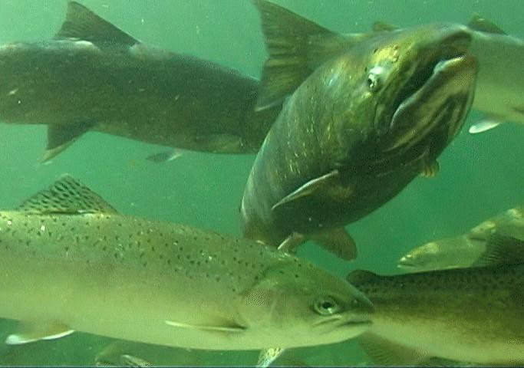
Many of the Bay Delta watersheds used to have abundant runs of salmon and other fish that utilized the cold water in the upper watersheds. There were even runs of salmon, for every season. Now that so much of the watershed is dammed, diked and diverter and there is little habitat left. This has led to the winter run and spring run chinook, green sturgeon and Delta Smelt facing extinction. Reverse flows from large diversion in the Delta also threaten fish. Most of the dams do not have fish passage leaving upstream Tribes without. a valuable food source

Slide 3
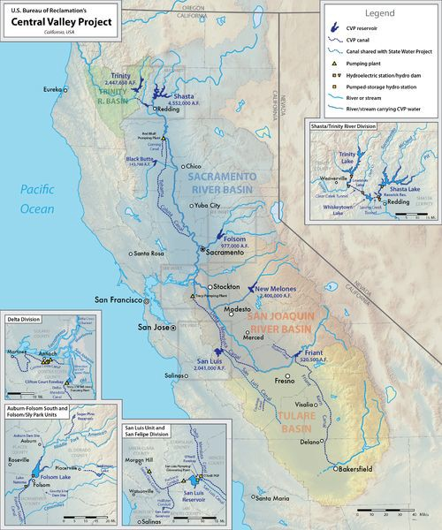
The dams and diversion in the watershed are part of the Central Valley state and federal water projects. These project use many of the same diversions and canals, but they operate different dams. The federal water project alone has 20 dams. The SWP has required the construction of 21 dams and more than 700 miles (1,100 km) of canals, pipelines. The federal water is managed by the Bureau of Reclamation and mainly feeds farms. The state project is mainly based in the Sierras and mainly feeds cities. The projects are usually analysed together and coordinated. There are also many privately held dams
Along with impacting the Central Valley and Sierra Watersheds the Central Valley State state and federal water projects impact the Trinity and Klamath Rivers. The Trinity River is diverted into the Sacramento River near the Shasta Reservoir.

Slide 4
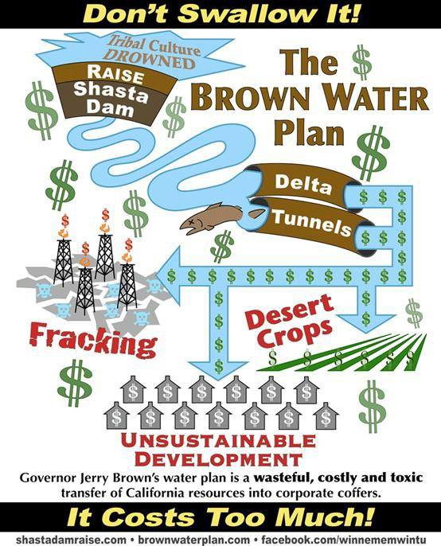
The current processes impacting the Central Valley and Bay Delta Watersheds, along with the Trinity River are.
The Trump Water Plan
The State Water Plan
The Proposal to Raise the Shasta Dam
The Proposal to Build the Sites Reservoir
The Proposal to Build the Temperance Flat Dam
The Westlands Permanent Contract
FERC dam relicensing all over the Sierras
The Delta Water Quality Control Plan Updates
Agricultural Pollution Permits
Water Rights Application

Slide 5
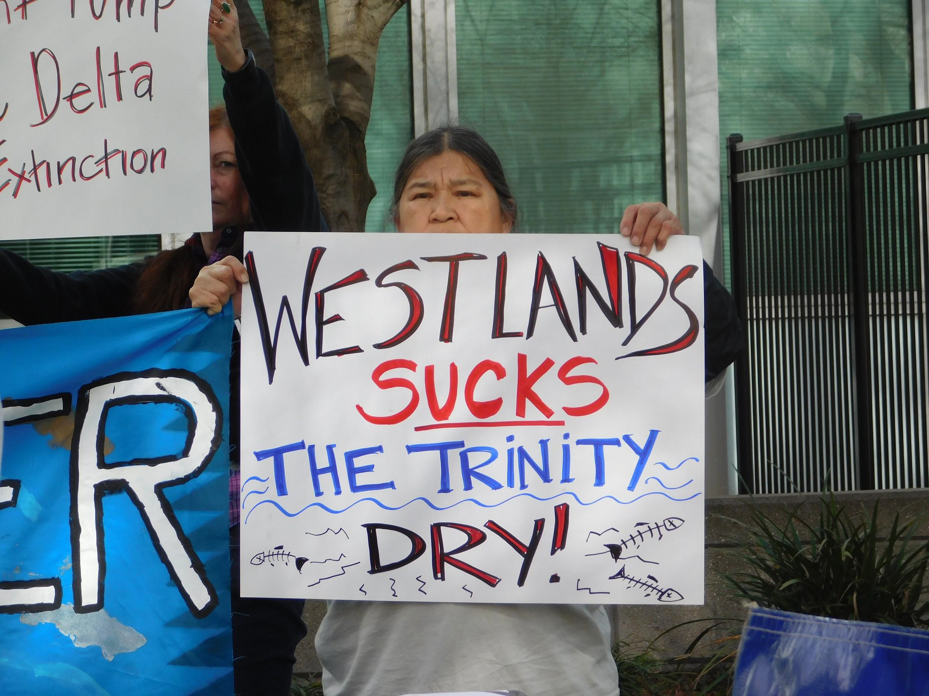
How much water that can be taken is also decided by water rights. Tribes should have senior water rights. Paper water is a huge issue in California.

Slide 6
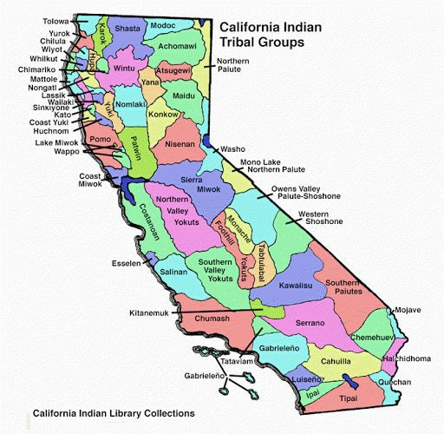
California is the home to many Tribes, many of which do not have federal recognition,or established fishing or water rights. Unlike other salmon states, none of California’s Tribes treaties were ratified and few California Tribes have reservations. Some Tribes do have rancheria and some native people have Indian Allotments or land claims. Many of these lands were taken, with establishment of its state and federal water projects and many Tribes were terminated.
https://www.youtube.com/watch?v=qRmklJfvq74 https://www.youtube.com/watch?v=T-azcPugmKQ
e

Slide 7
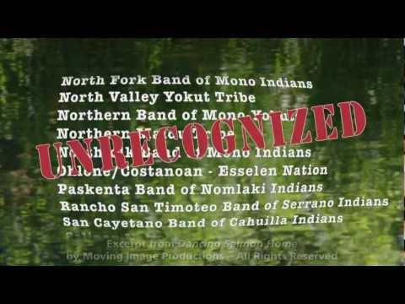

Slide 8


