Slide 1
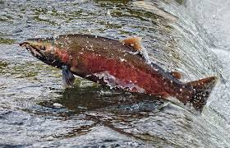
Bringing Salmon Home
Eel River Dam Removal
By Hilanea Wilkinson, Wiyot Tribal Member

Slide 2
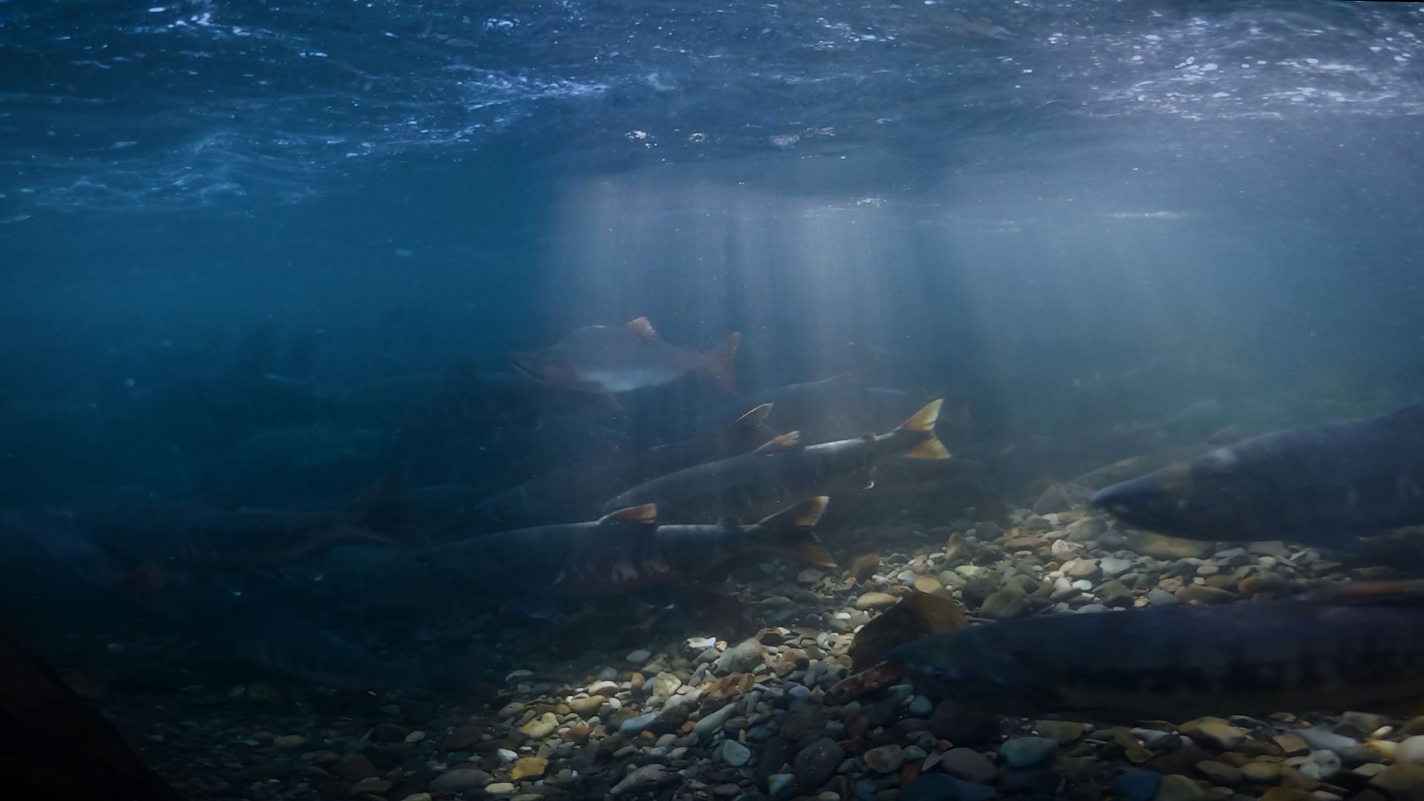

Slide 3
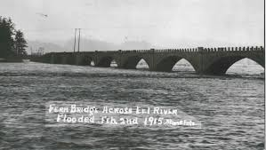
1915

Slide 4
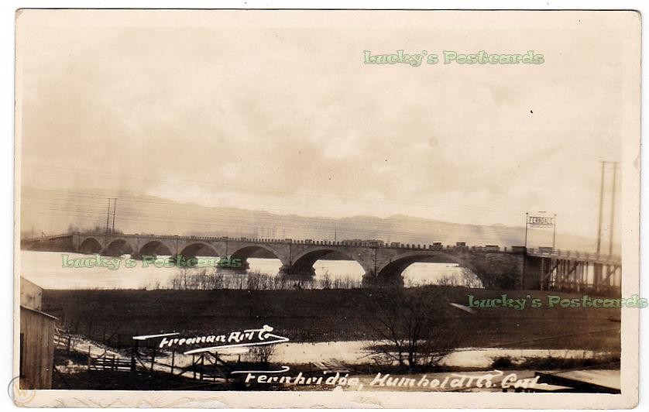

Slide 5
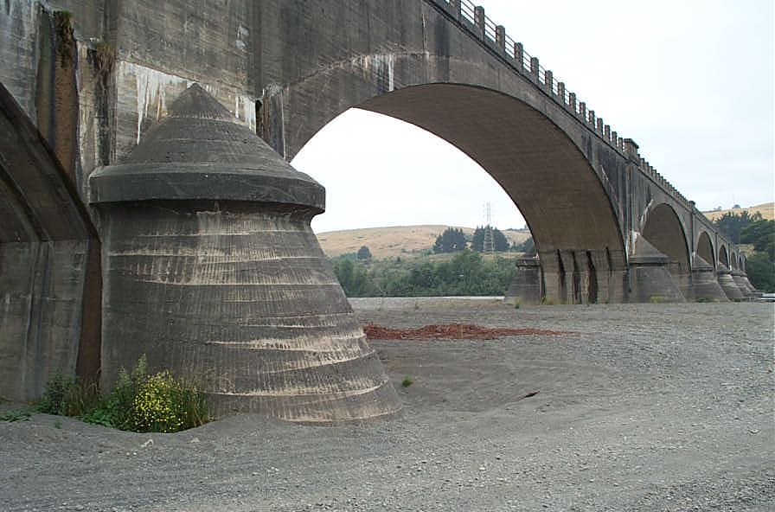

Slide 6
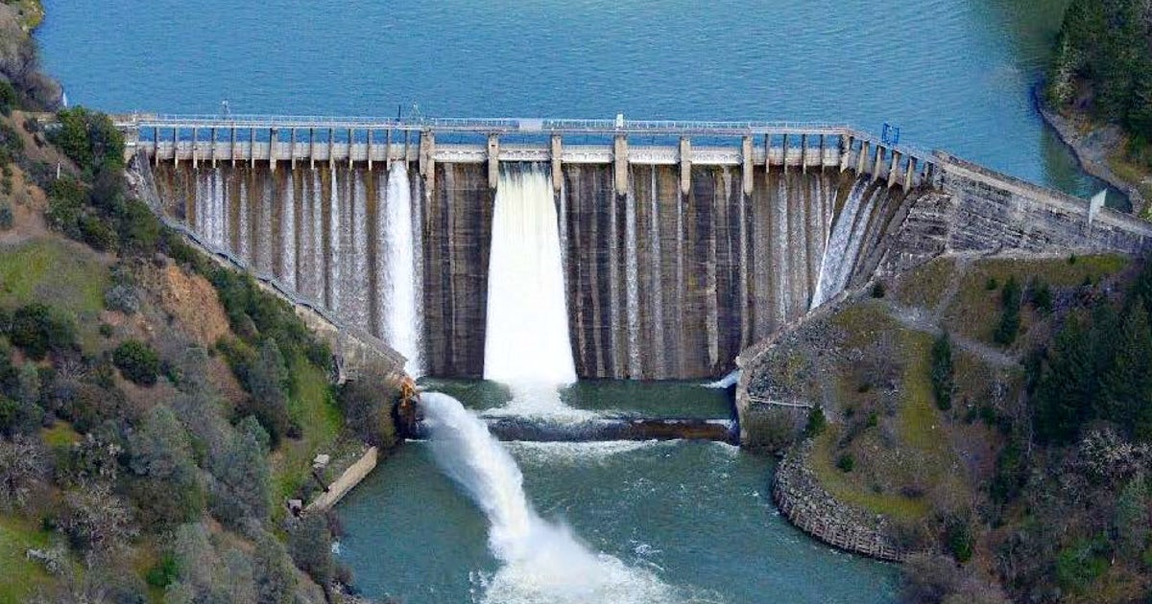
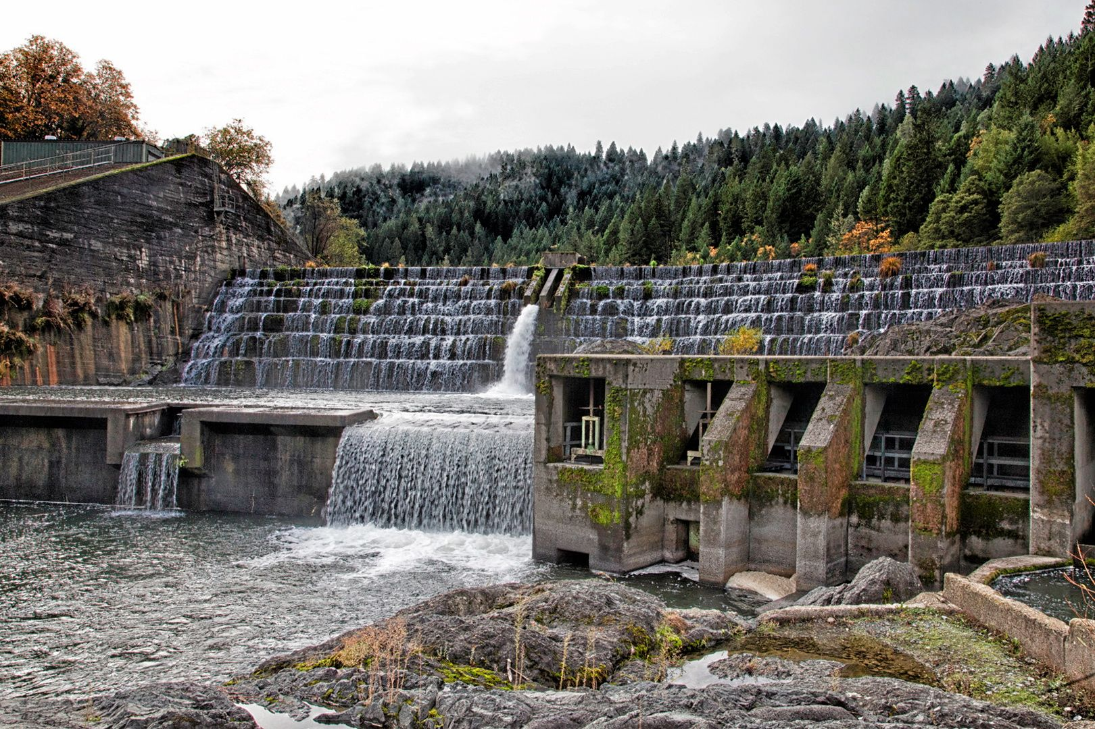
Eel River Dams
Scott dam built in 1922
Cape horn dam built in 1908
Historical records suggests the chinook salmon runs were a bout 100,000-800,000 fish per year.
The first half of the 20th century the runs were only 50,000- 100,000 fish per year

Slide 7
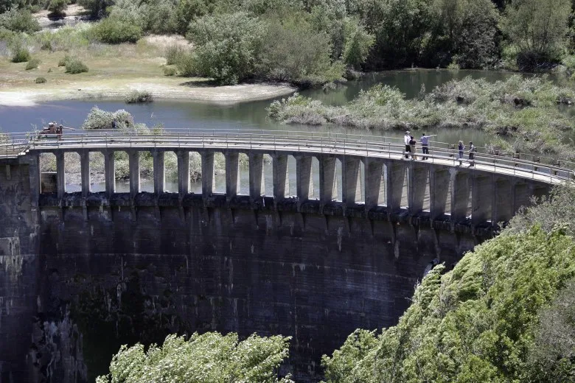
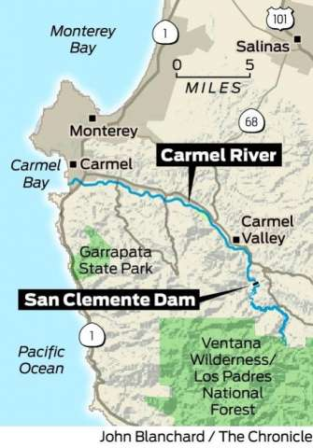
San Clemente Dam
Carmel River, between the Big Sur hills and the beach front town of Carmel.
First dam removal project in CA history
Built in 1921-Removed in 2016
Fish are returning already. So far this year 123 steelhead have traveled upriver.
Notes:
In 2016, the first year after it was removed, researchers found that no steelhead trout, an iconic type of rainbow trout listed as threatened under the Endangered Species Act, swam past its former site to a tagging location seven miles upriver. By 2017, seven steelhead had made the trip. Last year, the count was 29. So far this year, 123 steelhead have traveled upriver.

Slide 8
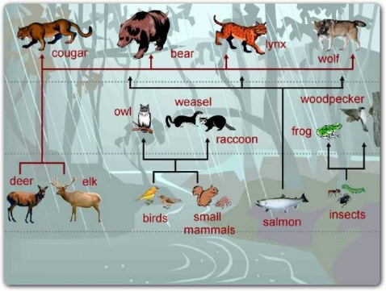
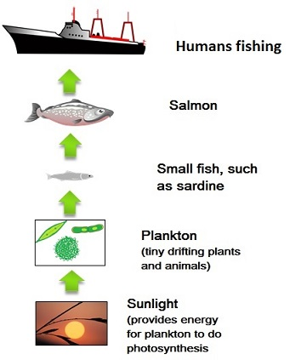
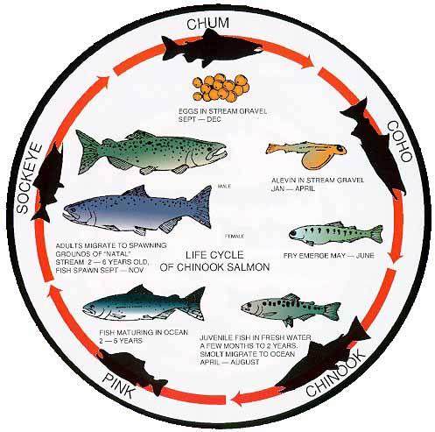
Humans are not the only animals that benefit from the salmon.
When a fish dies in the water the small fish and parasites eat the carcass
Other mammals require the fish to survive. (bear, raccoon, fox, seal)
Scavengers and waterfowl also benefit from the salmon
Notes:
Marine nitrogen detectable in bird feathers. The spawning fish which die are an important food source

Slide 9
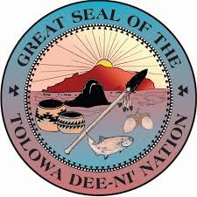
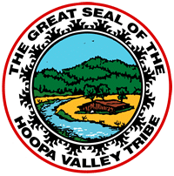
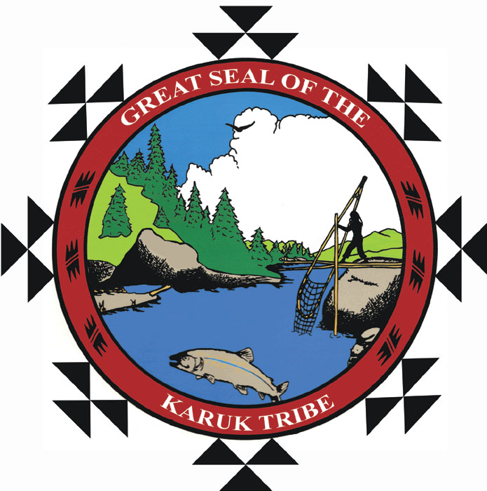
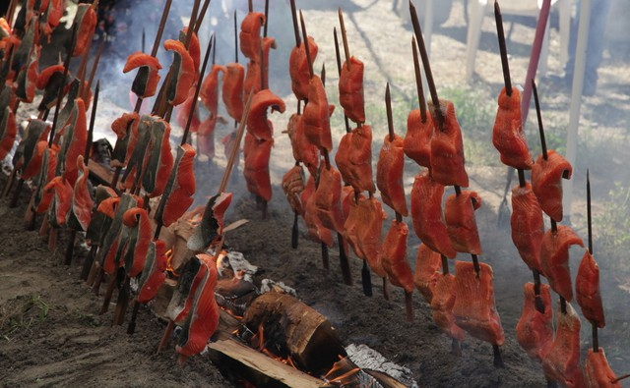
Native Tribes
Water is important in any tribe
Salmon is a staple for everyone around here
Water and animals are sacred
There are Salmon Ceremonies
We take what we need and do not waste anything
Notes:
Pike minnow suppression this summer

Slide 10
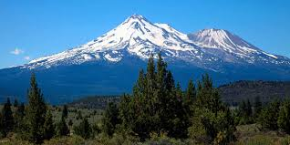
Giving Back
The salmon ceremony in spring. The tribes would place the salmon in a pit with leaves and cook it. When the fish is almost done someone runs it into the mountains to finish the cooking and leaves it there. This is a way to give thanks to the earth and bring the salmon back the next year.
Notes:
A story my aunt cheryl told me. She cant remember where she heard or read it

Slide 11
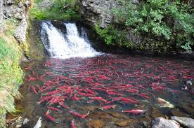
The Return
Removing the dams after several generations means we can help the river heal and prosper. The return of the salmon would greatly benefit every person in california. Not just the tribes and commercial fishing. It would mean a healthier ecosystem and animals around the waterways.
The way the river is deteriorating is causing experts to
hypothesise the extinction of some salmonid species
within 50 years.

Slide 12
