Slide 1
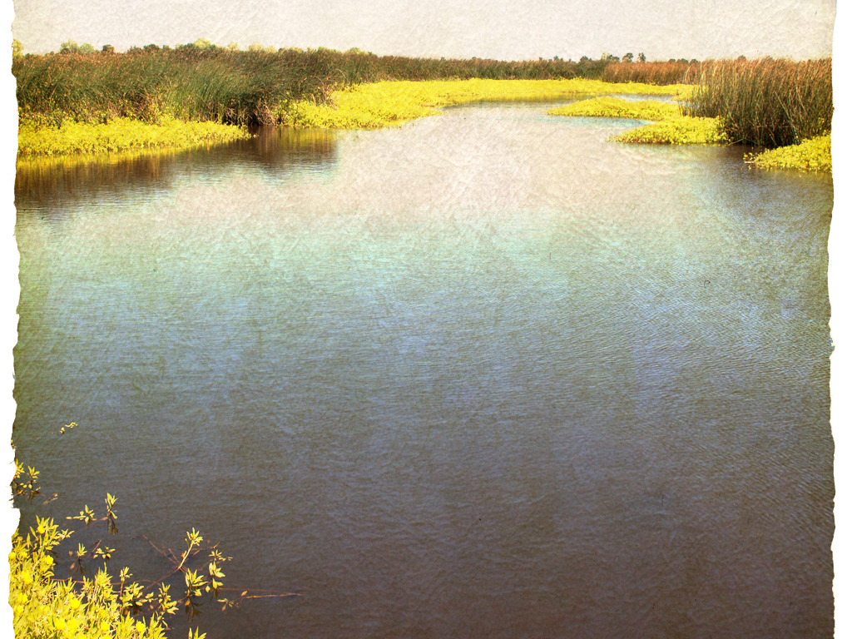
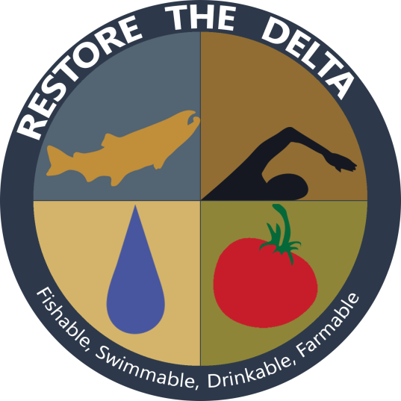
Who We Are
Who We Are
Our mission is to save the San Francisco Bay-Delta estuary for our children and future generations.
Barbara Barrigan-Parrilla
Executive Director
Barbara@RestoretheDelta.org
(209) 475-9550
Barbara Barrigan-Parrilla
Executive Director
Barbara@RestoretheDelta.org
(209) 479-9550

Slide 2
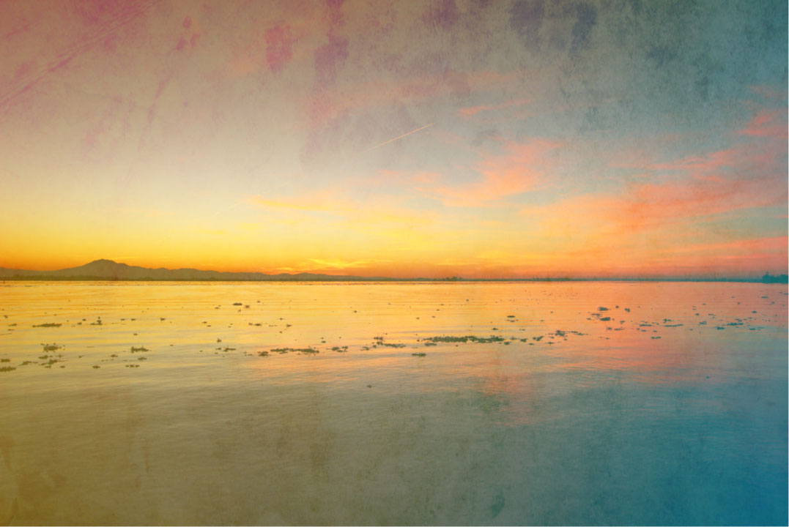
Today’s Presentation:
Why Does The San Francisco Bay-Delta Matter?
How To Solve The Conveyance Challenge?
Federal and State Water Management & Regional Outcomes!
Get Involved.
Connect With Us.
Change The Policy!

Slide 3
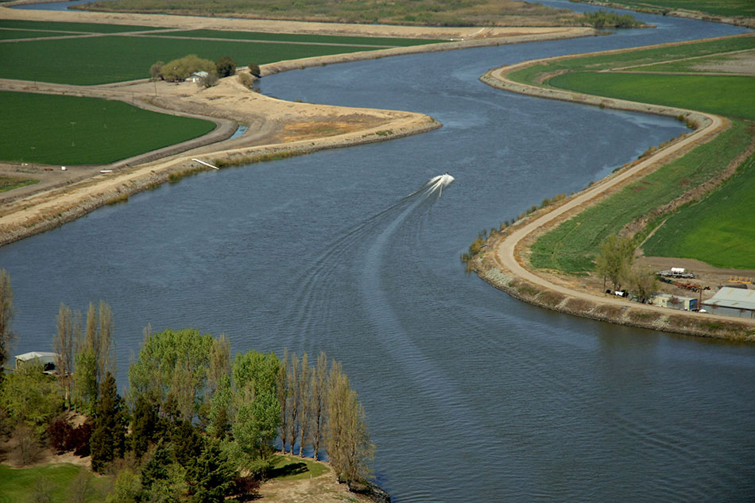
Rivers, Estuary & Water Projects California Water System 101 The science, engineering technical part of the talk today, explained in five maps!

Slide 4
Notes:
Watersheds drain into the Delta –largest estuary – supports fisheries –our fishing legacy salmon- canning etc.

Slide 5
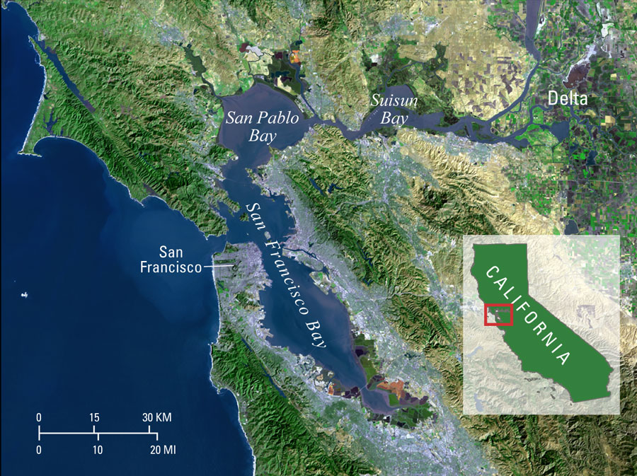
Notes:
Our legacy leaders (farmers developers align with SJ Valley) but I would argue that our watershed ties us geolpolitcially to the Bay Area (perhaps both) – ag still biggest economy (we need new economies and no tunnels) explain where water is pumped

Slide 6
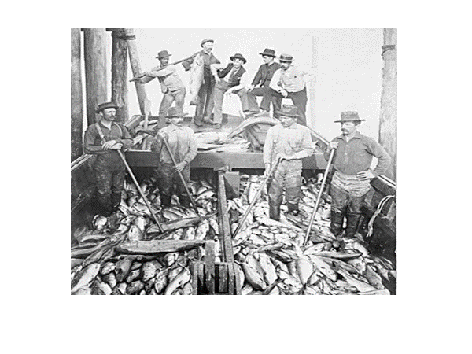
Our Delta’s Natural History! Salmon Runs!

Slide 7
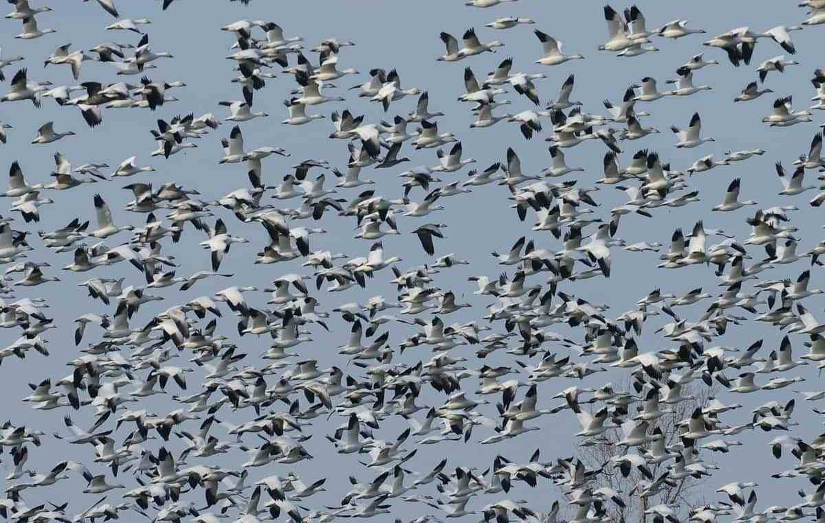
Largest Stop on Pacific Flyway

Slide 8
Central Valley Project

Slide 9
Trump Water Plan
Rollback of the biological opinions to protect fisheries
Rollback of Clean Water Act
Rollback of Endangered Species Act
Rollback of North American Migrating Bird Treaty
Rollback of NEPA
You know this story, the cruelty is the point!

Slide 10
State Water Project

Slide 11
Another view of the SWP

Slide 12
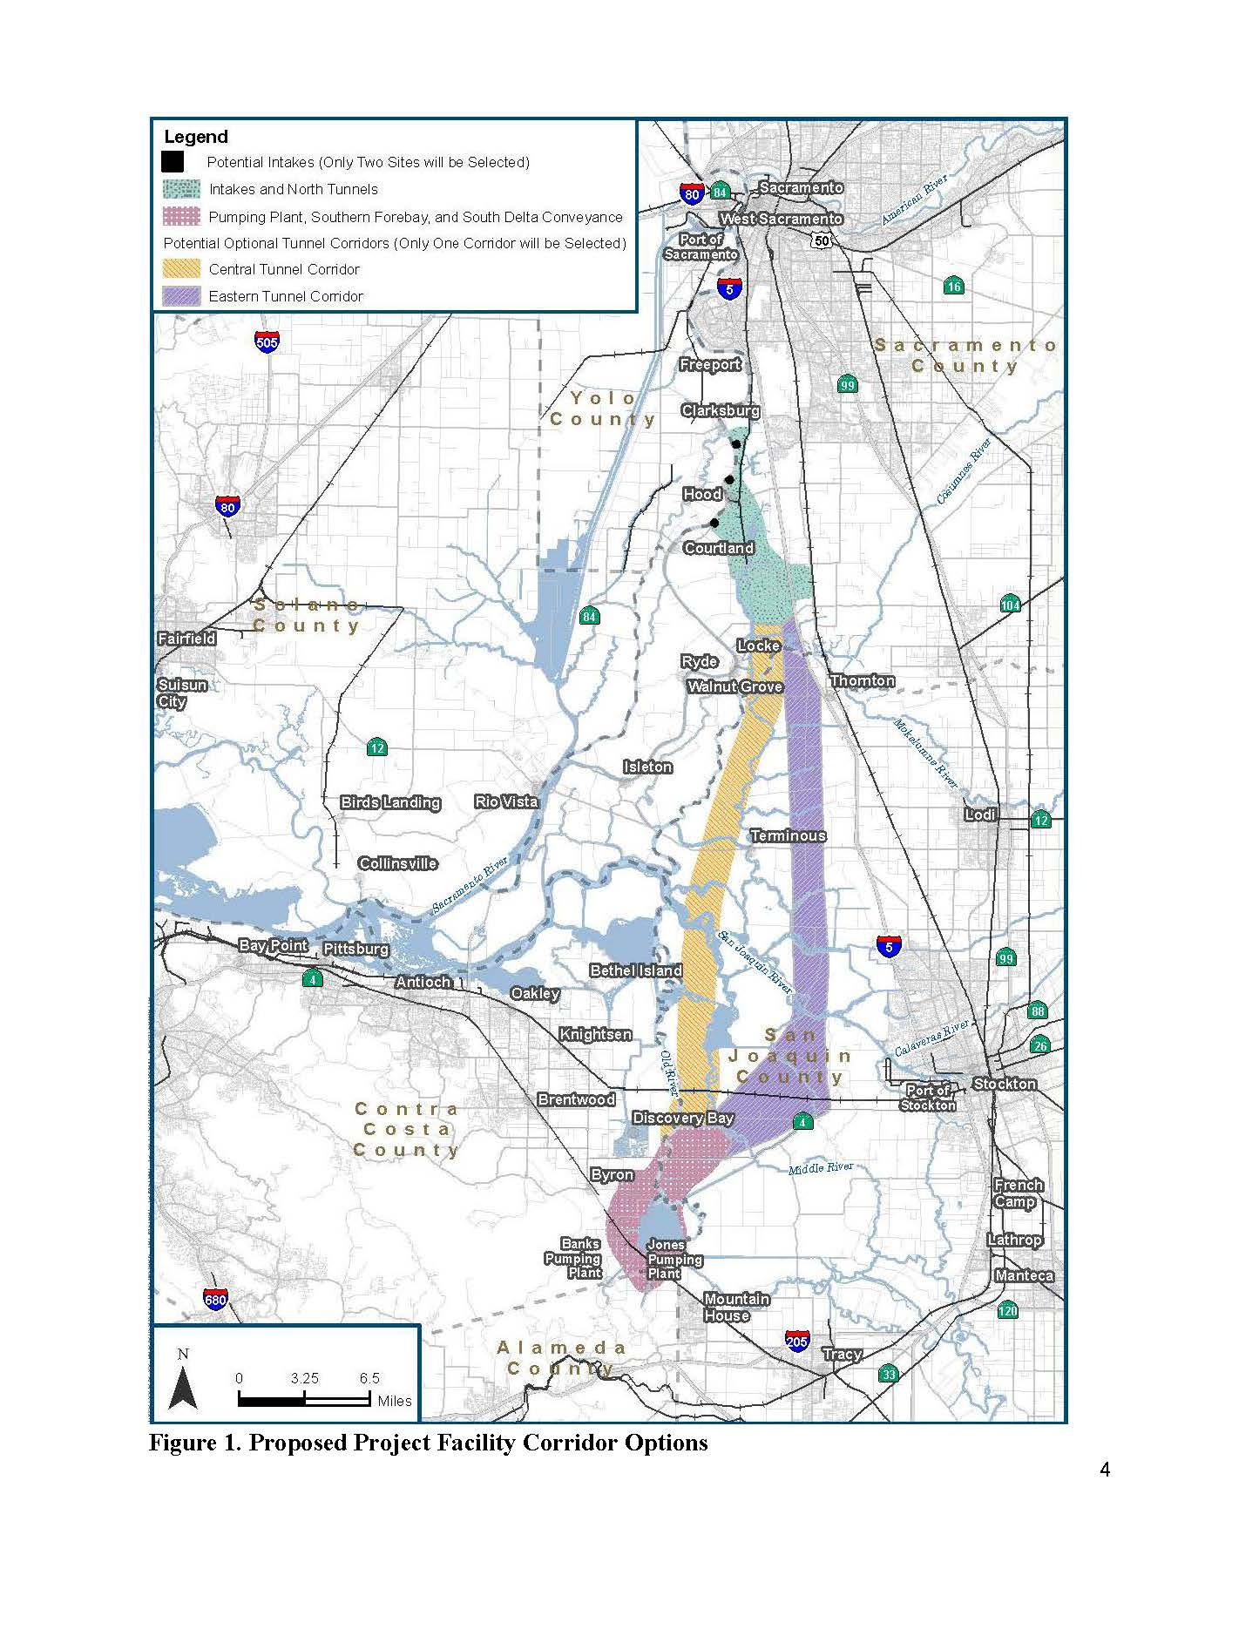
This Photo by Unknown Author is licensed under CC BY-SA
Delta Conveyance Project: AKA Delta Tunnel

Slide 13
Notes:
This is where 70% of wáter goes -- but growers now out – too expensive (and they don’t share wáter with farm worker communities in Valley)

Slide 14
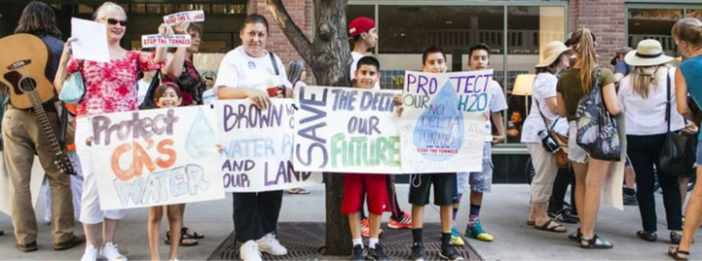
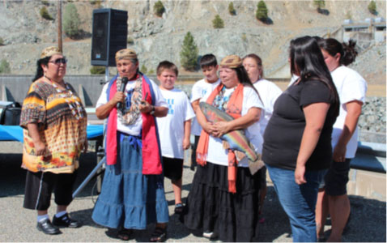
The Delta has 4 million residents. 34% of these residents make up the Environmental Justice Community

Slide 15
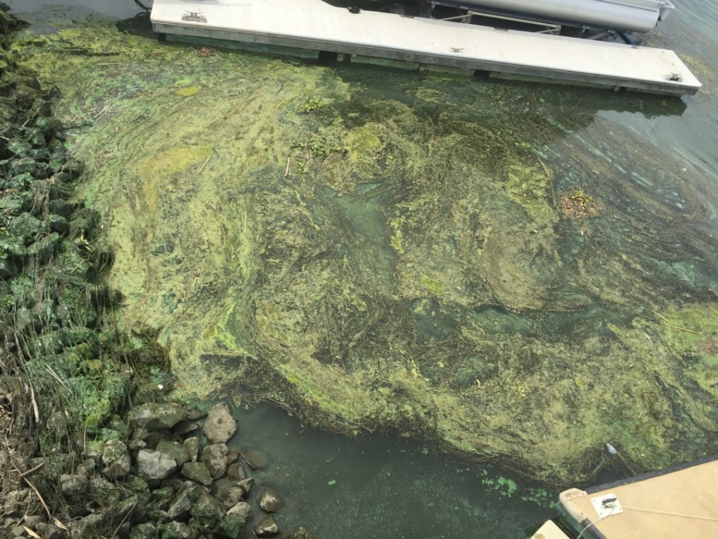
Water Quality Impacts
on Delta Communities
Toxic algal blooms
Construction or operational impacts
Accumulating contaminants
Fish contamination
Degraded water quality
What will be the perception that MWD took
the best water & left this behind?
Notes:
600,000 new cars on the road – loss of public access (not good to begin with)

Slide 16
In 2019, California produced 2.5 billion pounds of almonds, with over 1.25 million acres of almonds planted. Almonds use about 10% of our developed water supply.

Slide 17
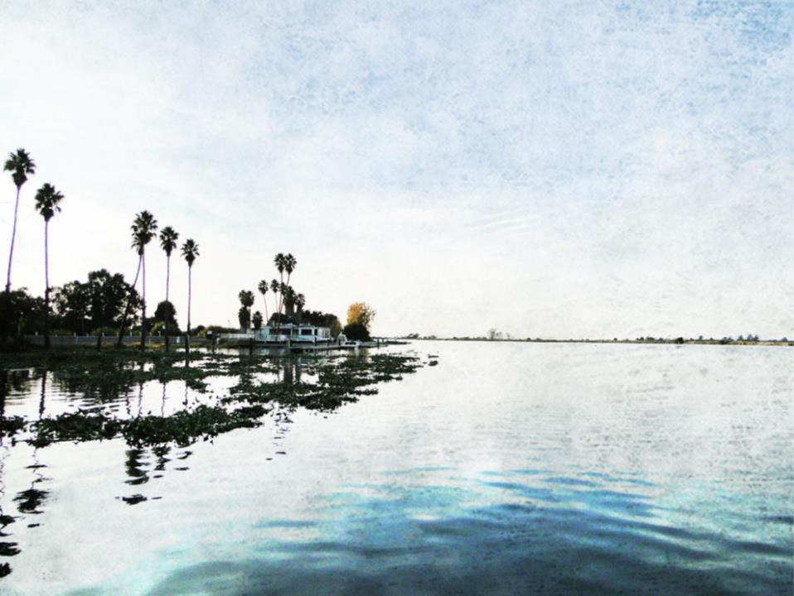
There is a better solution!
Sustainable Water Projects; Levee Improvements; Sharing a Sustainable Yield; Fixing Existing Infrastructure!
But the Newsom Administration is committed to the Delta Tunnel, while the Trump Administration remains committed to the raising of Shasta Dam

