Slide 1
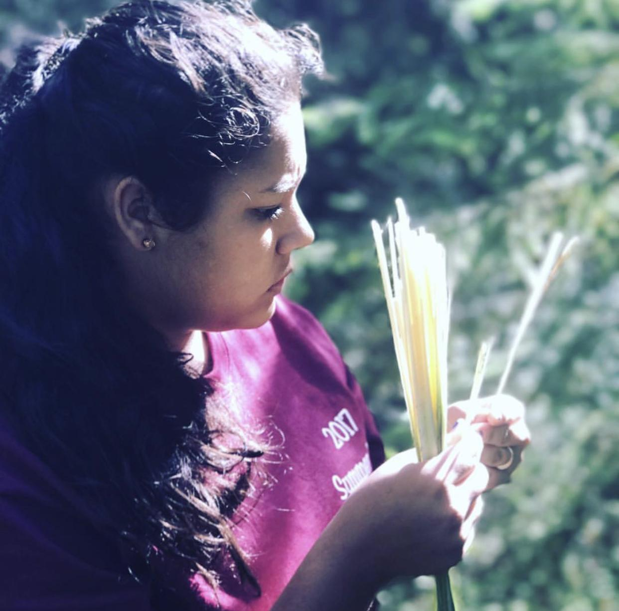
HUPA PEOPLE
“Our Home Forever”

Slide 2
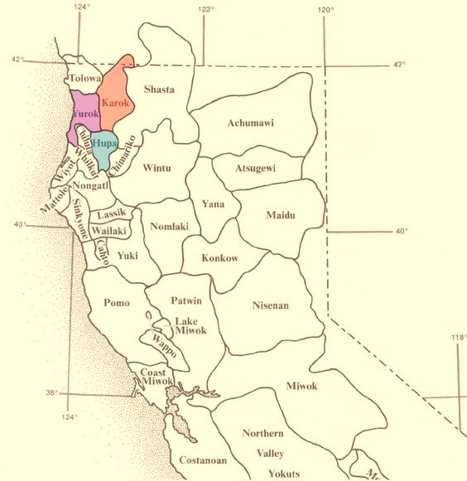
Na:tinixwe “Where the Trail Returns”
Northern California Tribe
12 Square Miles
144,0000 Acres Land Based Tribe

Slide 3
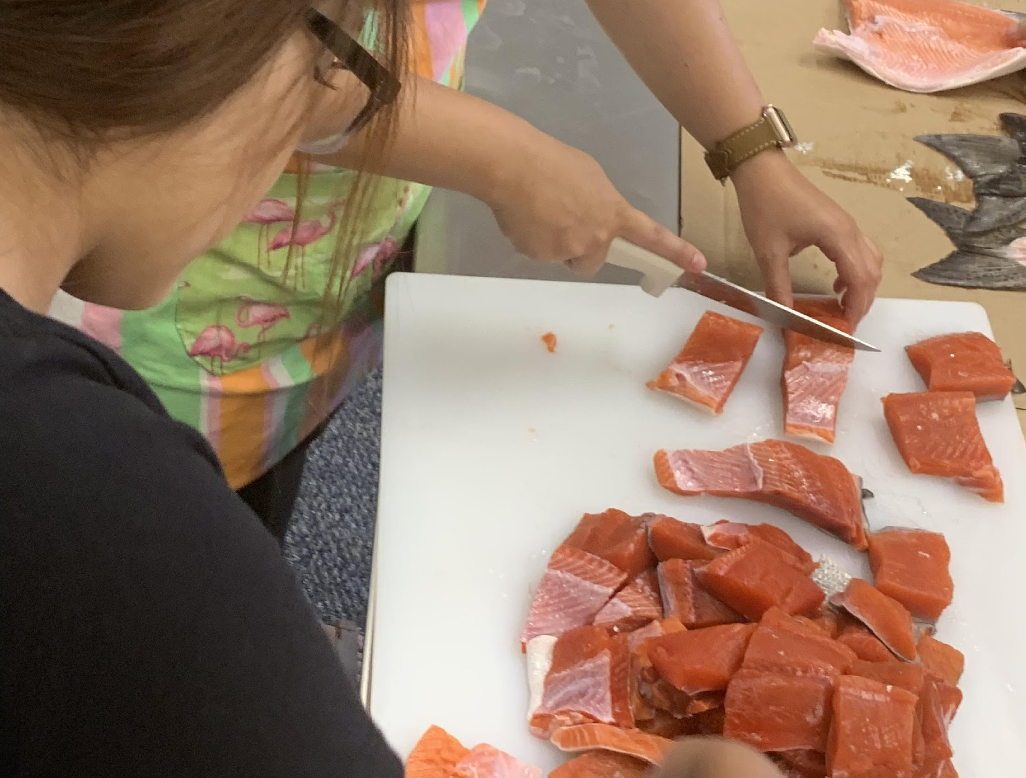

Slide 4
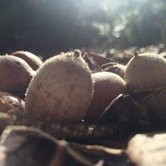
Staple food source in 1848
Acorns.
This nut known as an acorns was a staple in Hupa People’s diet. It is gathered in the fall and is dried, cracked, ground, leached, and made into a soup for in gestation.
This nut contains enormous amounts of nutrients needed for a person to live happy healthy life.
k’iwinya’n

Slide 5
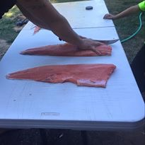
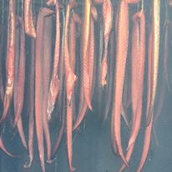
Salmon
Our salmon migrated from the pacific ocean, up to the Trinity river to spawn in our local creeks. We harvested in early spring and in early fall. Traditionally we speared, built weirs, and netted these fish out of the Trinity river.
Due to the abundance of fish and acorns on the Hoopa Valley Indian Reservation we were known as a trade center for local neighboring tribes.
lo:q

Slide 6
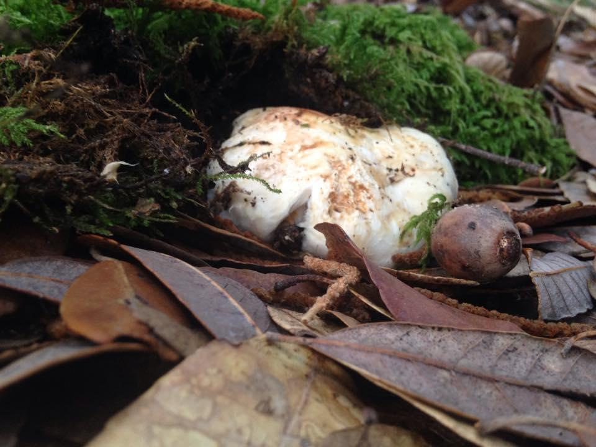
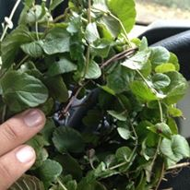
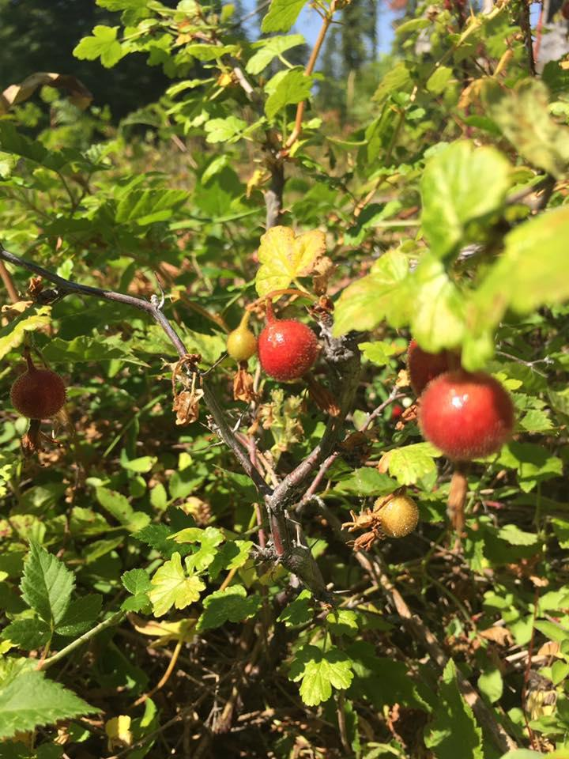
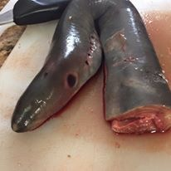
Tan Oak Mushrooms
'a:jiw'
l
k’i¬qos
Lamprey Eel
Gooseberries
t¬’iwhxa:n
l
Huckleberries
l
chwi¬ch
Indian Tea
Nah-stik

Slide 7
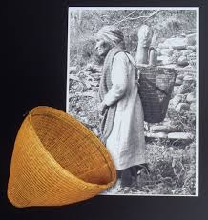
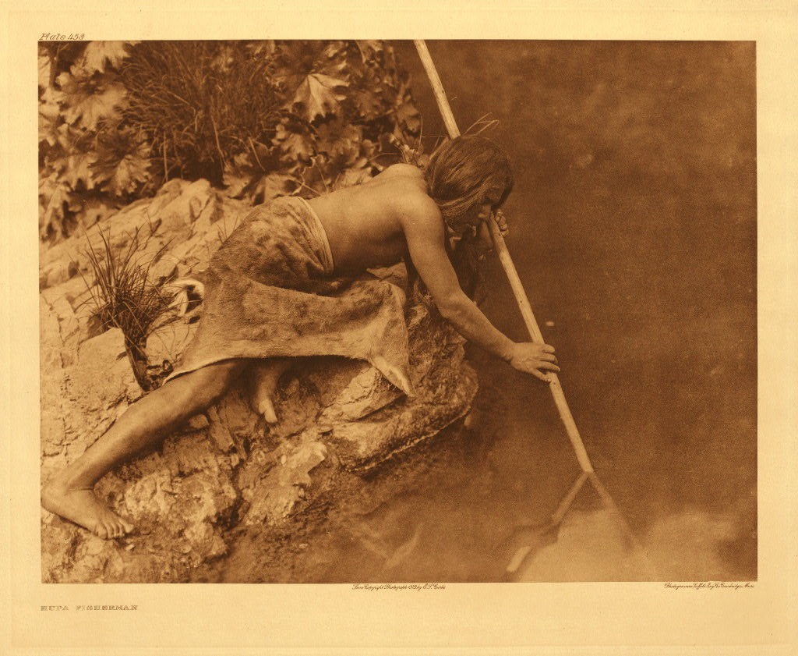
Traditional Gathering and Fishing

Slide 8
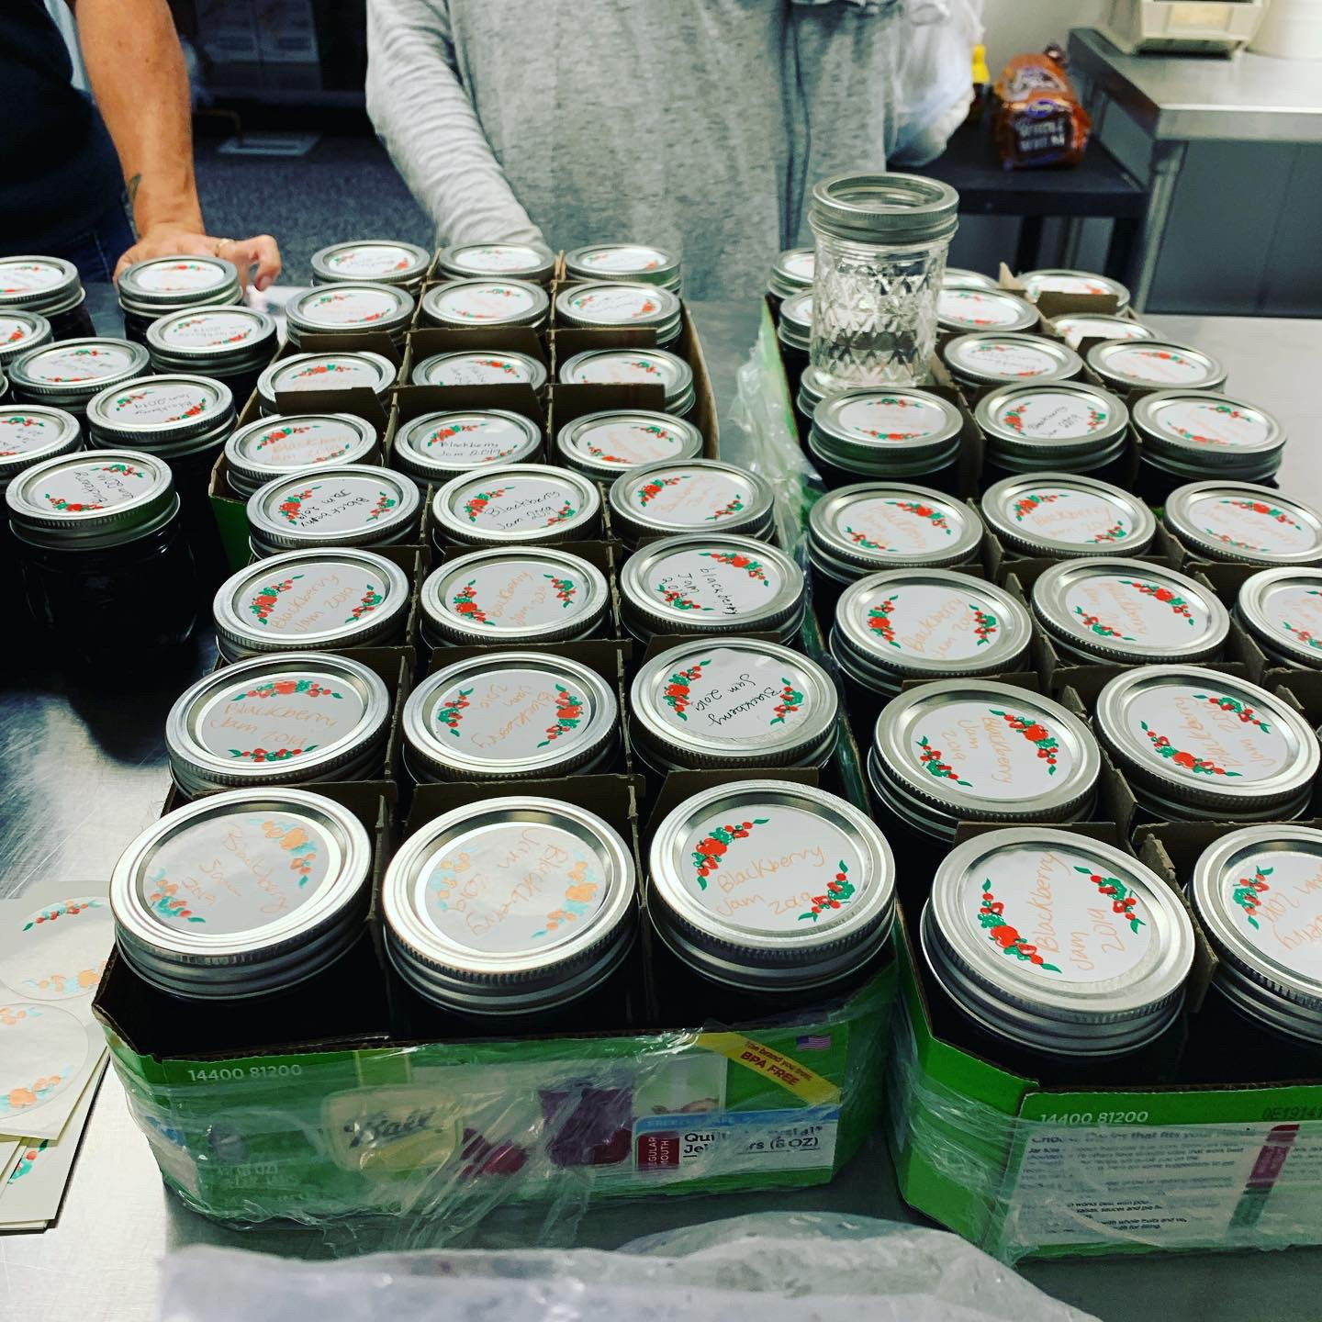

Slide 9
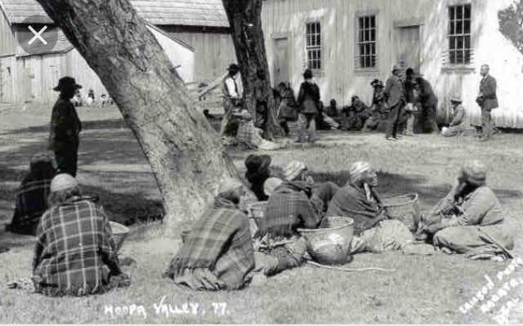
Where did it start?

Slide 10
General Allotment Act of 1887 (Dawes Act)The Allotment advocates eventually succeeded in convincing the federal government to adopt the policy nationally. In 1887, Congress passed the General Allotment Act, which authorized the president (at the time Grover Cleveland) to survey Indian tribal land and divide the area into allotments for individual Indians and families. The Allotment Act (also known as the Dawes Act, named for Senator Henry Dawes of Massachusetts, the Act’s lead proponent) was applied to reservations whenever, in the president’s opinion, it was advantageous for particular Indian nations. Members of the selected tribe or reservation were either given permission to select pieces of land—usually around 40 to 160 acres in size – for themselves and their children, or the tracts were assigned by the agency superintendent. If the amount of reservation land exceeded the amount needed for allotment, the federal government could negotiate to purchase the land from the tribes and sell it to non-Indian settlers. As a result, 60 million acres were either ceded outright or sold to the government for non-Indian homesteaders and corporations as “surplus lands.”

Slide 11
Agriculture became a way of life for Hoopa People. Many elders talk about their grandparents having food cellars, canning pantry, and home preservation became a way of life.
In the 1940s Hoopa had an established cannery in Hoopa, the people were able to bring their farmed goods and can them.
Then the logging industry hit. 1940-1980 the logging boom in Hoopa. The tribal people were issued percapitas from the logging revenue.
Families became two family earners.

Slide 12
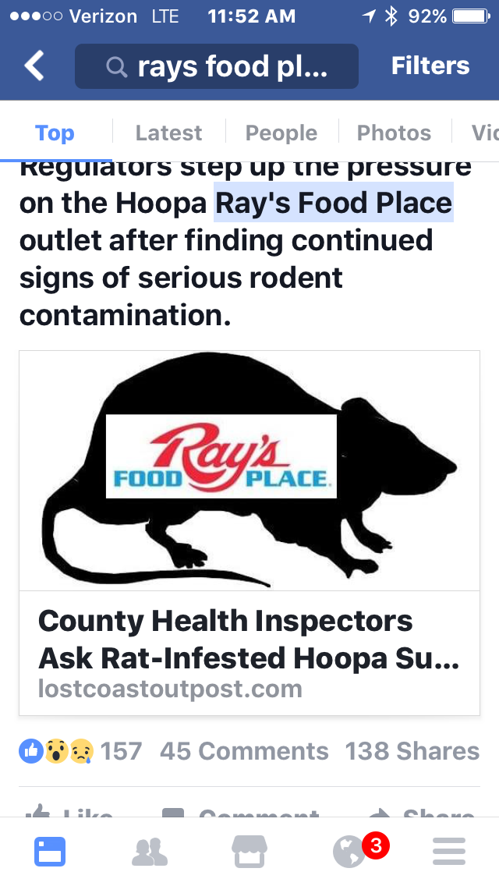
Our local store closed three months ago due to a large rat infestation.
We now have people starving locally.

Slide 13
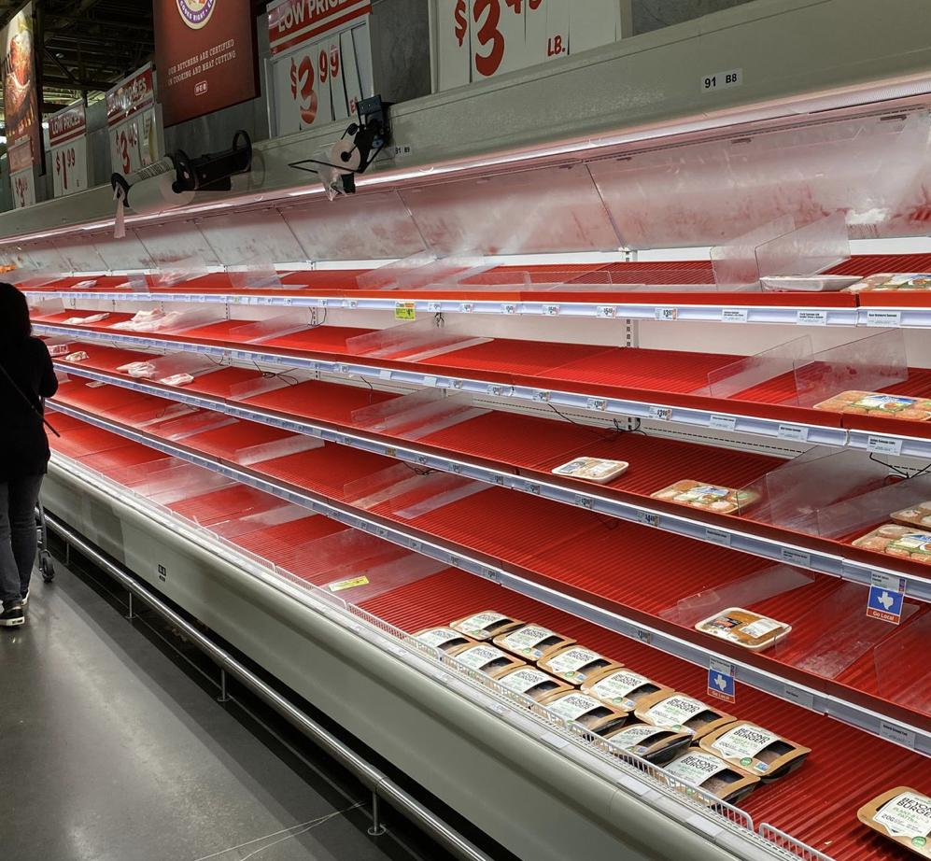
COVID-19 PANDEMIC

Slide 14
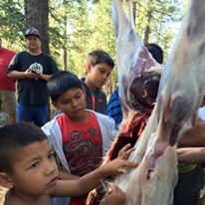
Food Sovereignty
Bringing back traditional staples
Harvesting Salmon
Harvesting acorns
Culture Camp, Dressing a Deer

Slide 15
Food Sovereignty
Teaching each other to properly identify our traditional foods.

Slide 16
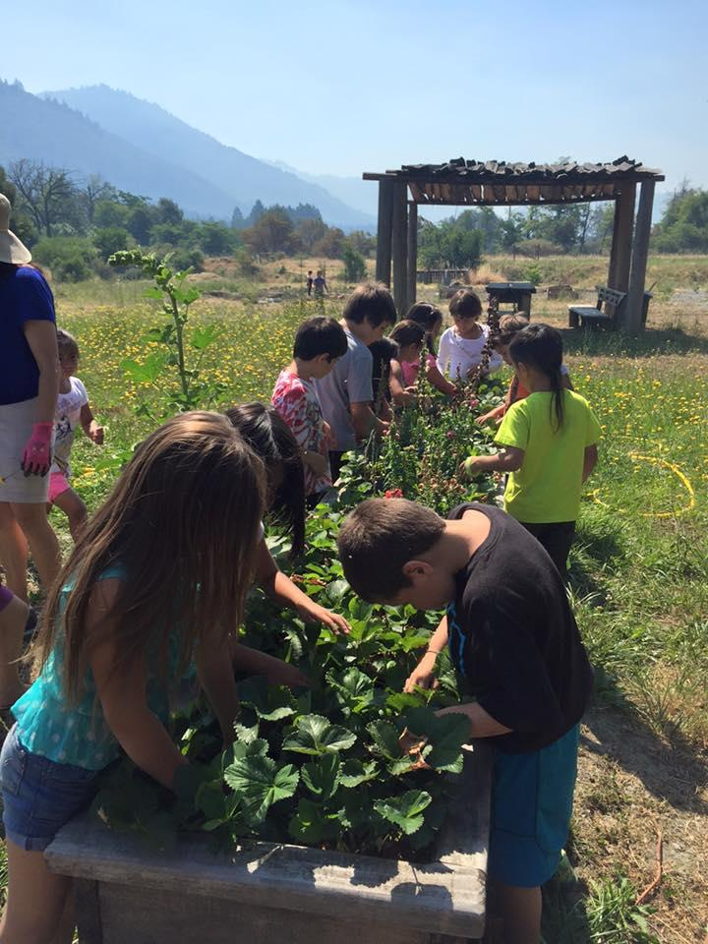
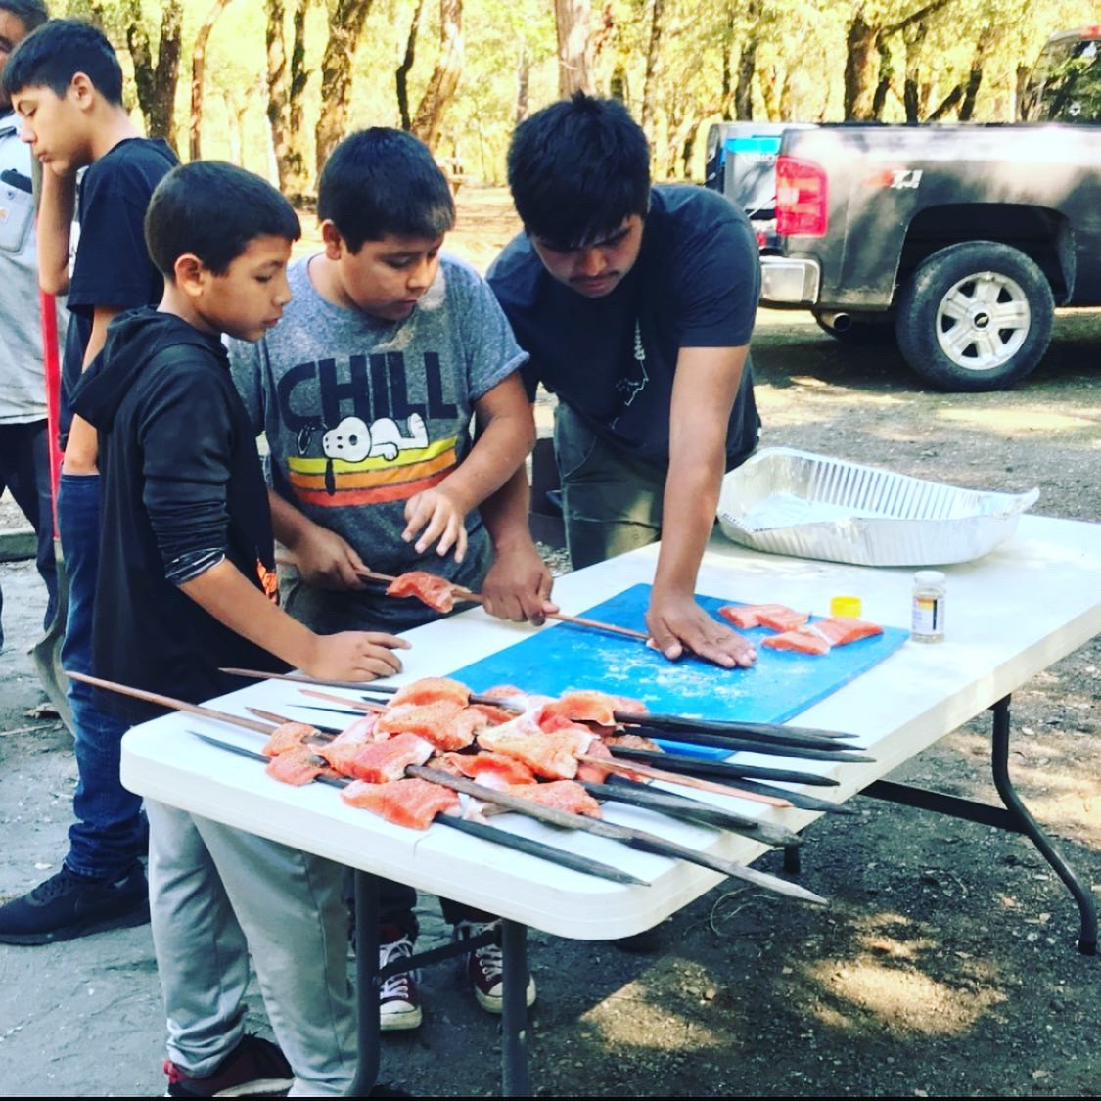
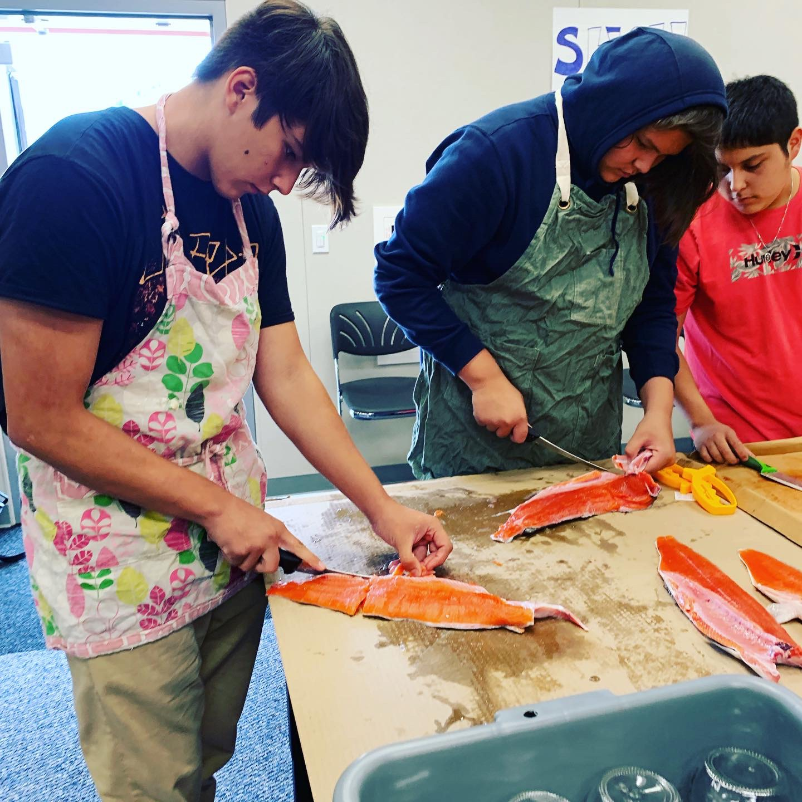
Food Sovereignty

Slide 17
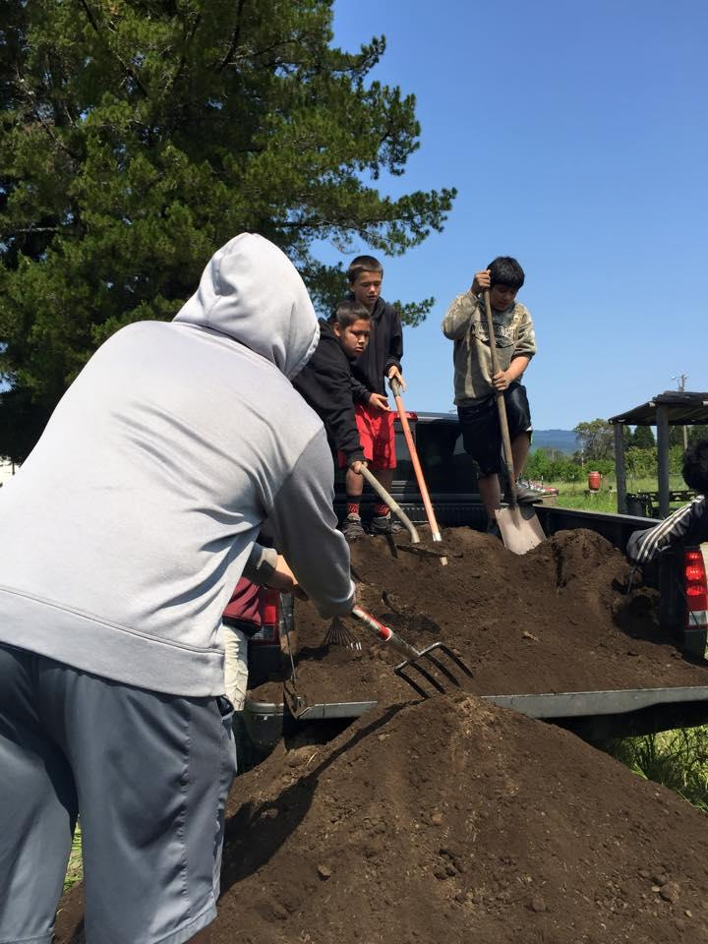
Food Sovereignty
Six Rivers Community Day Kids
Working the garden beds they built. Each one has over 100+ hours of volunteer time at the garden.

Slide 18
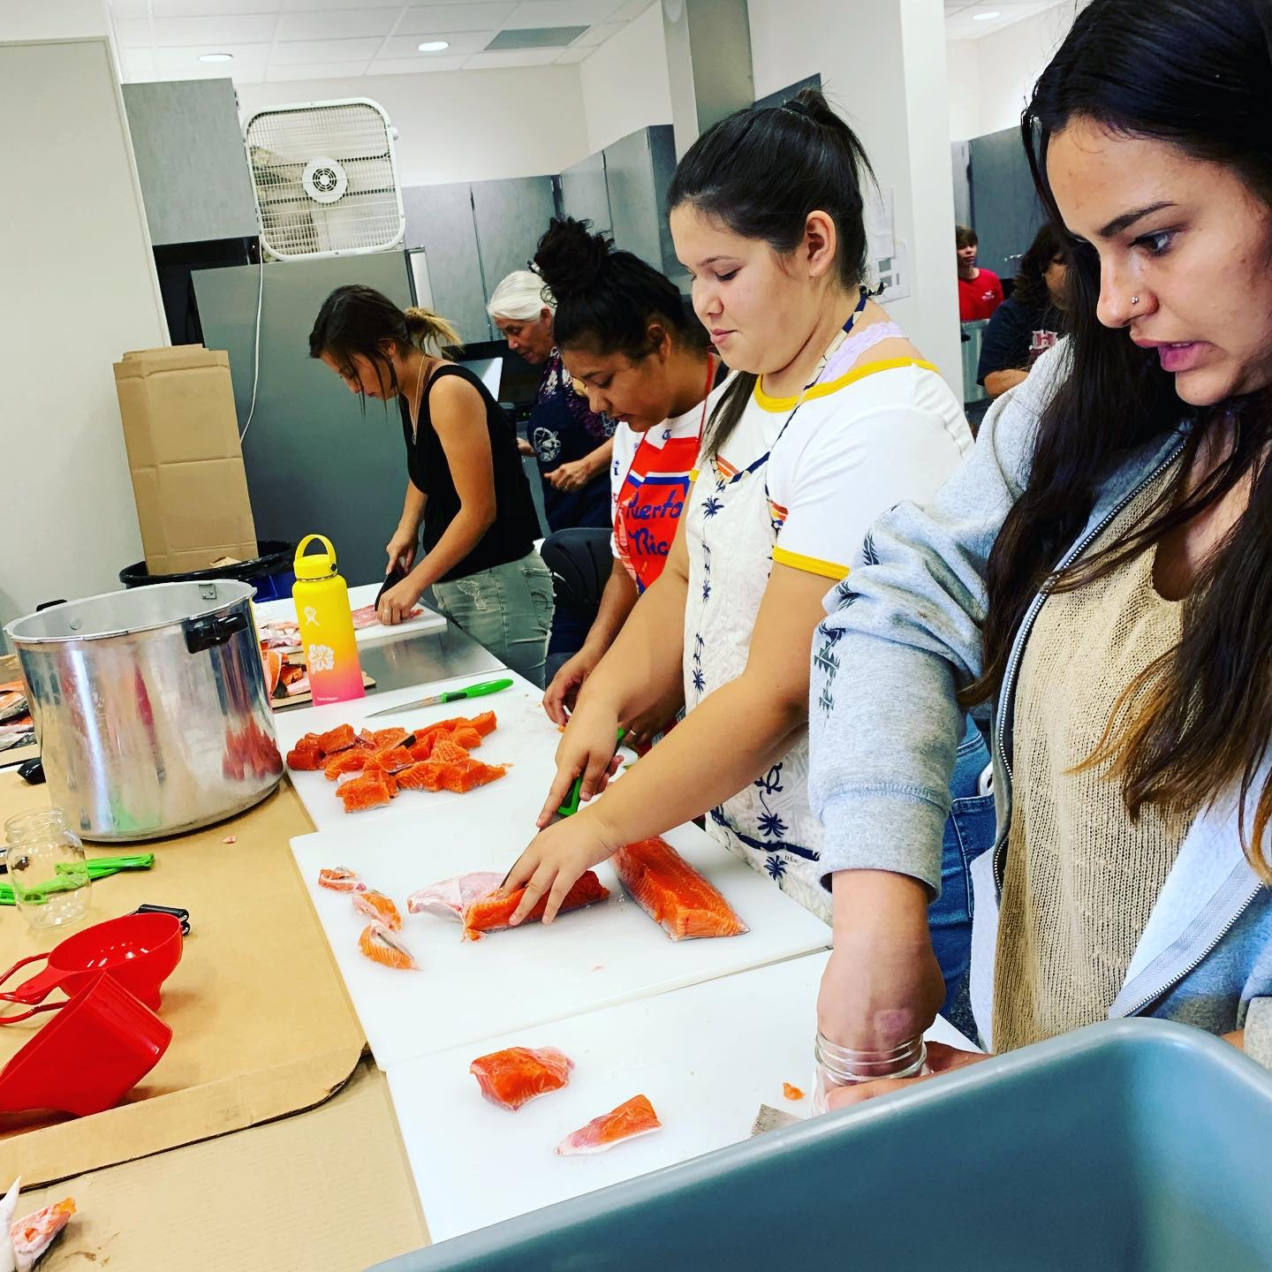
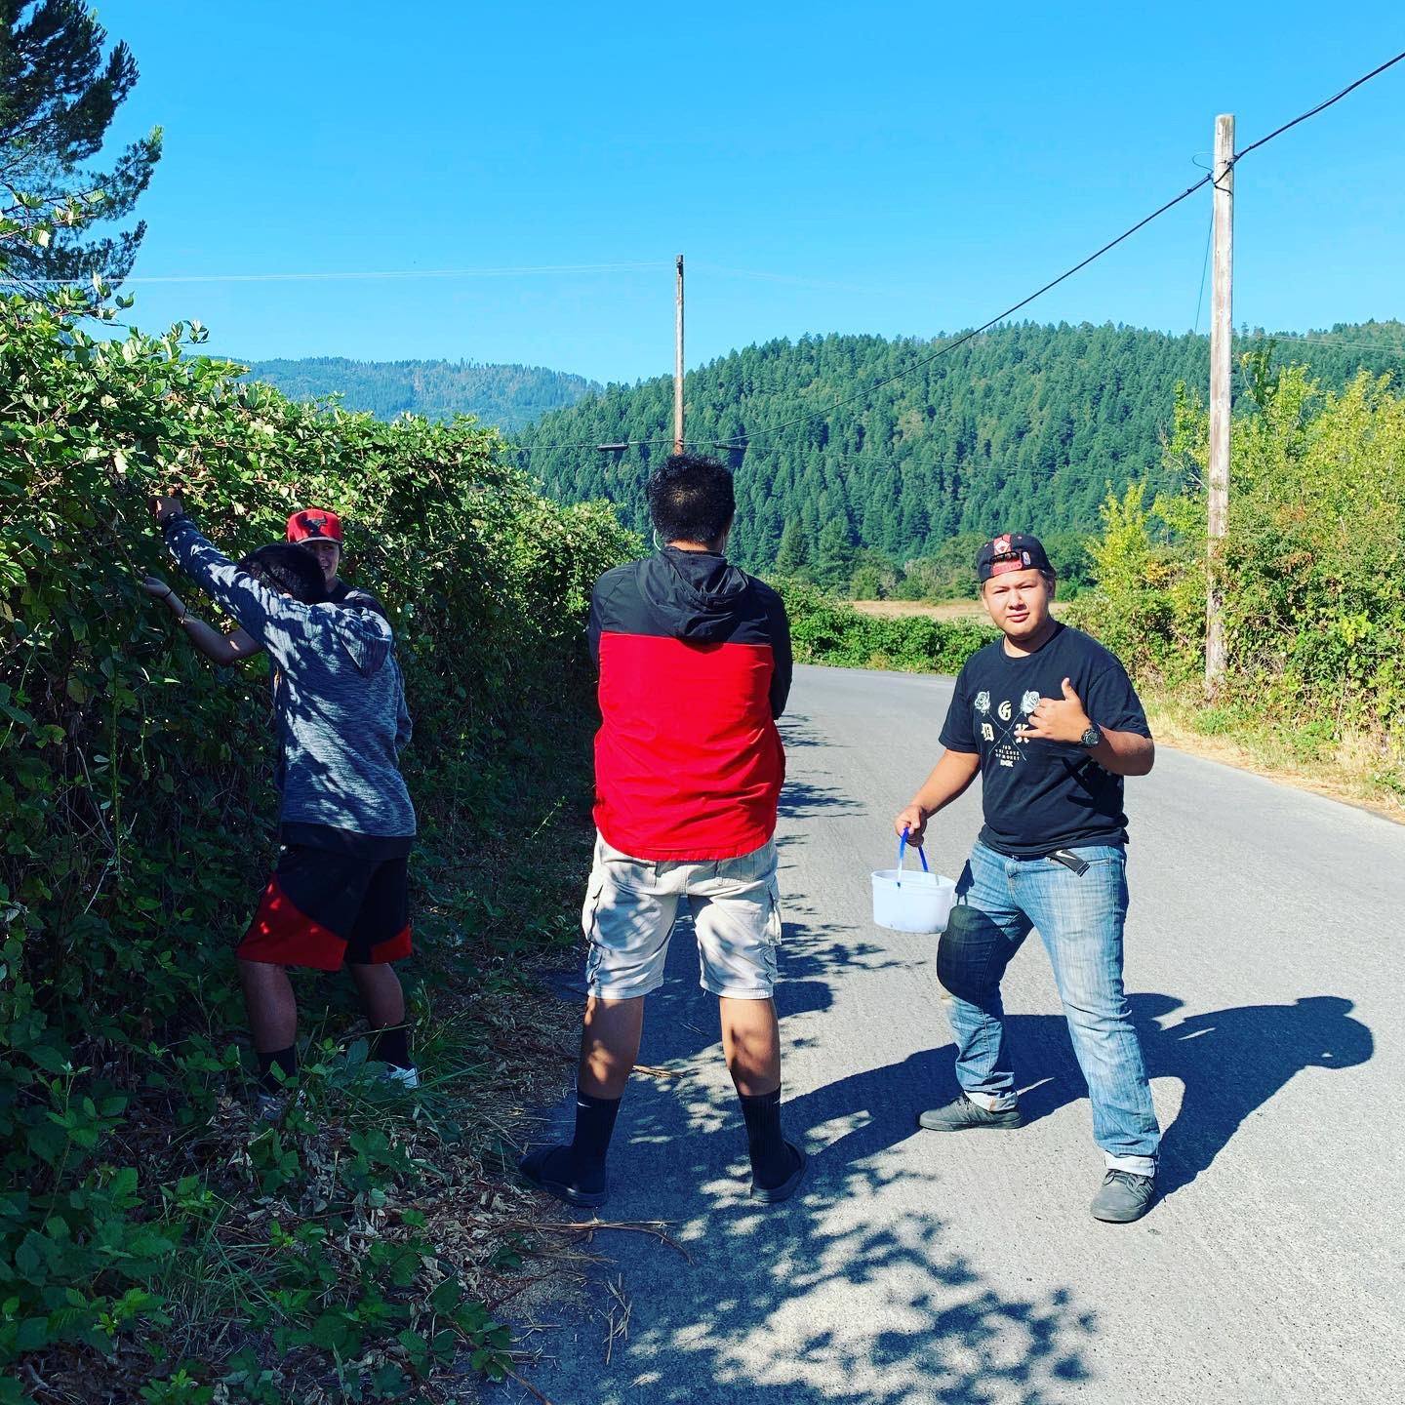
FOOD SOVEREIGNTY

Slide 19
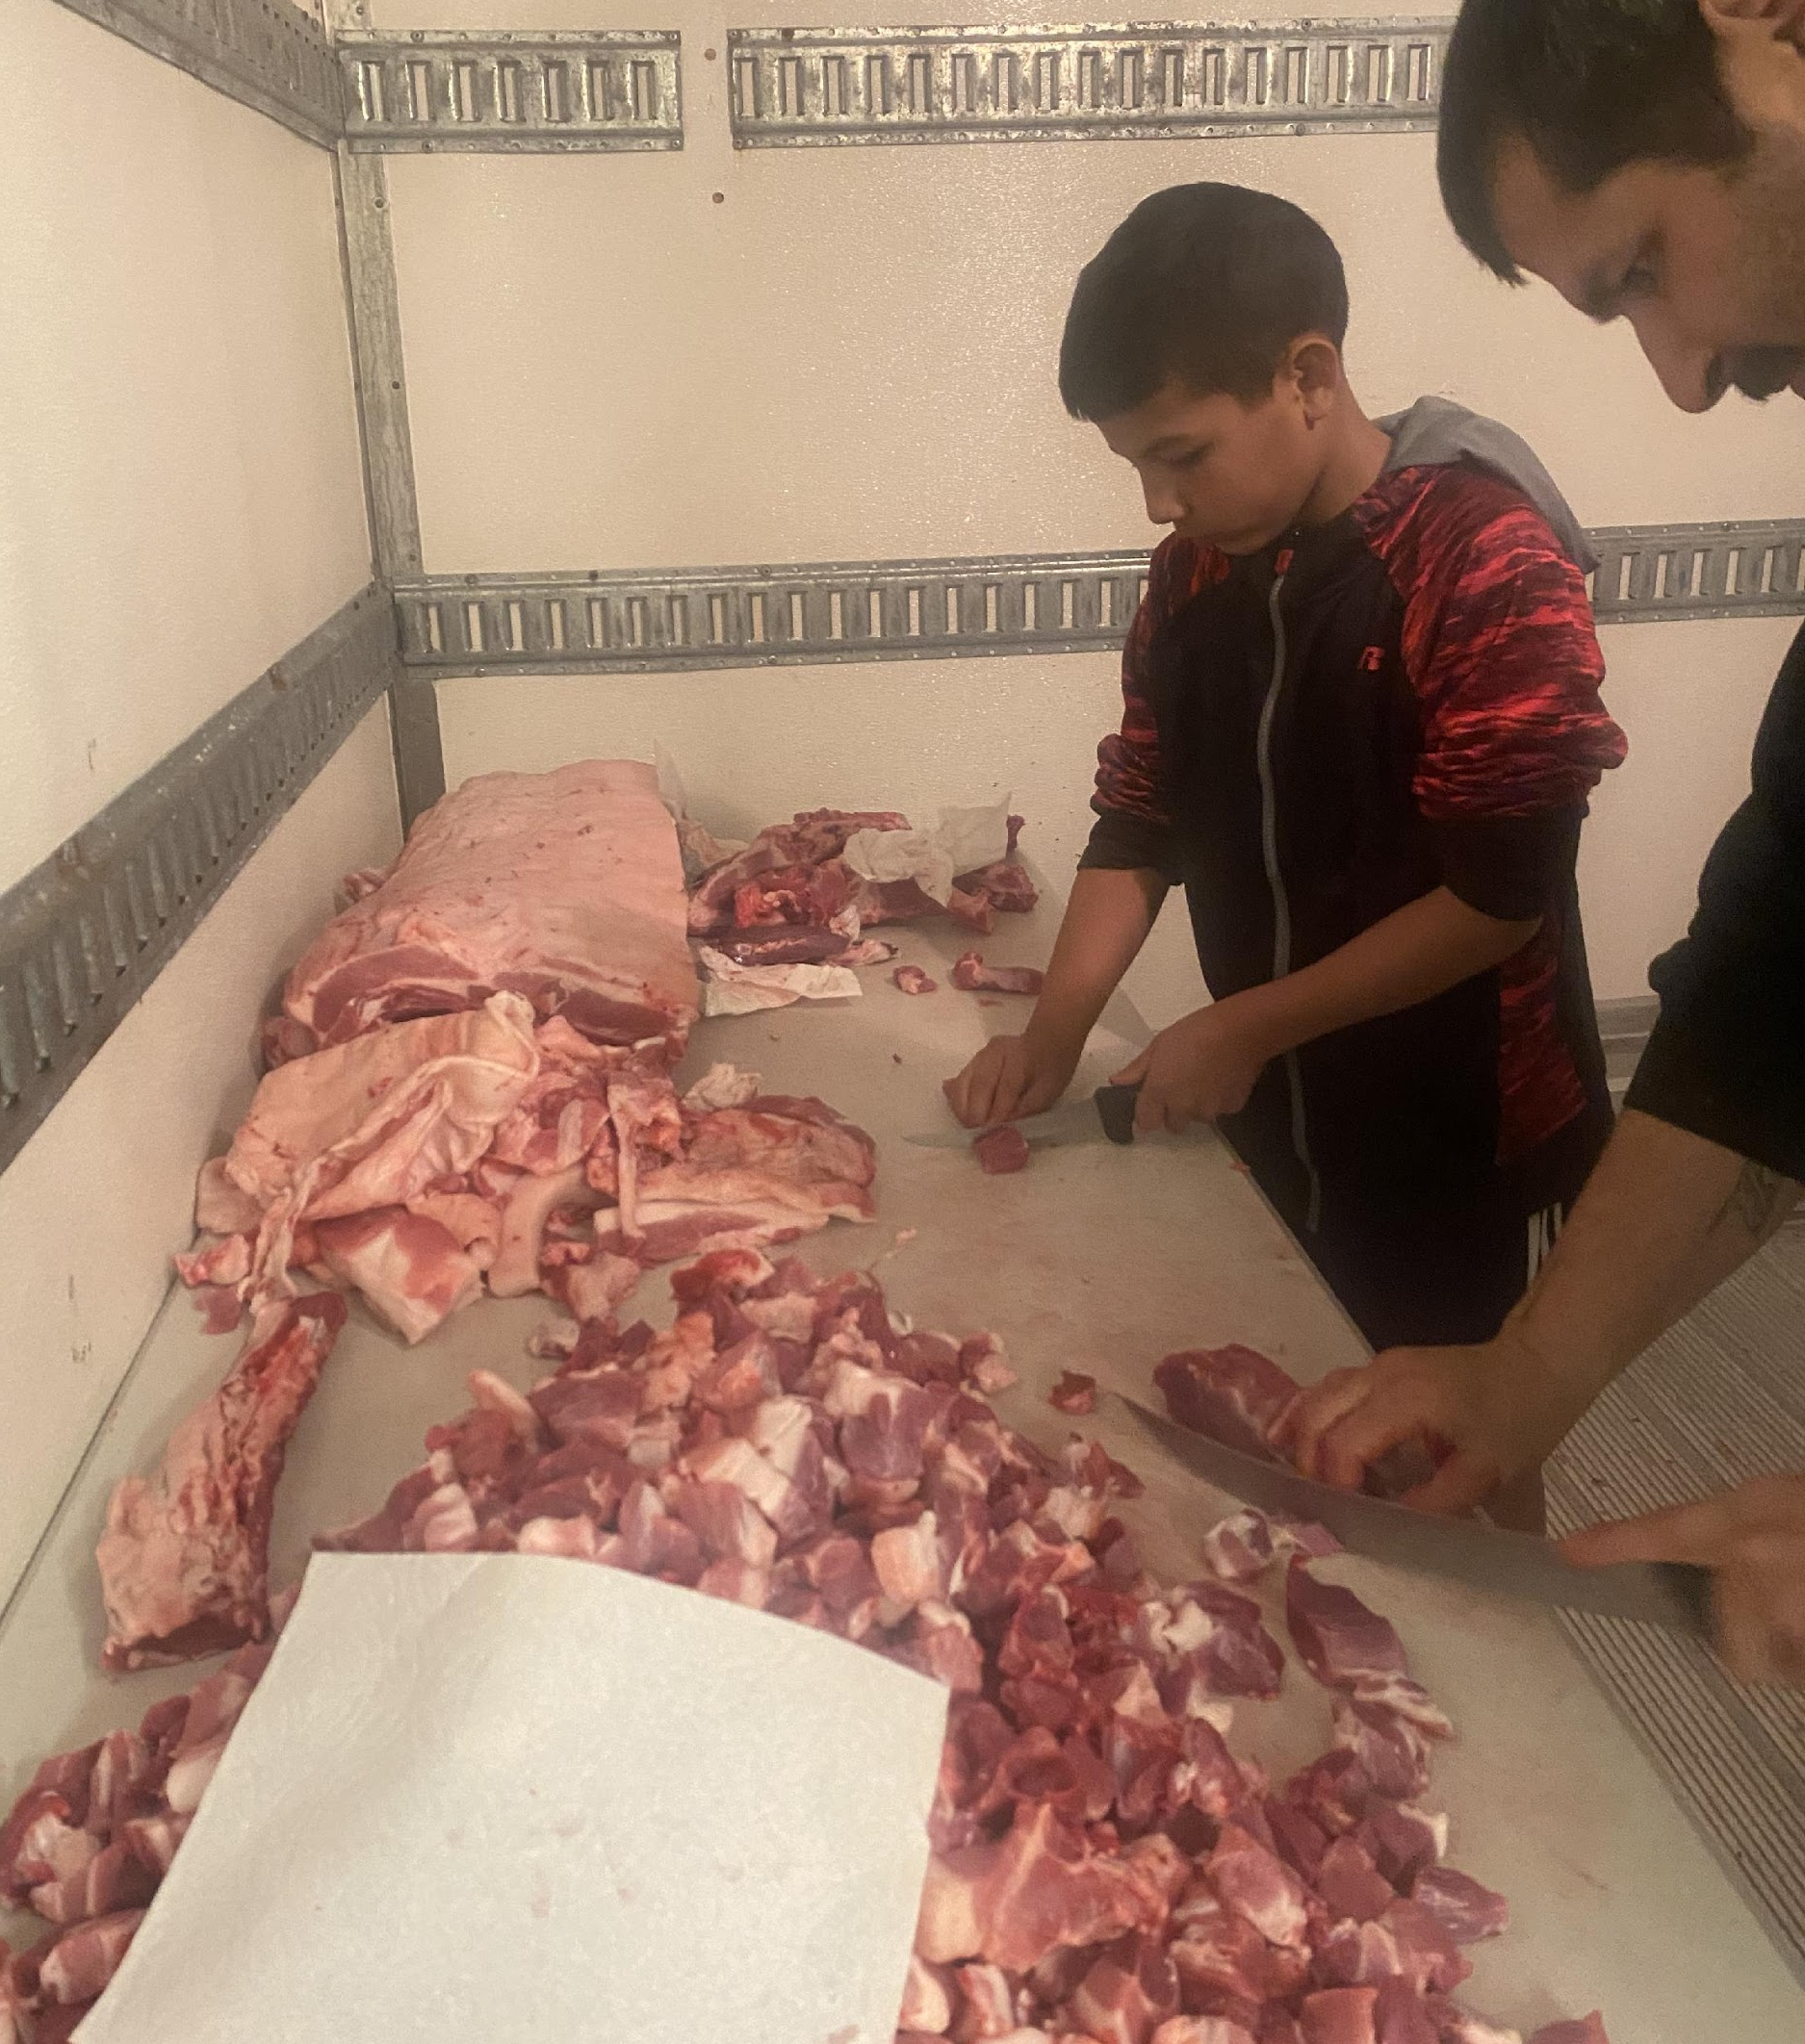
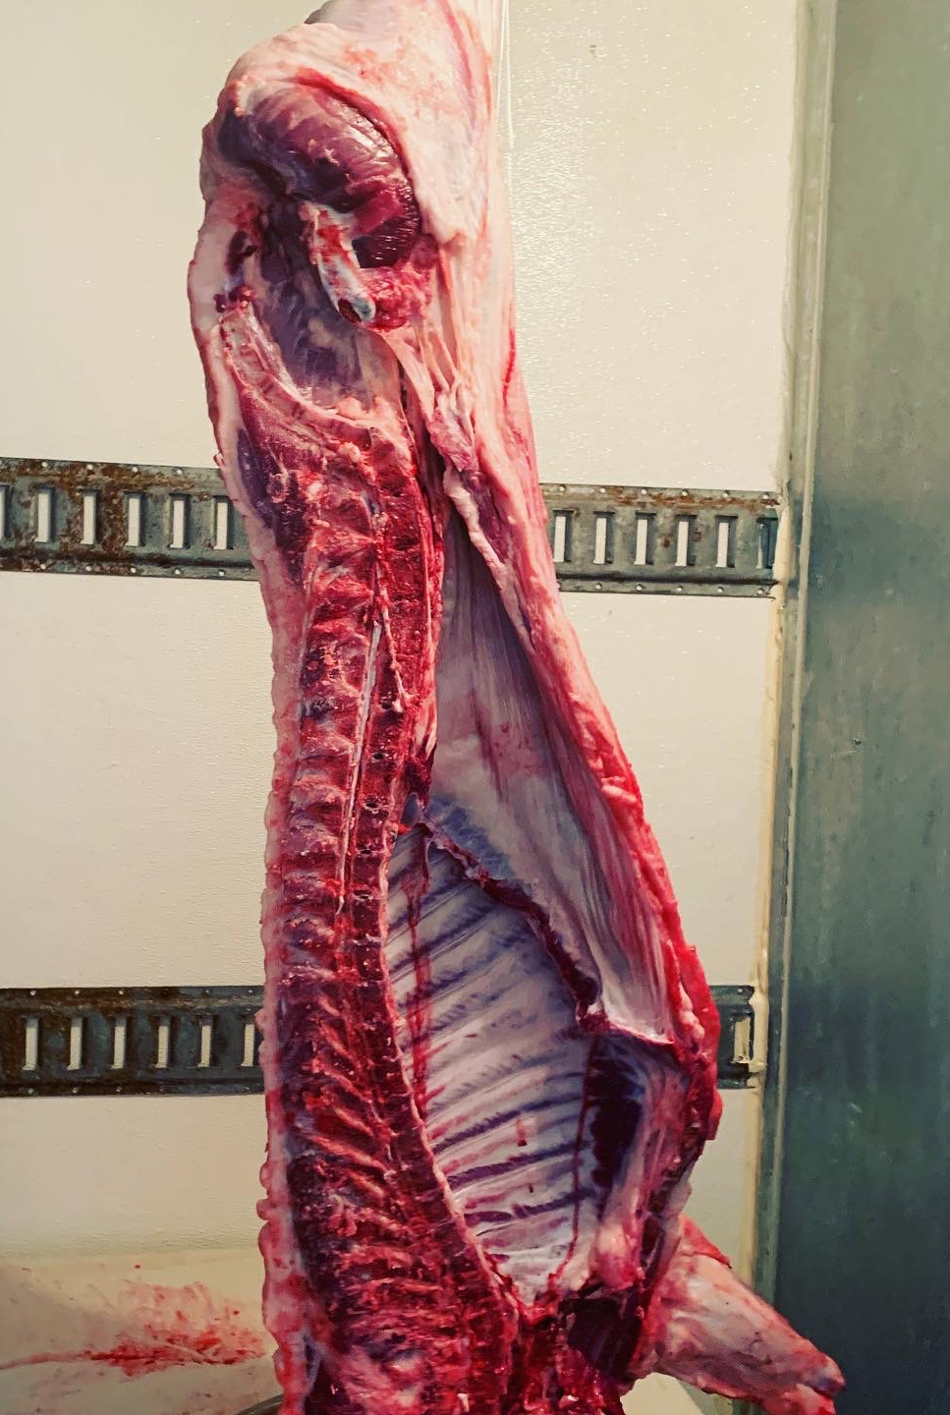
FOOD SOVEREIGNTY

Slide 20
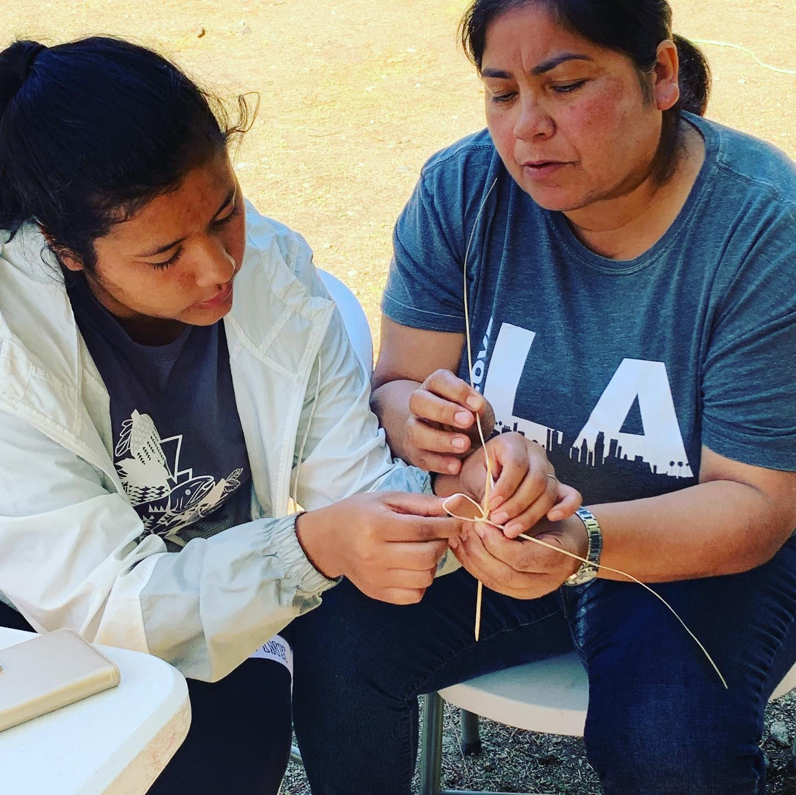
SHARE YOUR GIFT

Slide 21
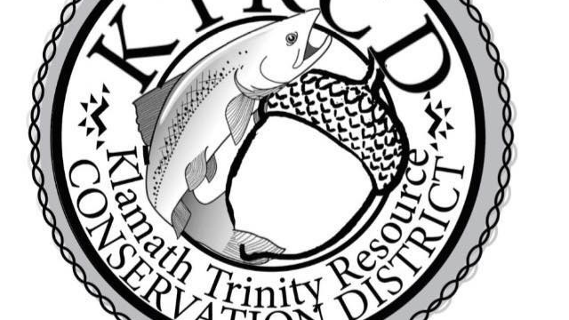
QUESTIONS?
Meagen Baldy
KTRCD District Coordinator
meagen18@gmail.com
(530)515-5223

