Slide 1
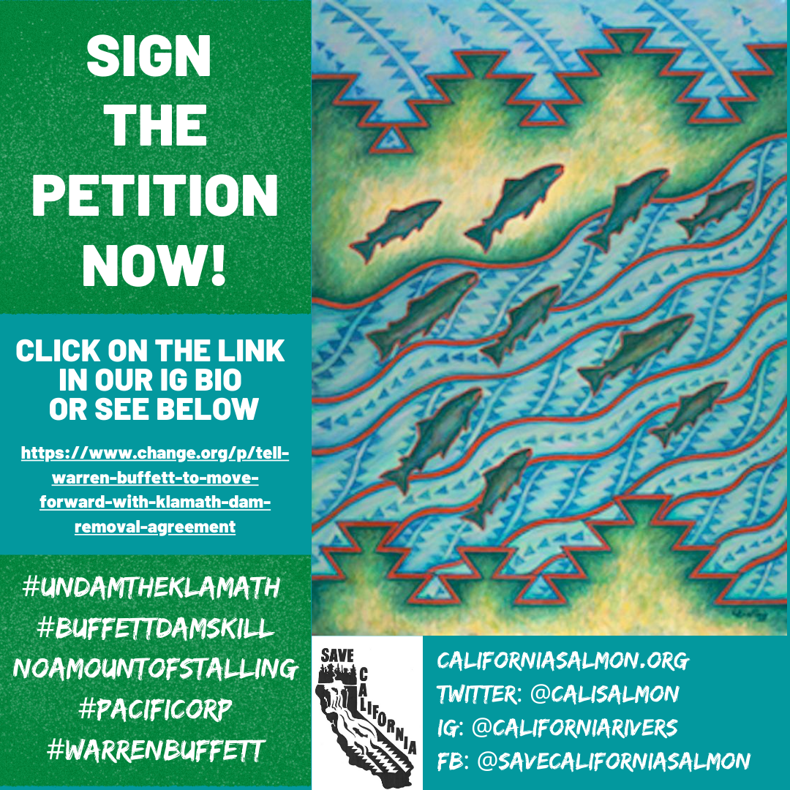
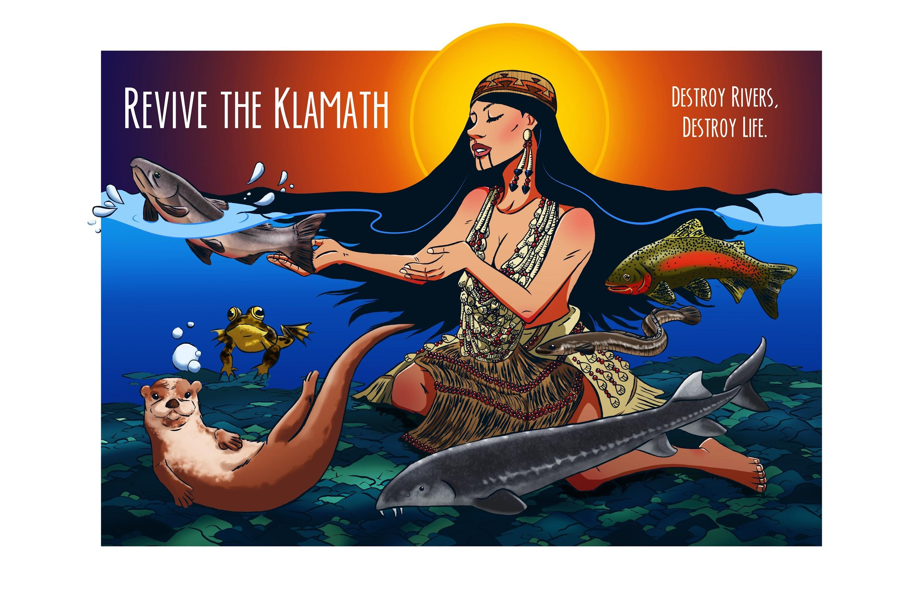
Take Action!

Slide 2
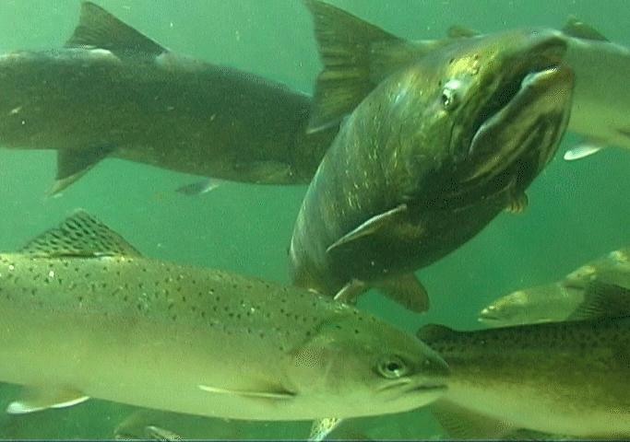
Community Organizing and Creating a Campaign
First, I want to say being active and engaged in your community and environment is so important. It is inspiring, it is wonderful. It is also often tiring, and at times heartbreaking.
For many of us this is a lifetime
commitment. That is why is so important to keep yourself grounded in your love for justice and the environment. It is also important to take care of yourself and your family. We need to fight, we need to strategize, but we also need to enjoy the things we fight for, and to rest and reflect.
It is also important to note there is not only one ways to organize. Today we hope to share some skills and tools, however everyone is unique, as is everyone’s passions and everyone’s activism.
Activism can be art, organizing, filing lawsuits or even feeding others and caring for each other and our children.
Now more than ever it is important to love and respect each other and each others skill sets, passions and limits.
Notes:
It is so important to keep yourself grounded in your love for justice and the environment

Slide 3
What are some of components of a successful campaign
Community Organizing and Action are important parts of any campaign for justice, and are focus today but they are not the only parts of a movement or campaign. It is important to respect all the different roles and tools that we utilize. These tools and roles can include.
Policy Advocacy
Political Work
Legal Work
Education and Research
Media and Outreach
Events and Engagement Opportunities
Action
Fundraising
Direct Community Support, such as ridesharing and babysitting. In the chat box please type in some tools and roles that you can think of

Slide 4
Movements and Campaigns are About Timing and Opportunities.
It is important to Schedule Your Campaign and Actions, and to Power Map your Opponent. It is also important to map your allies and strategy and think about escalation.
Along with Coordination with recognizing your opportunities and thinking about escalation are other important aspects of campaigns and movements.
Think about point of decision and point of destruction in your campaign. To be successful your really want to start your organizing early.
Many decisions have to go through processes. When are their public comment periods? How do you coordinate organizing, media, and legal and action strategy within these processes? How do these different aspects of your campaign bolster the other. For example does you action or organizing bolster a legal or political effort.
Who are your allies? Are they engaged in a meaningful way? Are they aware of, and helping each other?

Slide 5
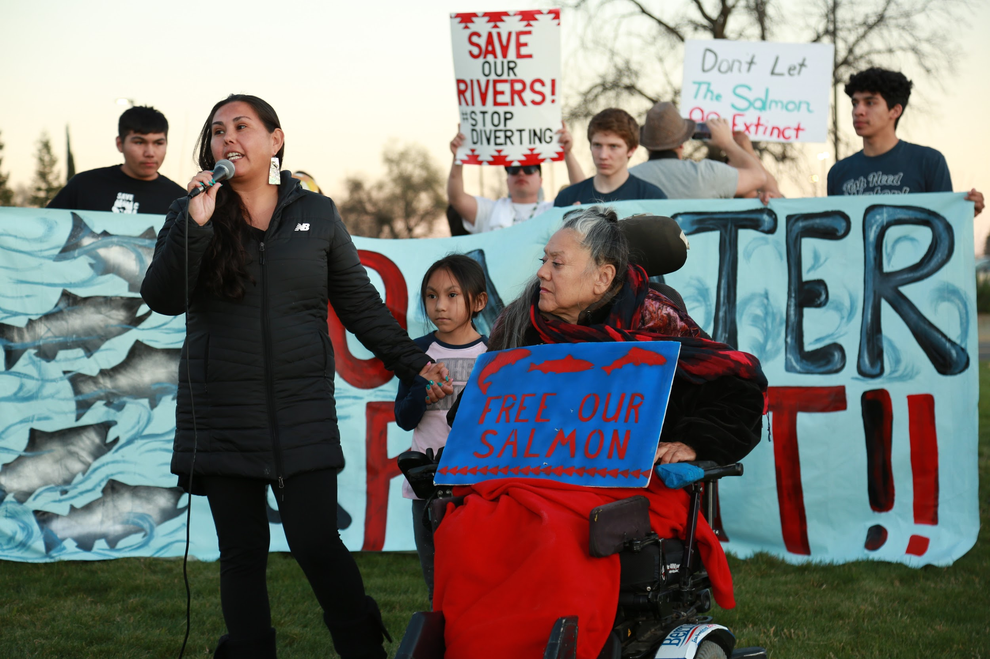
Community Organizing is an important part of any campaign or movement, but it is not only about going to the protest, hearing or action. Without a very organized campaign that analyses at all the roles and opportunities, and includes your community and allies in every step of the way campaign will likely be unsuccessful.

Slide 6
It is also important to realize there are so many aspects to activism and movements.

Slide 7
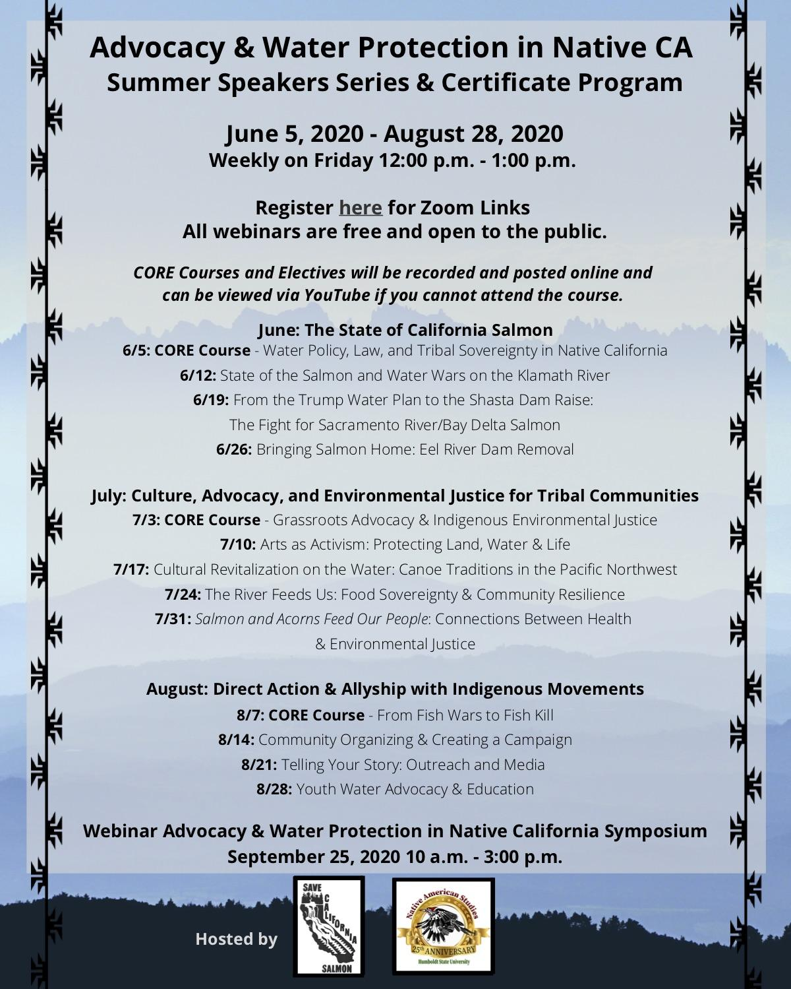
Education is a part of activism and movements.

Slide 8
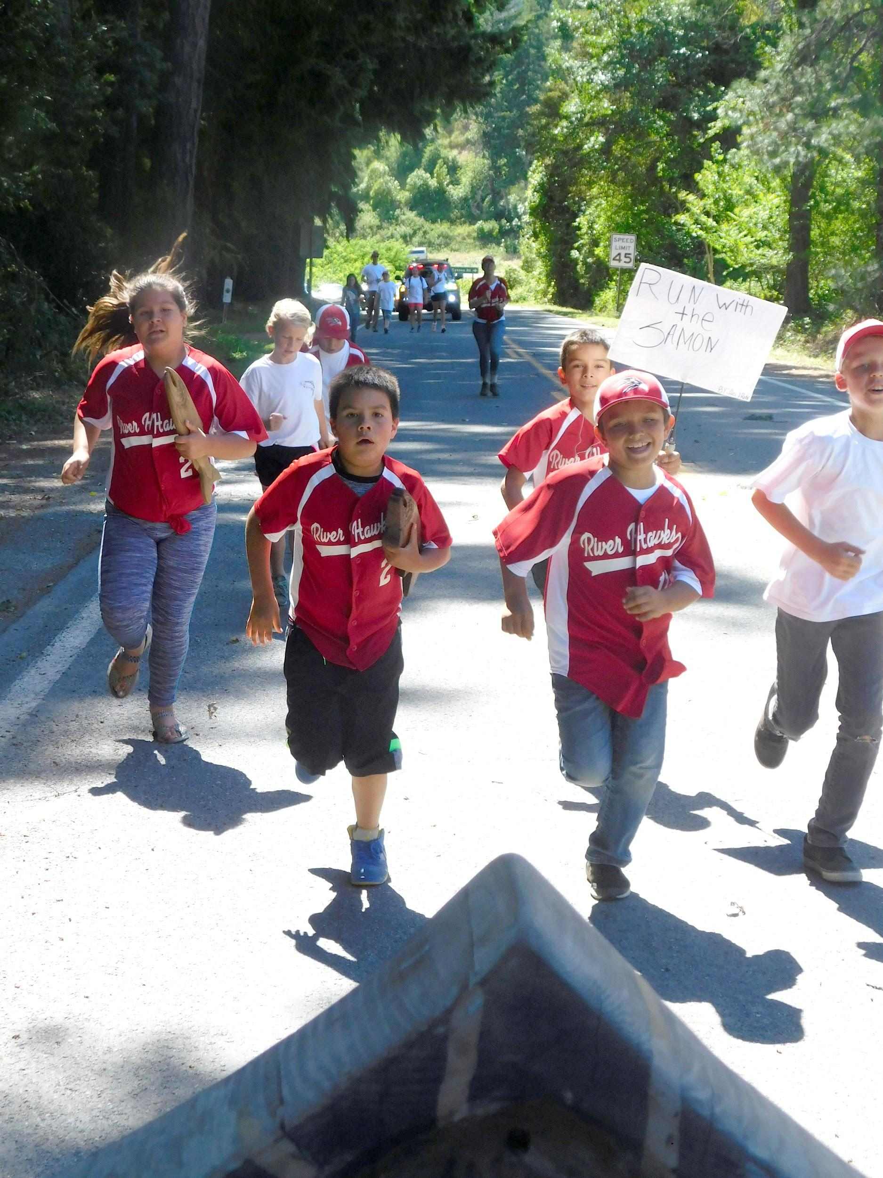
Community events that come from, and are centered around, the youth are part of activism and movements.

Slide 9
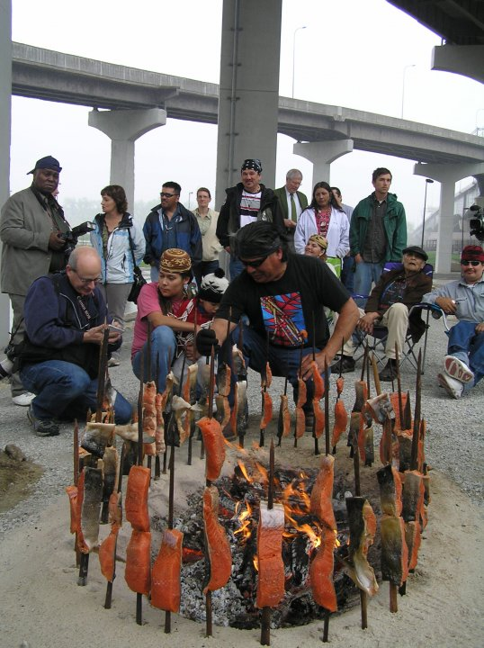
Sometimes actions are not confrontational, but are about sharing what is important to us which those that may not understand.

Slide 10
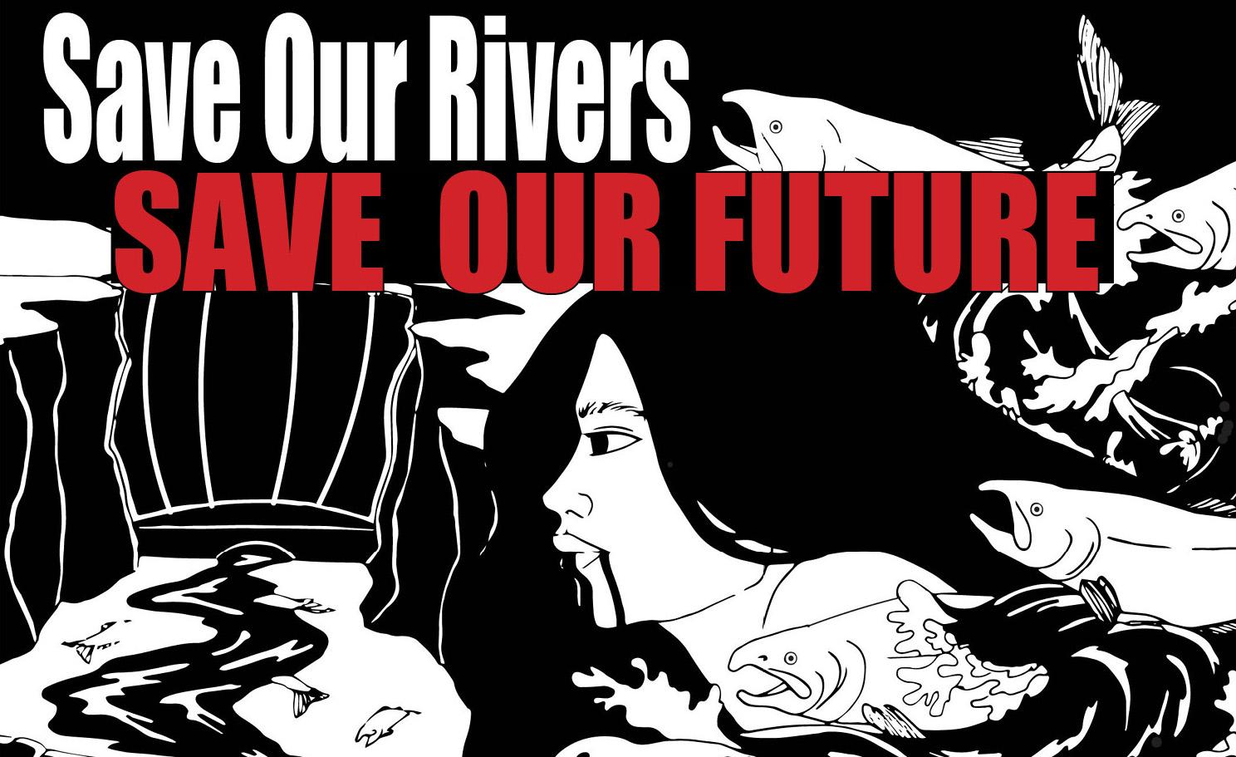
Art is activism

Slide 11
Direct Action is activism

Slide 13
Testifying in can be activism.

Slide 14
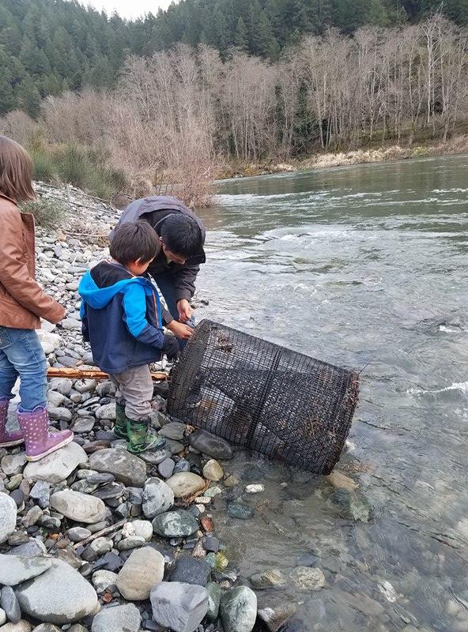
Fishing and reviving traditional practices can be activism.

Slide 15
The fact is the most successful campaigns can last years and use many tools and strategies. Some local examples include:
The Campaign to Stop the Pacific Connector Pipeline
The Campaign to UnDam the Klamath
Work to Bring Back Traditional Burning, and to let fires burn in some areas
Work to make sure MLPA’s are open to traditional gathering
The work to make sure ceremonies are allowed and protected on Forest Service lands
Drop some examples of successful campaigns that used, use many tools and strategies into the chat.

Slide 16
There are also movements and campaigns that can last lifetimes.
This is why it is important to remember no activism or organizing is done in vain. Real change is a marathon, not a sprint and making change is vitally important and at this point actually about life and death.
Every action and campaign leads to the next ,and every skill learned and lesson informs the future of movements for justice and the environment. A larger example is Black Lives Matter. Some local examples are the movements to save the Klamath Salmon or to Stop the Delta Tunnel and Shasta Dam Raise. These are intergeneration struggles.
That is why it is so important to avoid burnout and despair and to make sure there are no gatekeepers or knowledge or skill hoarding. It to always be reflecting, changing, mentoring the next generation. We need to do this even when it is hard. An example is the reckoning that the Sierra Club is going through right now

Slide 17

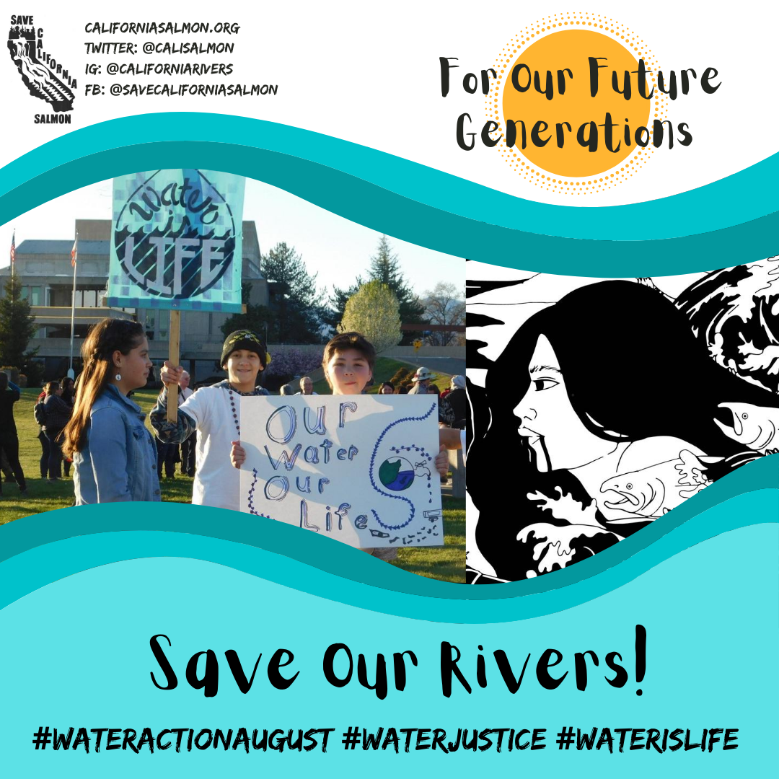
#WATERACTIONAUGUST
#WATERJUSTICE
What environment issues matter to you?
How are you addressing them?
Who are working with?

