Slide 1
Morning Star Gali, Tribal Water Organizer for Save CA Salmon
Ajumawi Band of Pit River

Slide 2
1978 Federal Courthouse

Slide 4
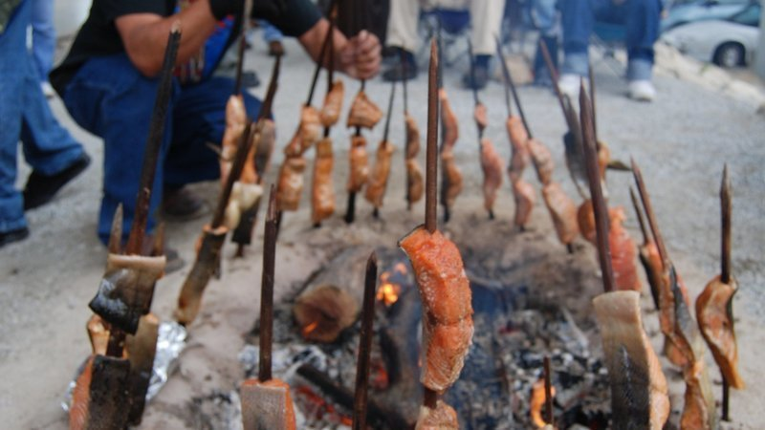

Slide 5
