Slide 1
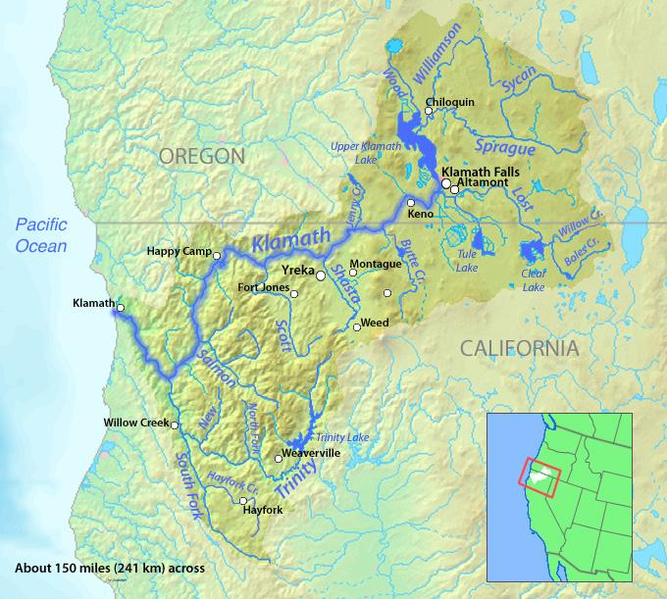
The Klamath Basin is a complicated watershed and story
The Klamath starts at Upper Klamath Lake and hosts many wildlife refuges, including Lower Klamath Lake and Tule Lake. It has many large tributaries including the Sprague, Wood, Williamson, Trinity, Scott and Shasta Rivers. It has been drained, dammed diked, and diverted, which has left many of it’s fisheries species in danger of extinction. They include the Coho and Spring Salmon, C'waam and Qapdo, and many Tribal trust species such as sturgeon, lamprey eels, fall -run salmon.

Slide 2
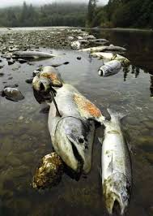
The Klamath is also complicated as far as water rights, case law, fishing allocations, and politics. In 2001 the Bush administration decide to use the Klamath in it’s push to undo the Endangered Species Act after farmers hosted a large protests call the Bucket Brigade. They overrode a Biological Opinion meant to protect coho salmon and endangered sucker fish, which limited the farmers water deliveries. The next year a fish kill of up to 64,000 on the
Yurok reservation devastated
the local community and the
fishing industry. Since then
juvenile fish kills have occurred
many years and adult fish kills
have been narrowly avoided due
to Trinity River water releases.

Slide 3
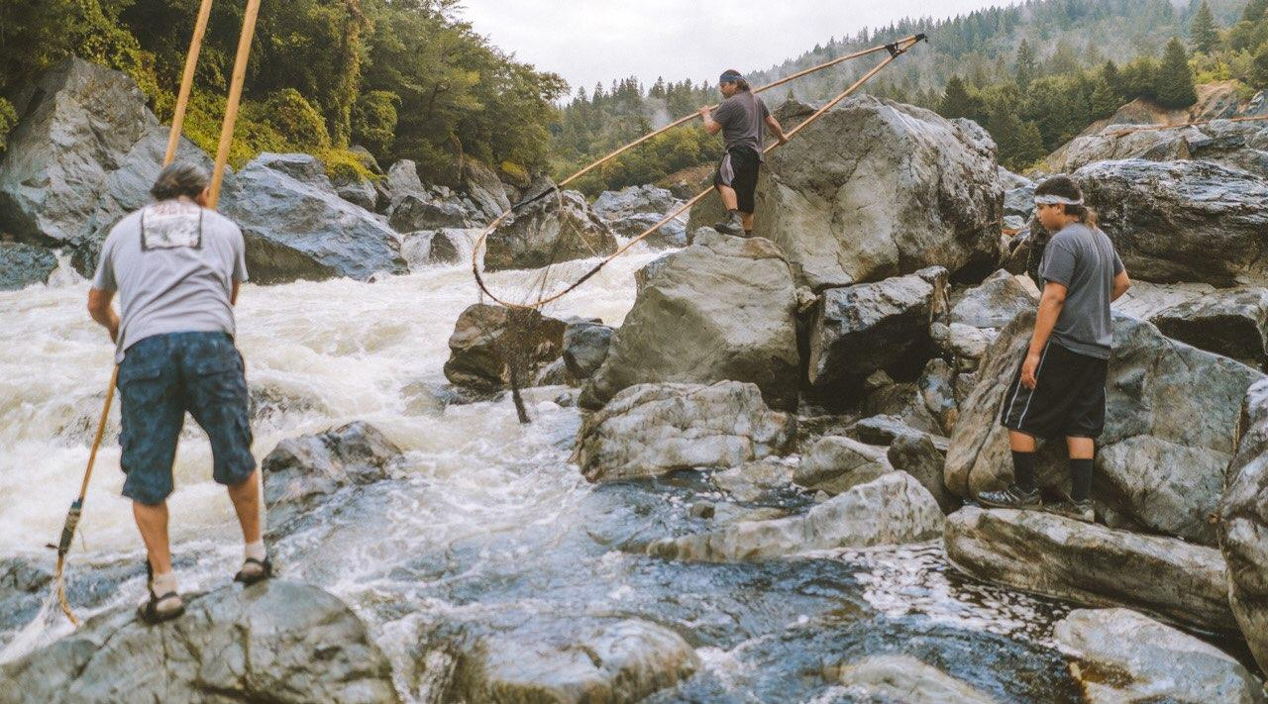
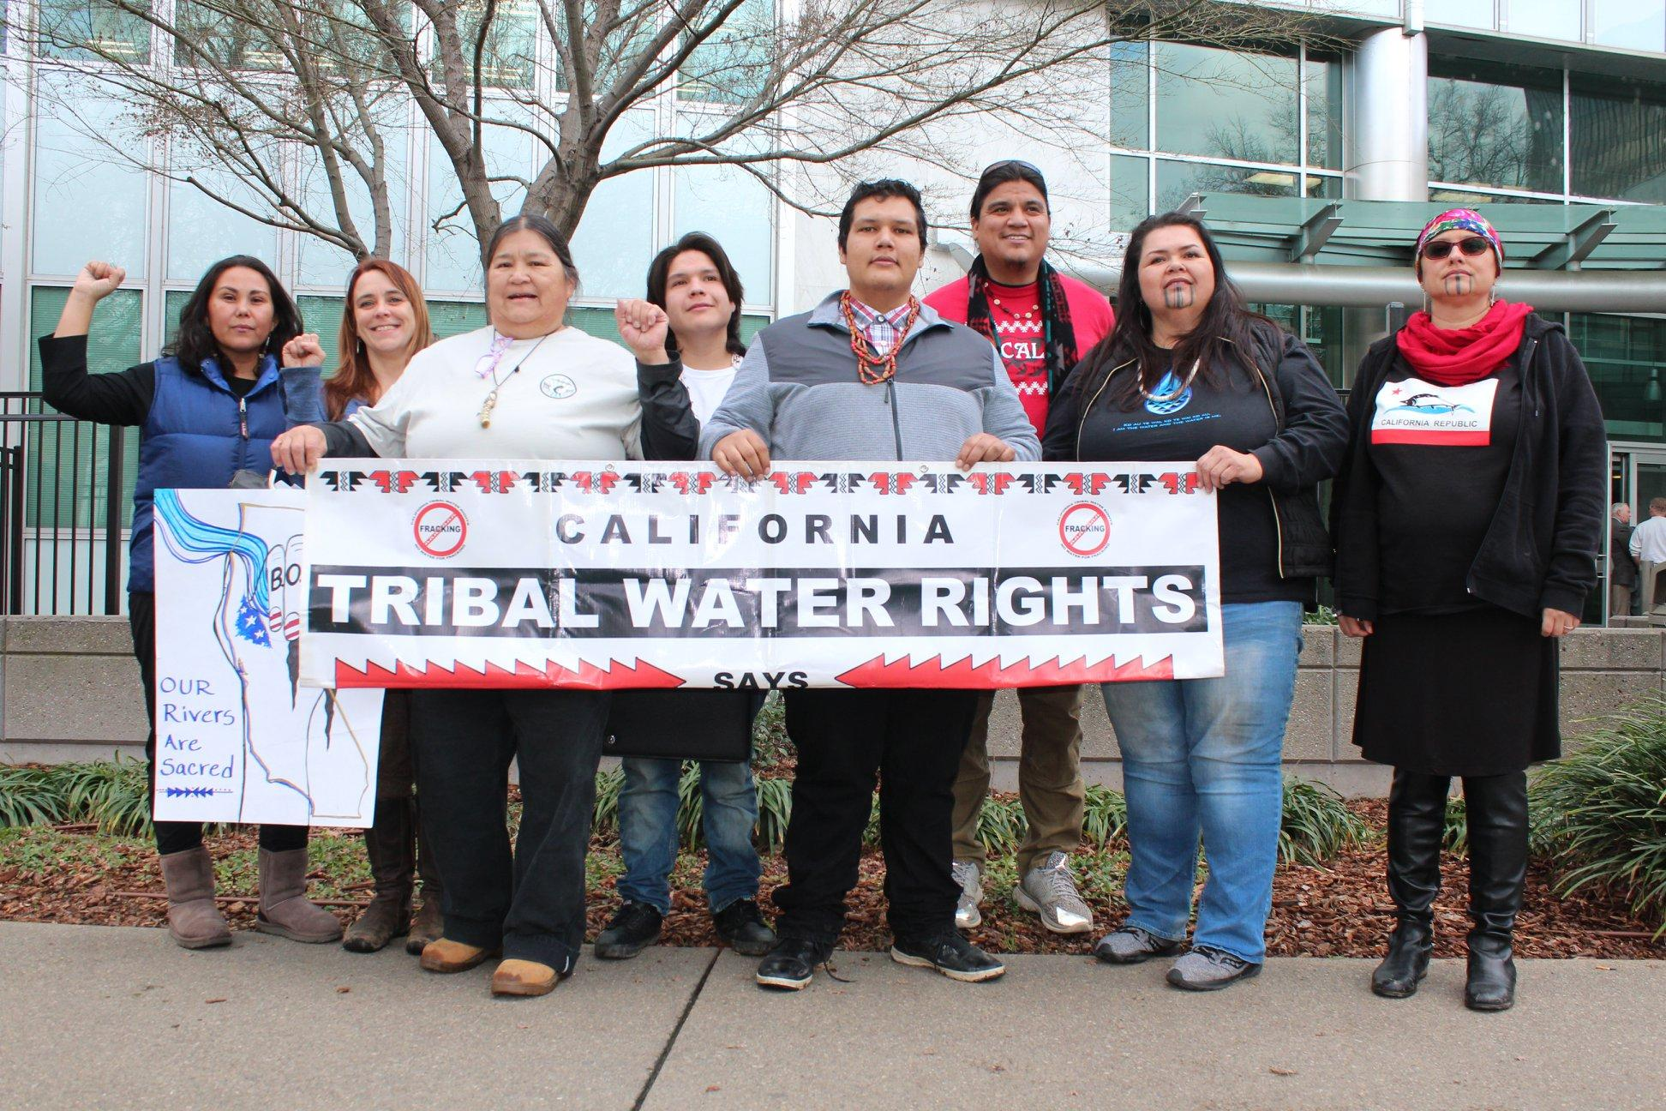
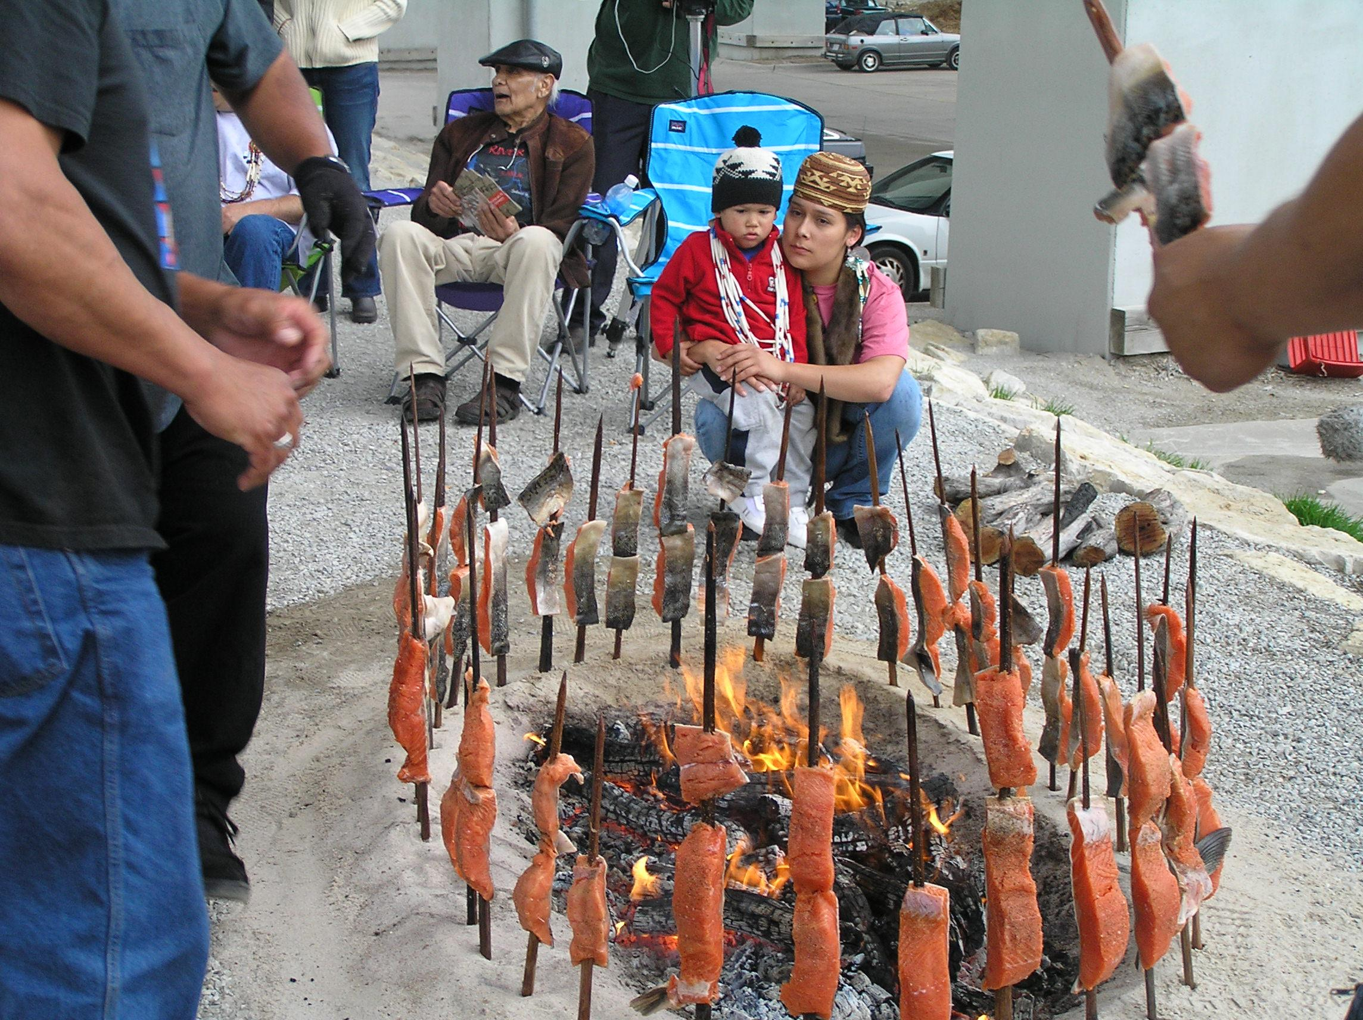
The Klamath is also complicated as far as Tribes and Tribal rights. The Yurok, Hoopa Valley, Karuk, Shasta, Quartz Valley, and Resighini Tribes call the basin their home. Some of these Tribes are federally recognised, some have reservations, some have been terminated and had their reservations taken, and some have rancherias. The Yurok Tribe has established fishing rights due to a case that went to the Supreme Court. The Hoopa Tribe also has fishing rights. The Klamath Tribe has an adjudicated water right won after about 30 years and two 9th circuit court of appeals cases, which helped establish important case law.

Slide 4
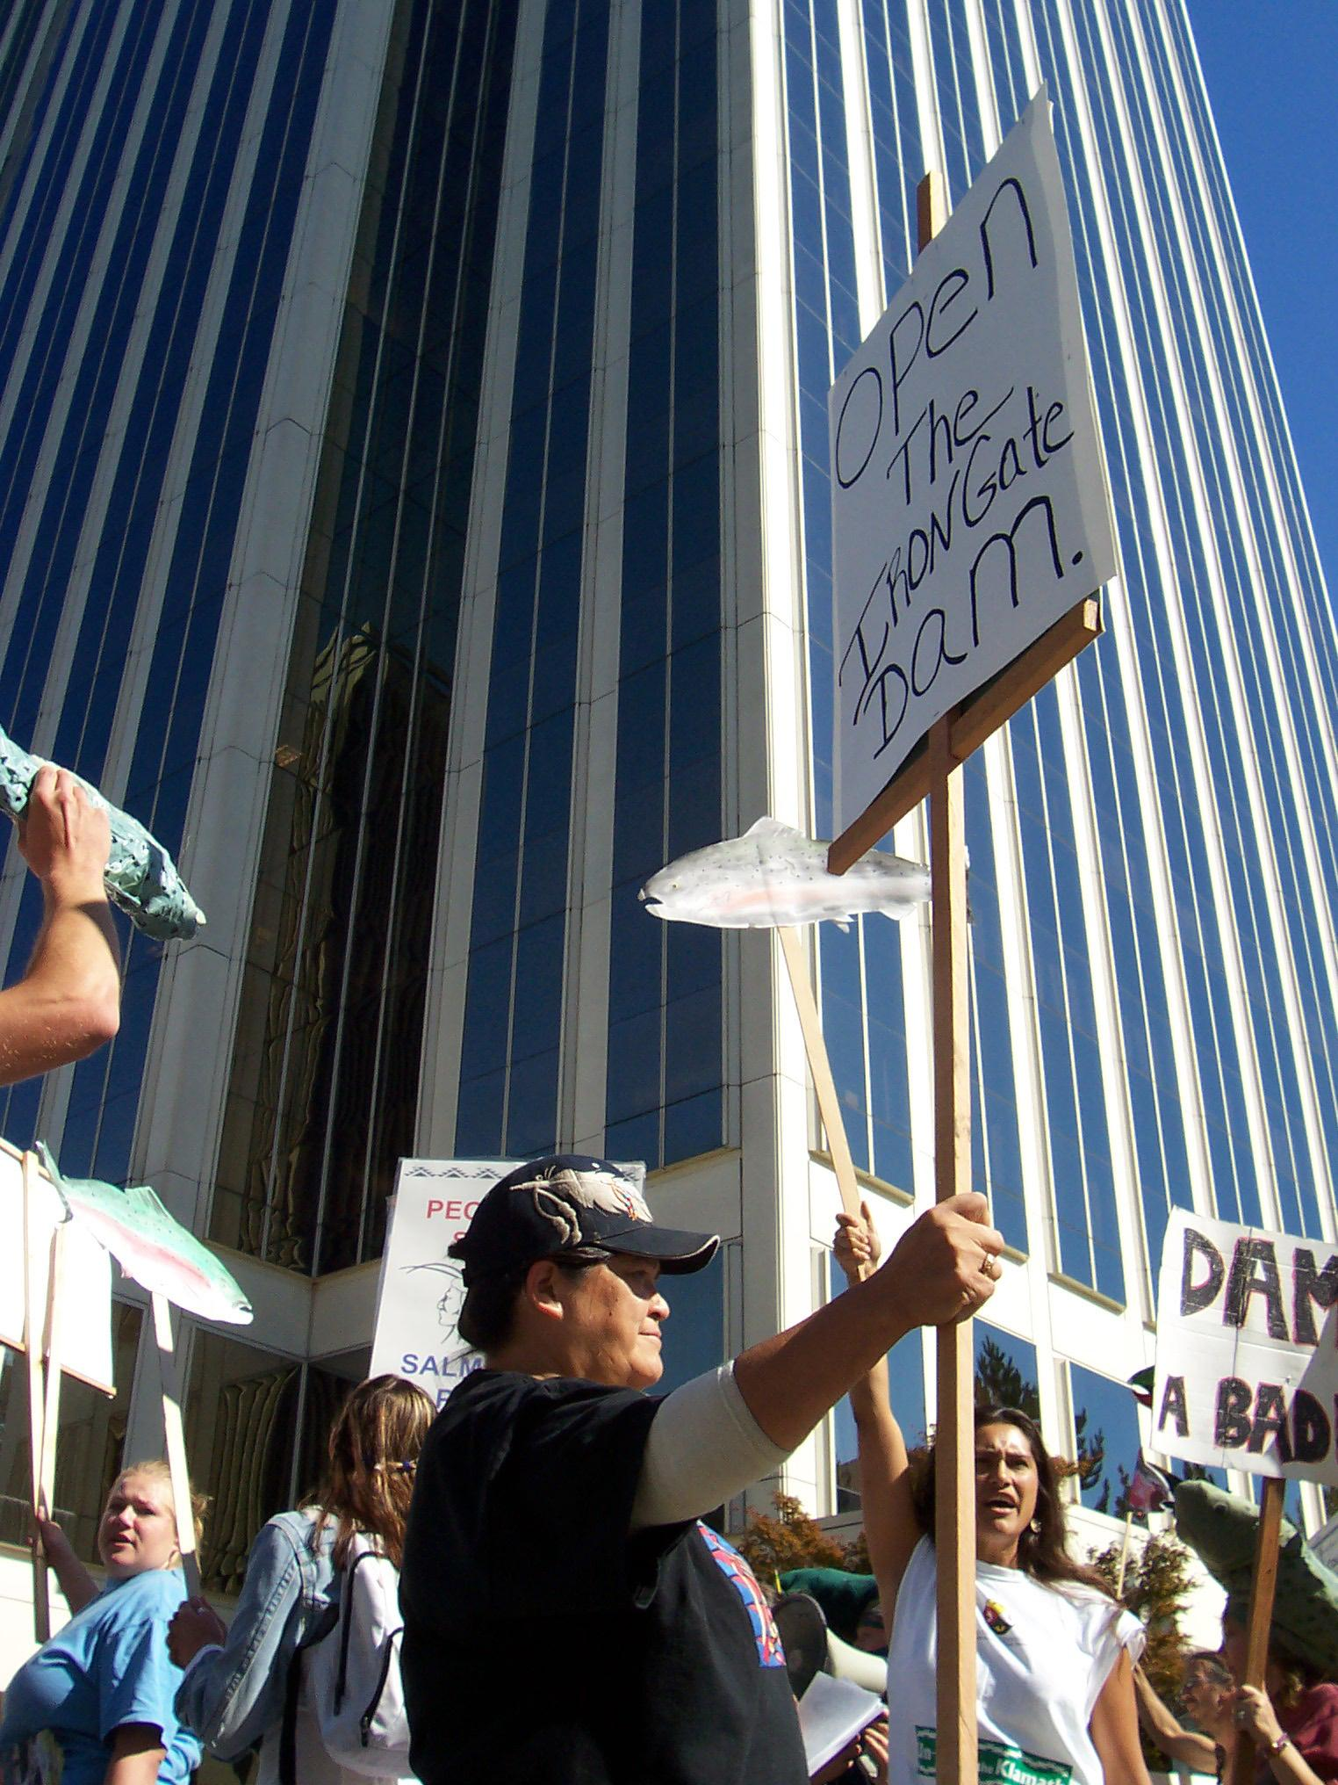
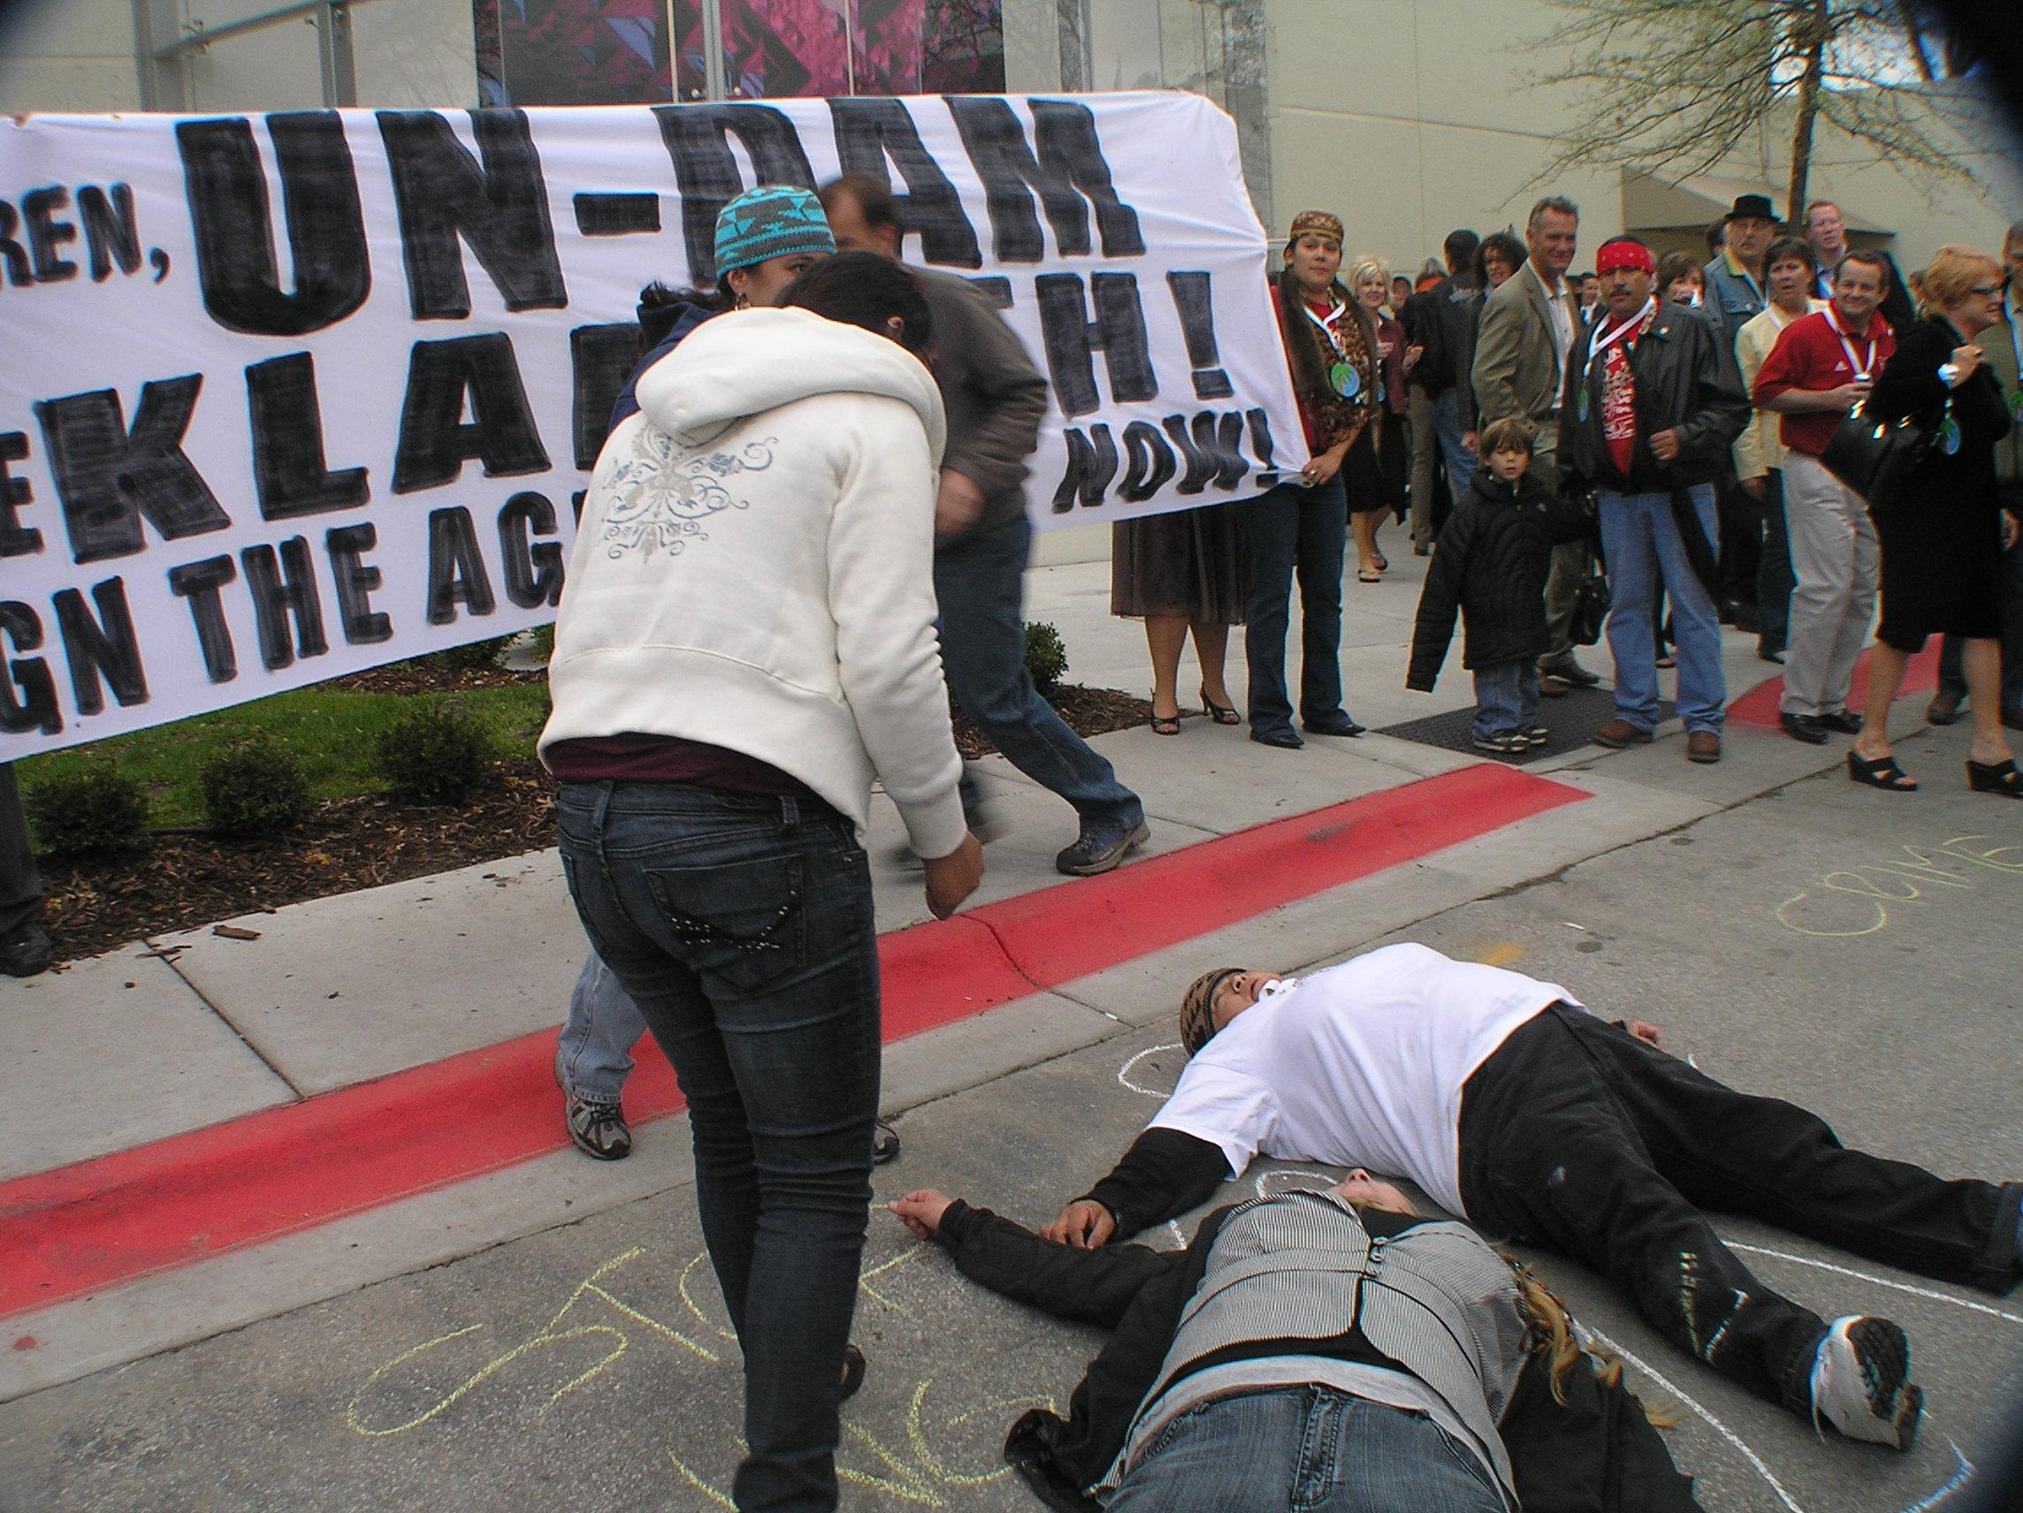
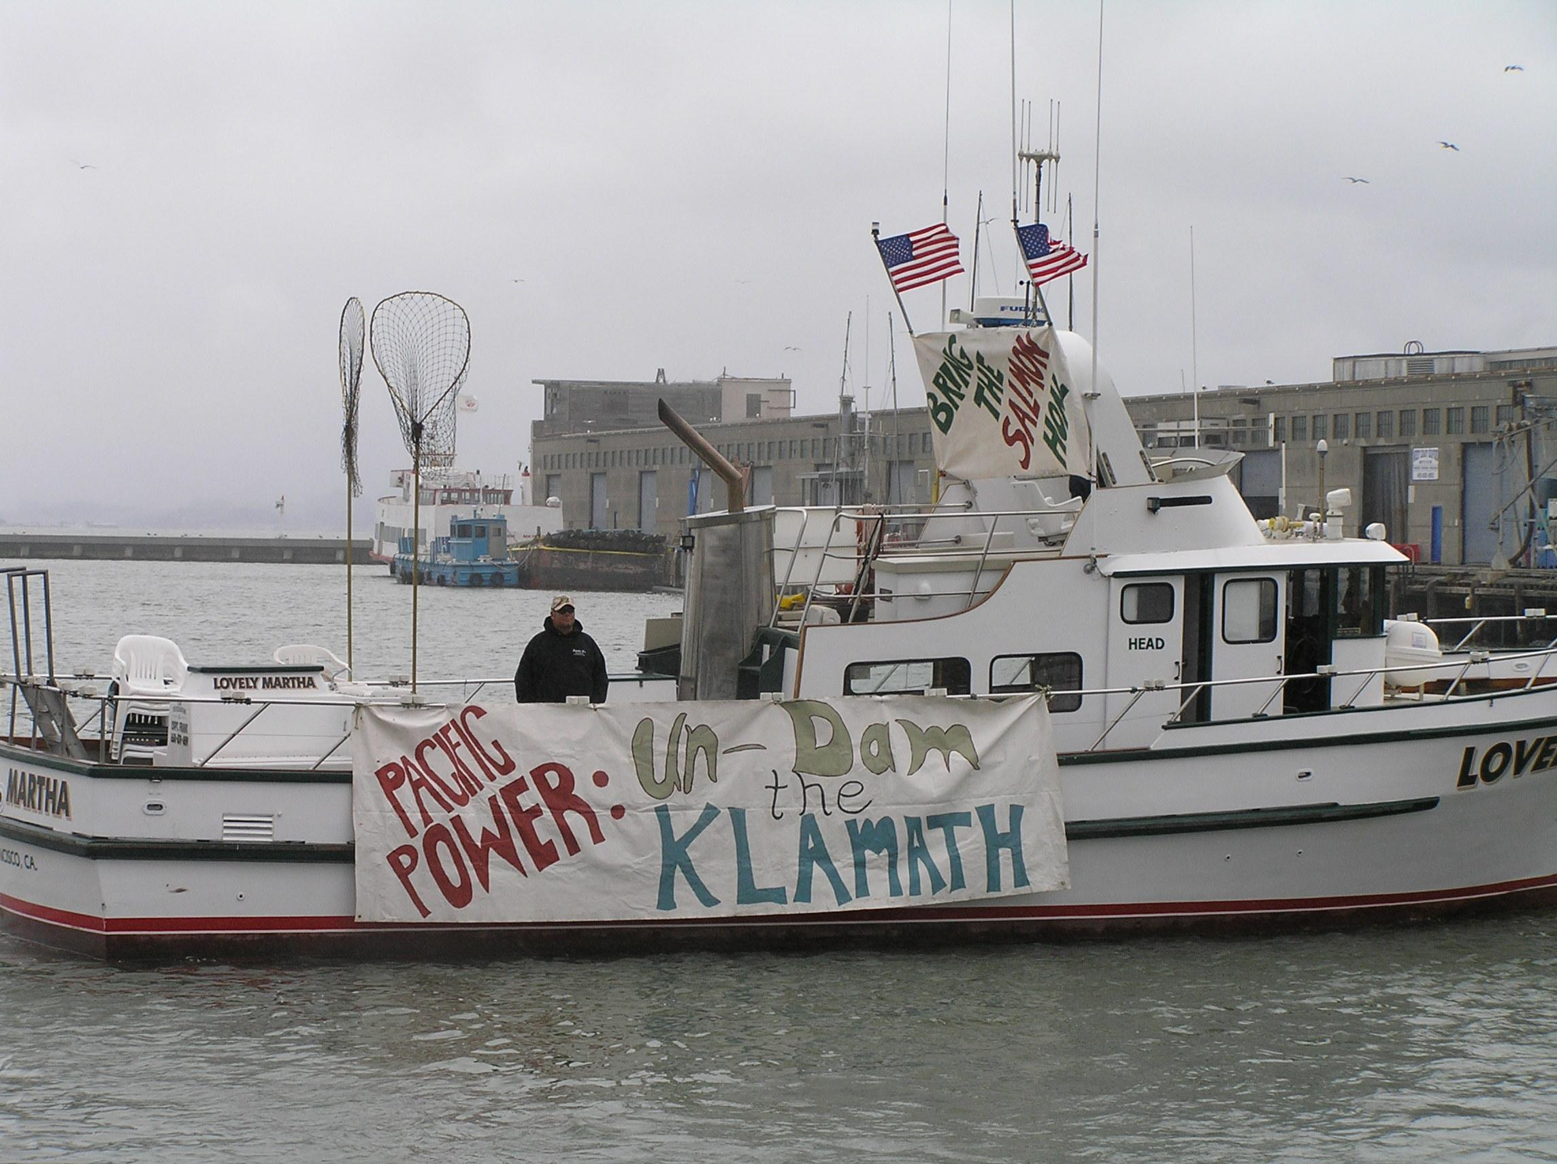
The Klamath is also undergoing a FERC relicensing, which has lead to an agreement to take down four dams. The campaign to take down the dams, which was led by Tribes, used science, the law, negotiations and direct action to accomplish its goal of dam removal . The fish kill was a catalyst for this movement.
,

