Slide 1
Environmental injustice, Art, and Activism on the Klamath River Basin
Brittani R. Orona (Hupa)
Ph.D. Candidate in Native American Studies with a Designated Emphasis in Human Rights
University of California, Davis

Slide 2
The Klamath River as Home
Tribes (Hupa, Yurok, Shasta, Karuk, Klamath) of the Klamath River and its tributaries (Trinity, Salmon, etc.) depended on the basin for cultural and physical renewal
Ceremonial dances take place along the sites near the river;
Fishing is a community event-families fish for Chinook, coho salmon, steelhead and Coastal Cutthroat trout, green and white sturgeon, and pacific lamprey
ta’na:n-na:niwe:sile’n or hun’ (Trinity River, as a power one should pray to)

Slide 3
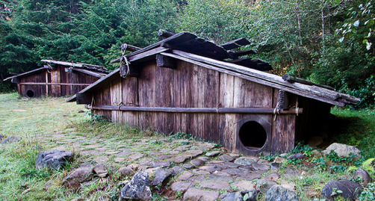
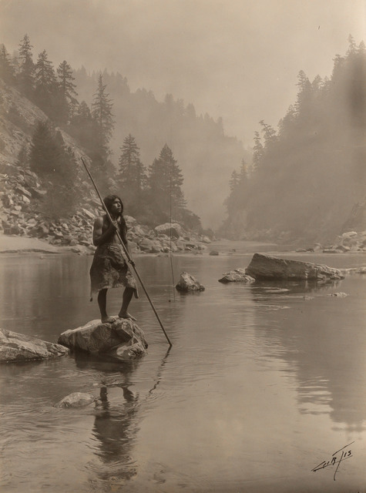
Tribes on the Klamath River Basin

Slide 4
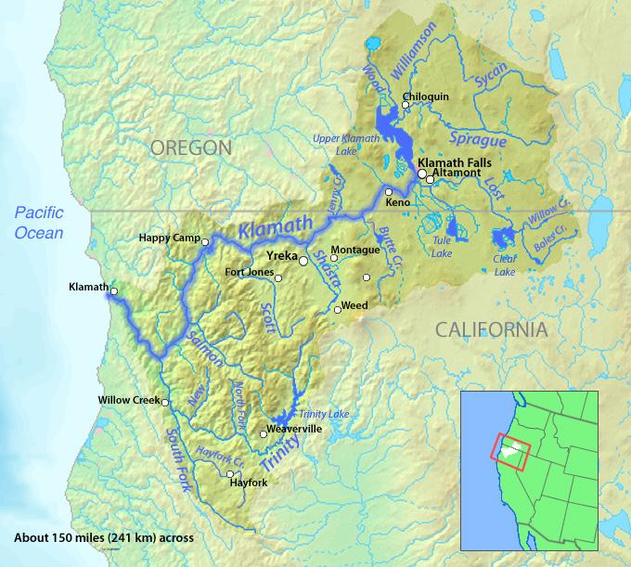

Slide 5
Problems on the Klamath River Basin
Mass diversion of Klamath water to Oregon farmers and ranchers via four dams (J.C. Boyle, CorpCo 1 & 2, Iron Gate) create dangerous water conditions on the Klamath River and its tributaries
In 2002, diversion created toxic, over-heated water that lead to a fish kill. 77,000 mature Chinook and Coho salmon died on the rivers.
This was the catalyst for major activism effort, lead by the Klamath Justice Coalition, to remove the dams

Slide 6
Map of the Klamath River Dams

Slide 7
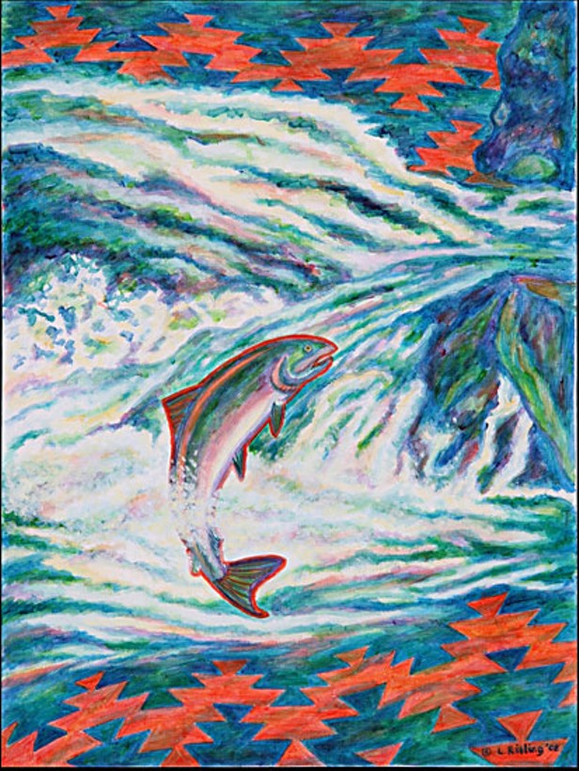
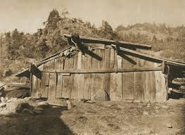
Visual Sovereignty
Notes:
“Reservation Reelism: Redfacing, Visual Sovereignty, and Representations of Native Americans in Film” Edward Curtis took photographs of Native Americans/Robert Flaherty

Slide 8
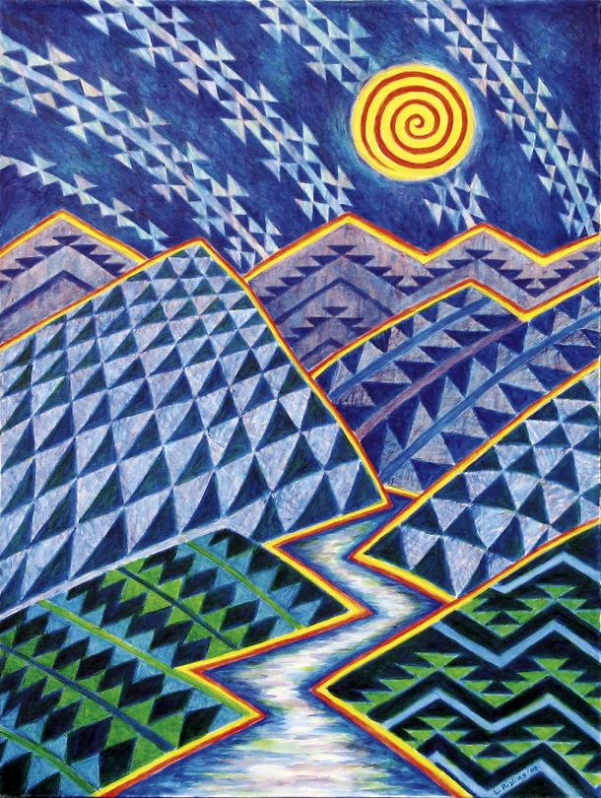
Paintings from the Klamath River Basin
Prolific and world-renowned artists have come from the NorthCoast and Klamath River:
Julian Lang (Karuk/Shasta)
Lyn Risling (Hupa/Yurok/Karuk)
Brian Tripp (Karuk)
George Blake (Hupa/Yurok)
Brittany Britton (Hupa)
Rick Bartow (Wiyot)
To name a few….

Slide 9
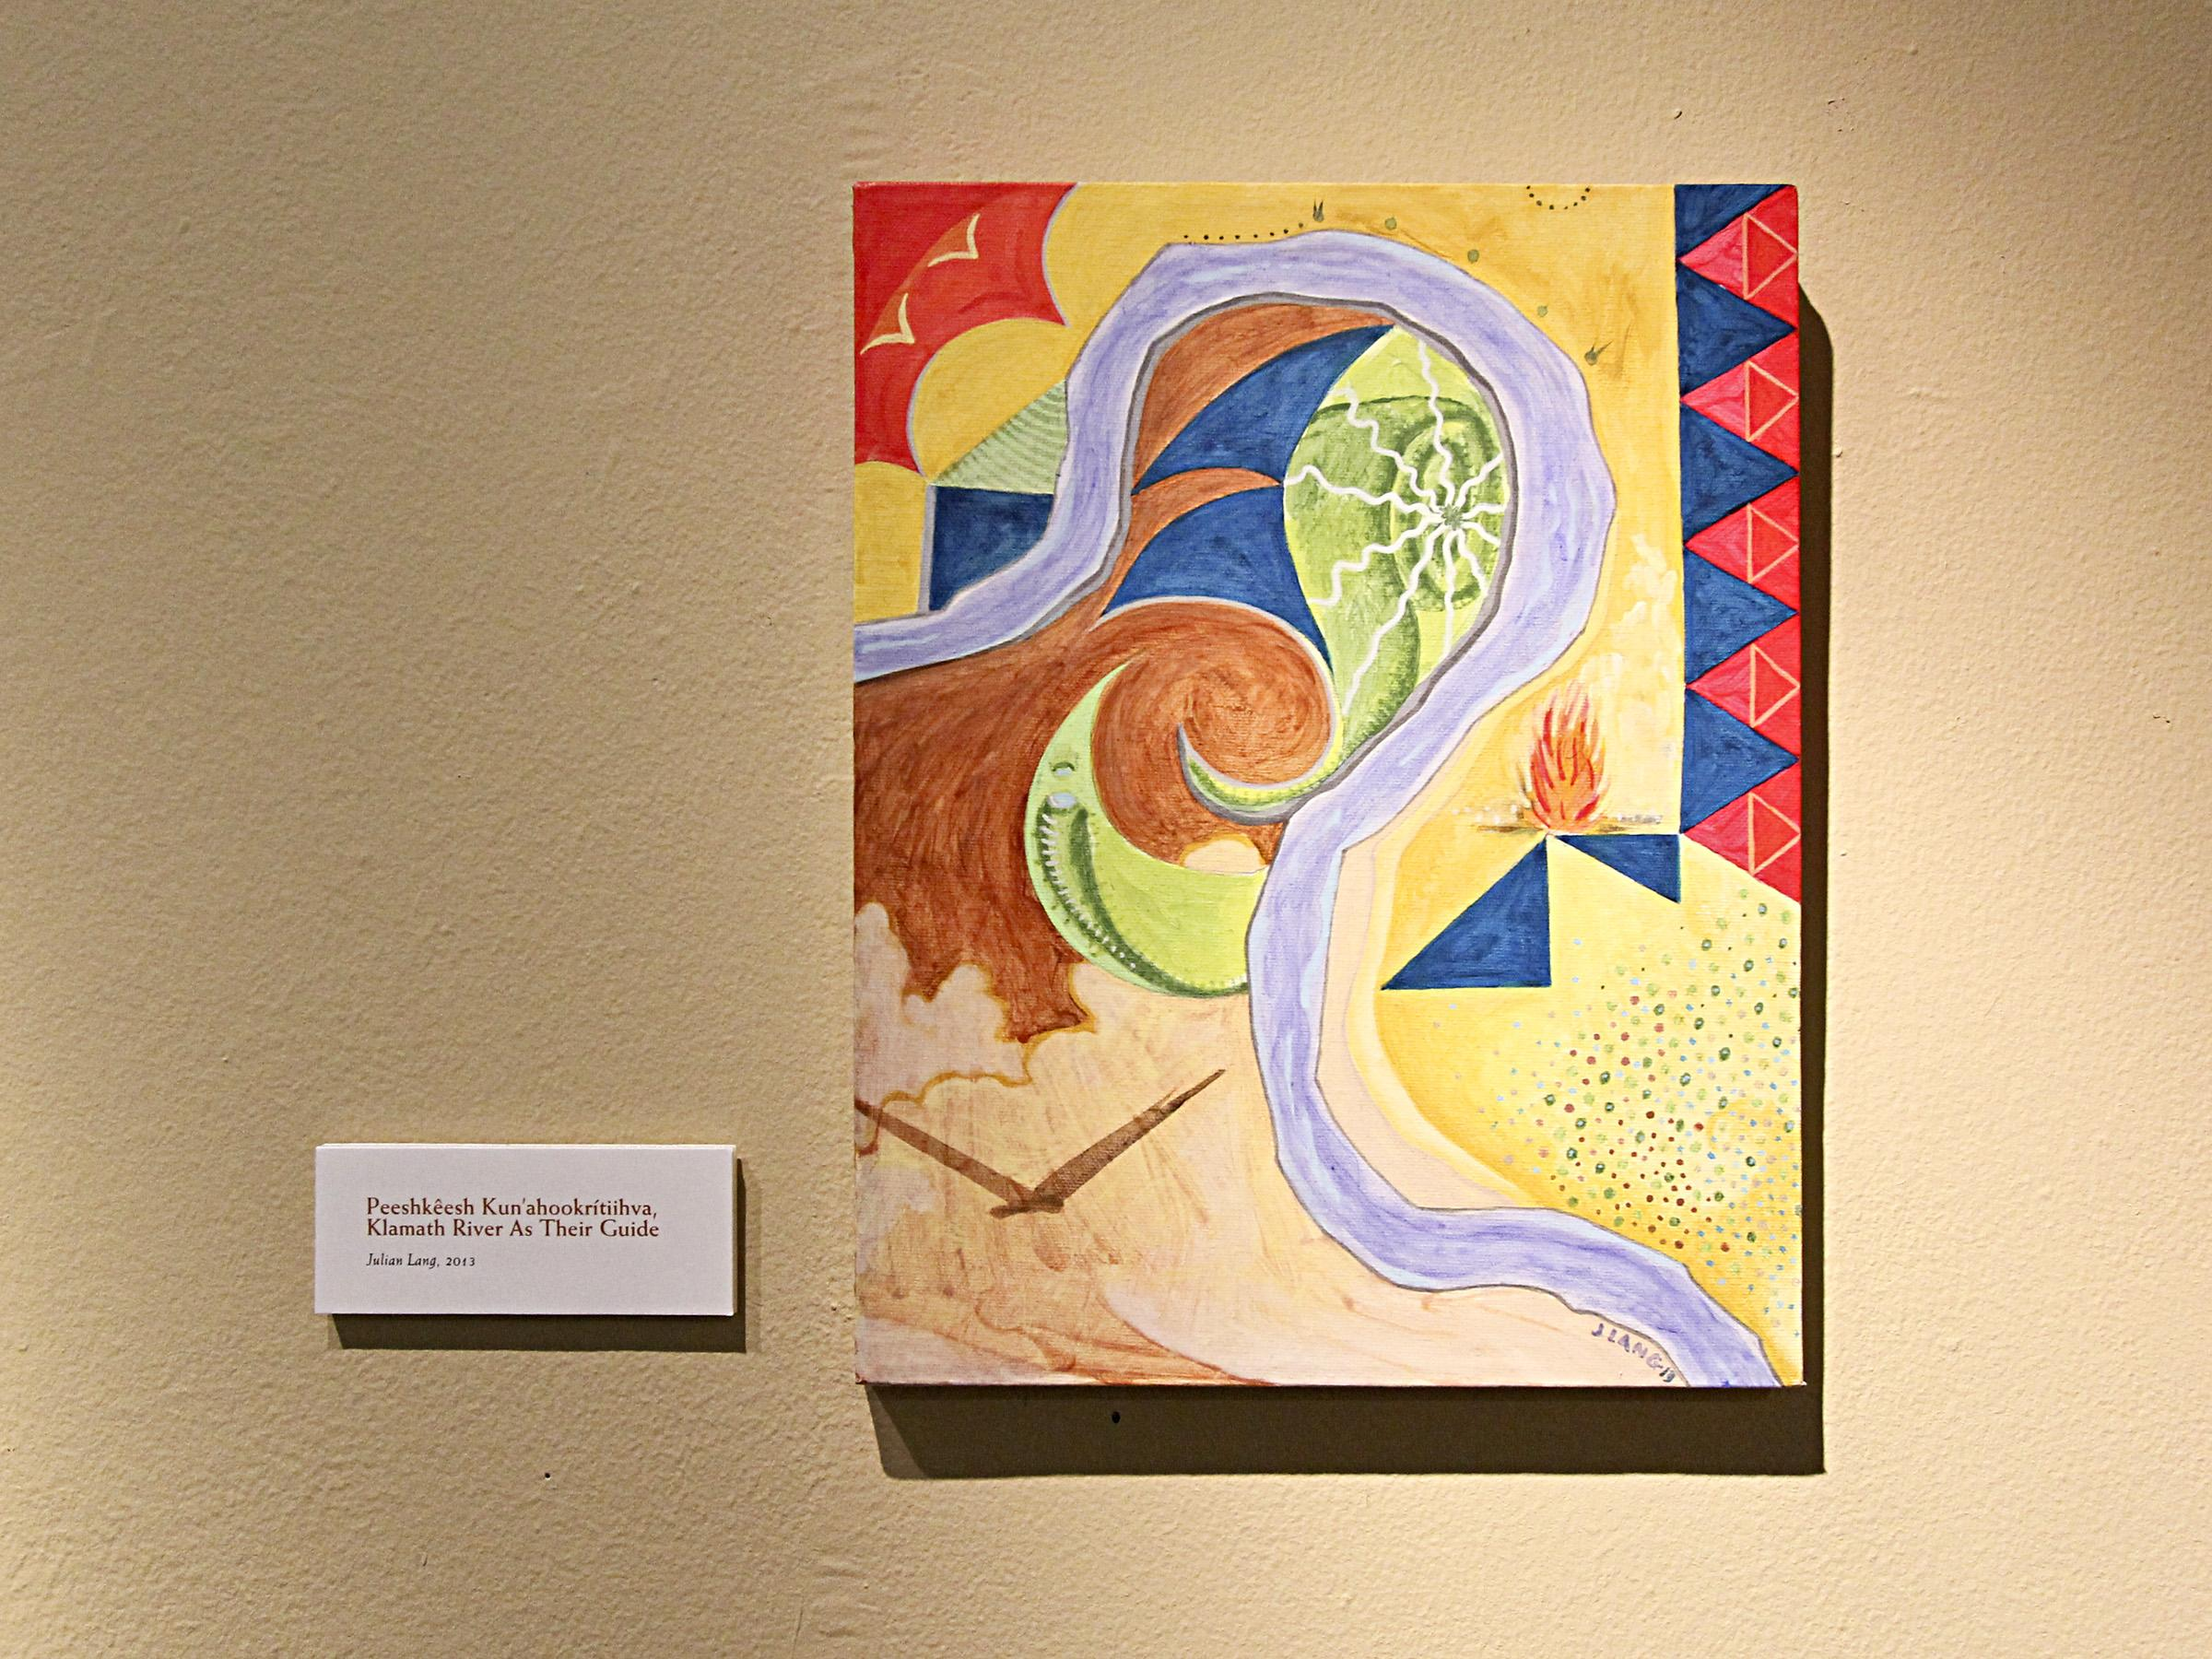

Slide 10
Ephemera
from the Klamath River Activism Movement/NOGO

Slide 11
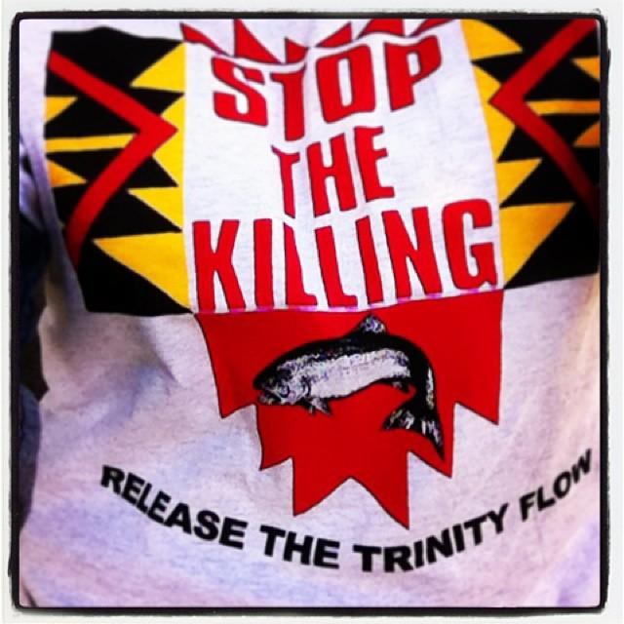

Slide 12
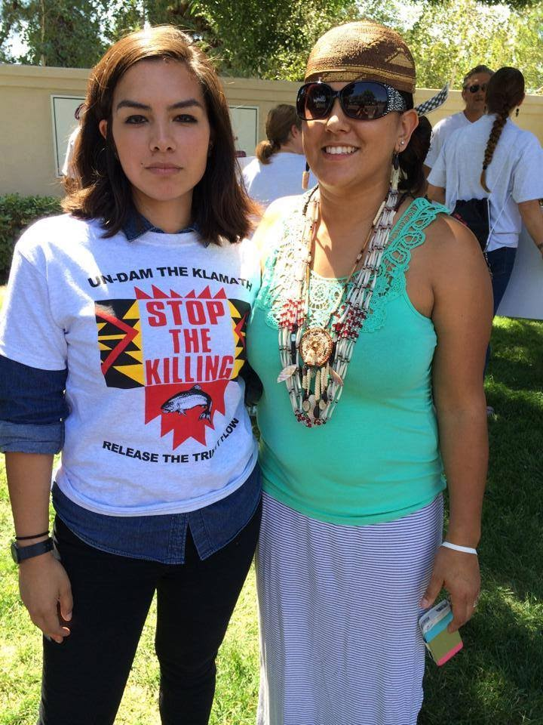

Slide 13
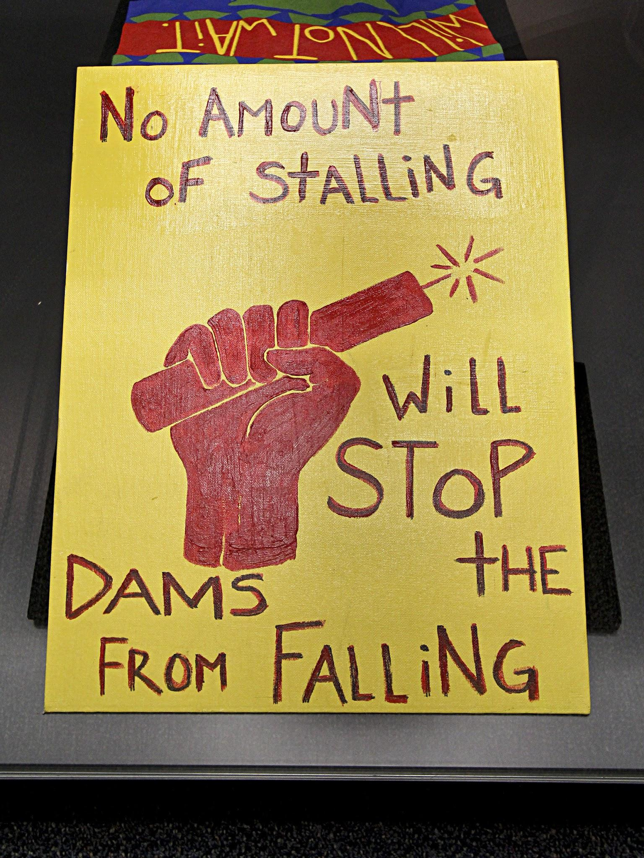
Annilea Hillman (Yurok tribal member and Klamath Justice Coalition activist)

Slide 14
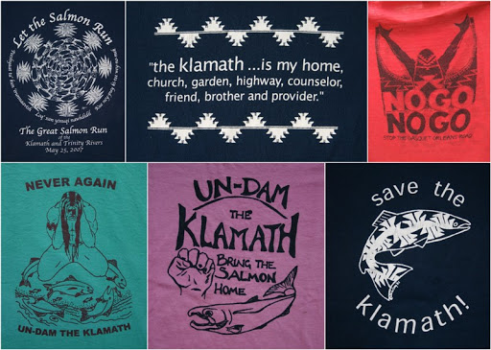

Slide 15
Photography
from the Klamath River Activism Movement

Slide 16
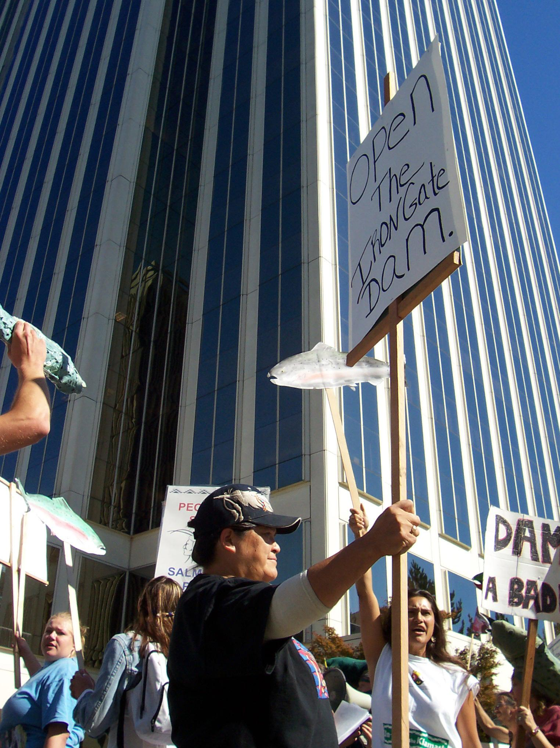

Slide 17
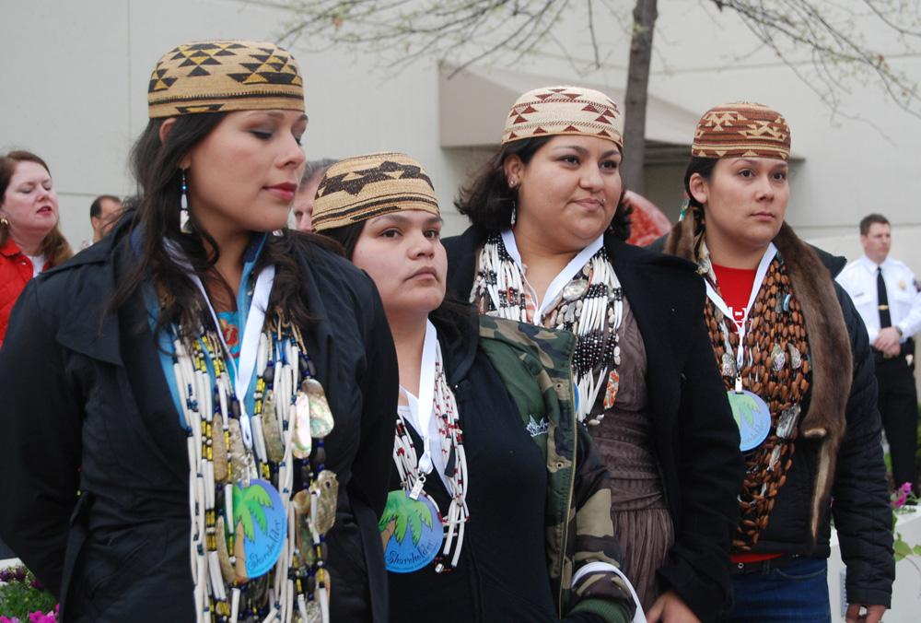

Slide 18
