Slide 1
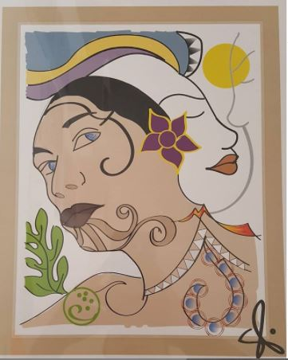
Storytelling
&
Social Media
Notes:
Introduction
Mom, Dad, born & raise Family kids
Palamanui graphic design
Self portrait (symbolism)

Slide 2
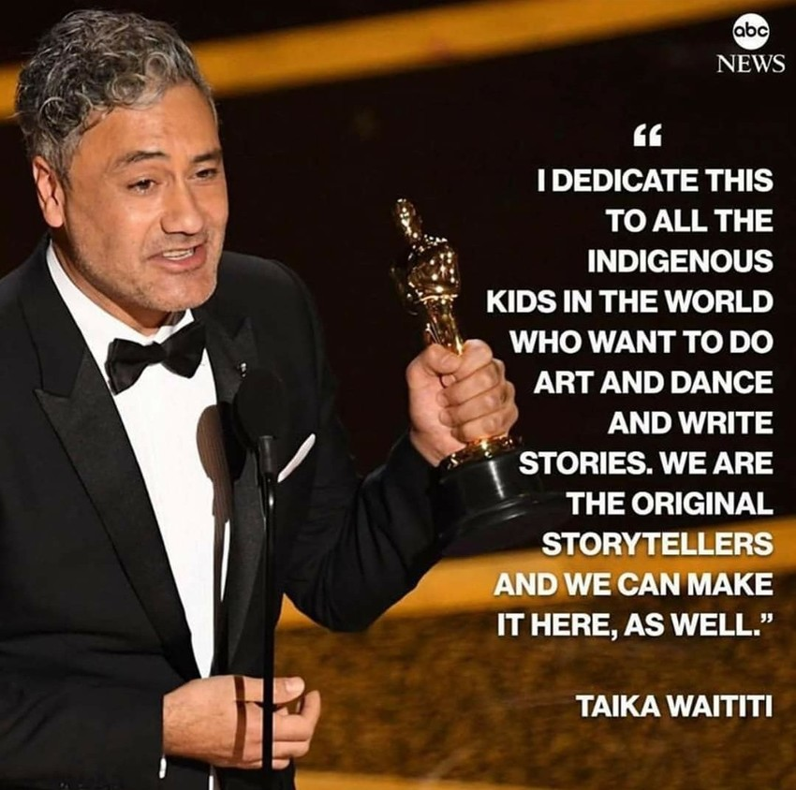
We Are The
Original
Storytellers
Notes:
Since we’re starting with telling stories I wanted to start with this quote
My introduction starts with the land and where I am from and the people in my life
These provide connections to my ancestors who have creation stories of our connection to the land
Genealogy traces back to land
Moolelo about land and

Slide 3
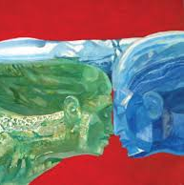
Relationship
&
Creativity
Artist: Solomon Enos
Notes:
Creation story relationship to land
Ask yourself when you get involved or do this work.
How do I relate and why do I relate? What was that moment.

Slide 4
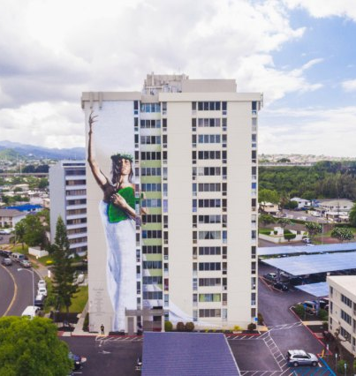
*ZOOM
*ADOBE PREMIERE
*VIMEO
"HINA" by Kamea Hadar for Pacific Development Group
Notes:
Zoom
Kamea Hadar
Mixing old with new
Reshaping old messages with new ones
Grassroots movements use Vimeo
Take a class or youtube it

Slide 5
Informative
&
Inspirational

Slide 6
Learn the
History
Klamath Dams via DamsOut
https://youtu.be/ahO9PEaCSjQ
2016 via KCET - An Oral History of the Klamath Salmon Wars
https://www.kcet.org/shows/tending-the-wild/salmon-fish-wars-klamath-river-susan-mast
en-raymond-mattz-diane-bowers
Notes:
Learn the history. Most people and media don’t acknowledge the history. We are on stolen land. Connect with land and connect with native people of that land
Susan Masten in the video it spoke of a tense moment where members of the Yurok tribe about to be confronted with men with billy clubs and they started singing a ceremonial song and they were scared of spirituality

Slide 7
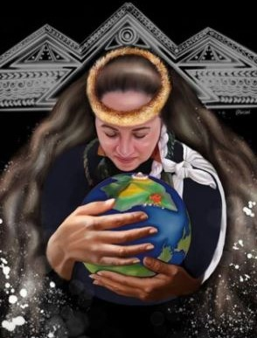
WE ARE MAUNA KEA
Standing Above the Clouds
https://www.youtube.com/watch?v=peDRsxYaF1U
Artist: @besoul
Notes:
It’s not just about a telescope, it’s about the very survival of our people and our culture.

Slide 8
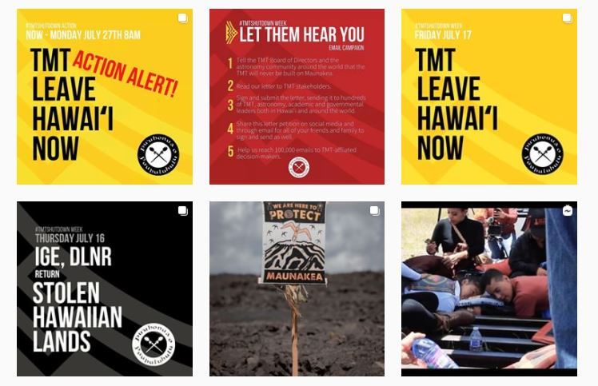
Checkout
@huli.nvda
on Instagram
Notes:
Whole
Press Releases
Call to Action
Snippets

Slide 9
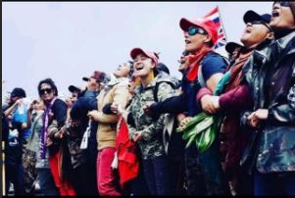
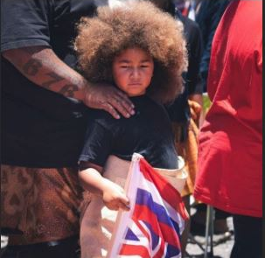
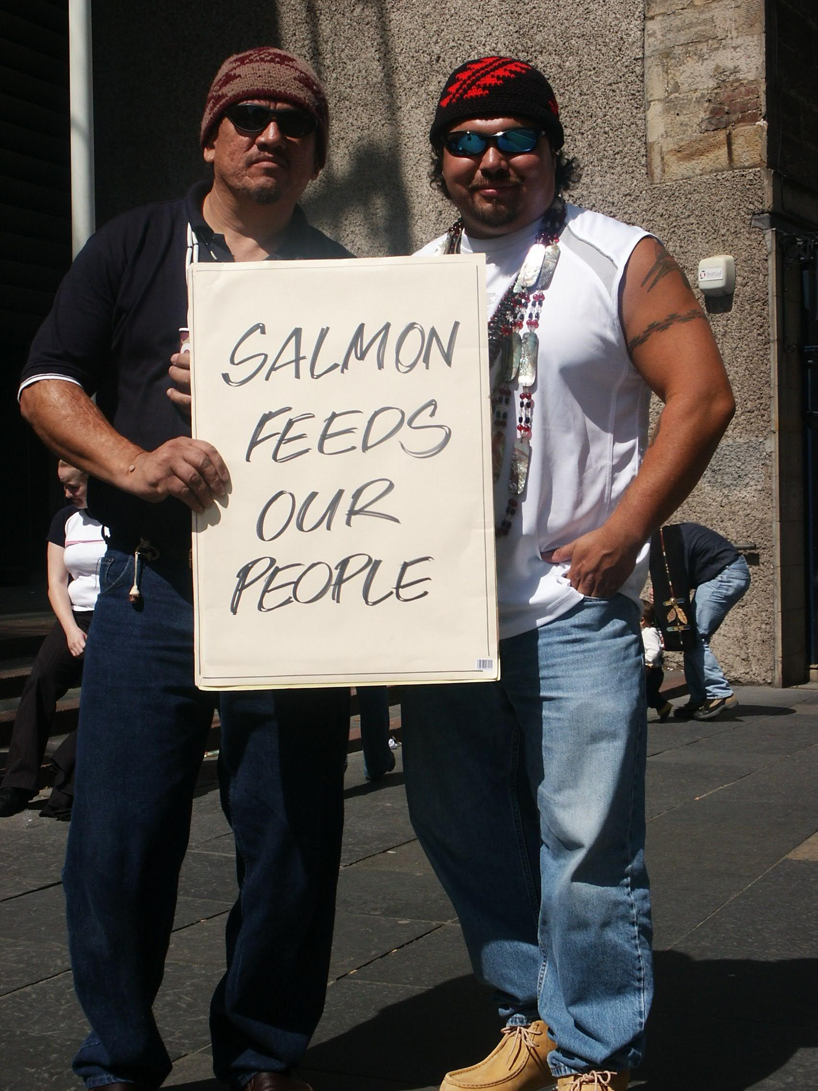
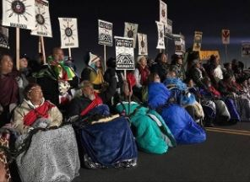
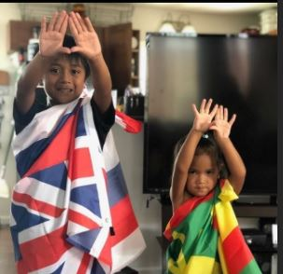
Notes:
Photos
At the heart of these movements are people
Its about people connecting to eachother and land
Older and younger generations

Slide 10
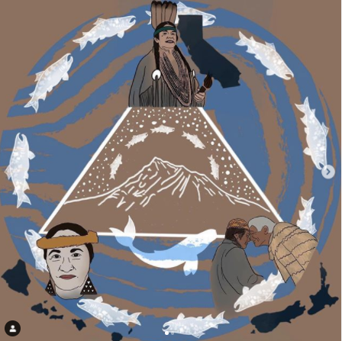
Visibility
&
Connectivity
Artist: Beatriz
Notes:
Making our causes and people visible when they otherwise wouldn’t be
Connecting our causes for strength

Slide 11
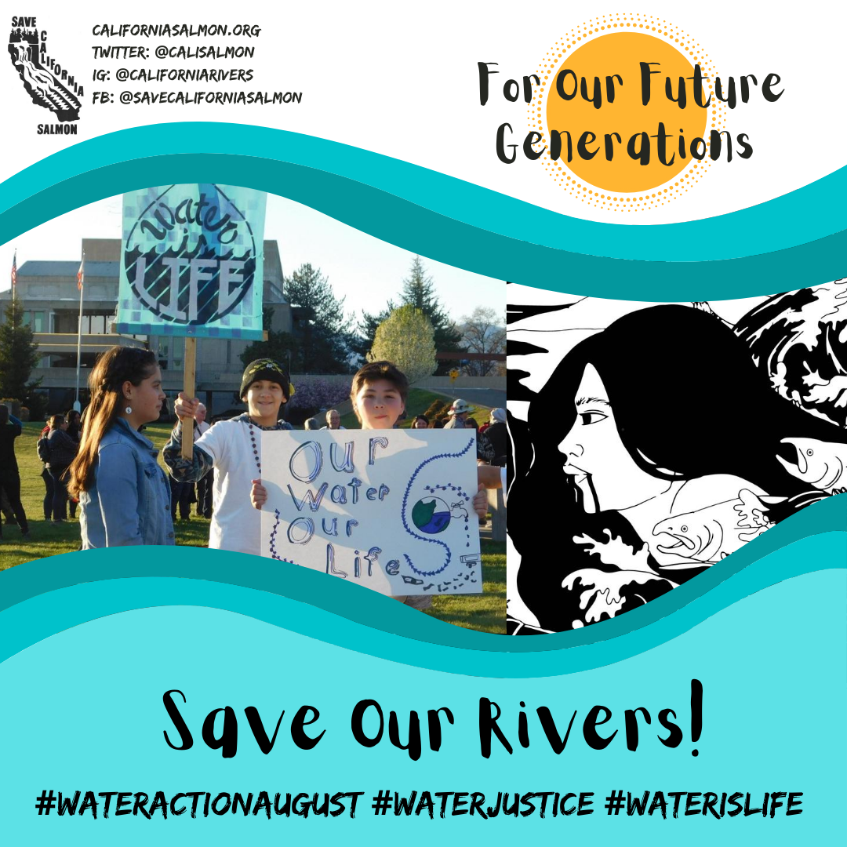
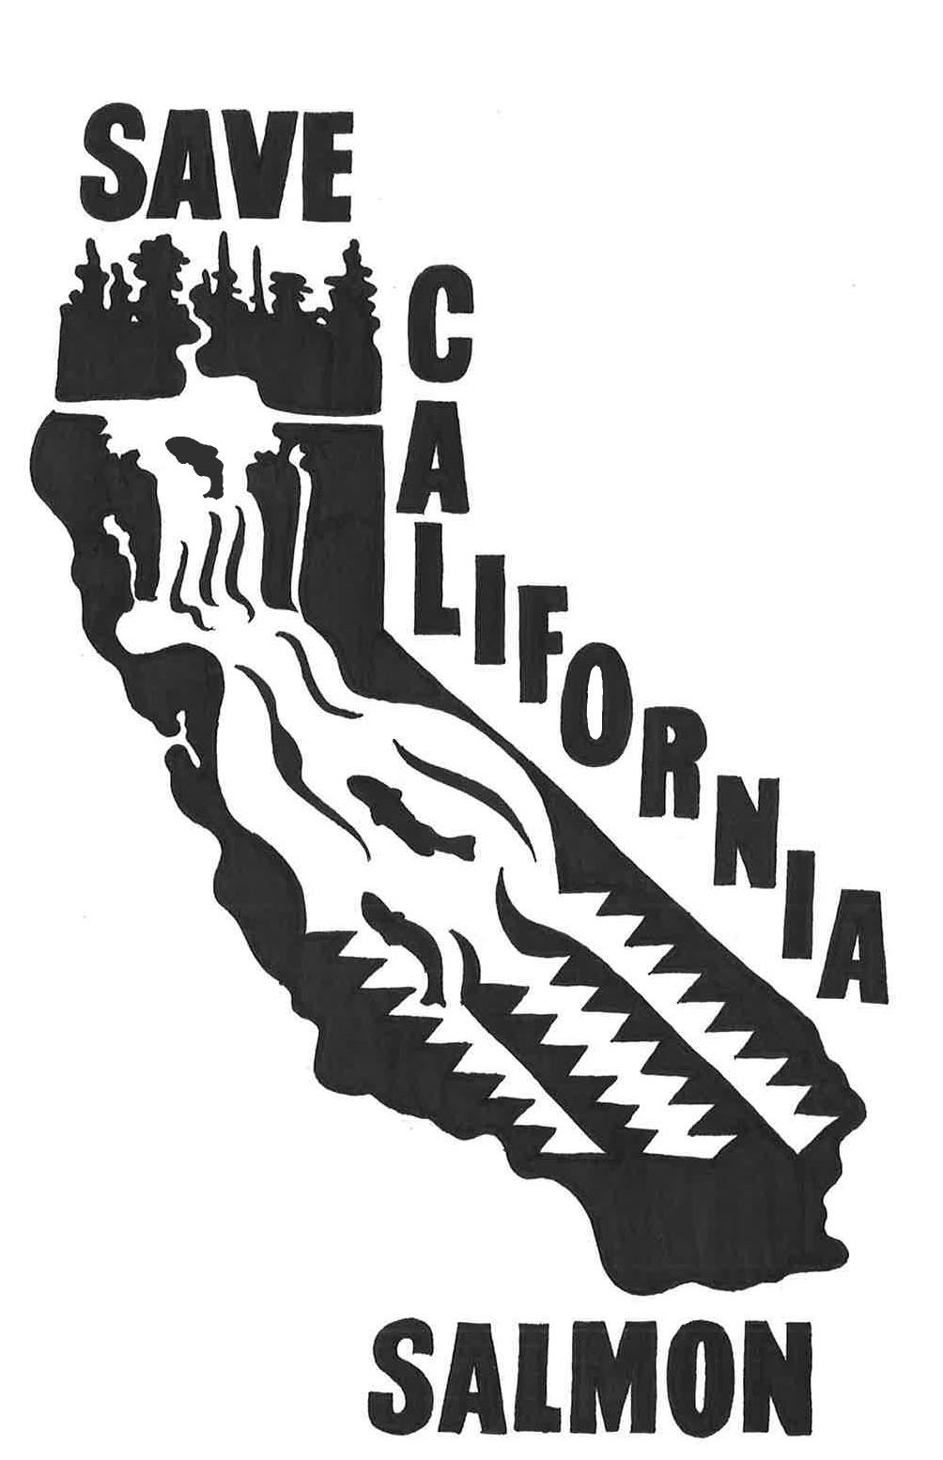
Notes:
Work with California Salmon
Involve other people in the process
Main points in image - use caption for more info

Slide 12
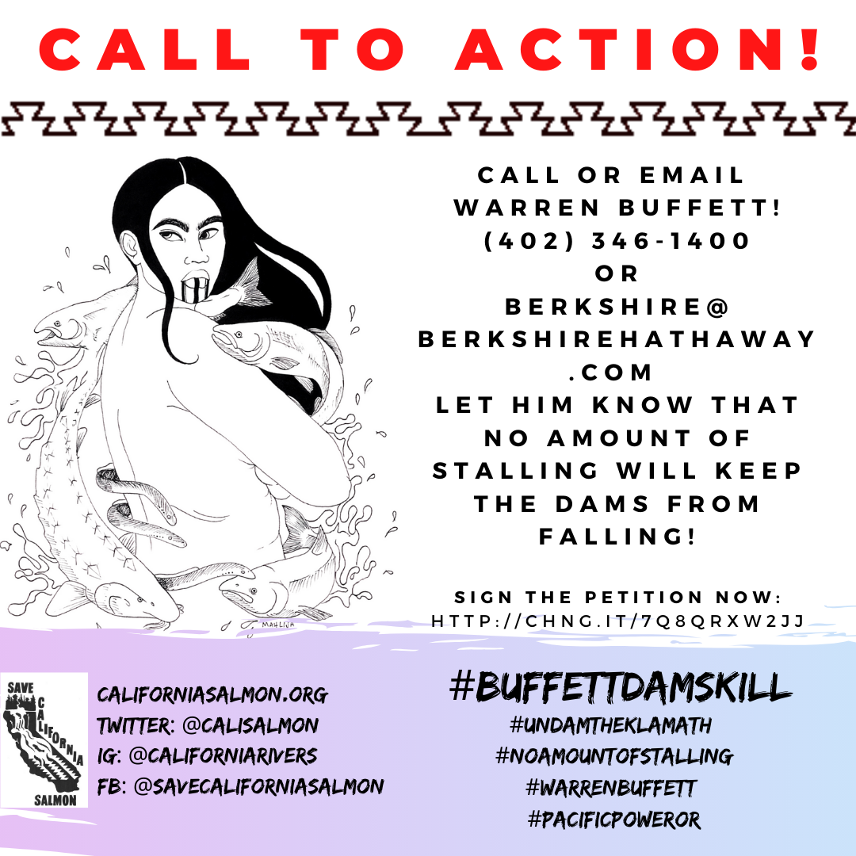
*CANVA
*IG/IGTV
*FB
*STORIES
*TWITTER

Slide 13
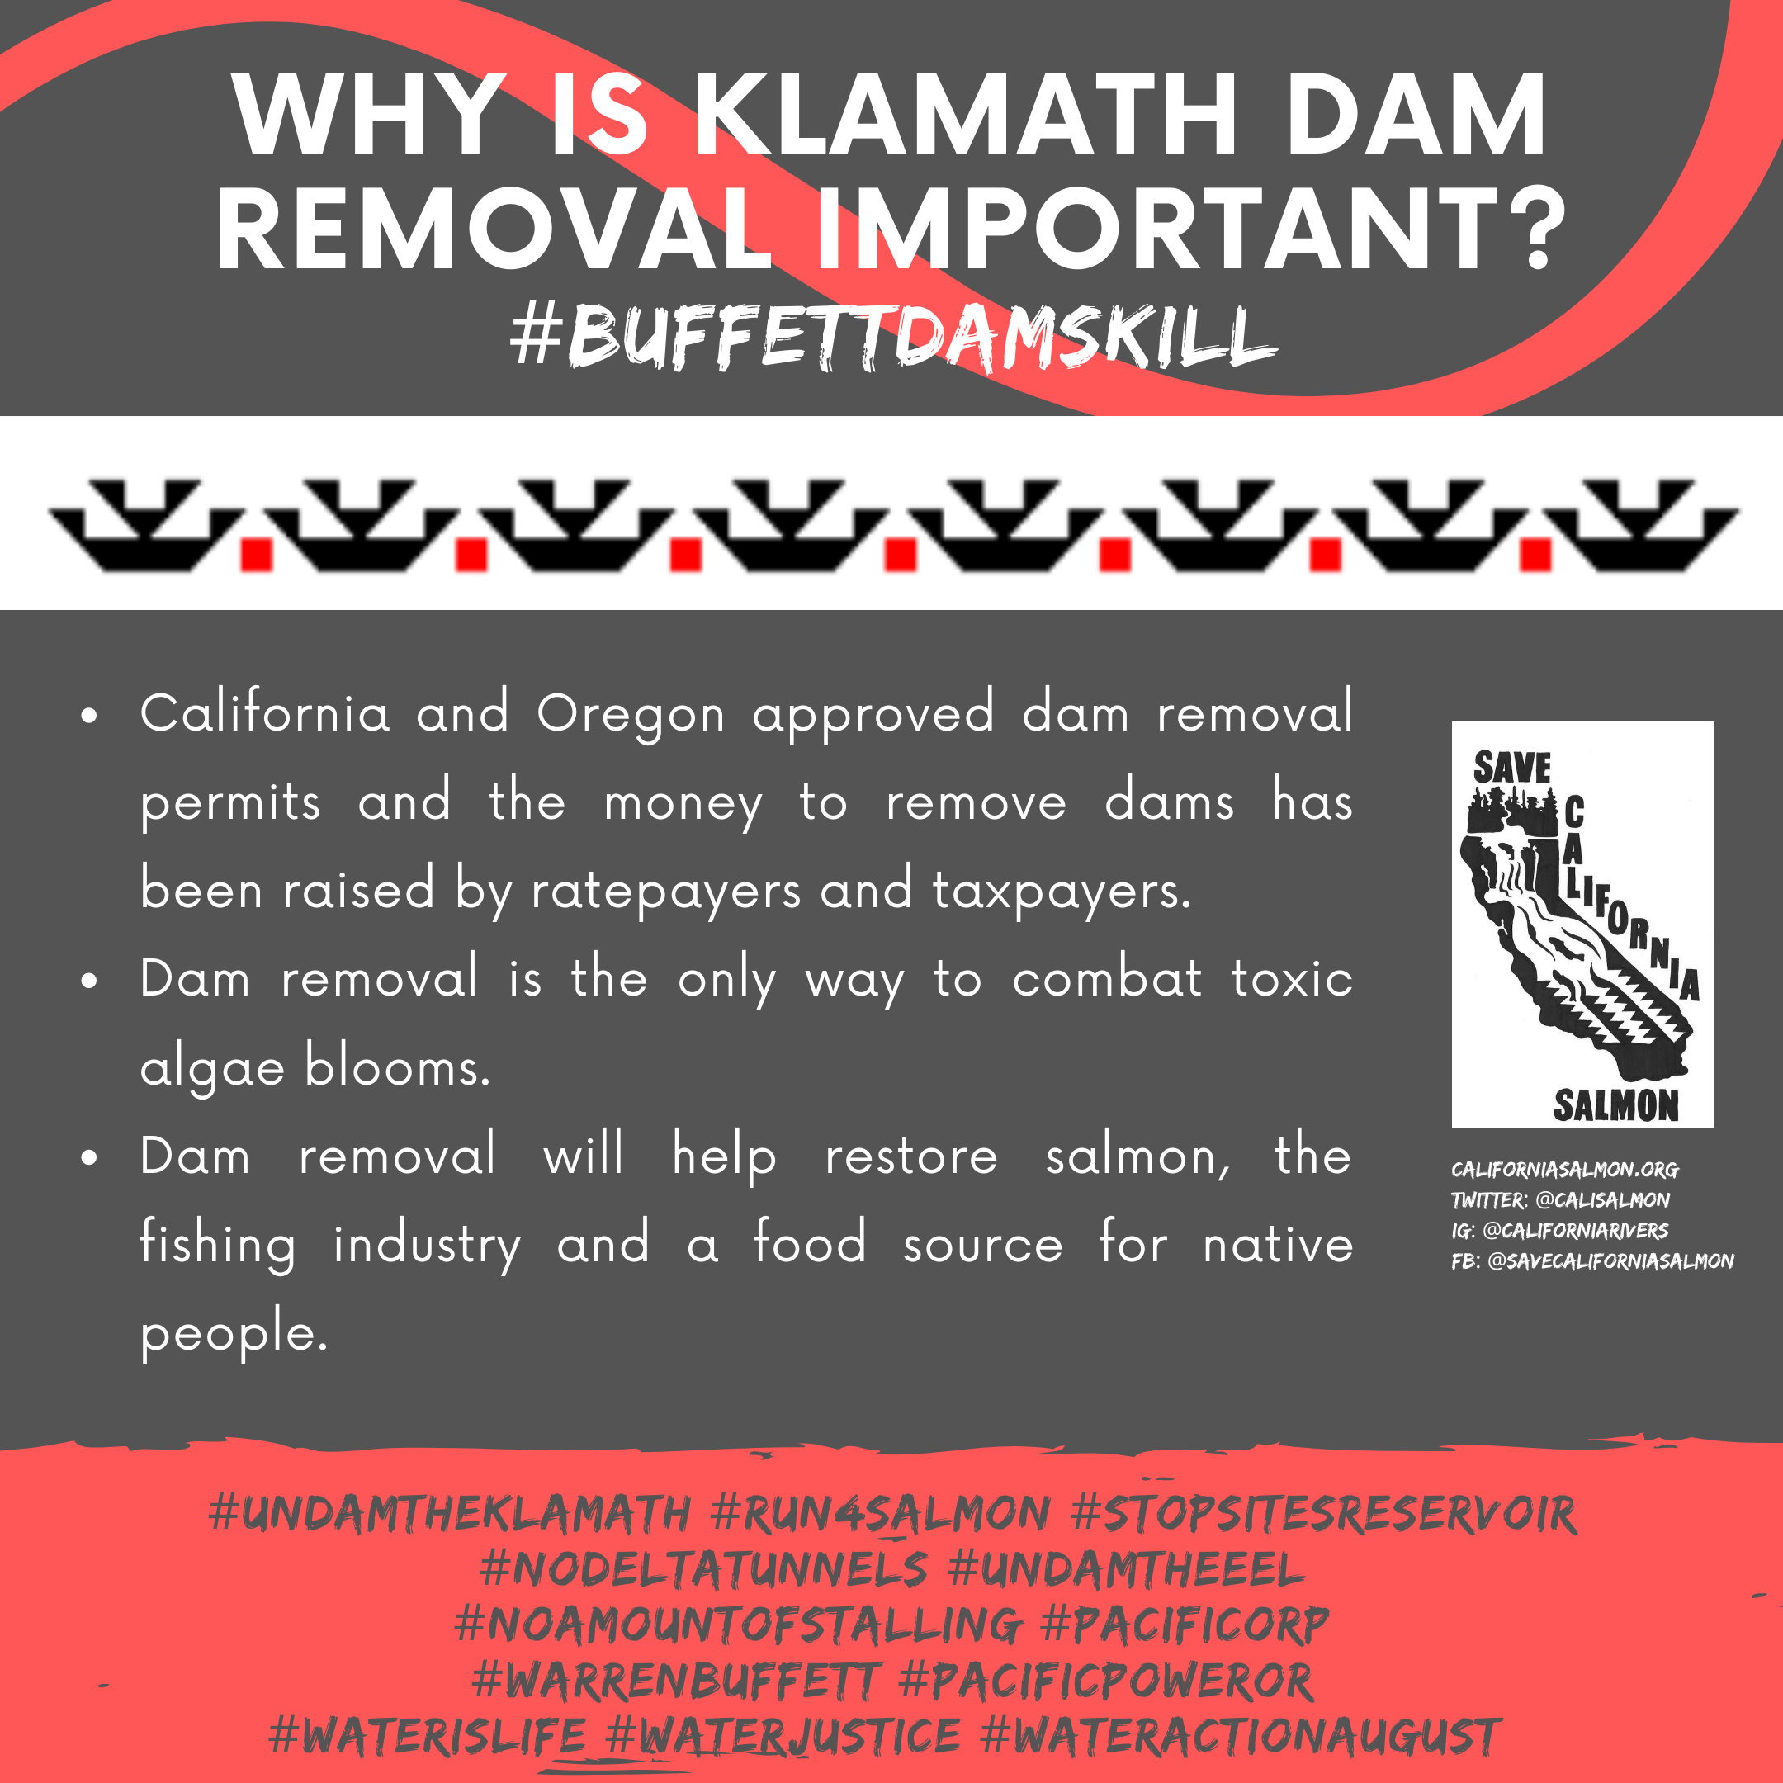
Ask
Permission
Native Symbols/Artwork
Copyright
Laws

Slide 14
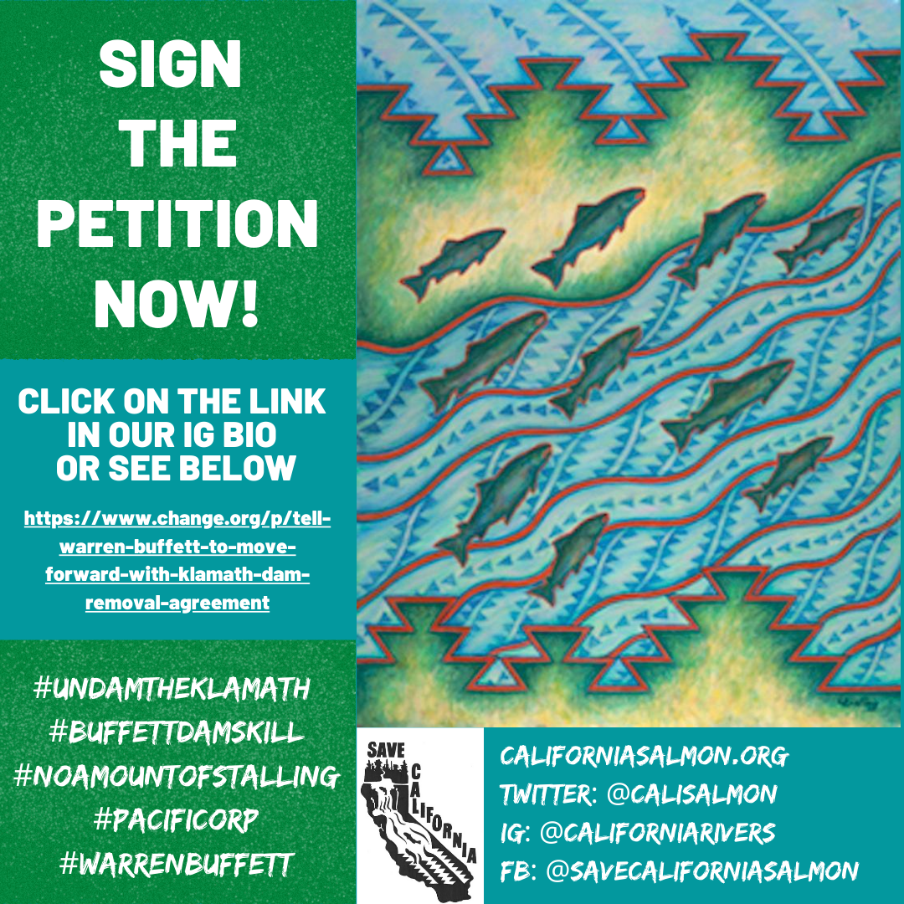
SIGN
THE
PETITION!
Notes:
Followers

Slide 15
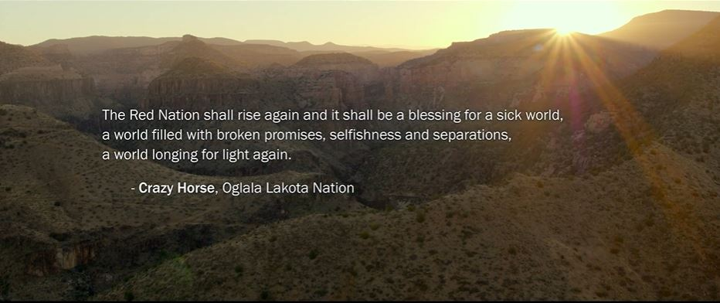
Checkout the movie by Gather with Sammy Gensaw from the Yurok tribe speaking about fishing/dam removal.

