Slide 1
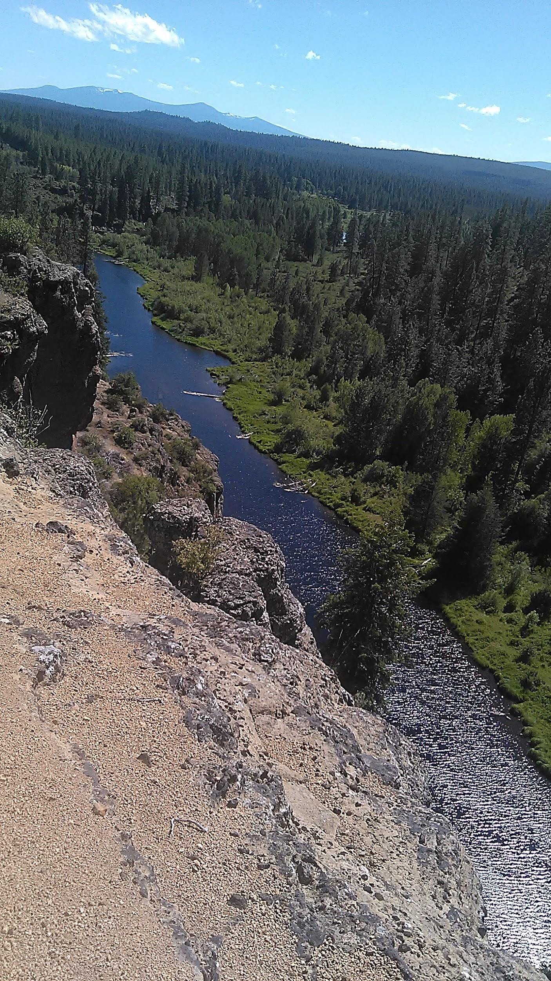
ART, IDENTITY, & ACTIVISM
I I I I I

Slide 2
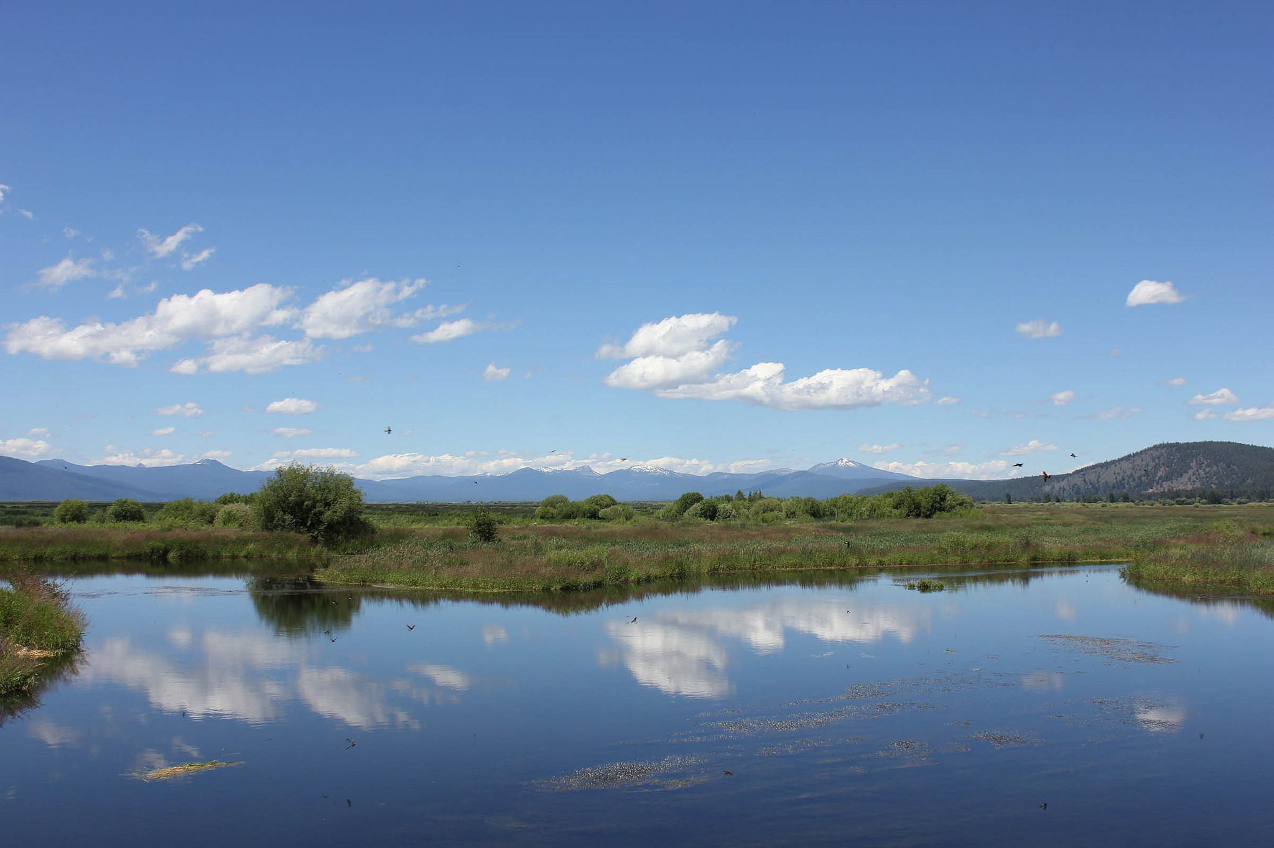
MAK’LAK MODOCN’ii
ANCESTRAL HOMELANDS

Slide 3
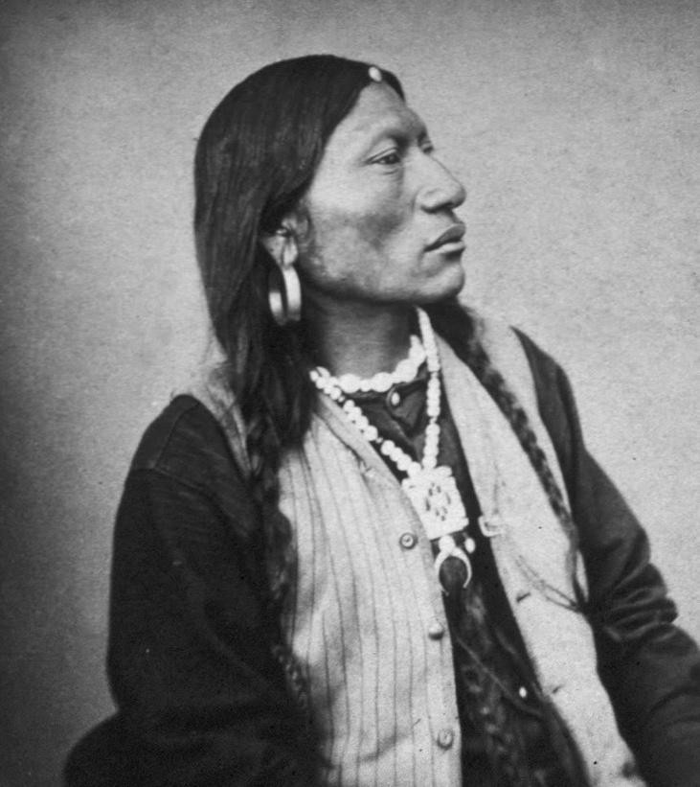
K I N T P U A S H
M O D OC N ‘ i i
S’ AA MAK’S DREAMER WARRIOR
WATER PROTECTOR ANCESTOR MENTOR

Slide 4
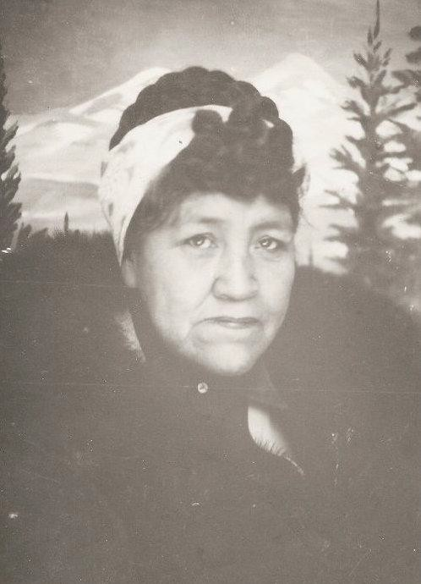
WEEW’ ANS
MAK’ LAK
S’ AA MAK’S DAUGHTER GRANDMOTHER ANCESTOR MENTOR
WATER PROTECTOR

Slide 5
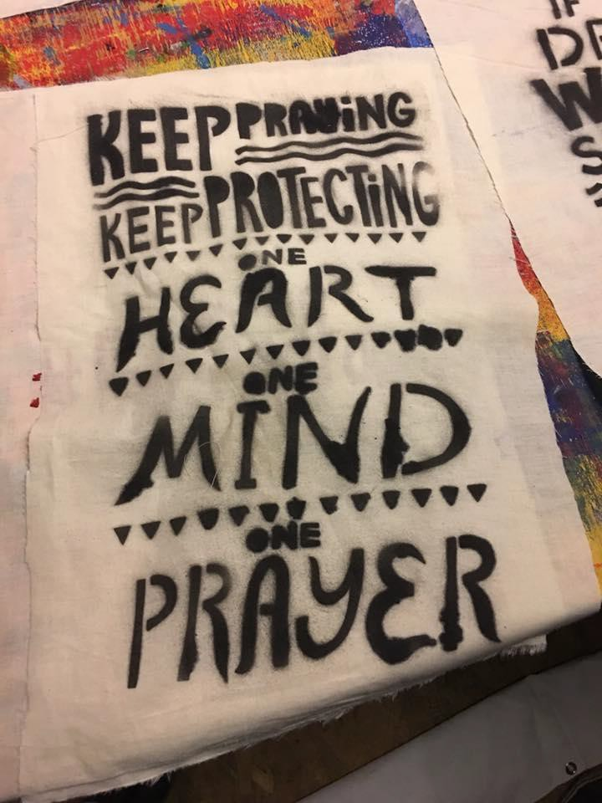
SEPK’ EE’ CA
THANK YOU, Hands Up!
Organizers and backstage Warriors
Indigenous Designers Water Protector Artists Local Community Solidarity
Local Tribes who are publicly Opposing the Jordan Cove Pipeline Project

Slide 6
Workshop Overview I I I I I
10-10:30 am: Invocation, Acknowledge Indigenous Lands, Facilitator Introductions,
10:30-11 am: Information presentation about No Jordan Cove pipeline campaign.
11-Noon: Overview of selected Indigenous led artists and practices reflecting the theme “Art, Identity, & Activism”.
Noon-2 pm: Lunch
2- 4 pm: Hands-on Healing Flags workshop. Group art making project.
4-4:30 pm: Clean-Up art projects.
4:30-5 pm: Closing
●

Slide 7
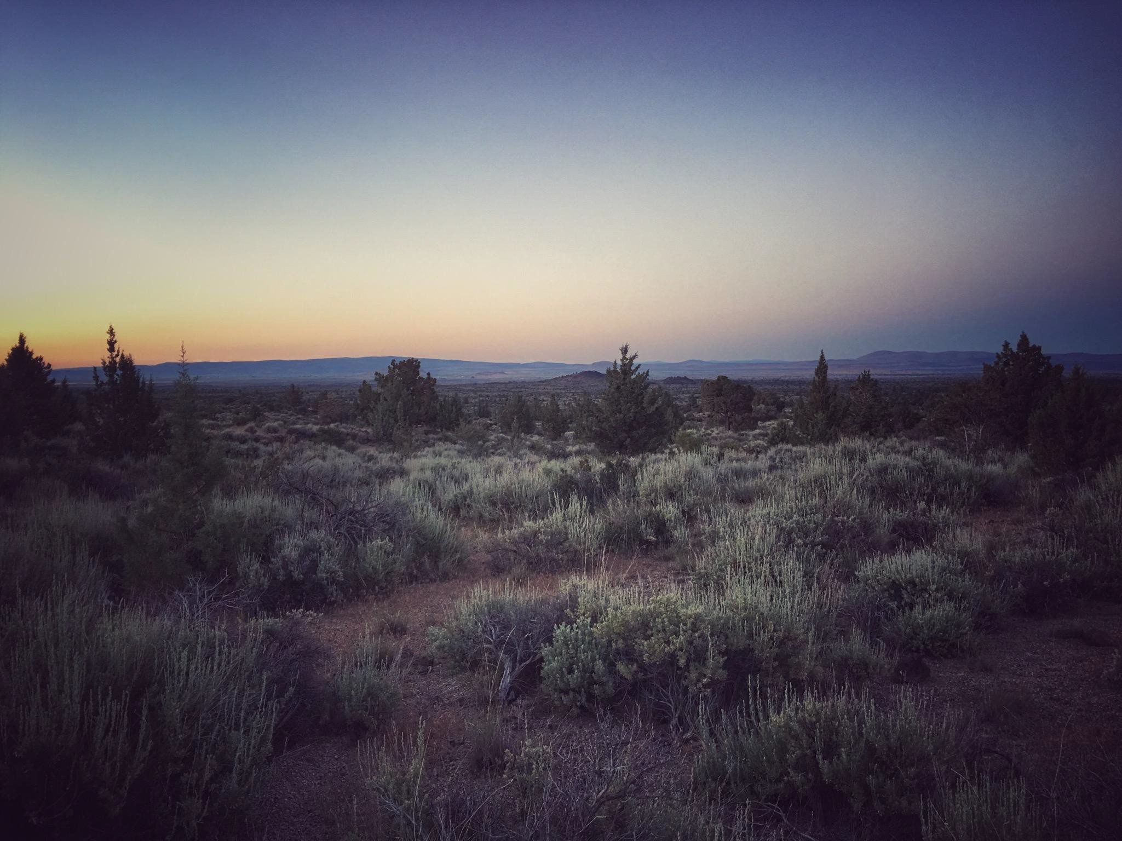
M O D O C N ’ i i
STRONG HOLD

Slide 8
NO
pacific connector pipeline
through...
ANCESTRAL INDIGENOUS HOME LANDS

Slide 9
Y E S
INDIGENOUS LED DREAMING
COLLECTIVE REMEMBERANCE

Slide 10
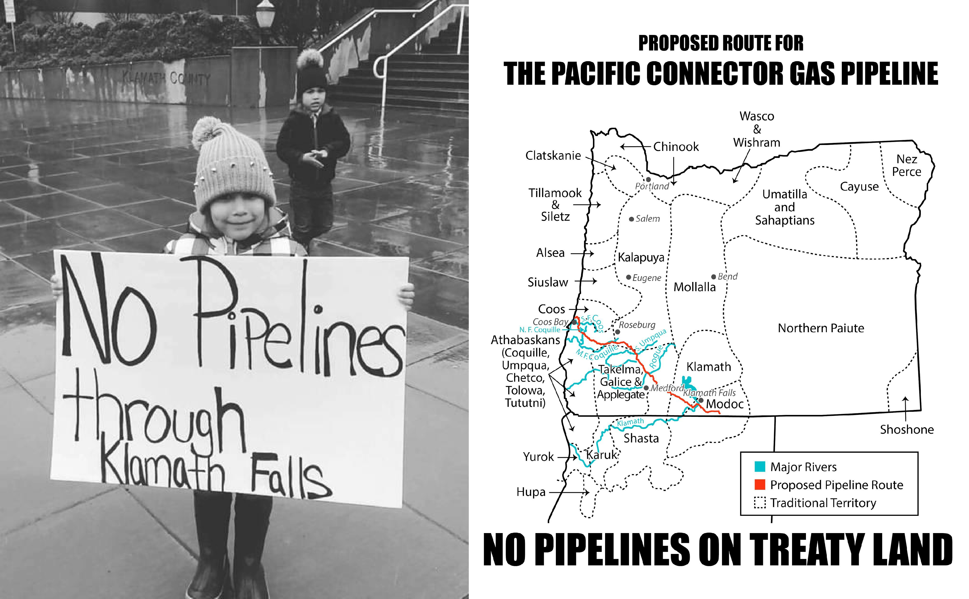

Slide 11
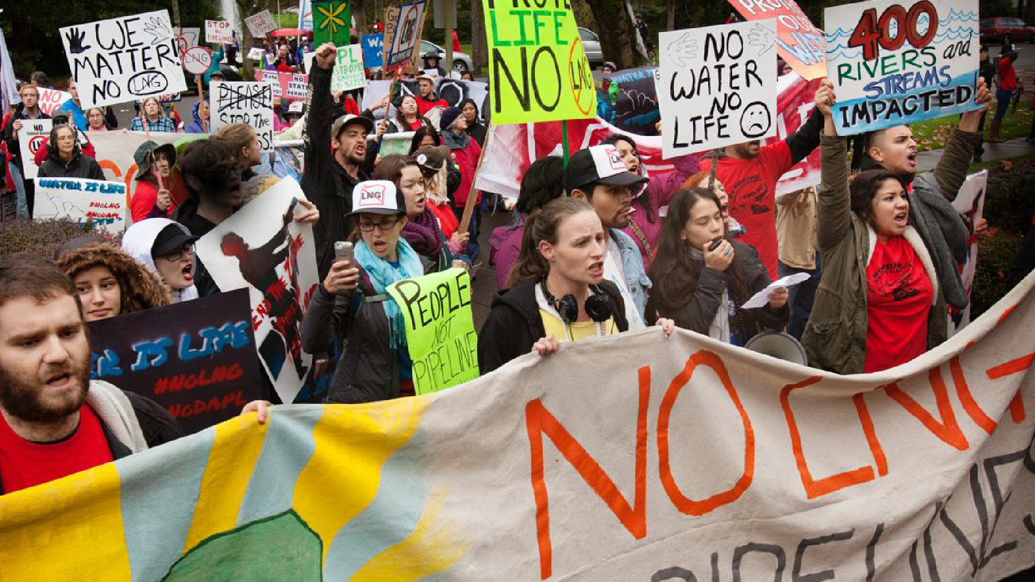

Slide 12
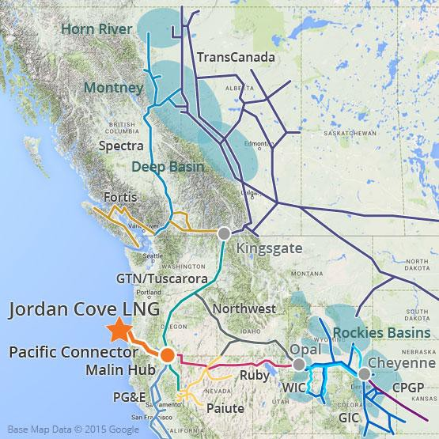
Jordan Cove Energy Project
6-10 billion dollar proposal to export
1.2 Billion Cubic Ft. / day of fracked natural gas overseas.
The first Liquefied Natural Gas (LNG) export facility on the west coast.
235 mile Pacific Connector Pipeline
through southern Oregon
Jordan Cove LNG export terminal in Coos County
Tankers to transport the gas overseas

Slide 13
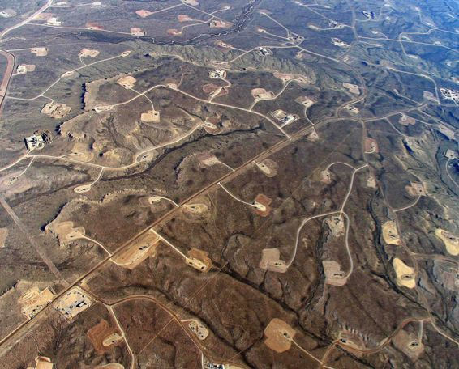
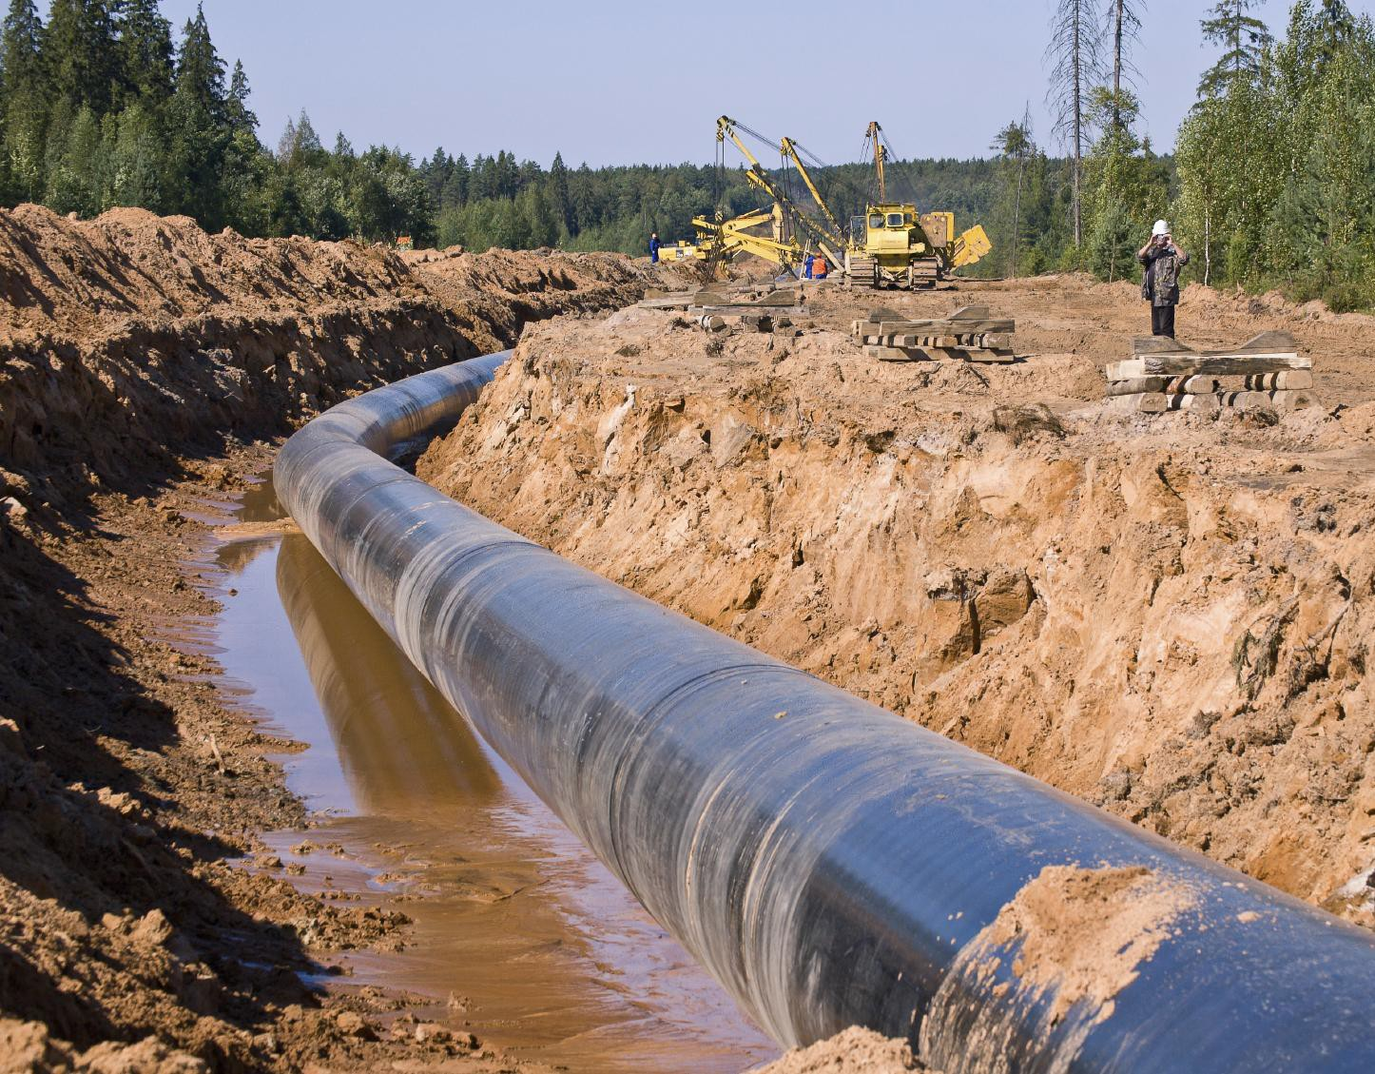
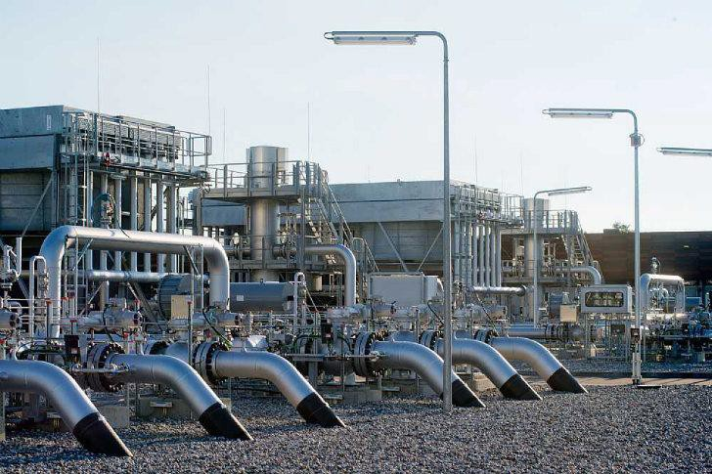
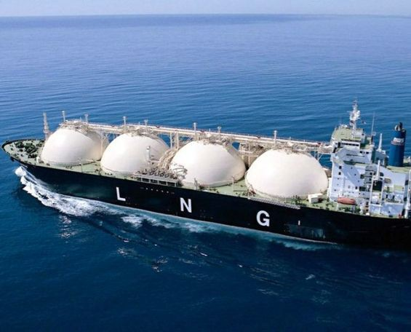
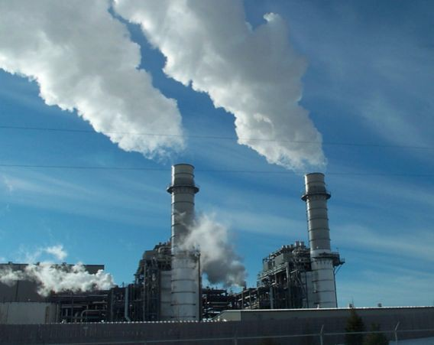
LNG = Liquified Natural Gas

Slide 14
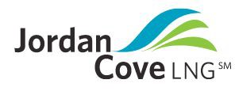
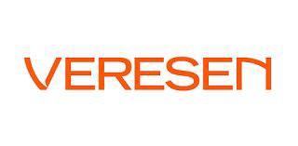
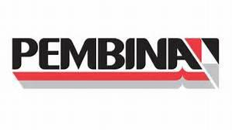

Who is proposing the project?
Veresen Inc. is a Calgary, Alberta-based pipeline and gas company.

Slide 15
History of the Jordan Cove Proposal
Originally proposed as an import project in 2005
Import terminal approved by FERC in 2009
Project withdrawn in 2012, replaced with request for export terminal due to the fracking boom in North America
Export application submitted in June of 2013
Export proposal denied by FERC in 2016 because, “the so called benefits of the project did not outweigh the impacts to landowners and communities along the pipeline route”.
Veresen re-applies in January 2017 under new federal administration

Slide 16
Impacts
Malin Compressor Station

Slide 17
FRACKING

Slide 18
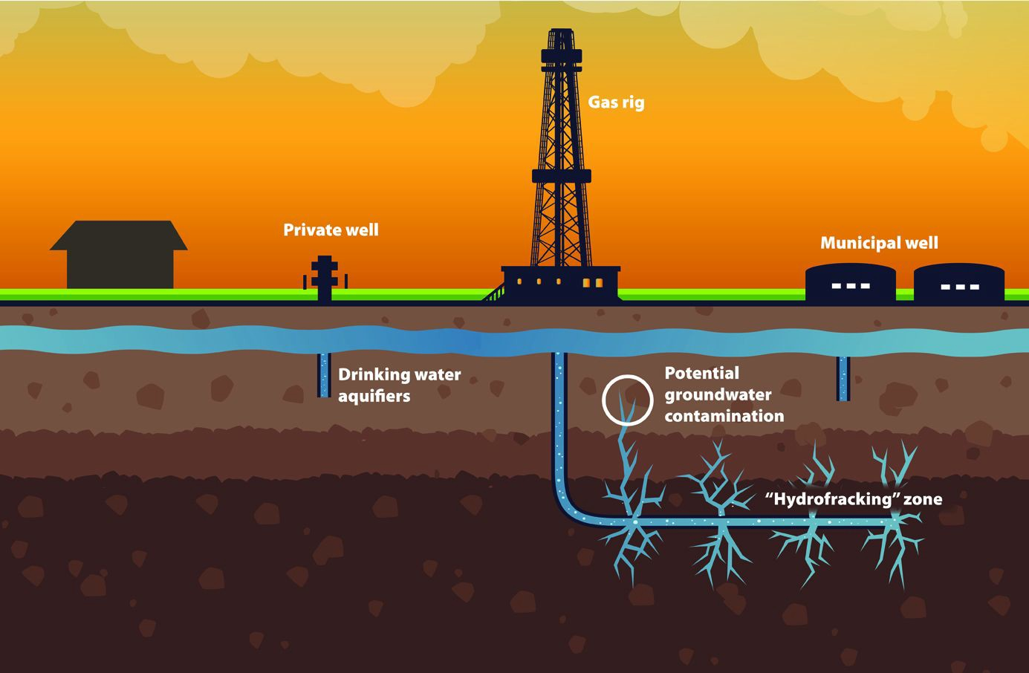
What is fracking?
‘Natural’ Gas can be found in coal, shale, and sandstone.
Large quantities of water (2-8 millions gallons) are mixed with sand and chemical additives and injected underground at high pressure to fracture the rock and release the gas.
Impacts include higher cancer rates, poisoned water, earthquakes, water depletion and more.

Slide 19
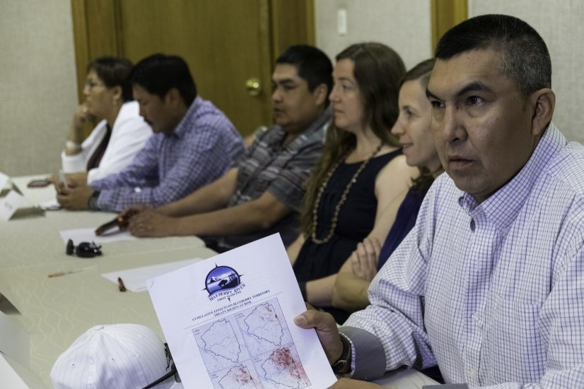
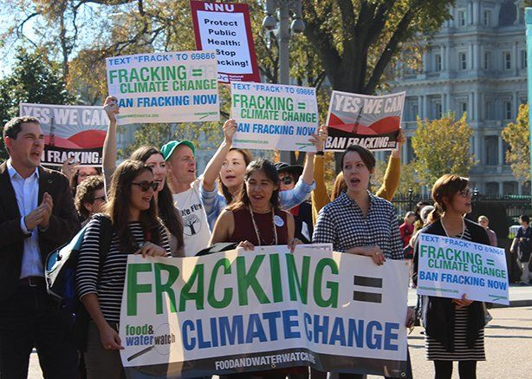
Where would the gas coming from?
Montney Basin in BC/Alberta; Blueberry River First Nation opposition
Piceance Basin in Colorado; local opposition there

Slide 20
Our very life, our way of existence, is being wiped out.
The industrial activity has really hammered our traditional territory, it affects our hunting, fishing, camping and teaching our children our way of life. The wildlife are vanishing. Our berry picking sites are being destroyed by pathways and pipelines.
Marvin Yahey, Blueberry River Chief

Slide 21
PIPELINE

Slide 22
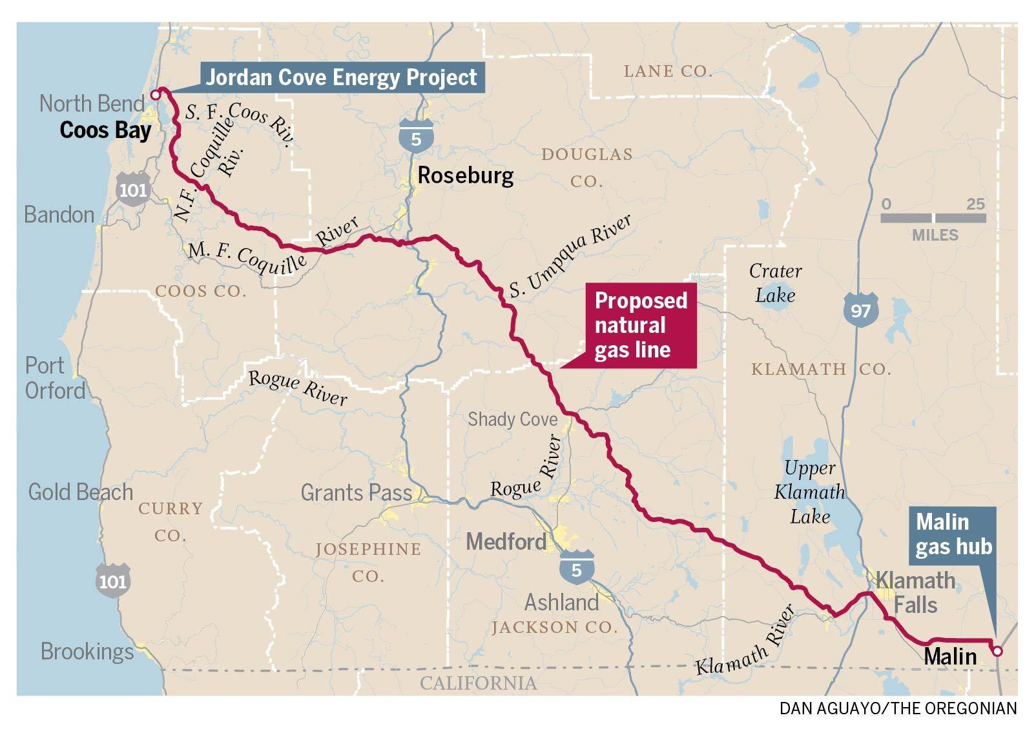
The Pacific Connector Pipeline

Slide 23
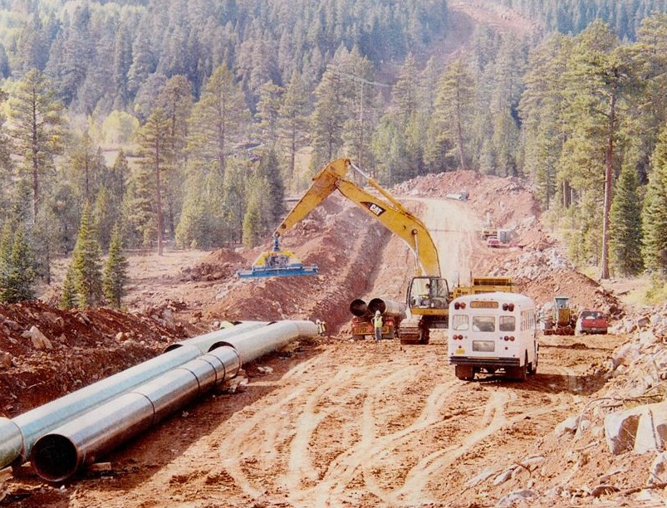
Pipeline Overview
235-mile-long pipeline
36-inch-diameter
95’+ wide clearcut right-of-way
1400 PSI of gas
630 Impacted Landowners
9 Impacted federally recognized tribes

Slide 24
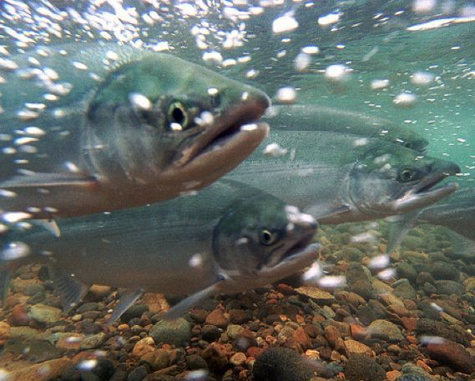
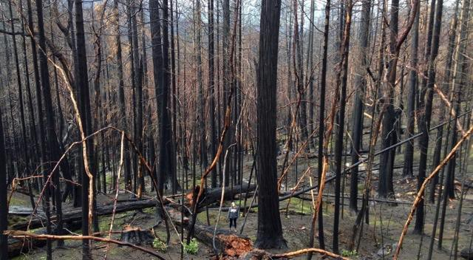
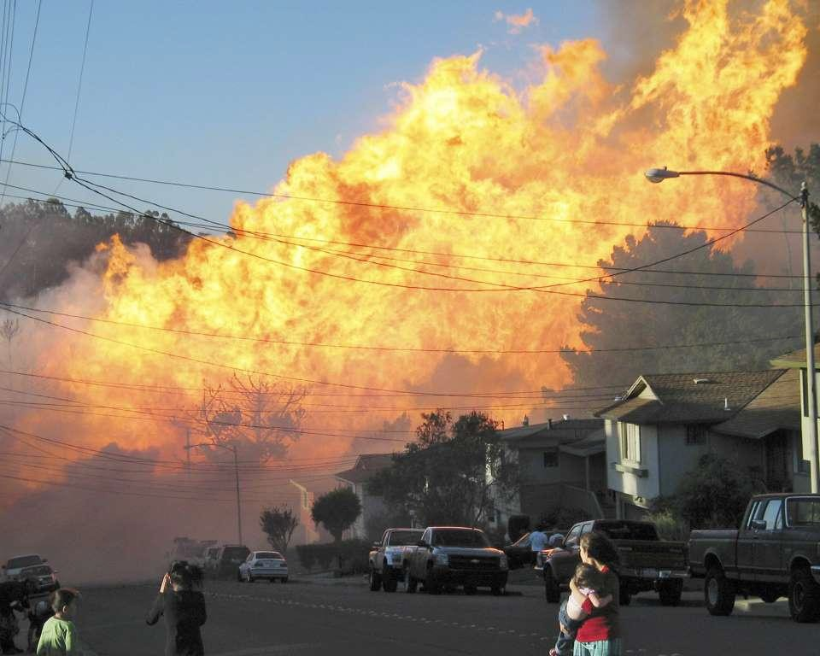
Pipeline Impacts
400 rivers and streams crossed including the Rogue, Klamath, Coos, Coquille and Umpqua.
Safety and wildfire risks
Lower safety standards in rural areas
Threat of eminent domain
Increase of domestic gas rates

Slide 25
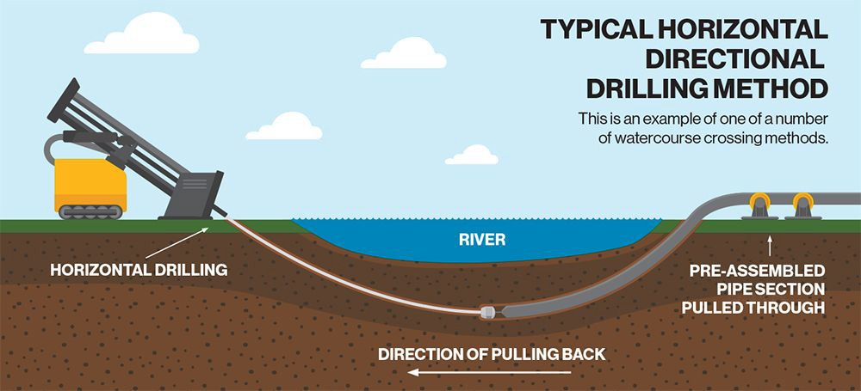
Impacts to Rivers
Horizontal Directional Drilling

Slide 26
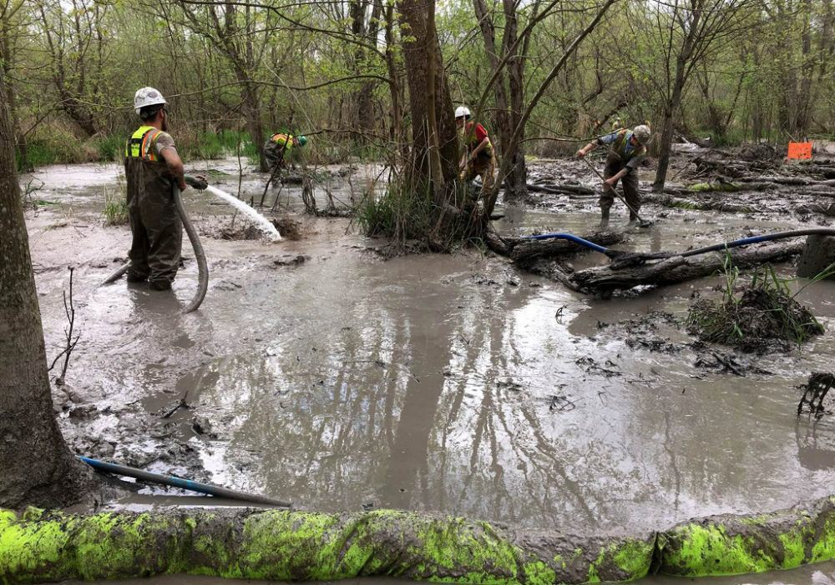
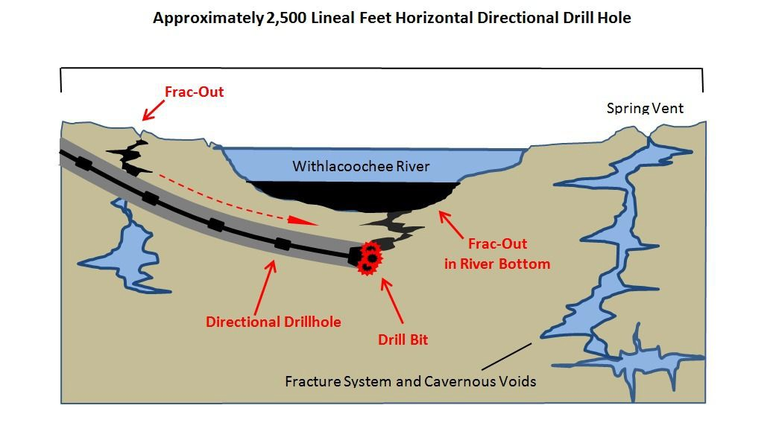
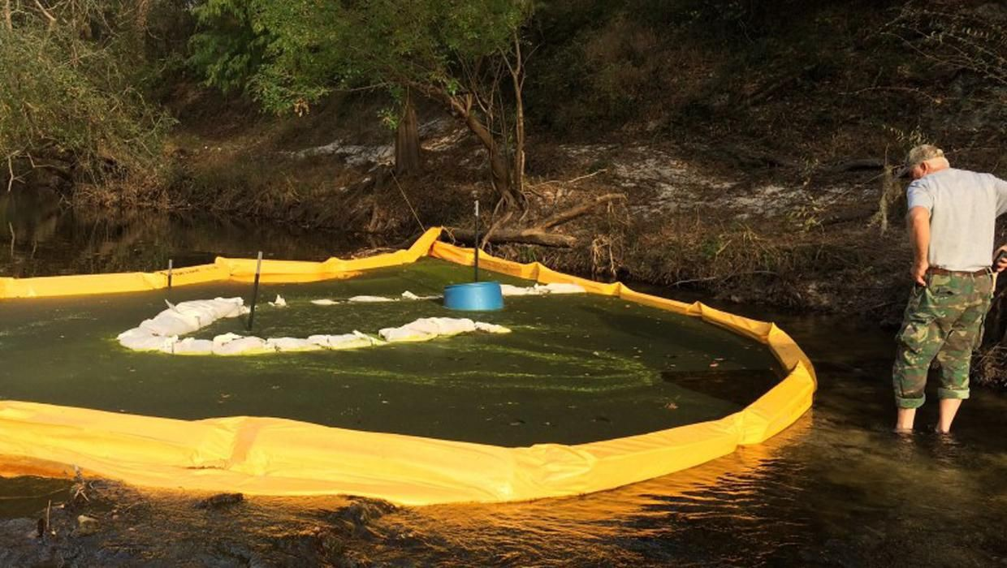
“FRACK OUT”

Slide 27
Malin Compressor Station
Located 1.75 miles northeast of Malin (57% Latino, while the rest of the county is only 11% Latino)
Compressor stations release toxic air pollution, including benzene, toluene, sulfuric oxide, and formaldehyde.
Compressor stations run 24/7 and would cause noise pollution, air pollution, and other harmful impacts to the community.

Slide 28
EXPORT TERMINAL

Slide 29
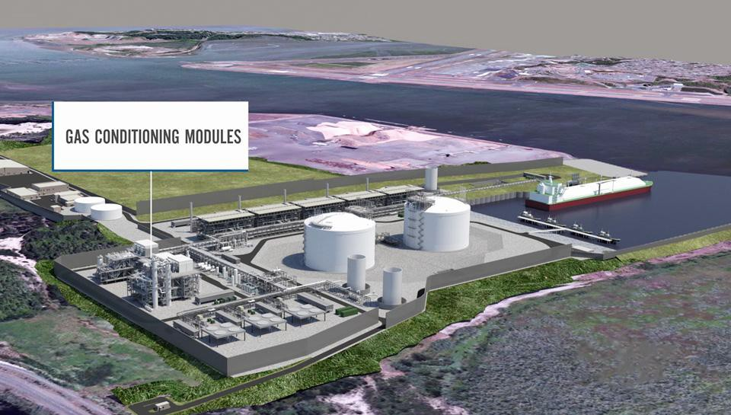
Terminal Overview
Gas is cooled to -260°F to transform it into a liquid
Proposed on traditional Coos Tribal Land, threatening cultural resources.
Built on unstable sand dunes, in a tsunami and earthquake zone in an area of high winds.

Slide 30
TANKERS

Slide 31
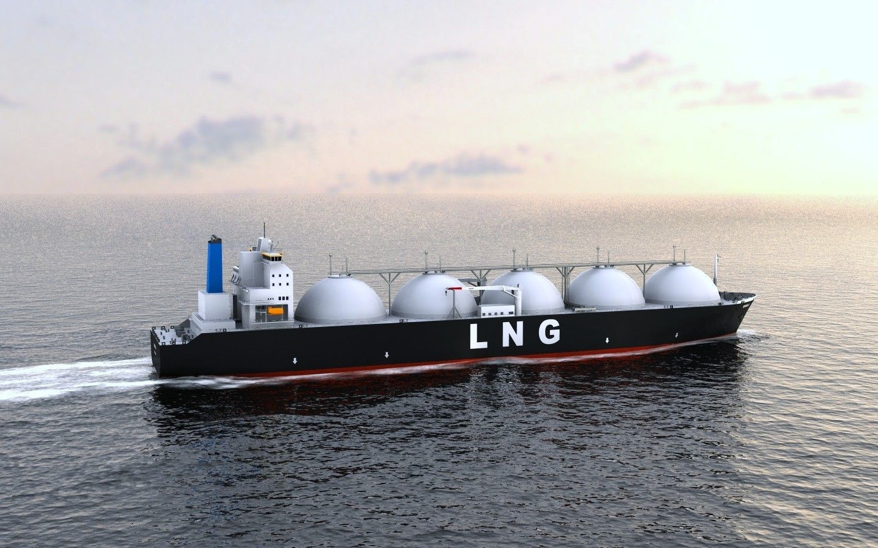



Tankers Overview
●
at
●
●

Slide 33
Indigenous Cultural Impacts for Klamath River Nations
FOOD SUSTENANCE
WATER
ART
COMMUNITY
Salmon (Ci’yaal’s), Fish, & Wocus (Food Staple) Water is Life!!!! Lu lu lu lu lu lu
Basket Weaving, Indigenous community art
We live, love and pray through practices rooted in
Our familial Ancestral Lands and Sacred Waters!

Slide 34
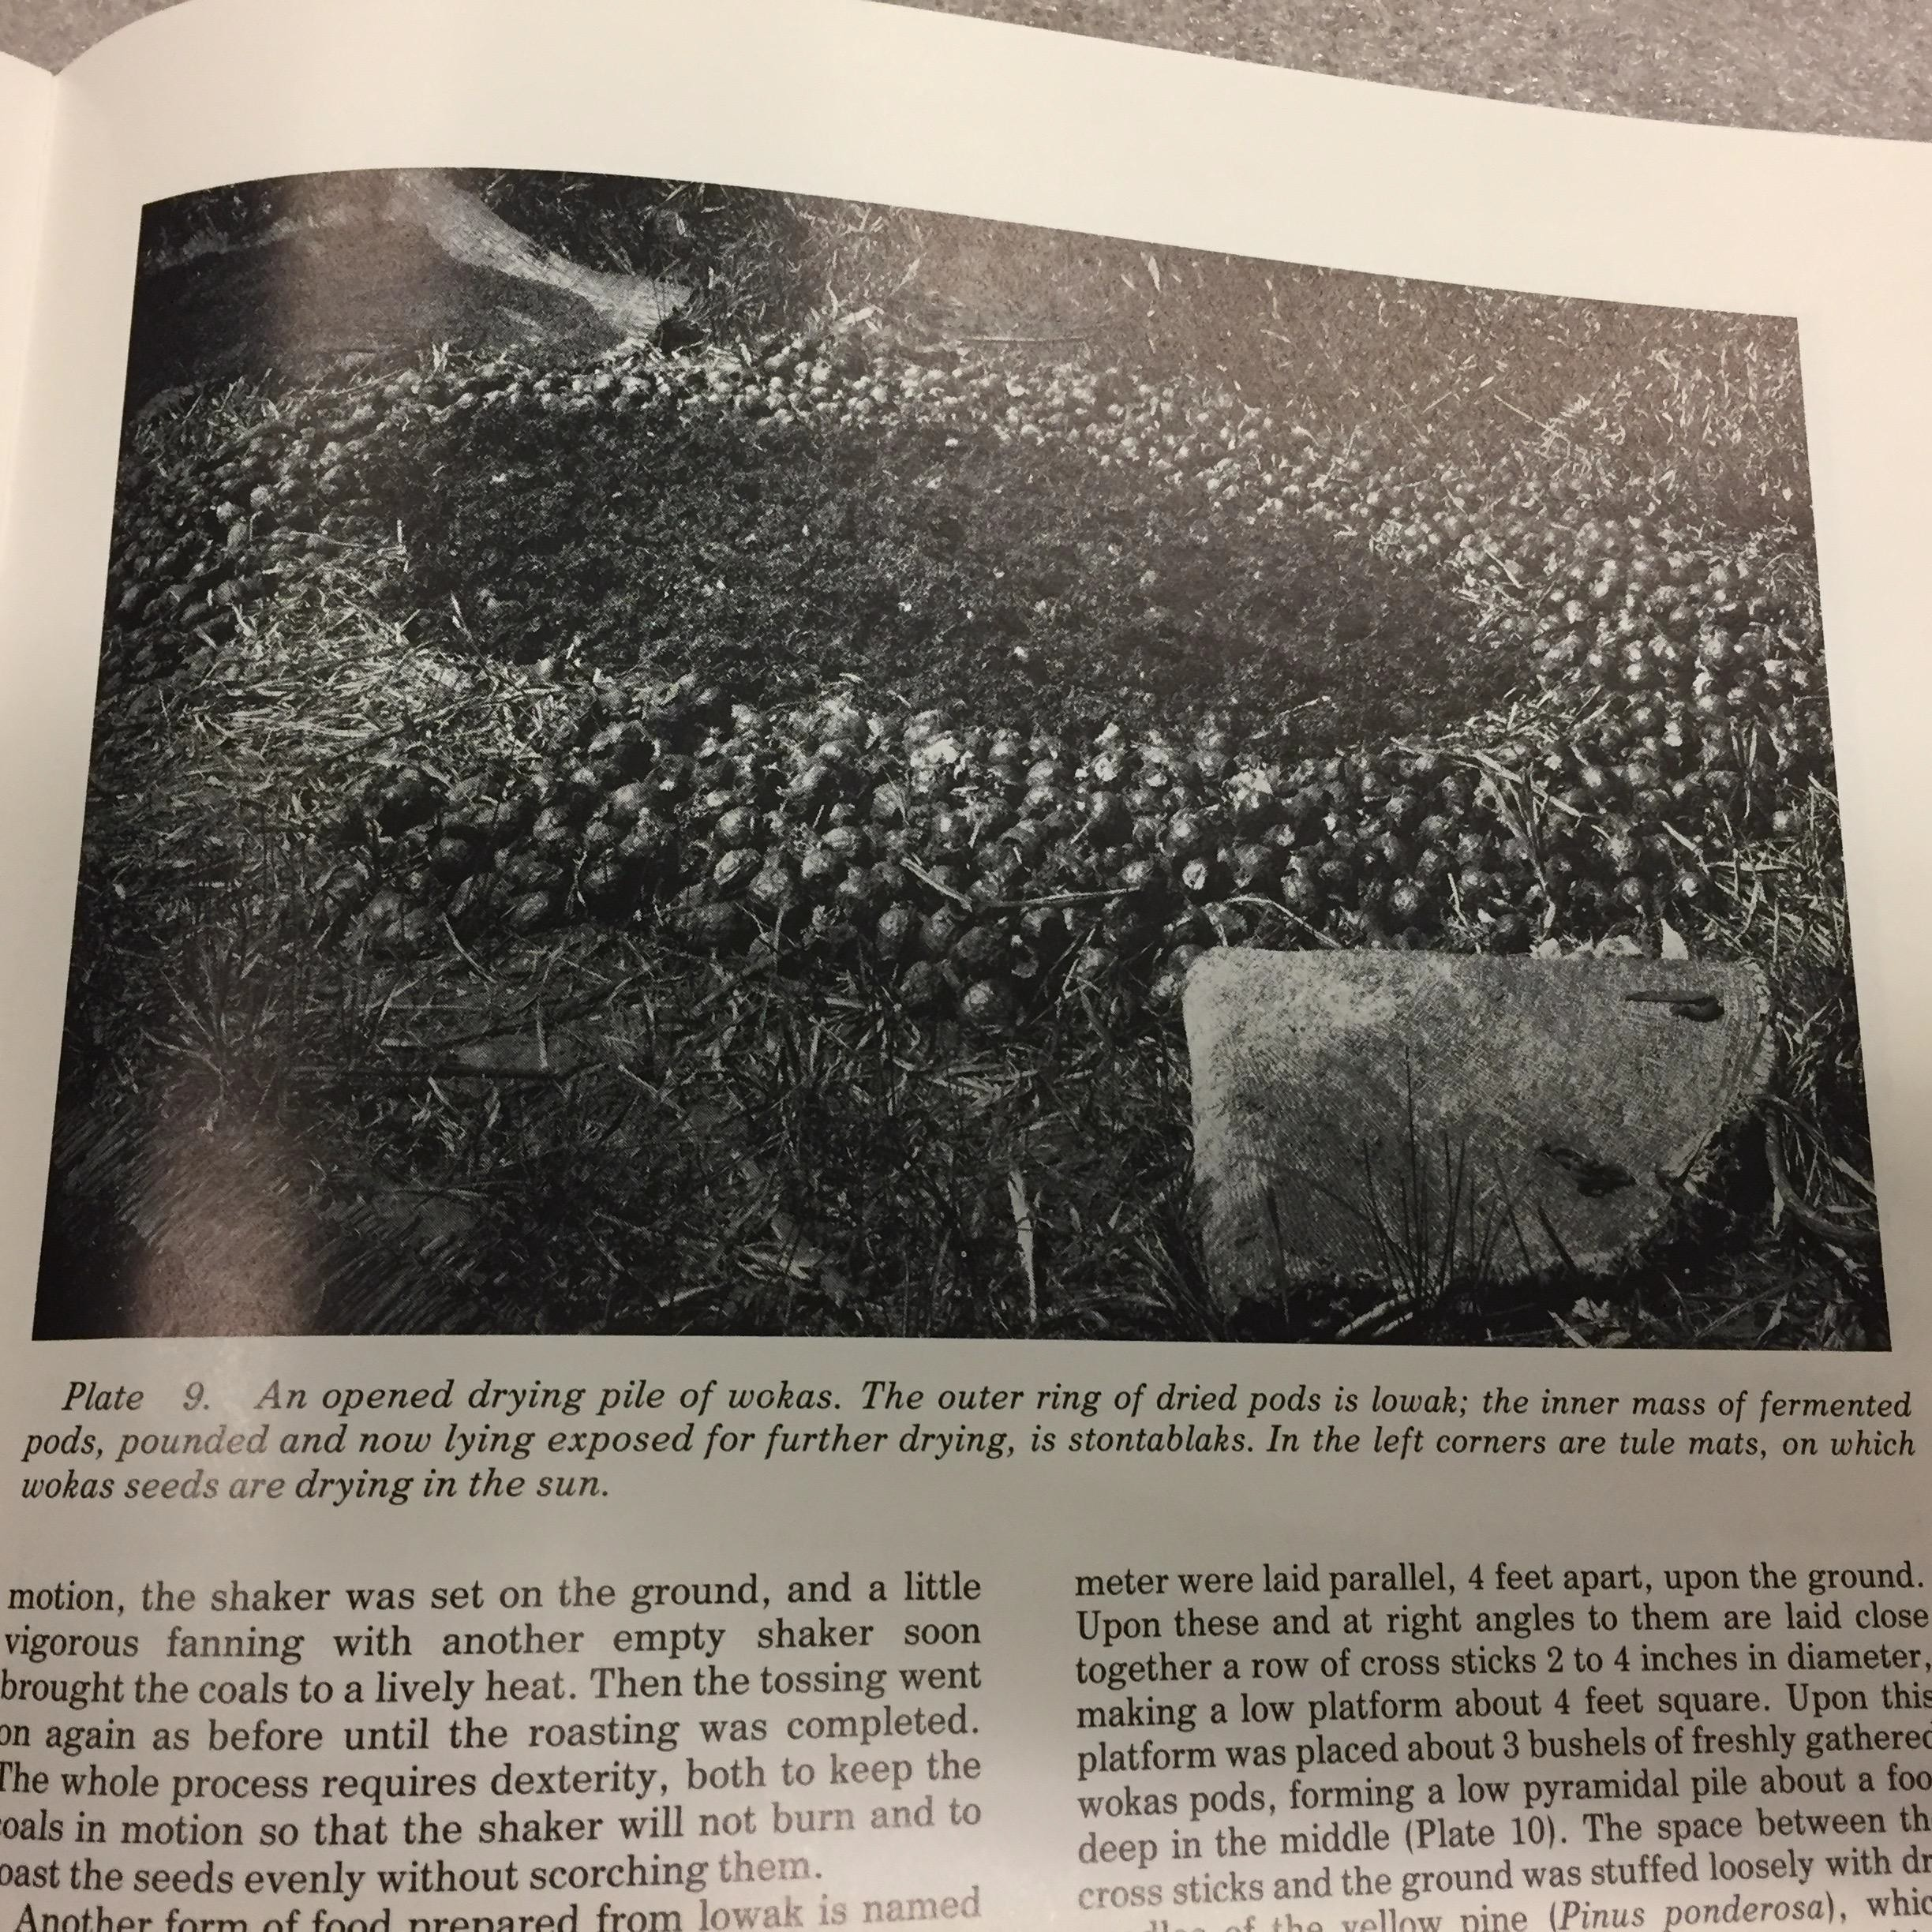
W O C U S

Slide 35
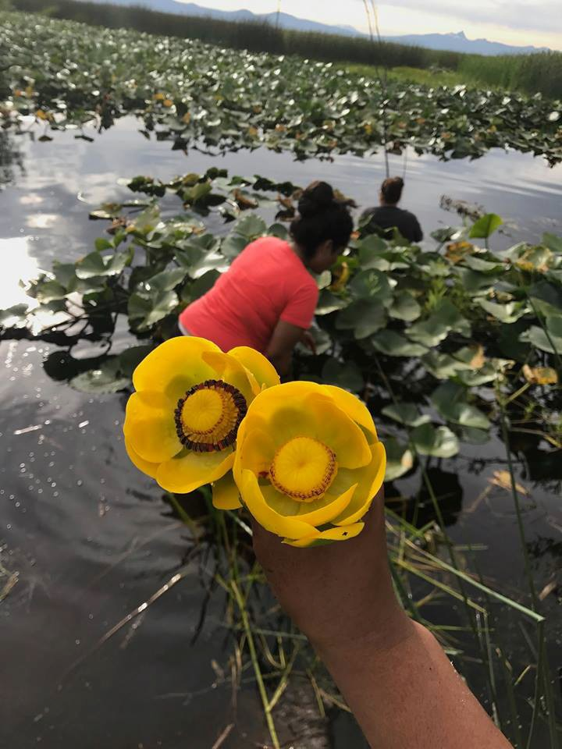
Wocus Gathering
Traditional Klamath and Modoc Cultural Practices of Food Harvest on Ancestral Homelands
Indigenous Led
7th Generation Led Ancestors Inspired
Indigenous Knowledge in Action

Slide 36
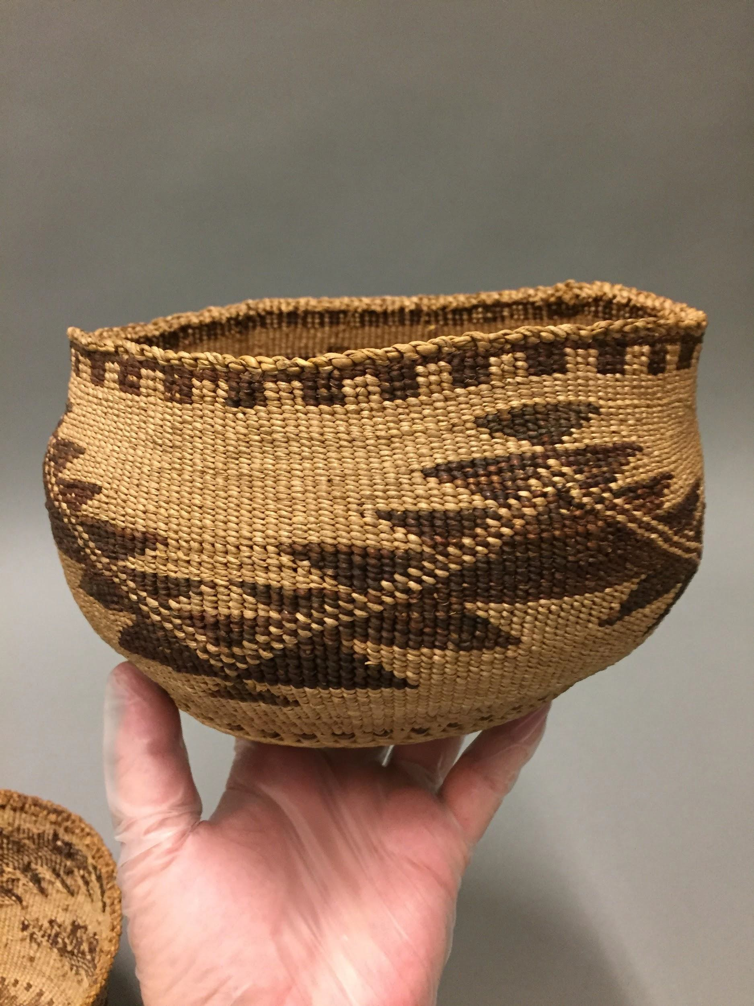
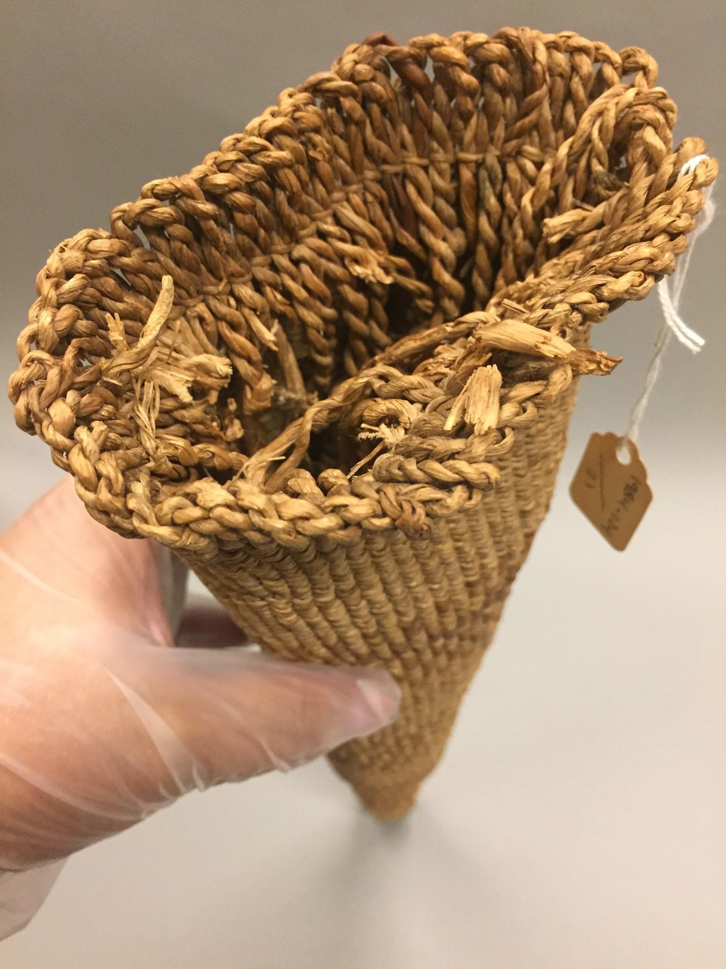

Slide 37
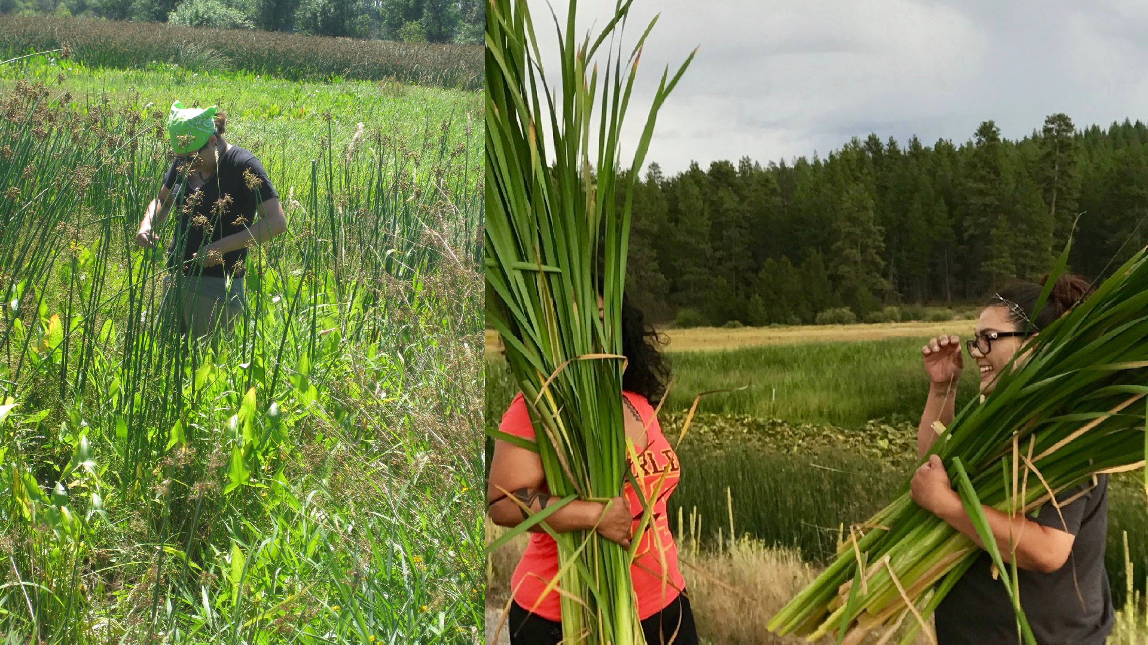
I I I I I

Slide 38
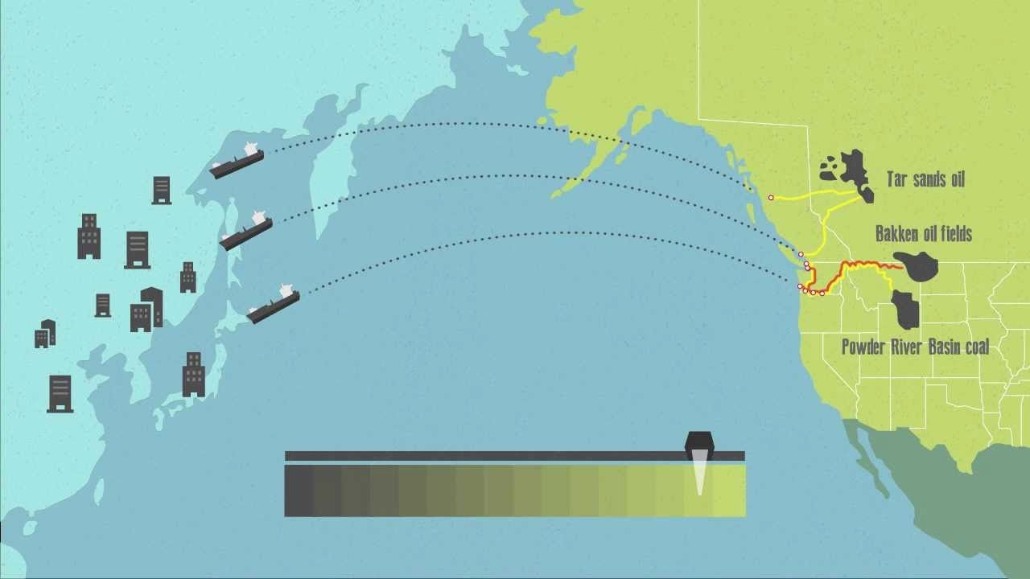
West Coast: Thin Green Line

Slide 39
What the company says: Jobs and Benefits
●
●
●

Slide 40
Who opposes the project?
The Klamath Tribes, the Karuk Tribe and the Yurok Tribe
Environmental, climate, and community groups
Impacted landowners concerned with eminent domain
The Jackson County Commissioners
Who supports the project?
The Oregon AFL-CIO, Building Trades, other labor groups
The Fossil Fuel industry
Coos, Klamath, and Douglas County Public Officials
Governor Brown? Sen. Merkley? Sen. Wyden?

Slide 41
Proposed Timeline Round 3
Pre-filing Application Approved: January 2017
Draft Resource Reports Submitted: March - July 2017
FERC application, state permit applications: August 2017
FEIS could be completed by December 2017
State Permits (Approve, Deny, or Extend): August 2018
FERC order granting authorization: November 2018
Start construction: First half of 2019
In service date: Between end of 2022 - beginning of 2024

Slide 42
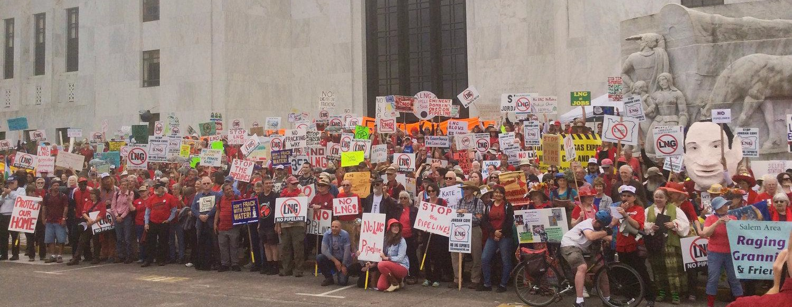

Slide 43
ART, IDENTITY + COLLABORATIVE EXPRESSION
Mirror Shields at Standing Rock
Oceti Sakowin Art + Ancestral Connections Painting & Healing Flags Workshop
War Hoop Flash Mob
I

Slide 44
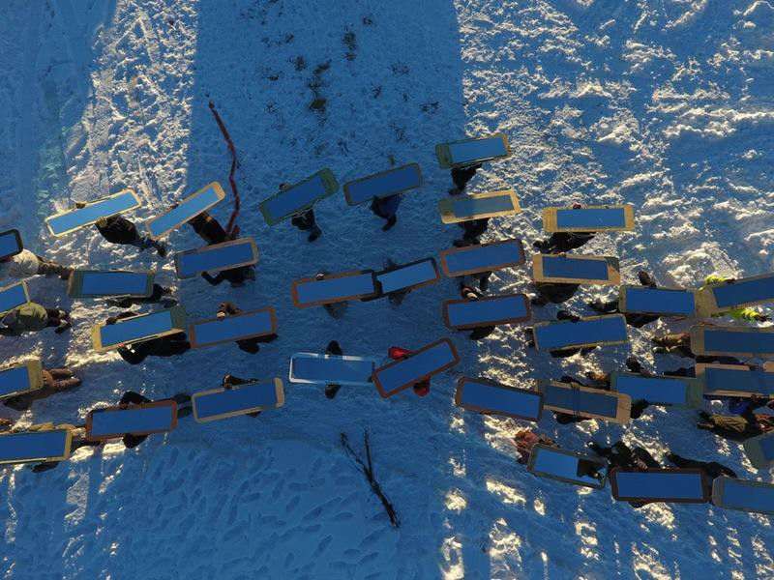
MIRROR SHIELDS

Slide 45
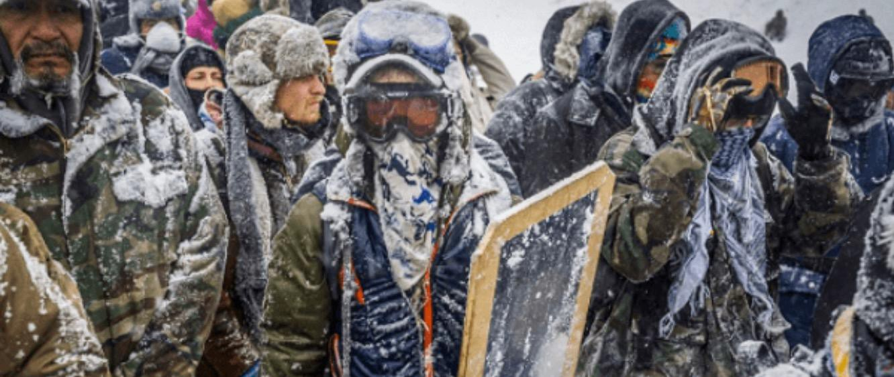

Slide 46
I I I I I
As protesters and police continue to clash in North Dakota over a $3.7bn oil pipeline, the artist plans this week to distribute mirrored shields they created, to inspire the demonstrators to “hold ground and not panic”. They also hope that, once the shields are in use, police will see the reflection of their own shared humanity “underneath their uniforms—and realise that they are also on our side”, they told The Art Newspaper.

Slide 47
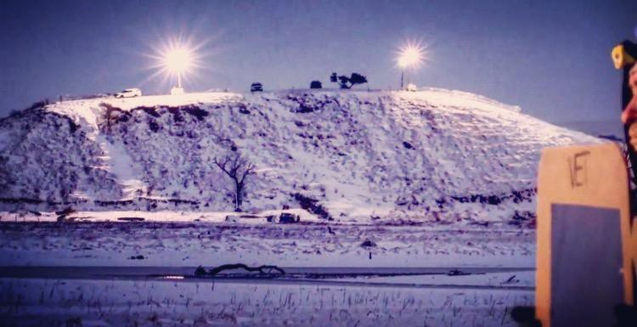

Slide 48
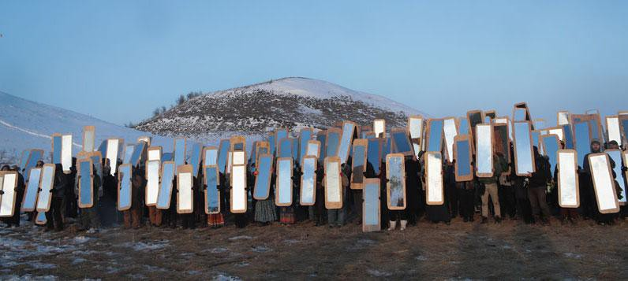
MNI WICONI

Slide 49
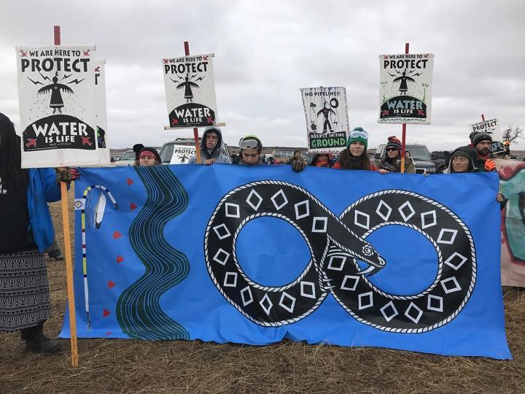
water protector art

Slide 50
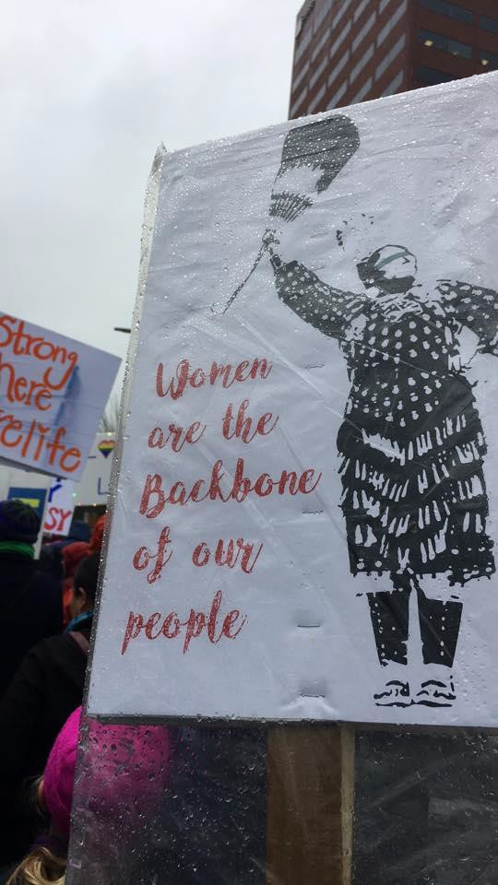
Noo’ a
MODOCN’ii
MAK’ LAK TWO SPIRIT FATHER BROTHER
WATER PROTECTOR ARTIST

Slide 51
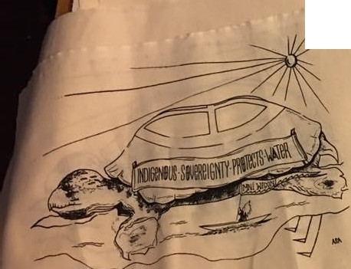
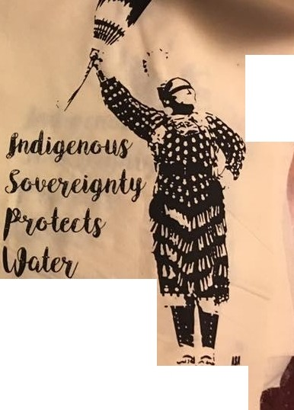
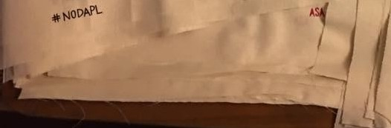
I
\
\
I
warer isLIFe

Slide 52
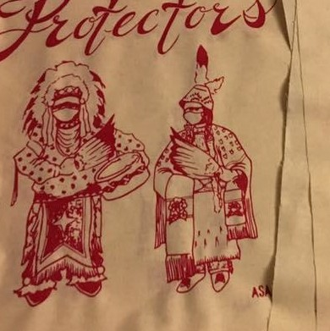
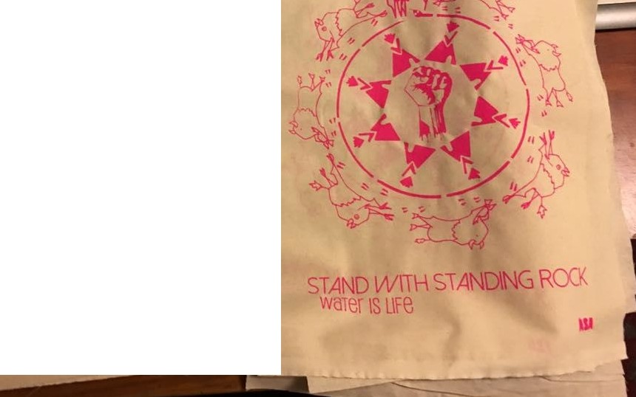
I
---in

Slide 53
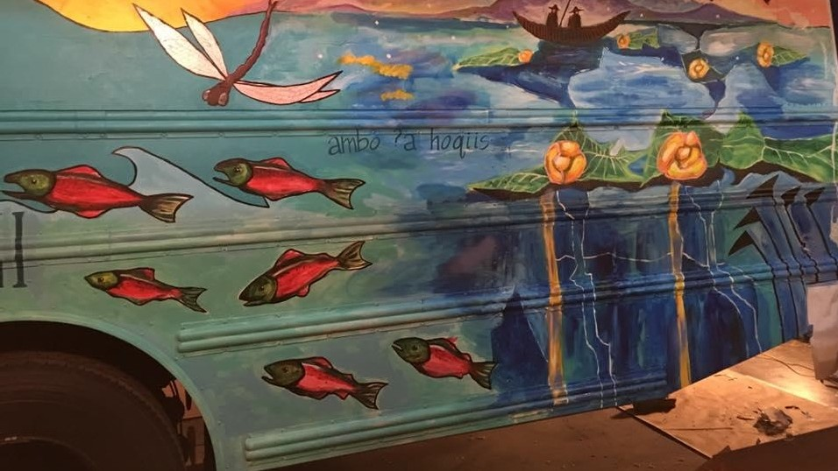

Slide 54


Slide 55

Noo’ a
MAK’ LAK
MODOC’Nii SISTER
BASKET WEAVER WATER PROTECTOR ARTIST

Slide 56


-

Slide 57

Water Protectors & Broken Treaties
24” x 18”
2017

Slide 58

HEALING FLAGS
COMMUNITY MAKING TOGETHER
INCOURAGE CONTEMPLATION and EXPRESSION
HANDS-ON ENGAGEMENT GIFTING + ACKNOWLEDGEMENT SHARING CONVERSATION + ART

Slide 59

Noo’ a
MODOC’Nii
MAK’ LAK MOTHER SISTER
WATER PROTECTOR ARTIST

Slide 60


Slide 61

WAR HOOP FLASH MOB
RECLAIMING SPACE
CACOPHONY (MAKING SOUND)
CELEBRATING COMMUNITY SOLIDARITY + UNITY RESISTANCE AGAINST ERASURE + SILENCE
“Resistance is woven into our Existence”
NATALIE

Slide 62

A War Hoop calls out
not from nothing and not silence, but it has meaning and intent. It is heard and fades again. It is responsive. The call exists in memory.

Slide 63


Slide 64


Slide 65


Slide 66
FRAMES OF FOCUS
INDIGENOUS LED + CENTERED
RESPECT INDIGENOUS PARADIGM + INDIGENOUS KNOWLEDGE ACCOMPLICES NOT ALLIES
DO NOT STEAL (a.k.a. “ insert culture here inspired”) CULTURAL ART FORMS THAT ARE NOT YOURS
WAIT TO BE INVITED POWER TO THE PEOPLE LOVE

Slide 67
Ho win-á, a win-a-win ee-á
Ho win-á, a win-a-win ee-á
HÕ winn-aá, a win-a-win ee-aá

Slide 68
W A T E R I S L I F E

Slide 69

LUNCH
2 hours
Regroup at 2 pm Healing Flags Workshop

