Slide 1
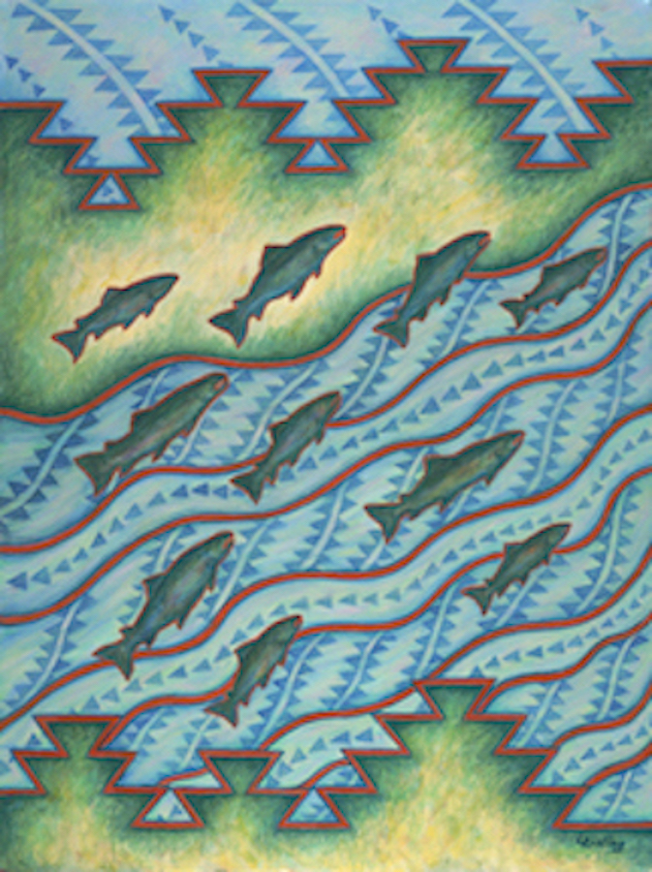
Swim Up the River

Slide 2
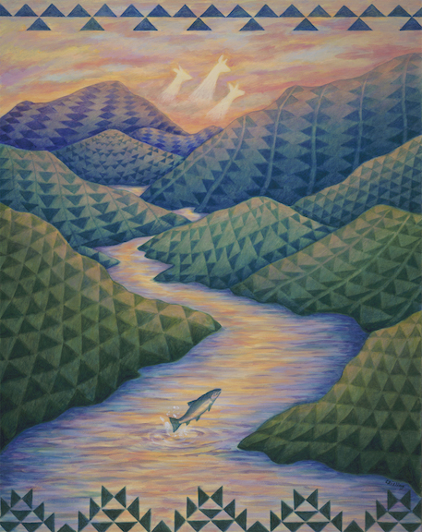
Chéemyach ik ishyâat

Slide 3
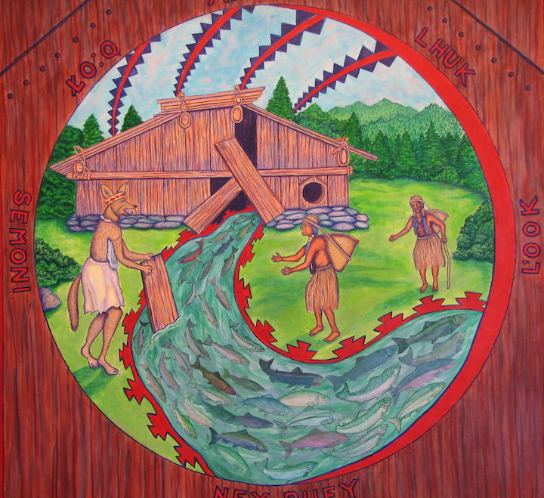
Coyote Steals Salmon for Humankind

Slide 4
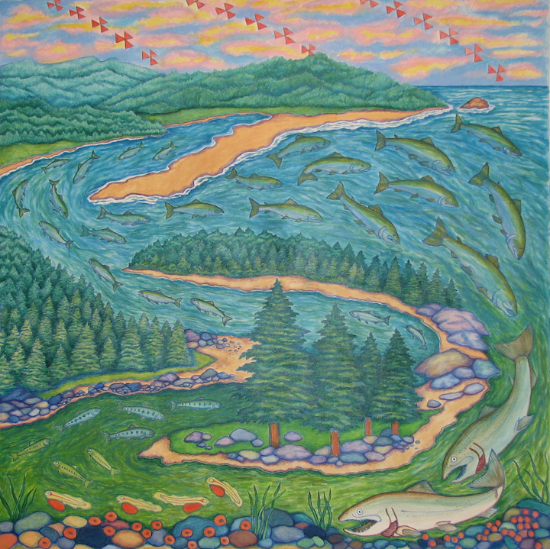
Life Cycle

Slide 5
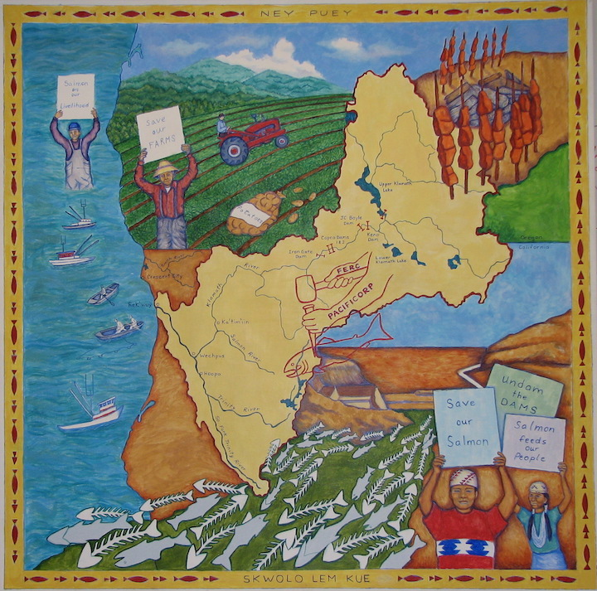
Save Our Salmon

Slide 6
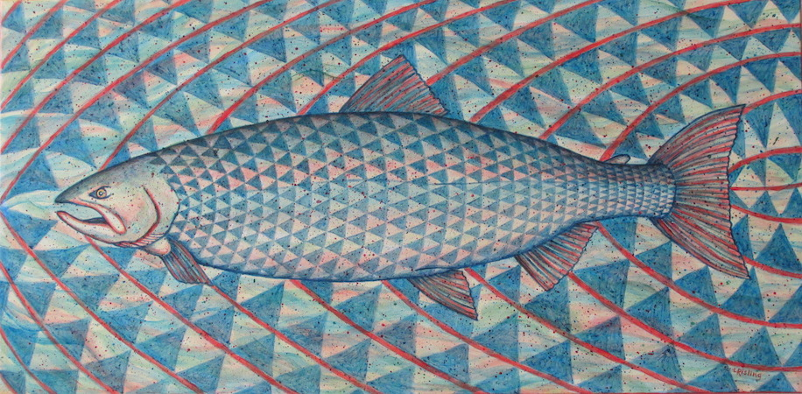
U’ípvâaram
(She’s Going Home)

Slide 7
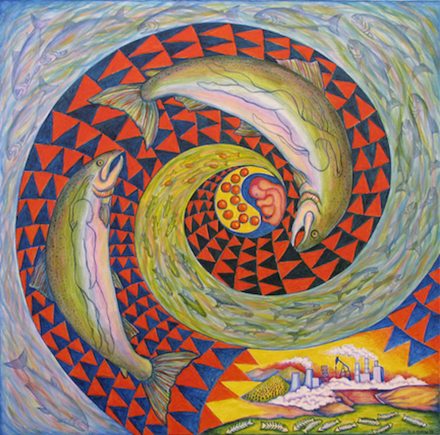
Hope and Renewal Swim Against the Current

Slide 8
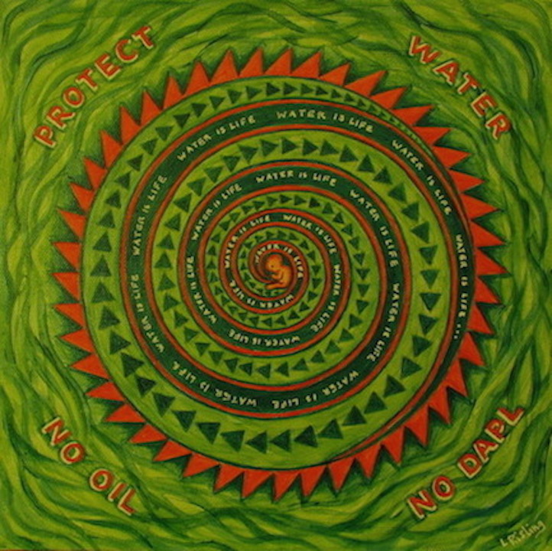
Water is Life

Slide 9
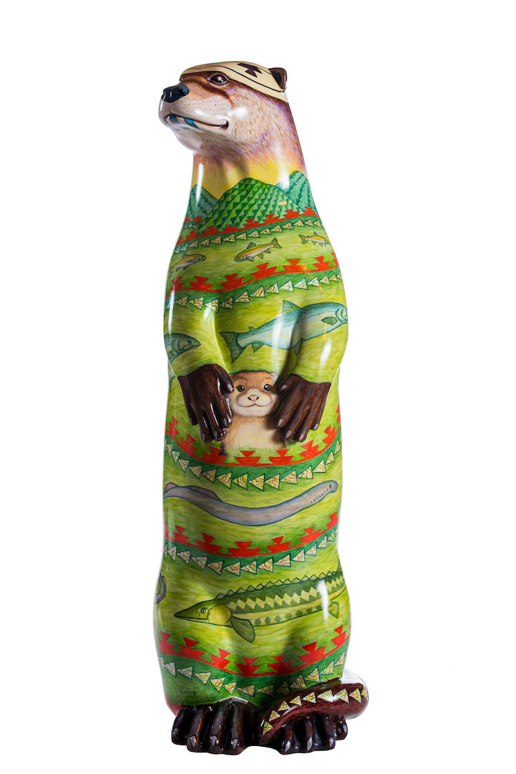
Íshaha uum Imyáatih (Water is Life)

Slide 10
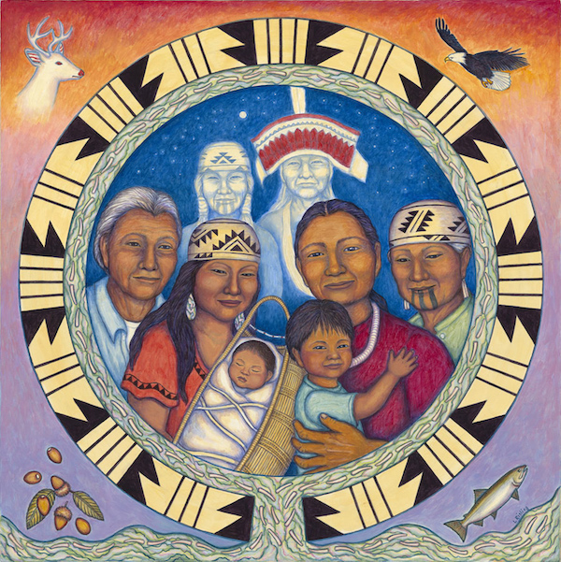
We Are Still Here

Slide 11
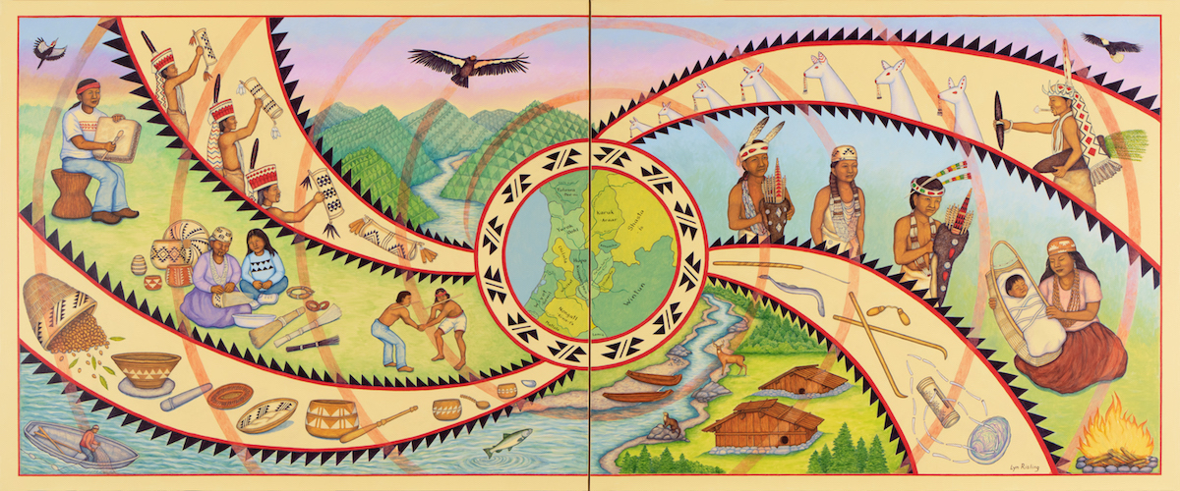
We Are These People

