Slide 1
“Telling Your Story” through
Terria Smith
Editor, News from Native California

Slide 2
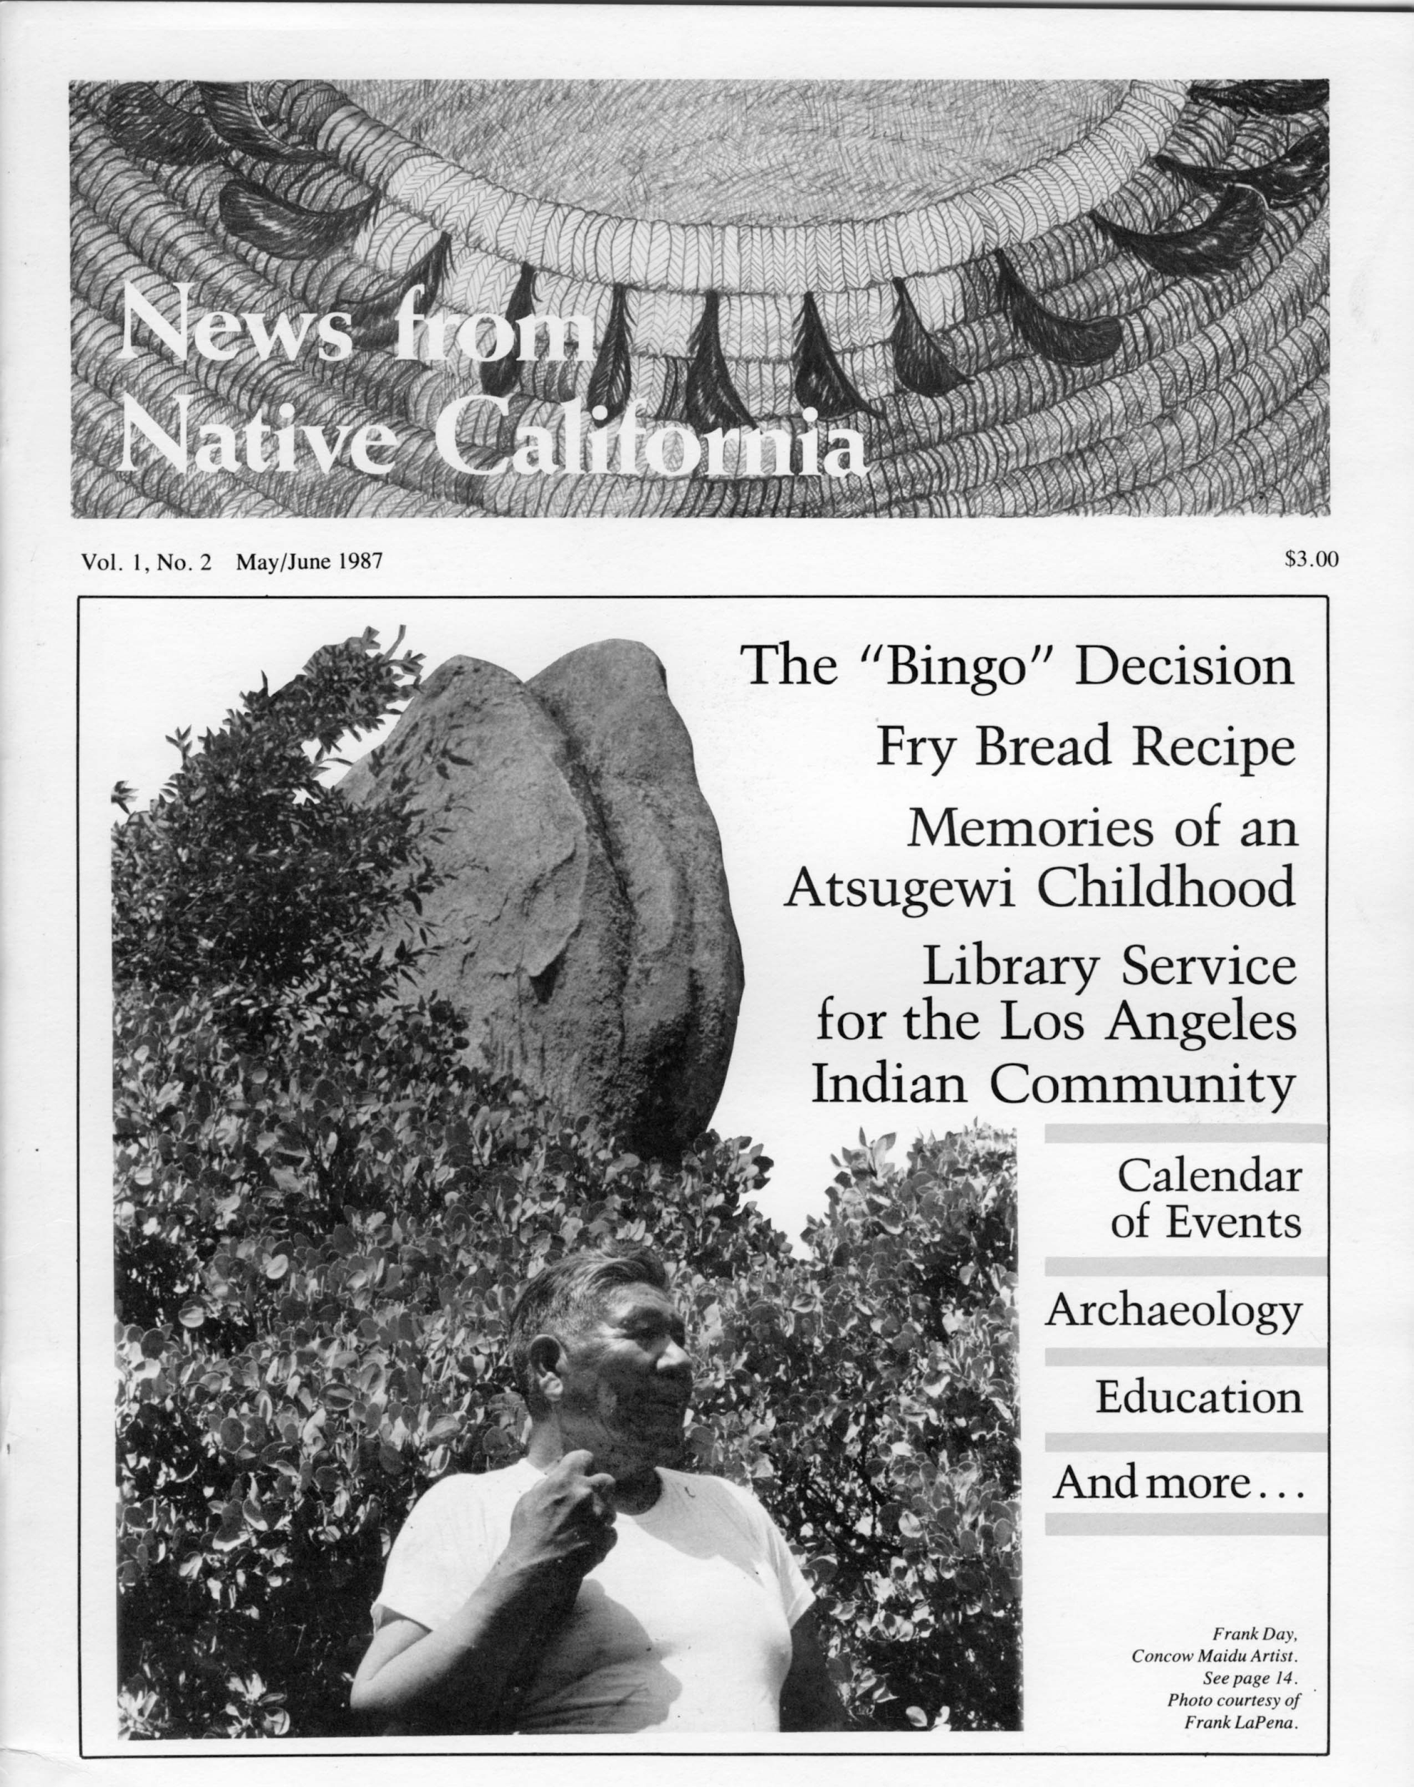
News from Native California background:
The magazine was founded in 1987
Published by the Berkeley Roundhouse Program with Heyday Books
Quarterly publication that focuses solely on tribes that are Indigenous to California
Primarily an arts and cultures focus

Slide 3
Environmental stories in News:
Unless there is a theme for the print magazine, there is almost always room for tribal environmental stories
We’ve had entire issues of the magazine dedicated to nature and the environment

Slide 4
Print edition
Submission based magazine (meaning it’s best if you write the stories yourself and turn them in to us)
The magazine accepts a wide variety of features including: art, photography, poetry, news stories, essays,short stories, open letters, opinion pieces
Final Deadlines:
Fall - August 1
Winter - November 1
Spring - March 1
Summer - May 1
Send pitches to me at terria@heydaybooks.com
For more info, visit: http://newsfromnativecalifornia.com/submission-guidelines/

Slide 5
Web edition
Submissions accepted for the website any time
Best option for breaking news, press releases, etc.
In the event that you are unable to write a story yourself, we do have a couple of writers who can help out if they are available
The website also has an events calendar, and we accept entries for this
Send pitches, stories, and events to me at terria@heydaybooks.com

Slide 6
Social media:
The magazine’s following is not enormous, but we have a very engaged following. So if there is something you want people to know it can gain a lot of traction
Please reach out to us via our platforms and - if the news is focusing on California tribal people - we will share it as soon as we can
Facebook - @NewsFromNativeCalifornia
Instagram - @newsfromnativecalifornia
Twitter - @NNCMagazine

Slide 7
For more information:
newsfromnativecalifornia.com

