Slide 1
How the Canoe Project came to be,,,
The first “Free the Snake Flotilla” held on the Snake River near Wawawai Canyon in Summer of 2015 was when we met some tribal folks who had their own canoes. These were the Kalispel, Spokane and Coeur d’ Alene. We began discussing the idea of our group carving one and learned much from their experience. We had a couple of folks go to the Selway Lochsa River area to check for some logs. They found two a Cedar and the one we chose a Yellow Fir. The next step was to get the log down to our site. This was a learning experience but we finally got it to Lapwai. Next step was to buy the tools we needed and were aided in this by Jim Jameson, Master canoe carver who provided direction and guidance. Jim and his friends put the log into the Clearwater to see how it “floated” and to determine how to carve the log.

Slide 2
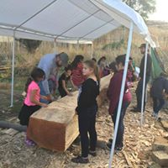
A Healing Journey, a story of bringing back Canoes to the Nez Perce reservation
It all began with an idea and of course a log. (Yellow Fir) that was acquired from the Selway River of the Nez Perce/Clearwater National Forest through a NPTEC Special Use permit, since it was in a Roadless/Wilderness area of the National Forest. After buying tools and a much needed canopy since in July in Lapwai, ID it was getting 105 degrees during the day. Undaunted we began our “Canoe journey” with no covering.

Slide 3
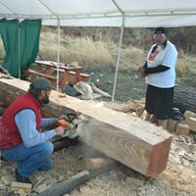
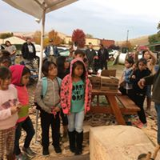
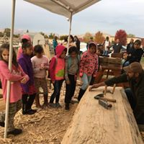
A Healing Journey…
We began in July 2017 and when school started in August, we made a connection with the Lapwai Elementary School and began having 30 4th and 5th graders and 2nd and 3rd graders come and learn to carve on the canoe. We also had David Paul a University of Idaho Professor who did and continues to teach “paddlemaking”. So we plugged away and during this time people from all over came to stop by, sent emails, facebook contacts to find out more about it.

Slide 4
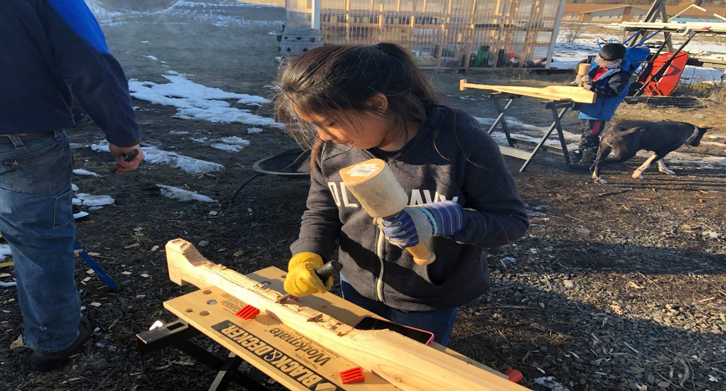
The journey continues…
The Tribal and non Tribal youth and adult volunteers were indispensable in getting the canoe carved. The energy the youth had and the willingness to learn about canoe carving was inspirational and many were enthralled by being a part of history. This Dugout canoe was the first in 110 years that was carved on the Nez Perce Reservation so it was a big deal. We finished the canoe in July of 2018 and took in on the Water for a trial run and then to the Flotilla in September where it floated great.

Slide 5
While we were carving the canoe we had some interest in making a video of the process and so Earthjustice one of our partner groups hired UnderSolen Media to do this. They later finished it and is now out, called “ A Healing Journey” as it relates to the healing of a canoe making culture that was lost for over a hundred years. As I said during this time we made many friends and even had Salish-Kootenai Tribal members come over to check it out and discuss what was needed. They carved one over there on the Flathead Reservation not too much later.
The canoe was carved from a native tree from our traditional area and was not cut but had fallen in a storm. As we used canoes for travel, hunting and fishing this project was bringing back many positive thoughts and ideas to those involved.
In addition to the return of a traditional craft we also used the canoe as part of our Snake River Dam breaching goal to show how we couldn’t travel up and down the Snake with the Dams along with the Salmon who have terrible trouble going back and forth to the ocean to return home.

Slide 6
Canoe journey today...
Currently as we rest up during the summer while the youth are gone we are working on getting a Cedar log from the same area in the Nez Perce/Clearwater National Forest. We wish to continue with the carving for the next students. Cedar is a softer wood and doesn’t dry/wood rot so fast as other types.
As I have seen how much the youth like carving and the paddlemaking we look forward to creating the inspiration and motivation to continue this traditional, wonderful and practical art form that was almost lost to our people.

