Slide 1
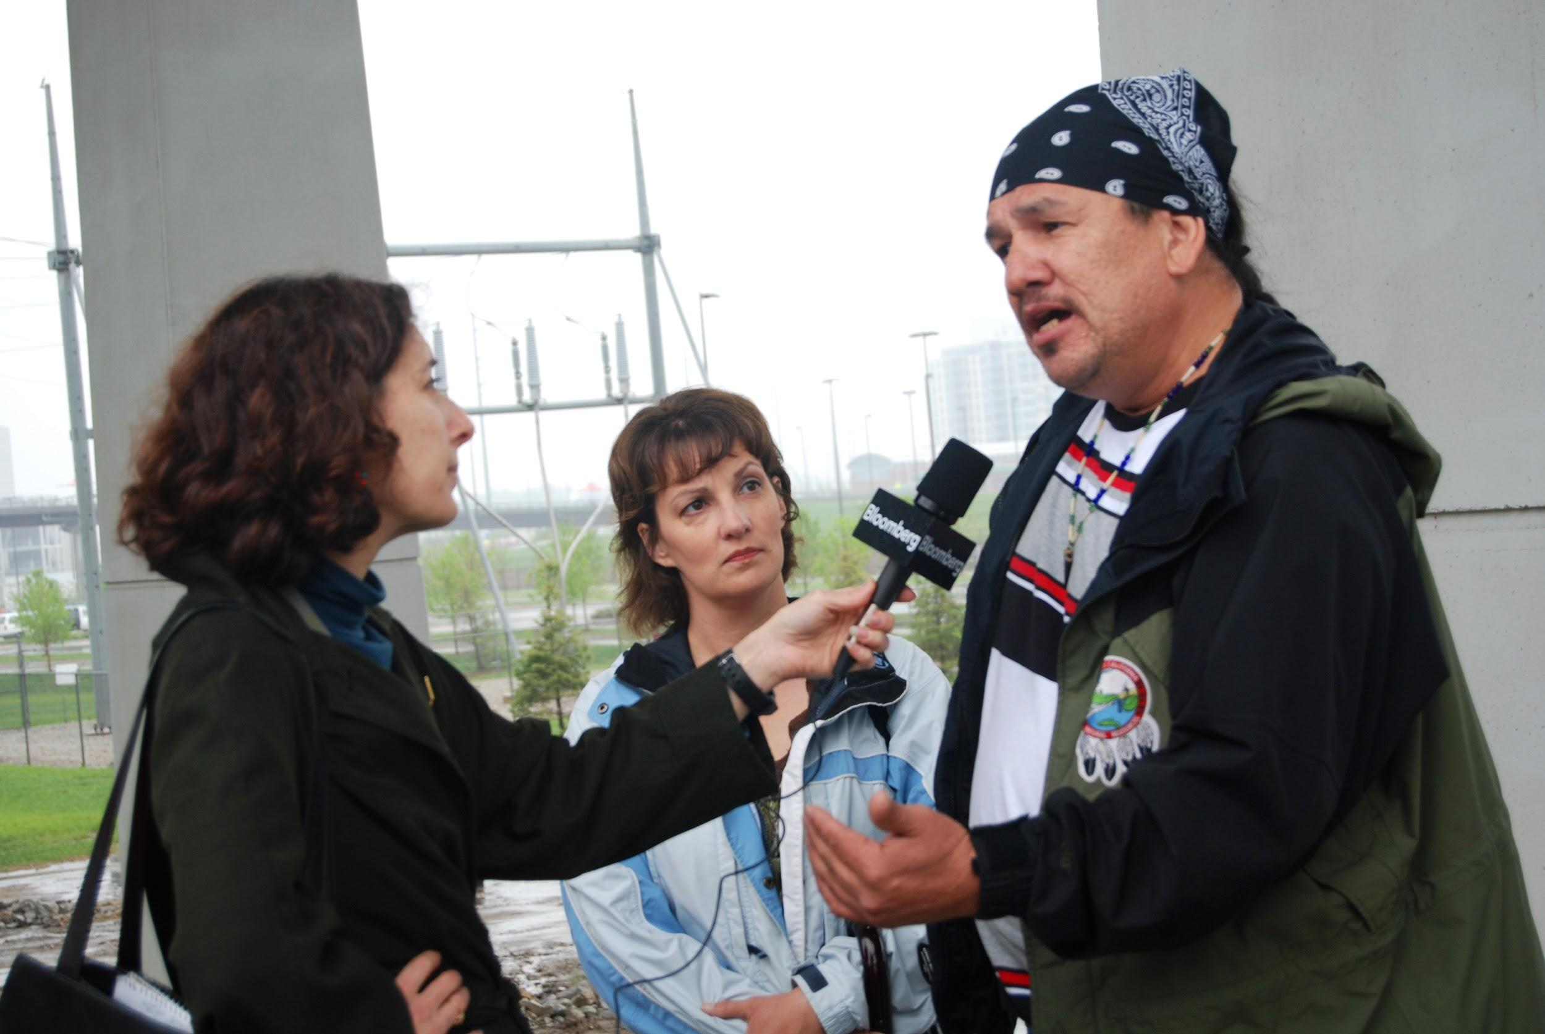
Outreach & Media

Slide 2
Outreach & Media are Key to a Campaign
There are many forms of media to help you tell your story:
Print Media includes: weekly and/or daily newspapers & magazines
TV includes: nightly news, more full-length shows, & documentaries
Radio and Podcasts
Social Media
Art focused media such as photography, visual art, or memes
Self-published media

Slide 3
Types of outreach and DIY media includes:
Creating Flyers and Publications
Writing Articles
Creating Websites
Creating Petitions or Action Alerts
Making professional and low quality videos
Making documentaries
Creating and/or sharing educational materials
Hosting events and meetings
Direct outreach: “In-person” one-on-one meetings
What are other ways to outreach to communities?

Slide 4
The most important thing to remember:
Be prepared, keep it simple, and communicate clearly
Know your issue and audience:
  How do you communicate your issue in an easy-to-understand way?
  How does your communication impact your community?
  What are the facts and what decisions are being make?
  What are you asking your audience to do?
  Who is impacted, are they your spokespeople or communicators? Who are your advisories? Have you studied their points and counter-arguments?
Not everyone is good at everything, but everyone has something to add.

Slide 5
Press Releases, Advisories & Statements
When dealing with mainstream media the main way to get your issue in front of a reporter is by issuing press releases, statements and advisories. They need to be timely and focused around an event, decision, or something that is happening NOW in order to get covered.
You need to cover: WHO, WHAT, WHERE & WHY in both a release and an advisory. The news moves fast so it is good to have statements and press releases ready if you are expecting a decisions or event. If you do not engage the other side, if one exists will completely frame the story because reporters are overworked. Releases, statements and advisories need clear titles, information and contact information.
First research press contacts and create a contact list
Press advisories are short (less than a page) and usually released several days ahead of time
Press releases are longer (1 to 1.5 pages) and include quotes from impacted people, and tell a story
Press statements are usually just a quote for someone else’s release

Slide 6

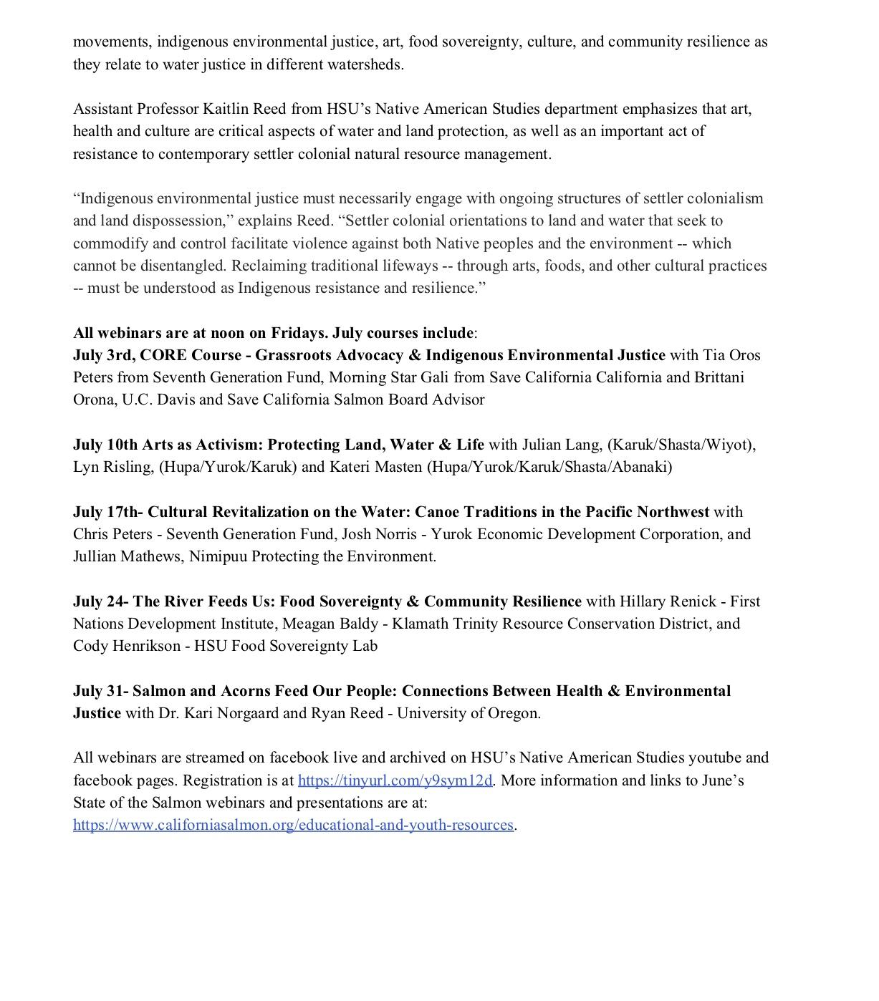

Slide 7
Opinions, Editorials and LTE’s
An Opinion is 500-700 words long & covers an issue that is important to a publication, or deals with a recent article or event. These should come from well known, or impacted people and tell their story.
An Letter to the Editor is about 150-250 words long and also deals with current events, but is easier to publish
An Editorial comes from the publication itself
Editorials and Opinions are preferred by some overworked outlets, however they are not always easy to get. As with press releases and reporters, you need to possibly meet with, educate and talk with with the editorial board in many cases to make these happen. An Editorial is probably the most impactful and hard to accomplish of these three.

Slide 8
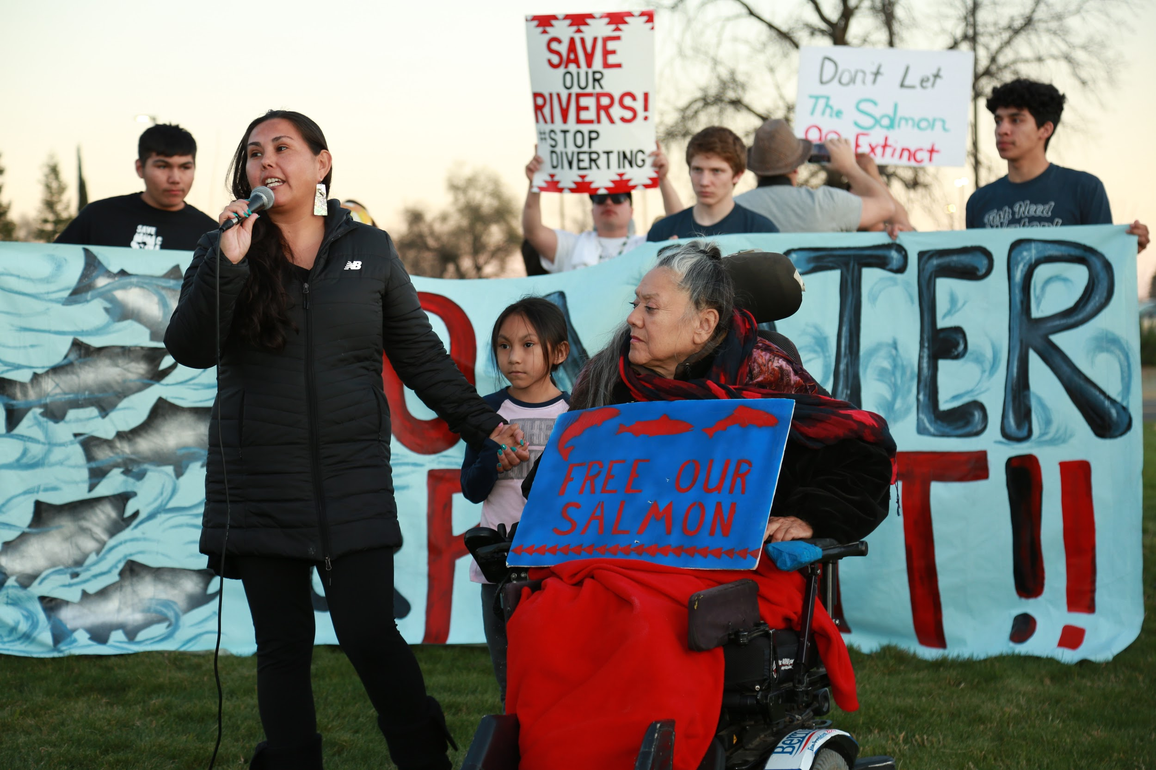
Press Conferences, Interviews, and Public Speaking
Bring a press packet or release
Assign appropriate speakers
Assign a press liaison
Know your talking points
Don’t get off your points
Practice a lot
Never get thrown off your game. If you do, keep going
It is okay to not answer or say you do not know something

Slide 9

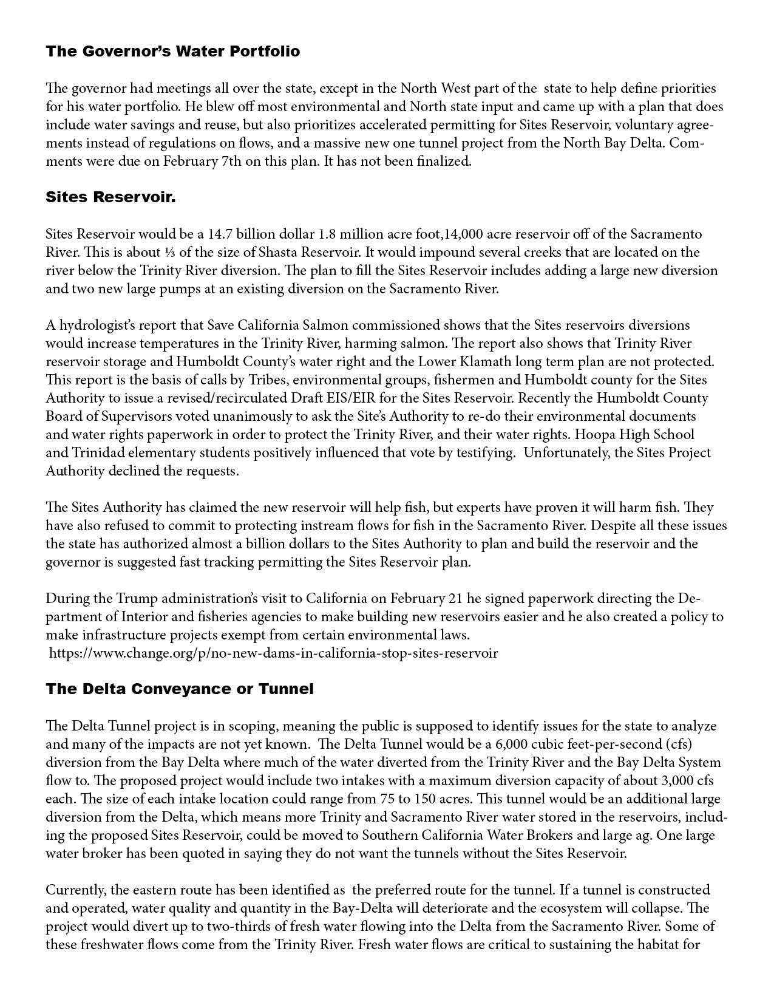
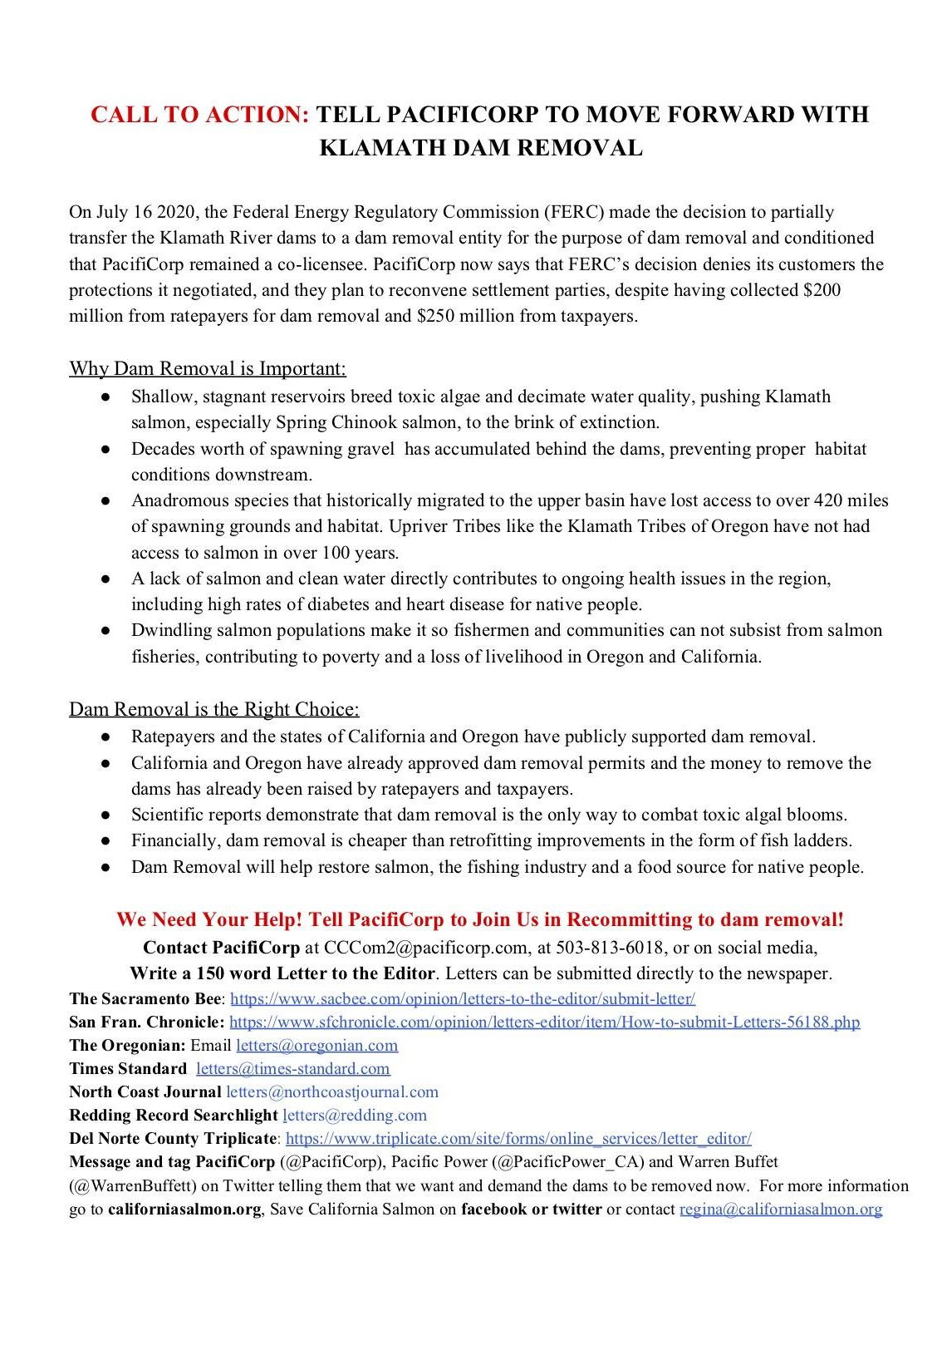
Examples of Talking Points

Slide 10
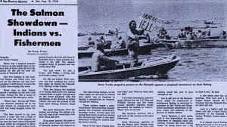
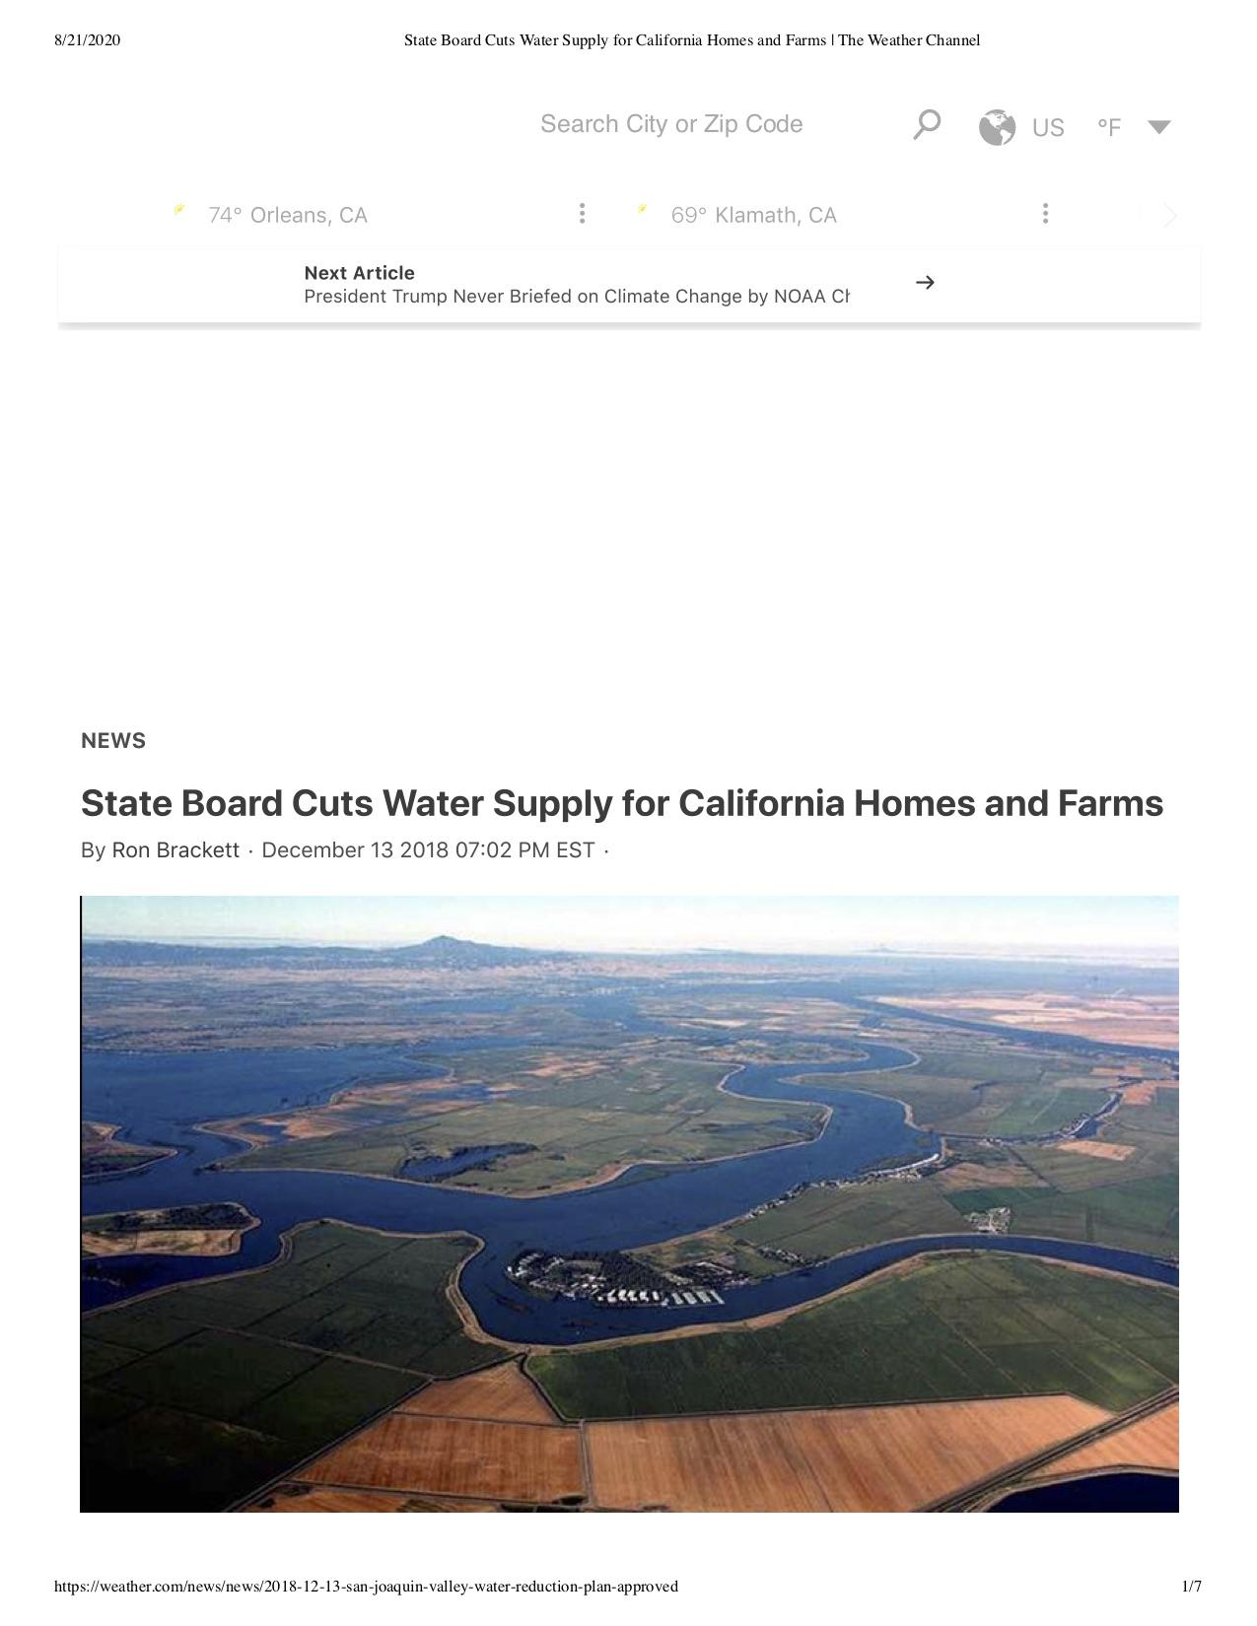
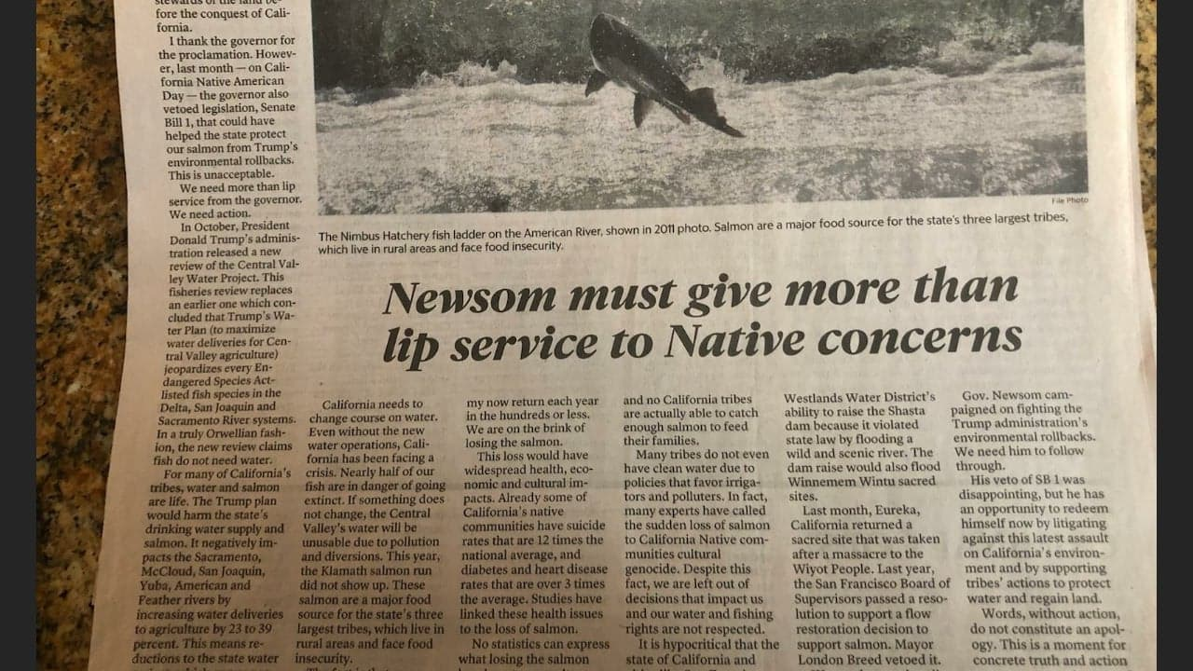
Sometimes stories work out the way you want, sometimes they don’t. Breaking down false narratives is part of media. It is not over once the story is printed. Follow up, share on social media, write LTEs, and educate reporters further.

Slide 11

It’s a good idea to create your own media
Write your own story and shop it around
Create publications
Create memes, social media posts
Make and share videos
Consider paid placements or ads

Slide 12
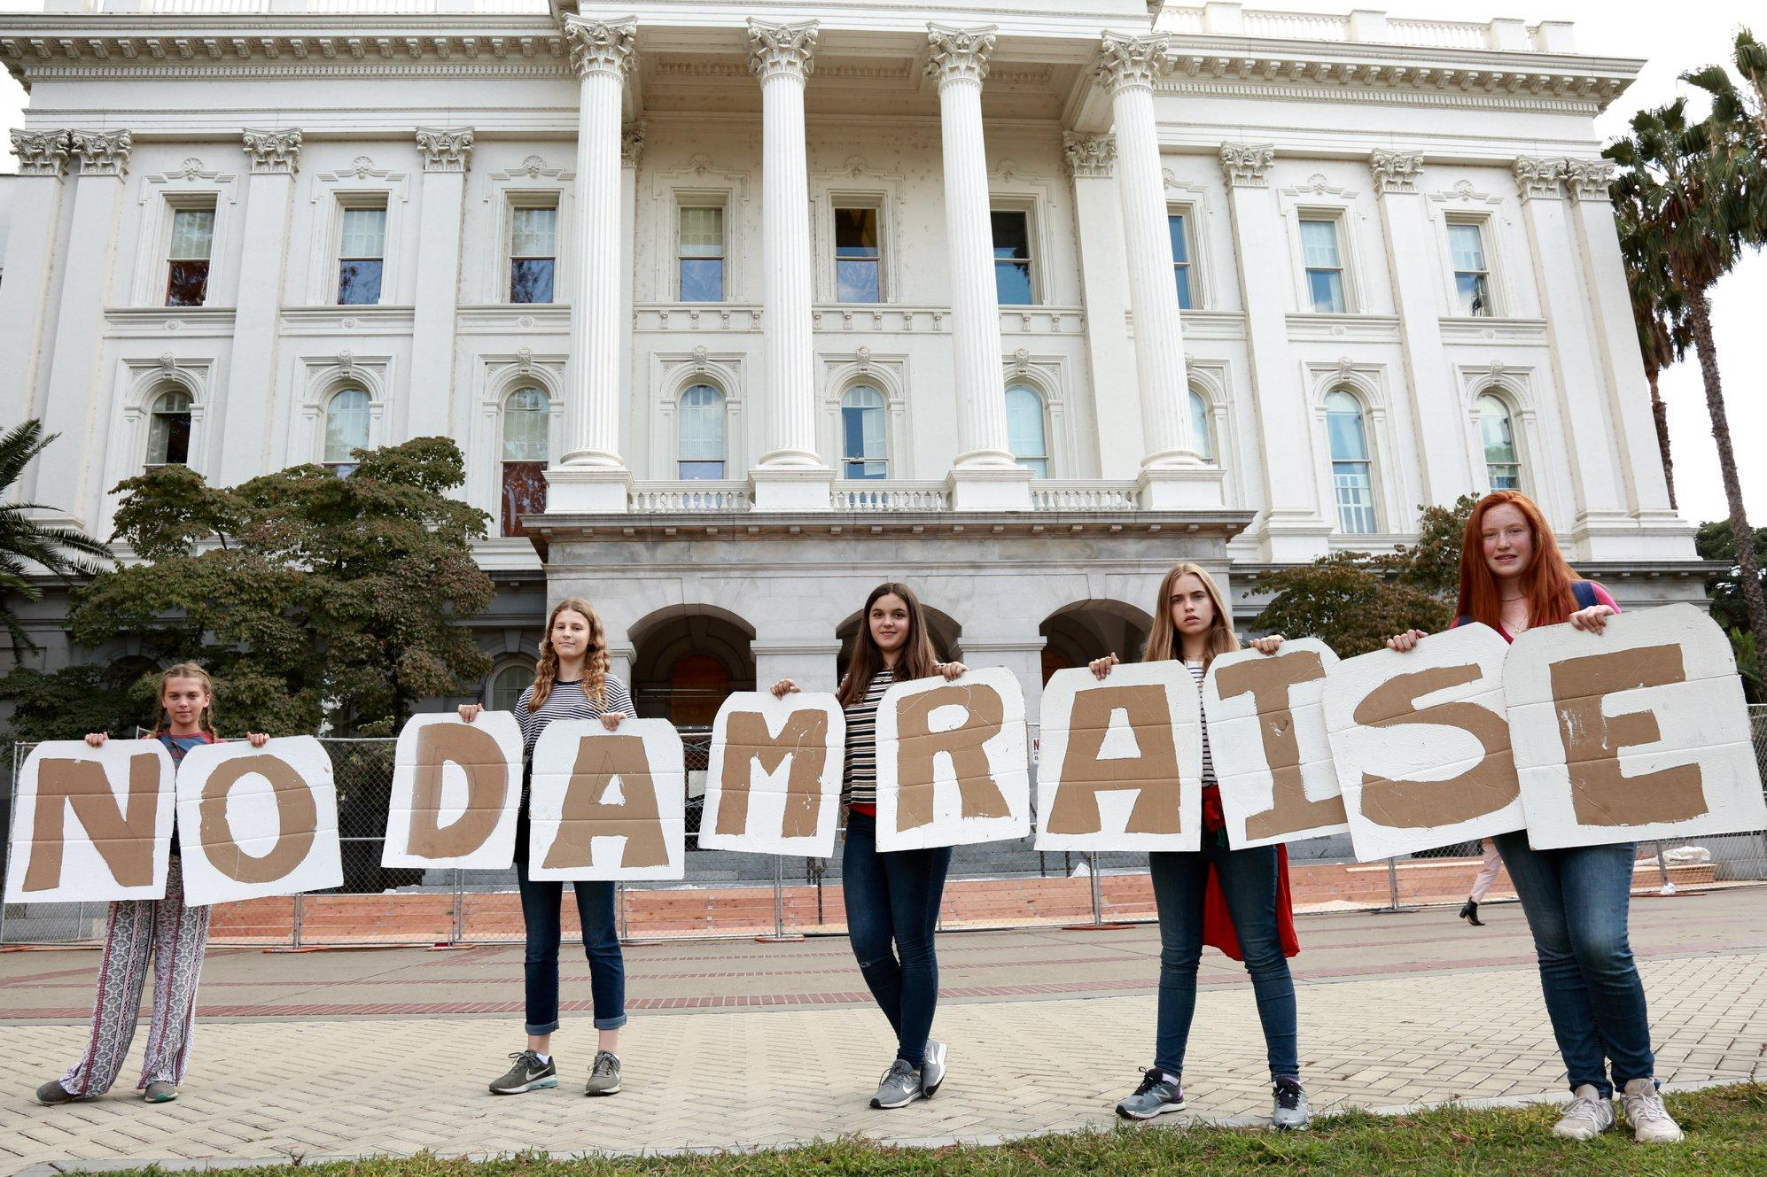
Always remember to
share knowledge,
respect each others skills,
& help each other!!

