Slide 1
Ohl-we’-yoch

Slide 2
Cultural Heritage Tourism
=
Cultural Revitalization
+
Economic Development

Slide 3
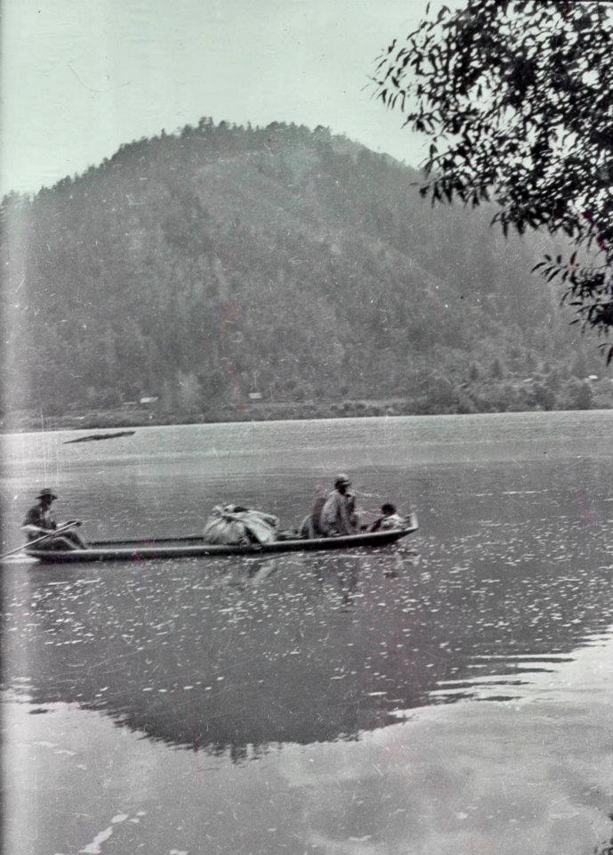
I can’t define your culture for you.
I can’t judge or blame you for what your culture has taught you.
Culture is fluid and ever changing.

Slide 4
“In physical development they are scarcely inferior to whites.”
“in a few years there will only be an old Indian ranch scattered here and there along the river banks, and a few old broken shriveled Indians remaining, to remind the early settlers on the Klamath that it was once thickly populated with an intelligent, dangerous tribe of Indians.”

Slide 5
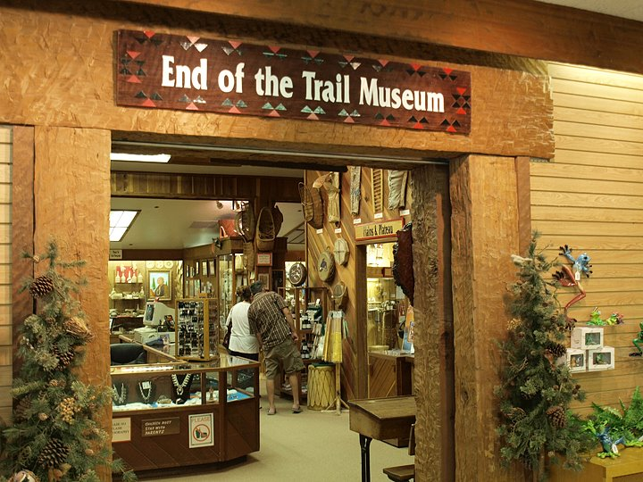
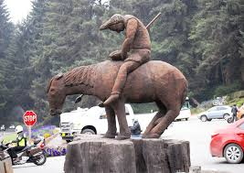
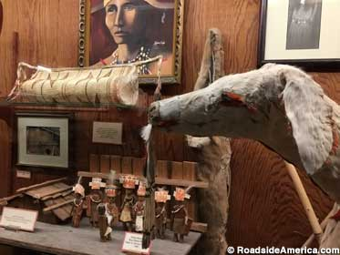
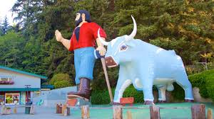

Slide 6
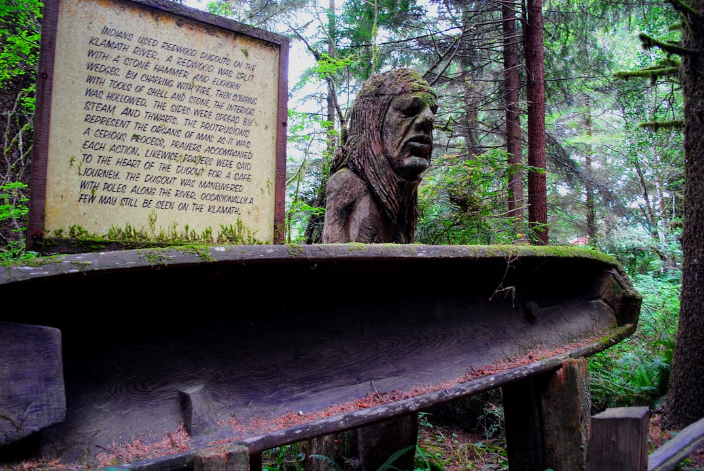

Slide 7
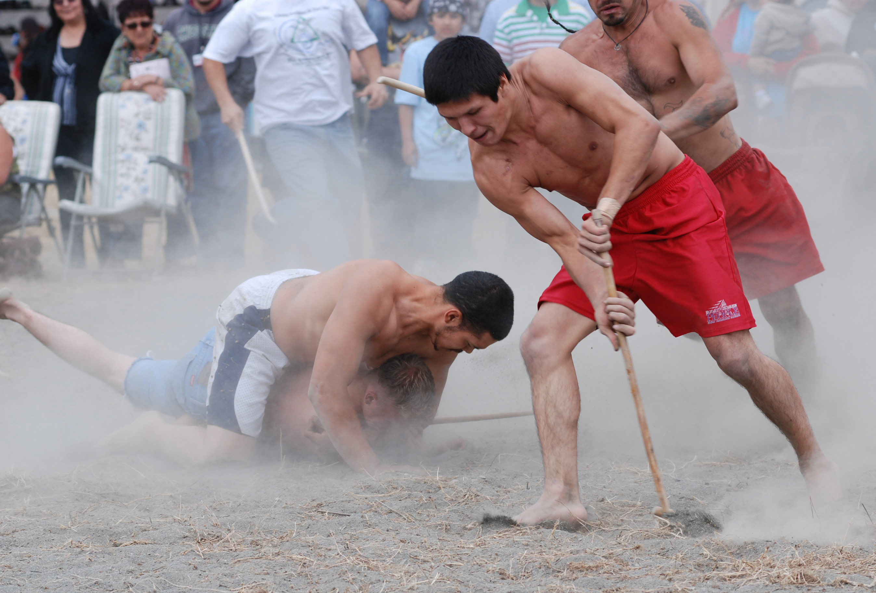

Slide 8
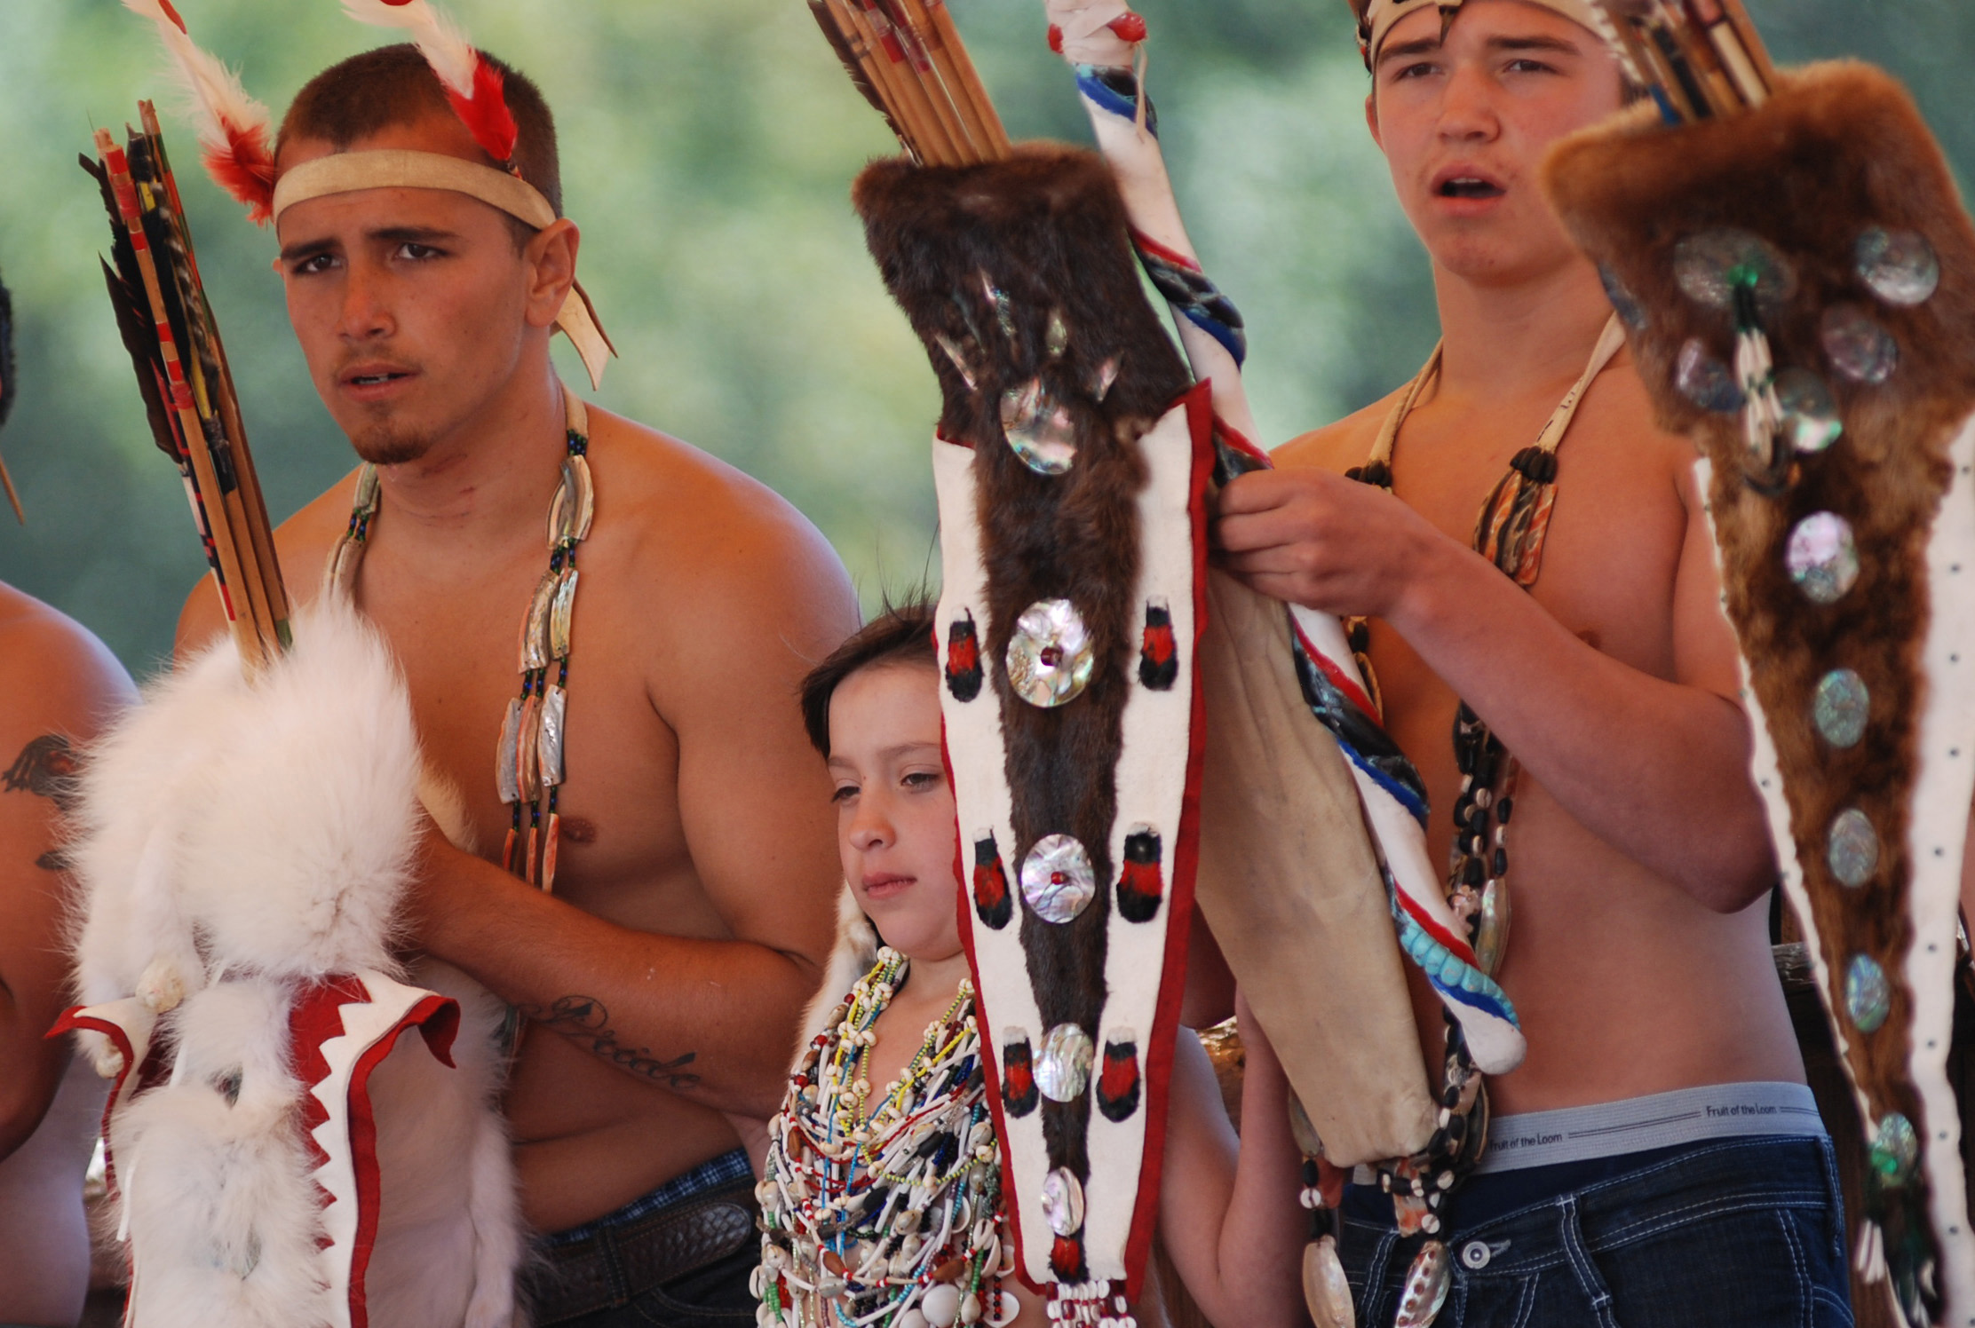

Slide 9
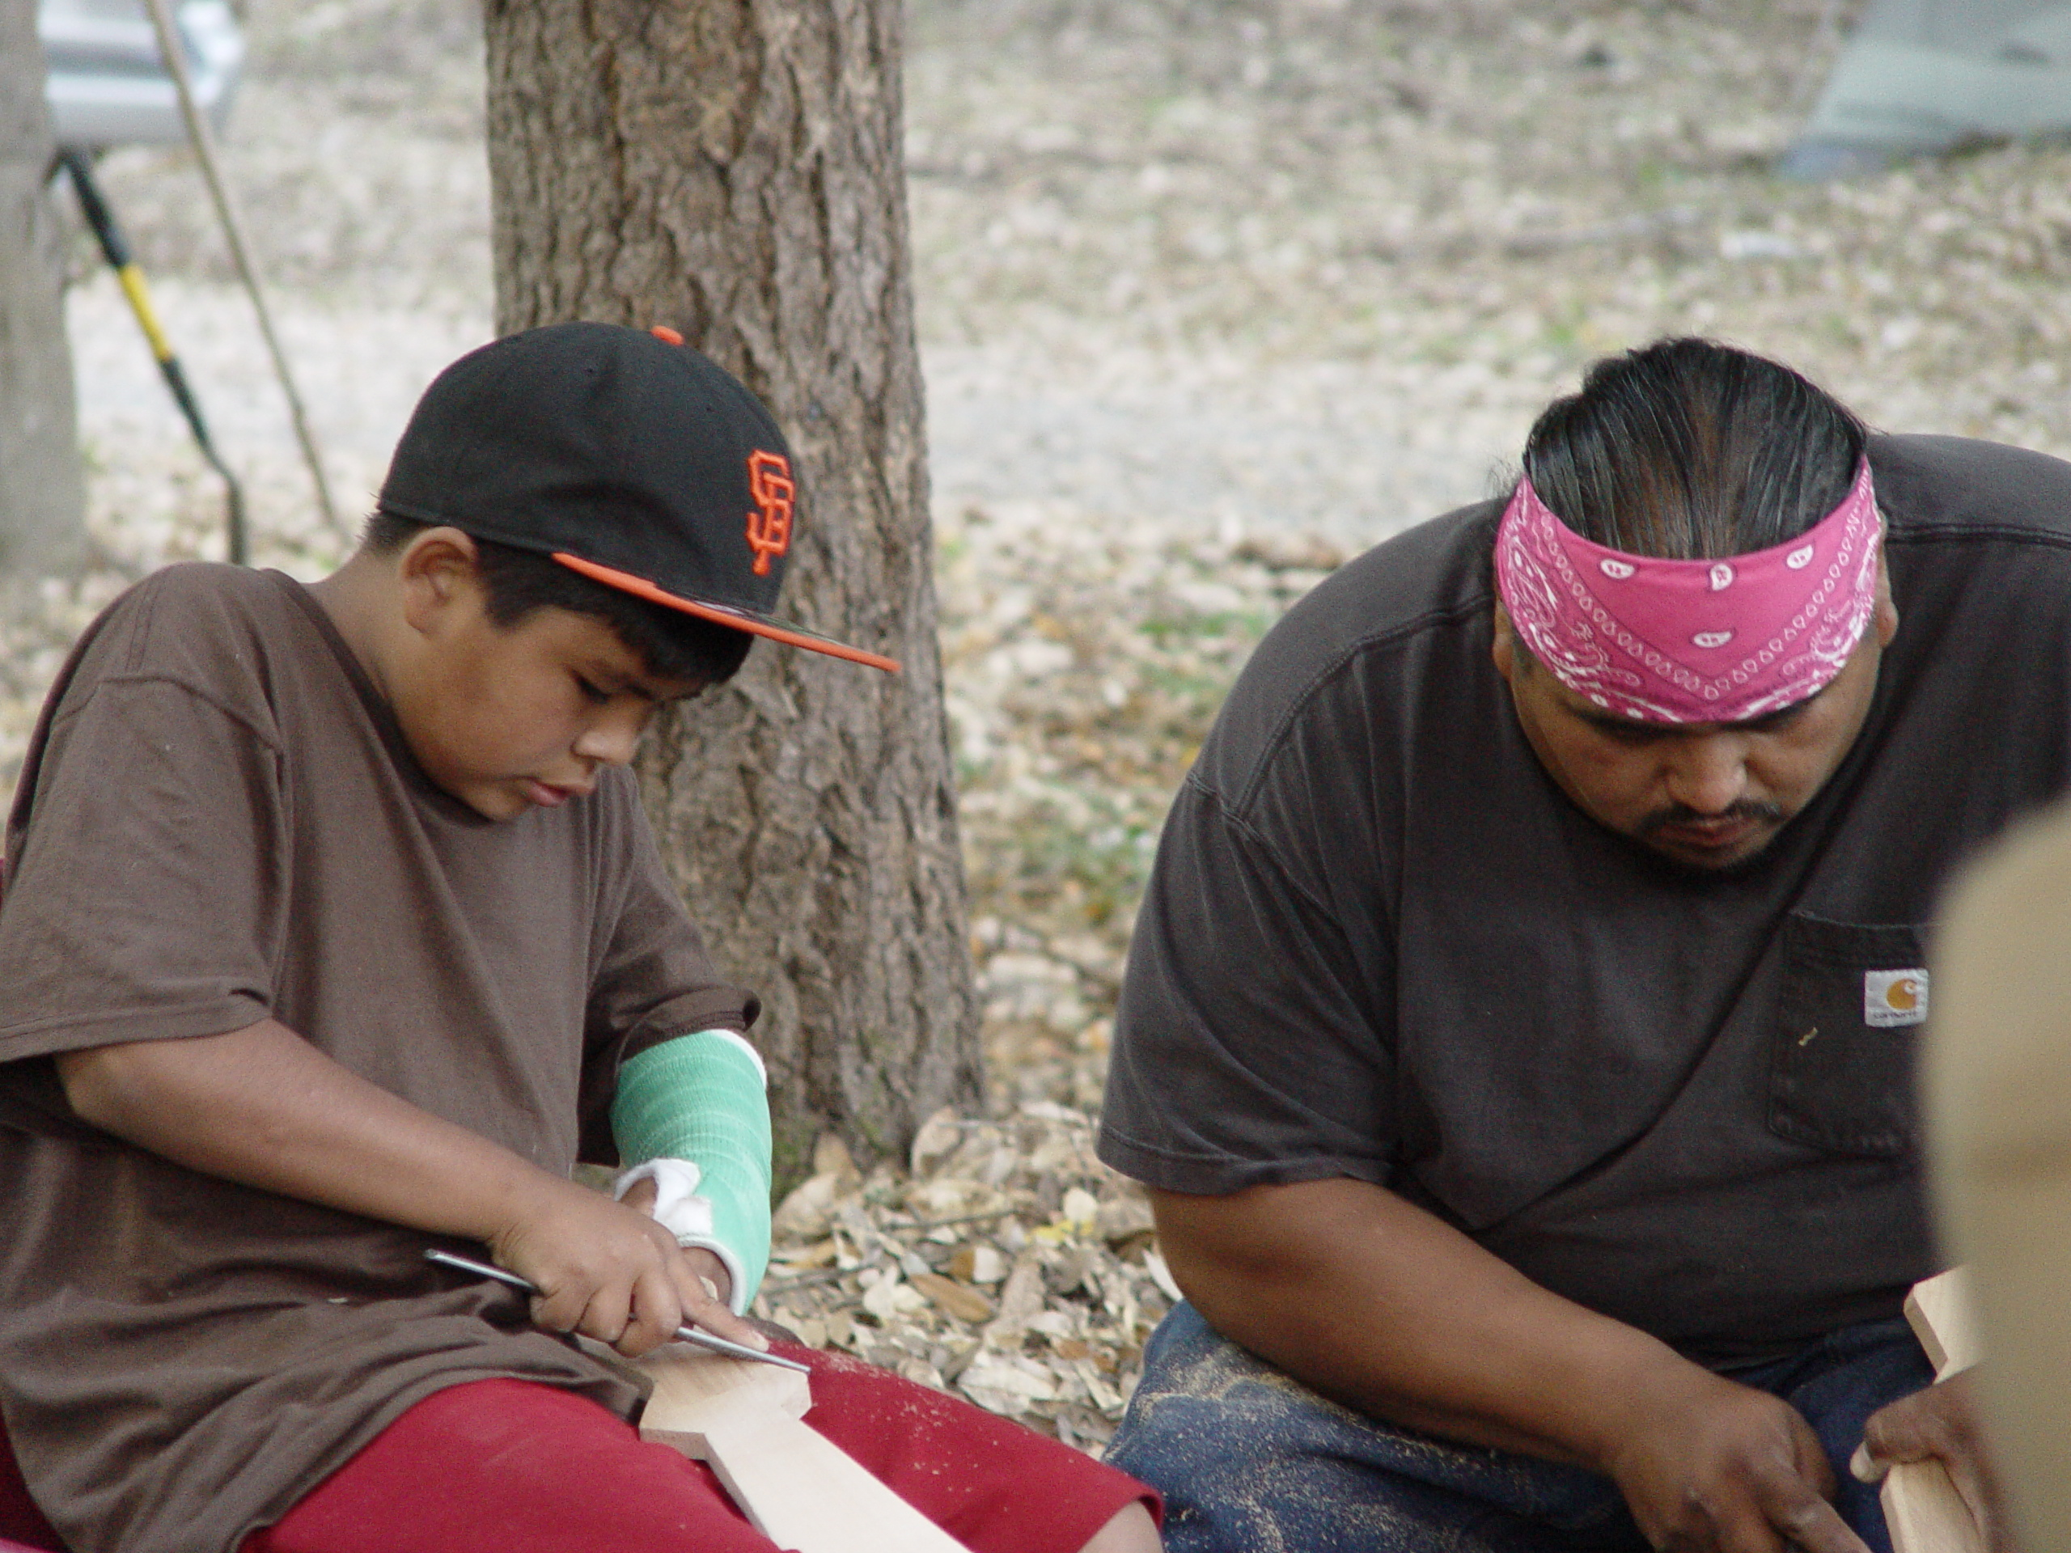

Slide 11
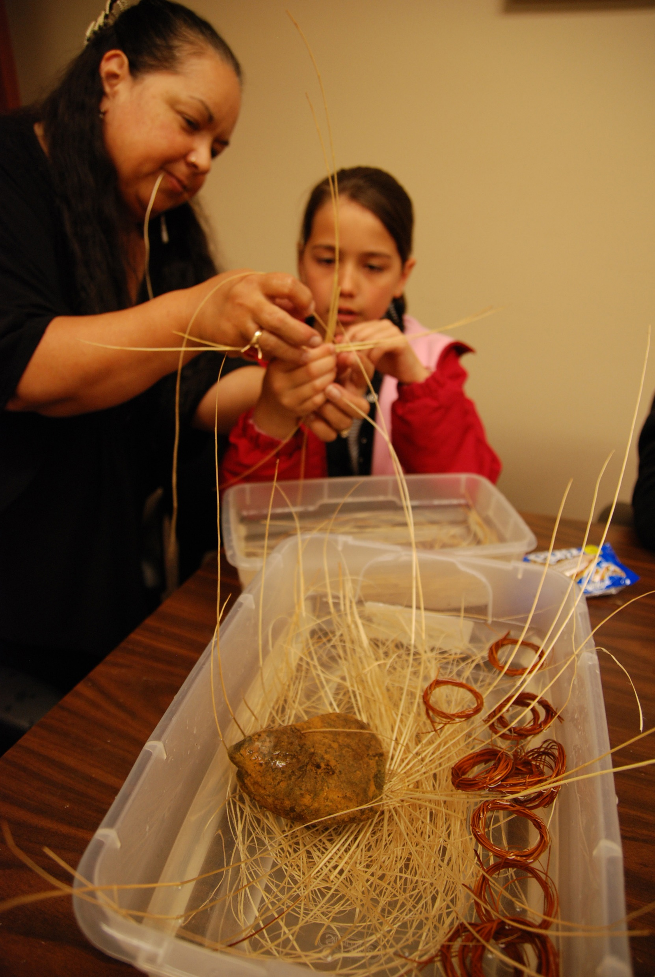

Slide 12
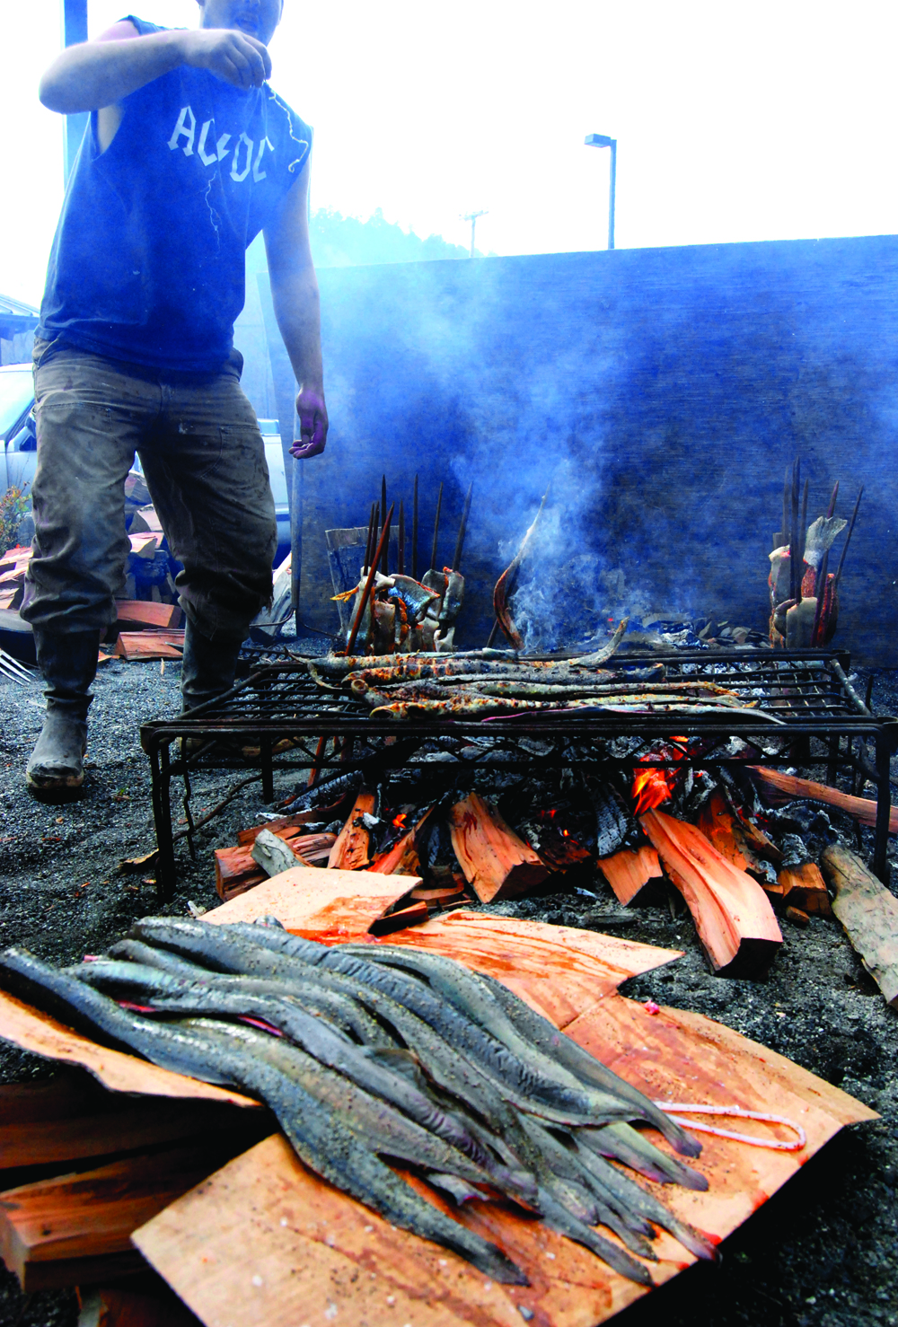

Slide 13
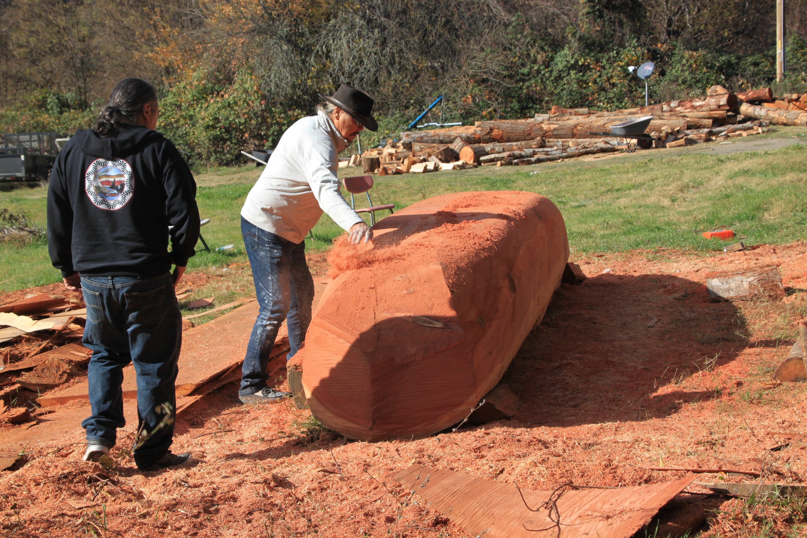

Slide 14
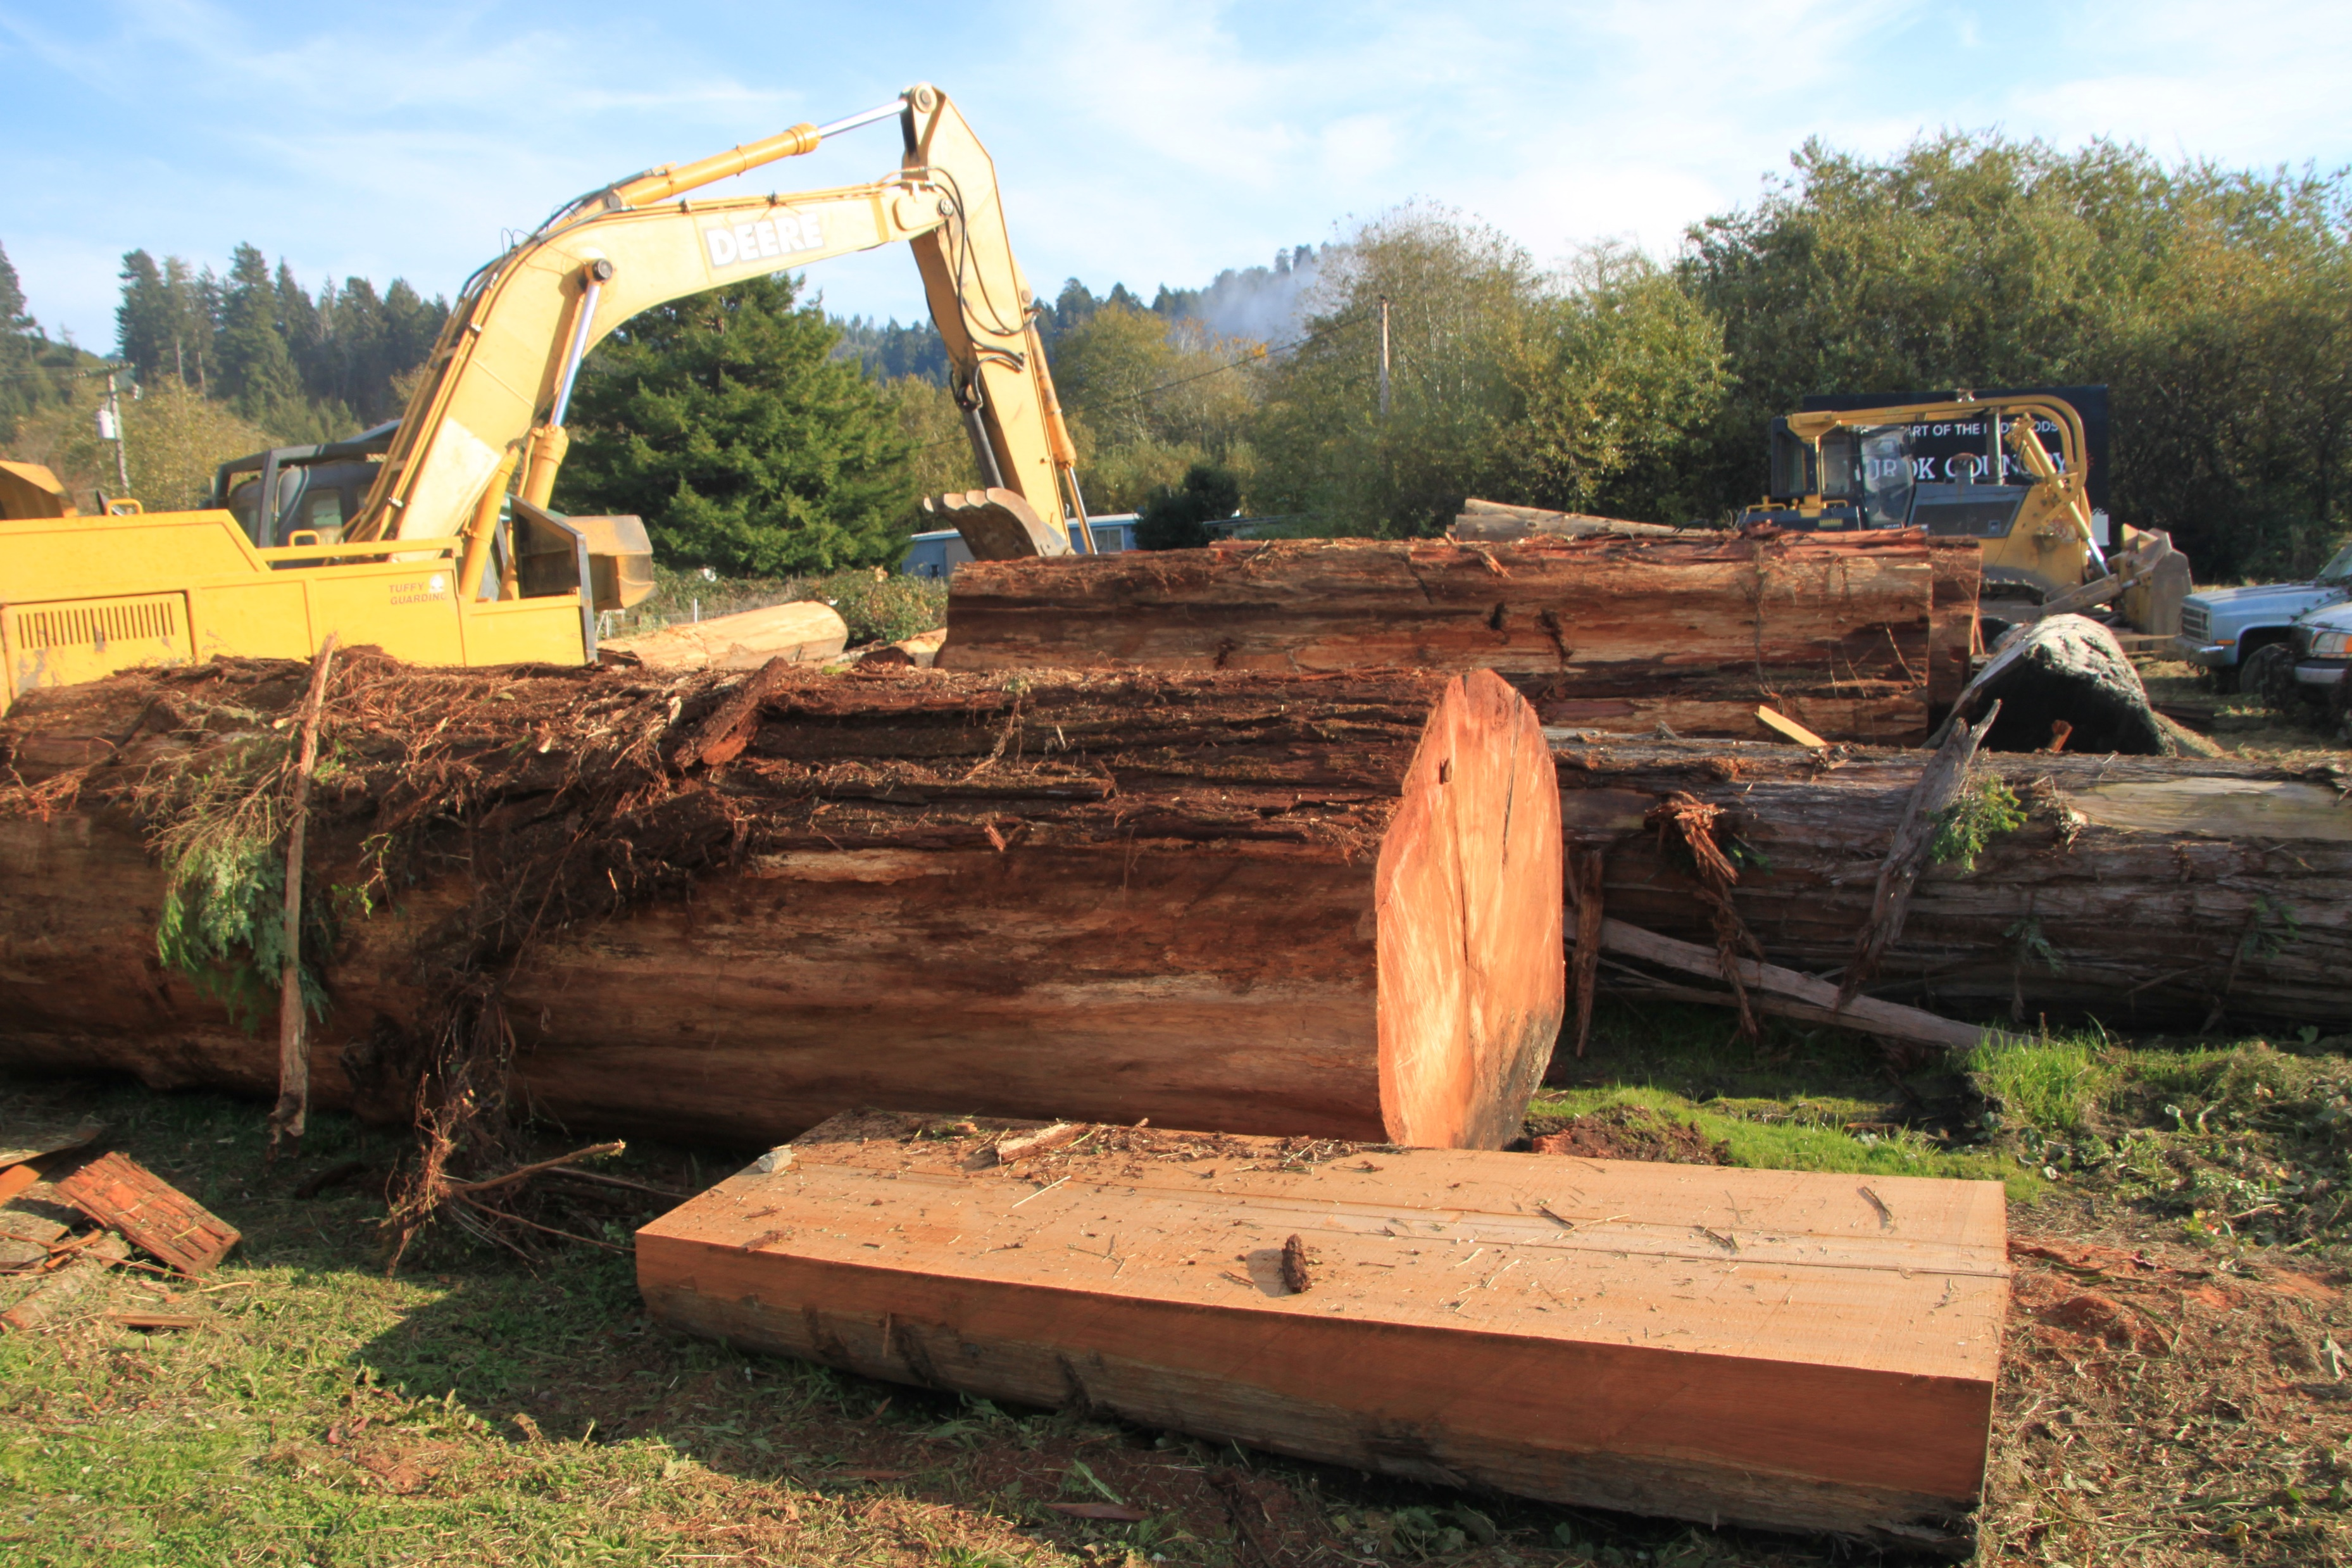

Slide 15
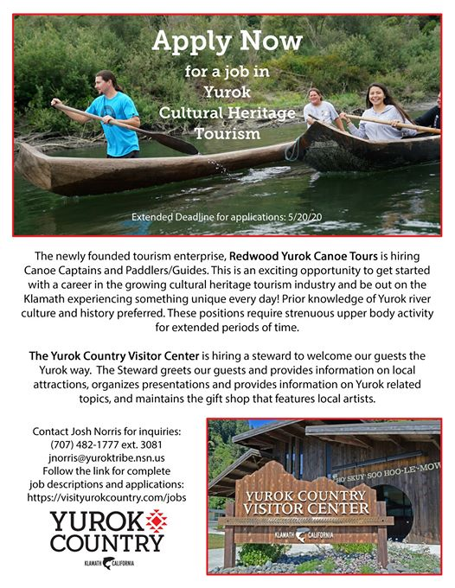

Slide 16
https://www.facebook.com/VisitKlamathCA/
www.visityurokcountry.com/canoes

Slide 17
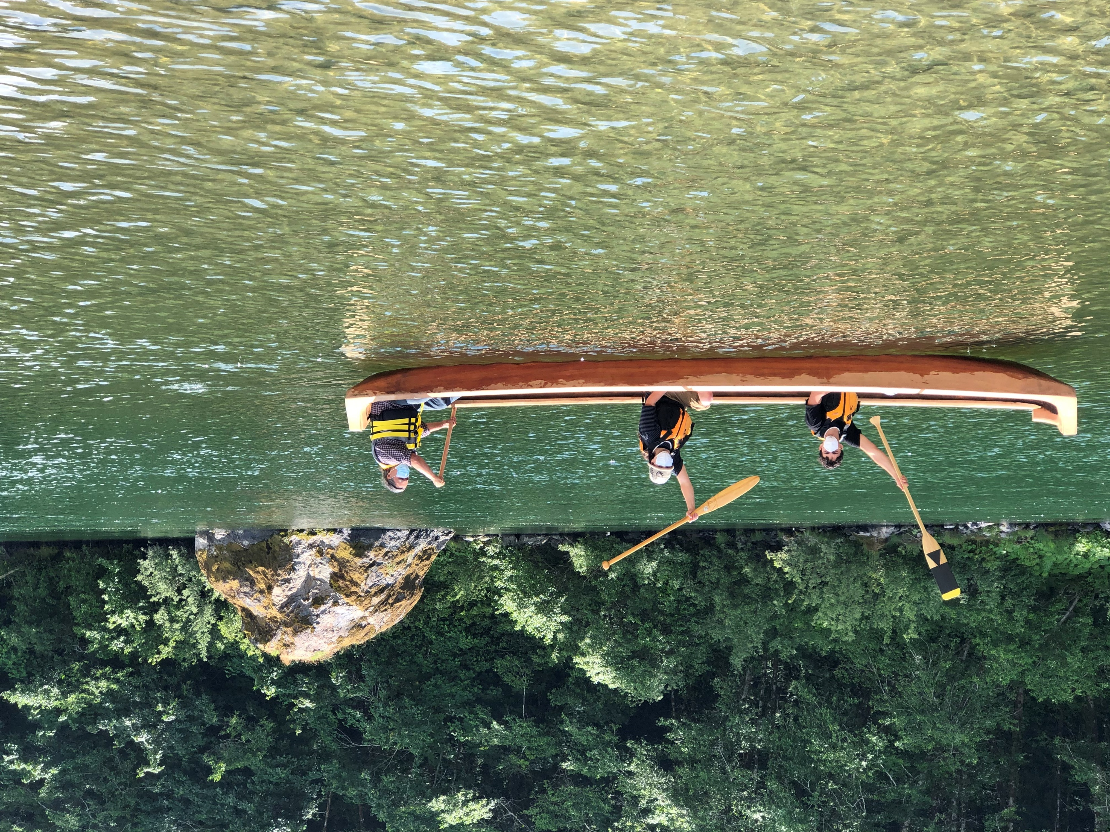

Slide 18
