Slide 1
COMMUNITY ORGANIZING: Through the arc

Slide 2
01
My story
02
WHat is community organizing
03
STRATEGY: arc of organizing
04
Organizing in a time of isolation
Community Youth Organizing in Indigenous Communities
Finding examples from the group - Word Cloud activity
What is the arc of organizing? How do I use it?

Slide 3
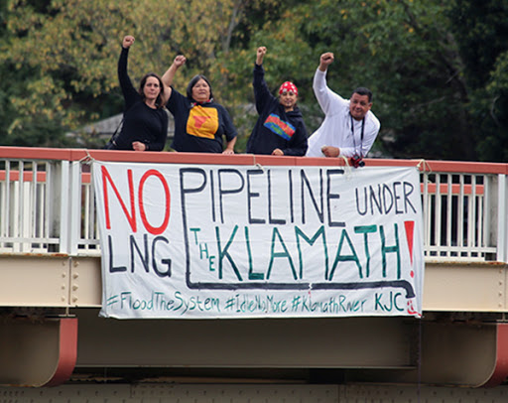
Banner drop for NOLNG Movement
Banner drop for Undam the Klamath Movement

Slide 4
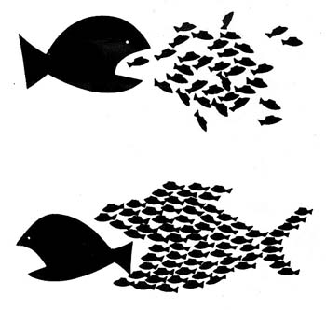
Community organizing
“The Coordination of cooperative efforts and campaigning carried out by local residents to promote the interest of the community.”

Slide 5
an organizer
To build a collective power with people to work toward a common goal.
Should not be a position of authority - There is always more power when working together.
Has no specific designated role
Is always learning

Slide 6
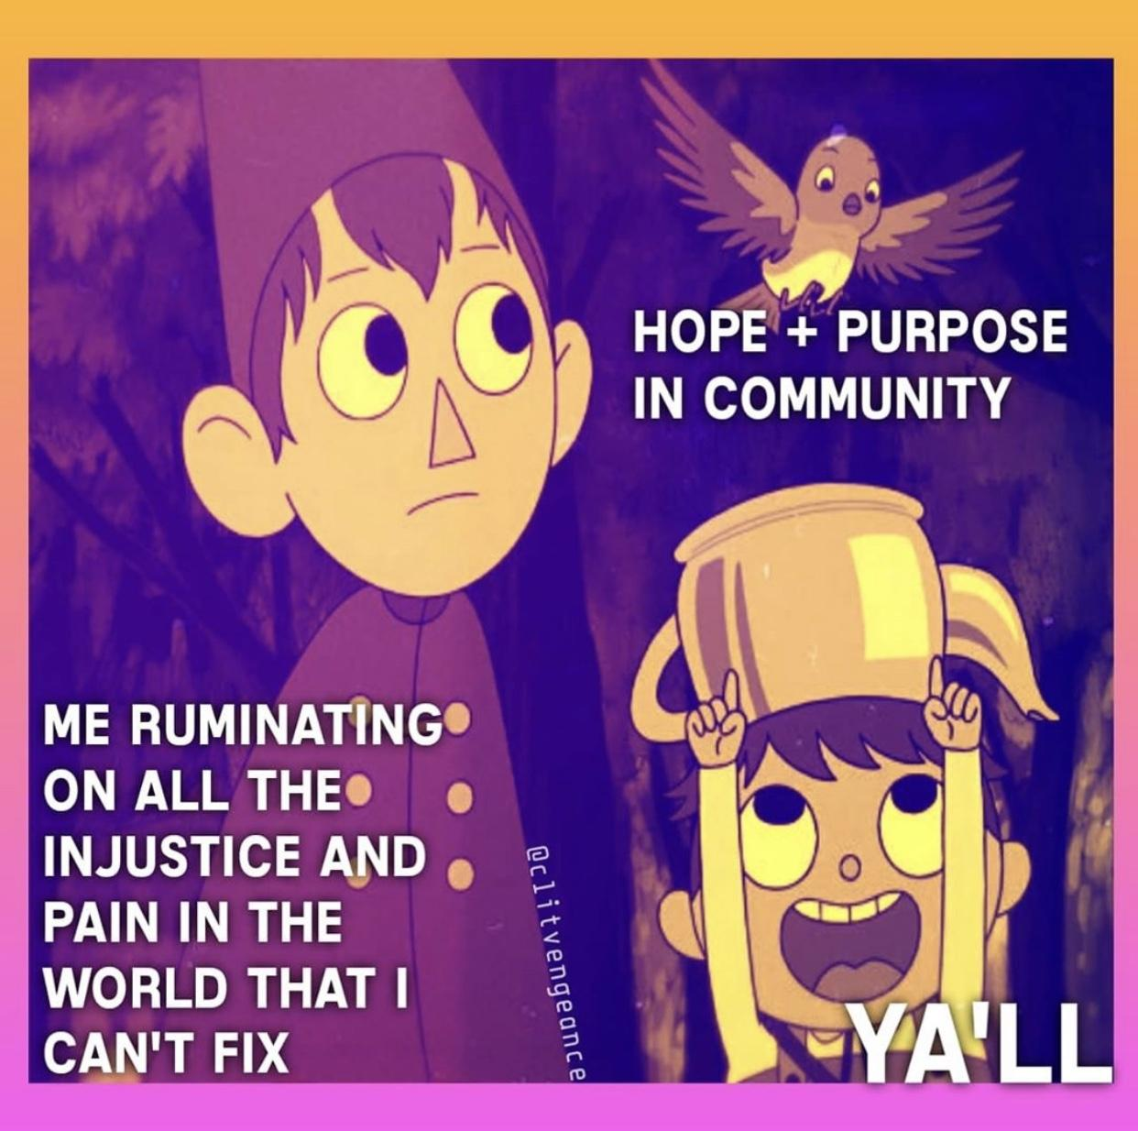
The long term strategy of the Organizer is to build and train leaders to the point where they are able to do the work of the organizer and lead campaigns.

Slide 7
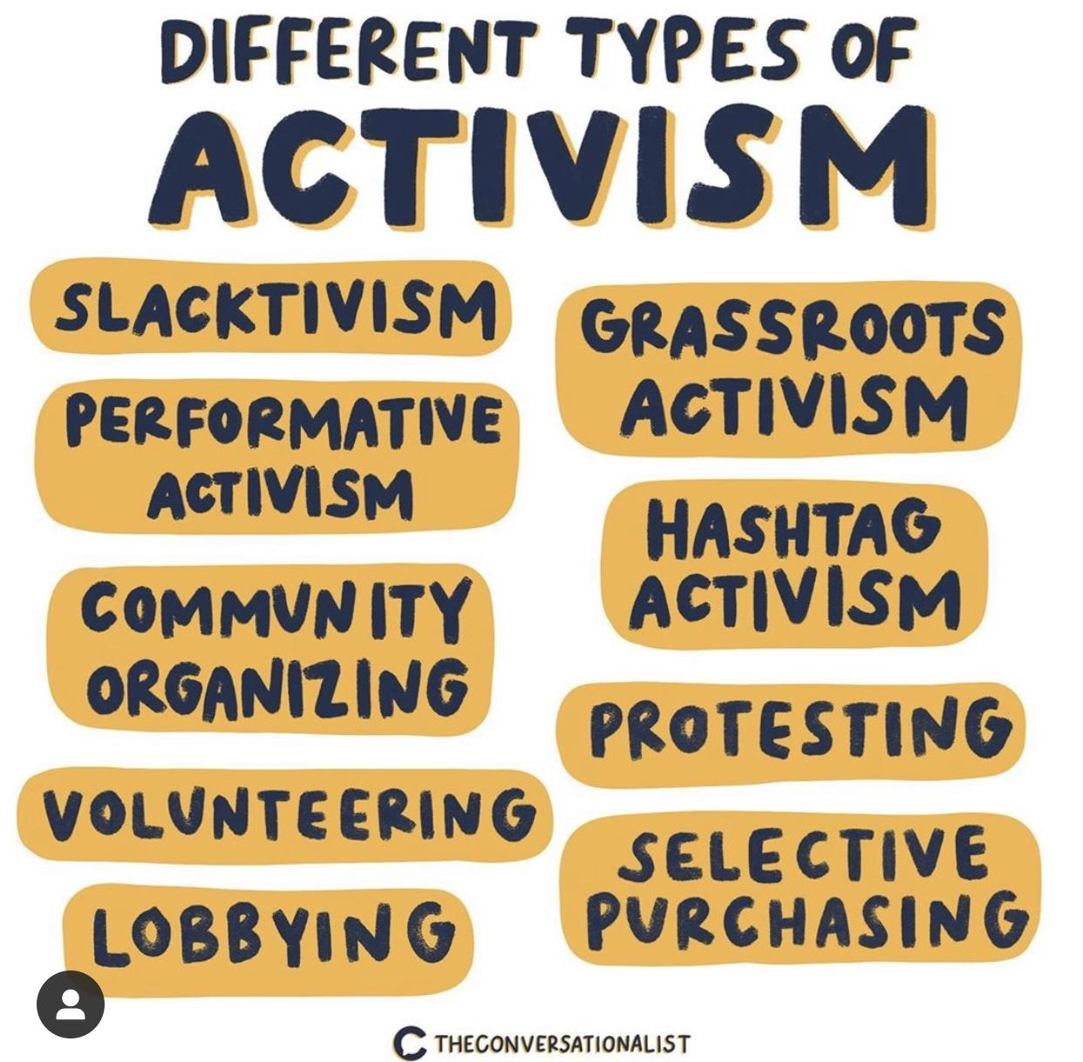

Slide 8
WORD CLOUD
What are some examples of community organizing?
Respond at: PollEv.com/mahlijaflore664
Or text MAHLIJAFLORE664 to 37607 to join through text.

Slide 9
The arc of organizing
Celebrate
The encounter
rEFLECTION & follow up
Disruption
aCTION
Remaining/Strategy

Slide 10
The encounter
The organizer must know and understand their story of self
Time for meeting people and building a relationship
This is a time for networking and building the campaign.

Slide 11
Disruption
This is when an organizer will be using 1:1's with people building a coalition or a L.O.C ( Local Organizing Community) and honing in on an issue that the LOC can committee to building a campaign around.
Awakening will begin to happen as you are entering people a day to day life and making them aware of an issue and welcoming them to build shared power to make a change.
Typically the LOC along with the organizer will do a lot of the groundwork to make sure the group has accurate information and has done research into the issue.

Slide 12
remaining/strategy
Creating a new vision of how things should/could be. This vision should be built with the LOC and agreed with as the LOC should be the people closest to the issue.
Using your research, the organizer should have an understanding of who the targets are that have the power to create the change or help with your strategy.

Slide 13
Action
Radical system transformation.
put pressure on target or disposition maker.
This can look many different ways.

Slide 14
Reflection & follow up
Reflect with your LOC on what happened
Sometimes you have to follow up with the decision makers if they agreed to make a radical change. Hold them accountable to the changes they agreed to help make, This could look like policy change, replicating funds in a more equitable way, or join the LOC.

Slide 15
Celebrate your wins!!!
This can look many different ways. The spectrum of wins ranges.

Slide 16
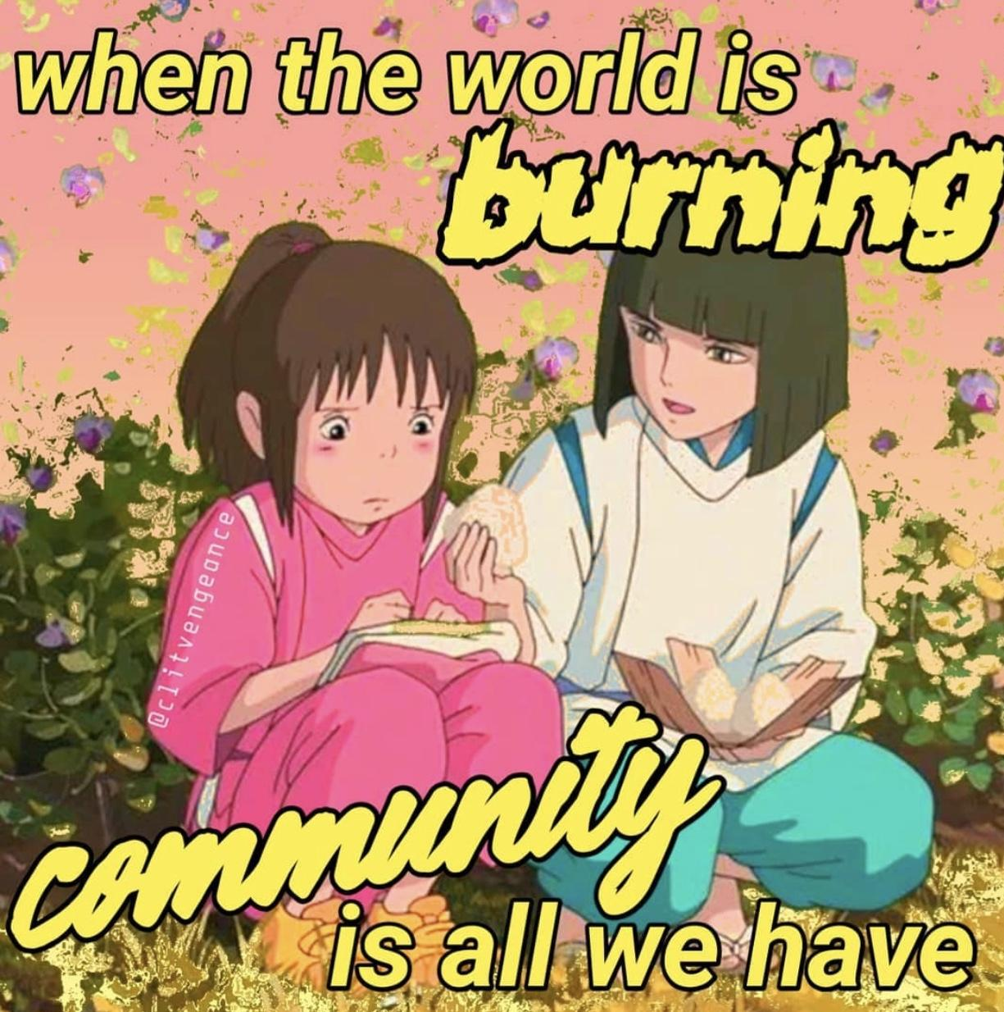
How do we organize in a time of isolation?

