Slide 1
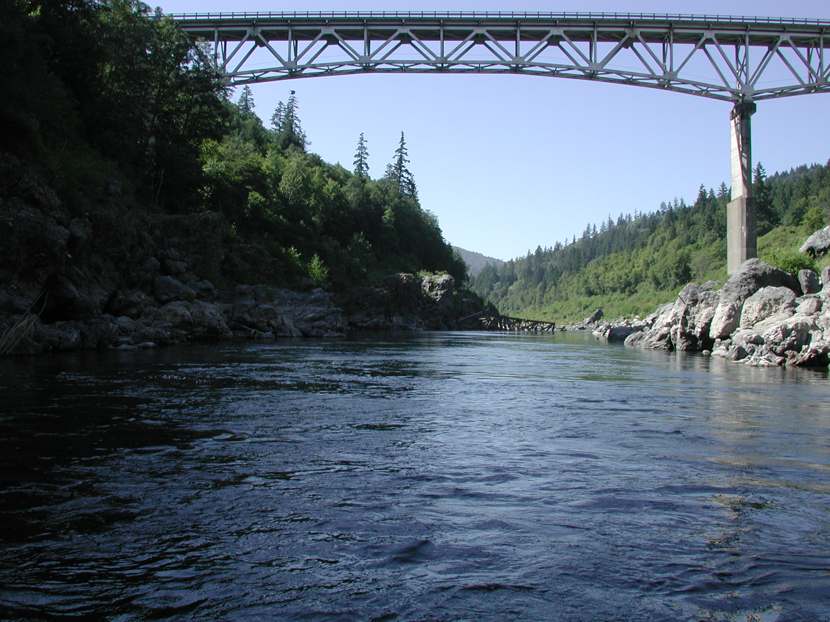
Klamath River Basin Restoration State of the Salmon
Michael Belchik
Yurok Tribal Fisheries Program
Notes:
Past present and future of flow study science in the Klamath Basin.

Slide 2
What’s the Mission?
The mission of the Yurok Tribe is to exercise the aboriginal and sovereign rights of the Yurok People to continue forever our Tribal traditions of self-governance, cultural and spiritual preservation, stewardship of Yurok lands, waters and other natural endowments, balanced social and economic development, peace and reciprocity, and respect for the dignity and individual rights of all persons living within the jurisdiction of the Yurok Tribe, while honoring our Creator, our ancestors and our descendants.
Simply put, the job is to fix the river cultural landscape now, and into the future.
The problems on the Klamath are big, and require landscape-scale solutions.
We’re going to talk about water and fish today…

Slide 3
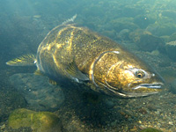
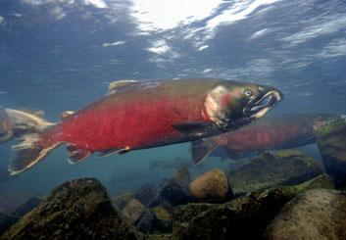
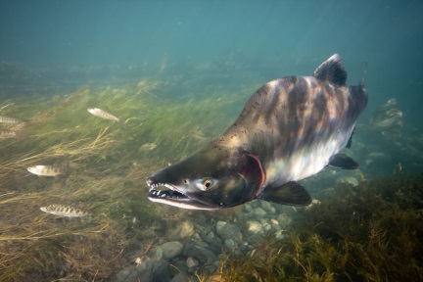
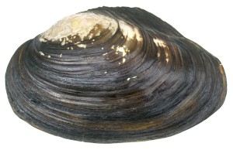
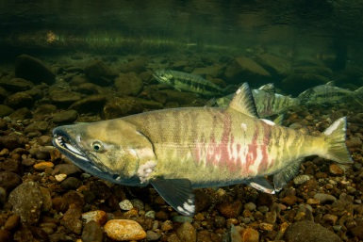
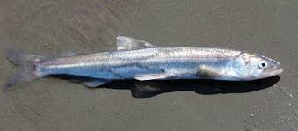
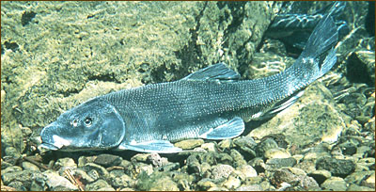
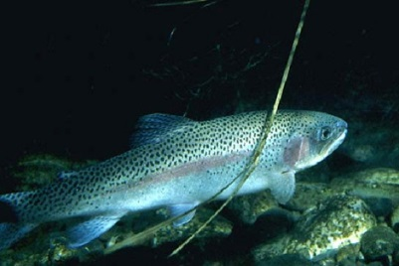
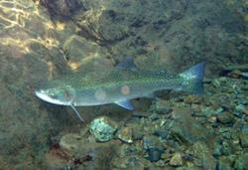
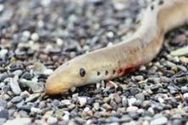
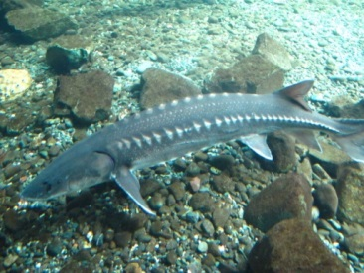
Diversity is the Spice of Life
Fall Chinook
Spring Chinook
Coho Salmon
Pink Salmon
Mussels
Chum Salmon
Candlefish
C’wam
Winter Steelhead
Summer Steelhead
Pacific Lamprey
Green Sturgeon

Slide 4
Diversity is the Spice of Life
Fall Chinook
Spring Chinook
Coho Salmon
Pink Salmon
Mussels
Chum Salmon
Candlefish
C’wam
Winter Steelhead
Summer Steelhead
Pacific Lamprey
Green Sturgeon

Slide 5
Diversity is the Spice of Life
Fall Chinook
Spring Chinook
Coho Salmon
Pink Salmon
Mussels
Chum Salmon
Candlefish
C’wam
Winter Steelhead
Summer Steelhead
Pacific Lamprey
Green Sturgeon

Slide 6
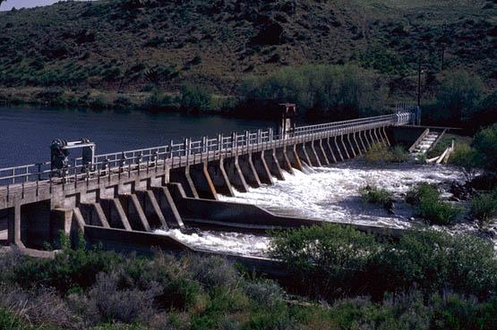
How much water does a river need to live?

Slide 7
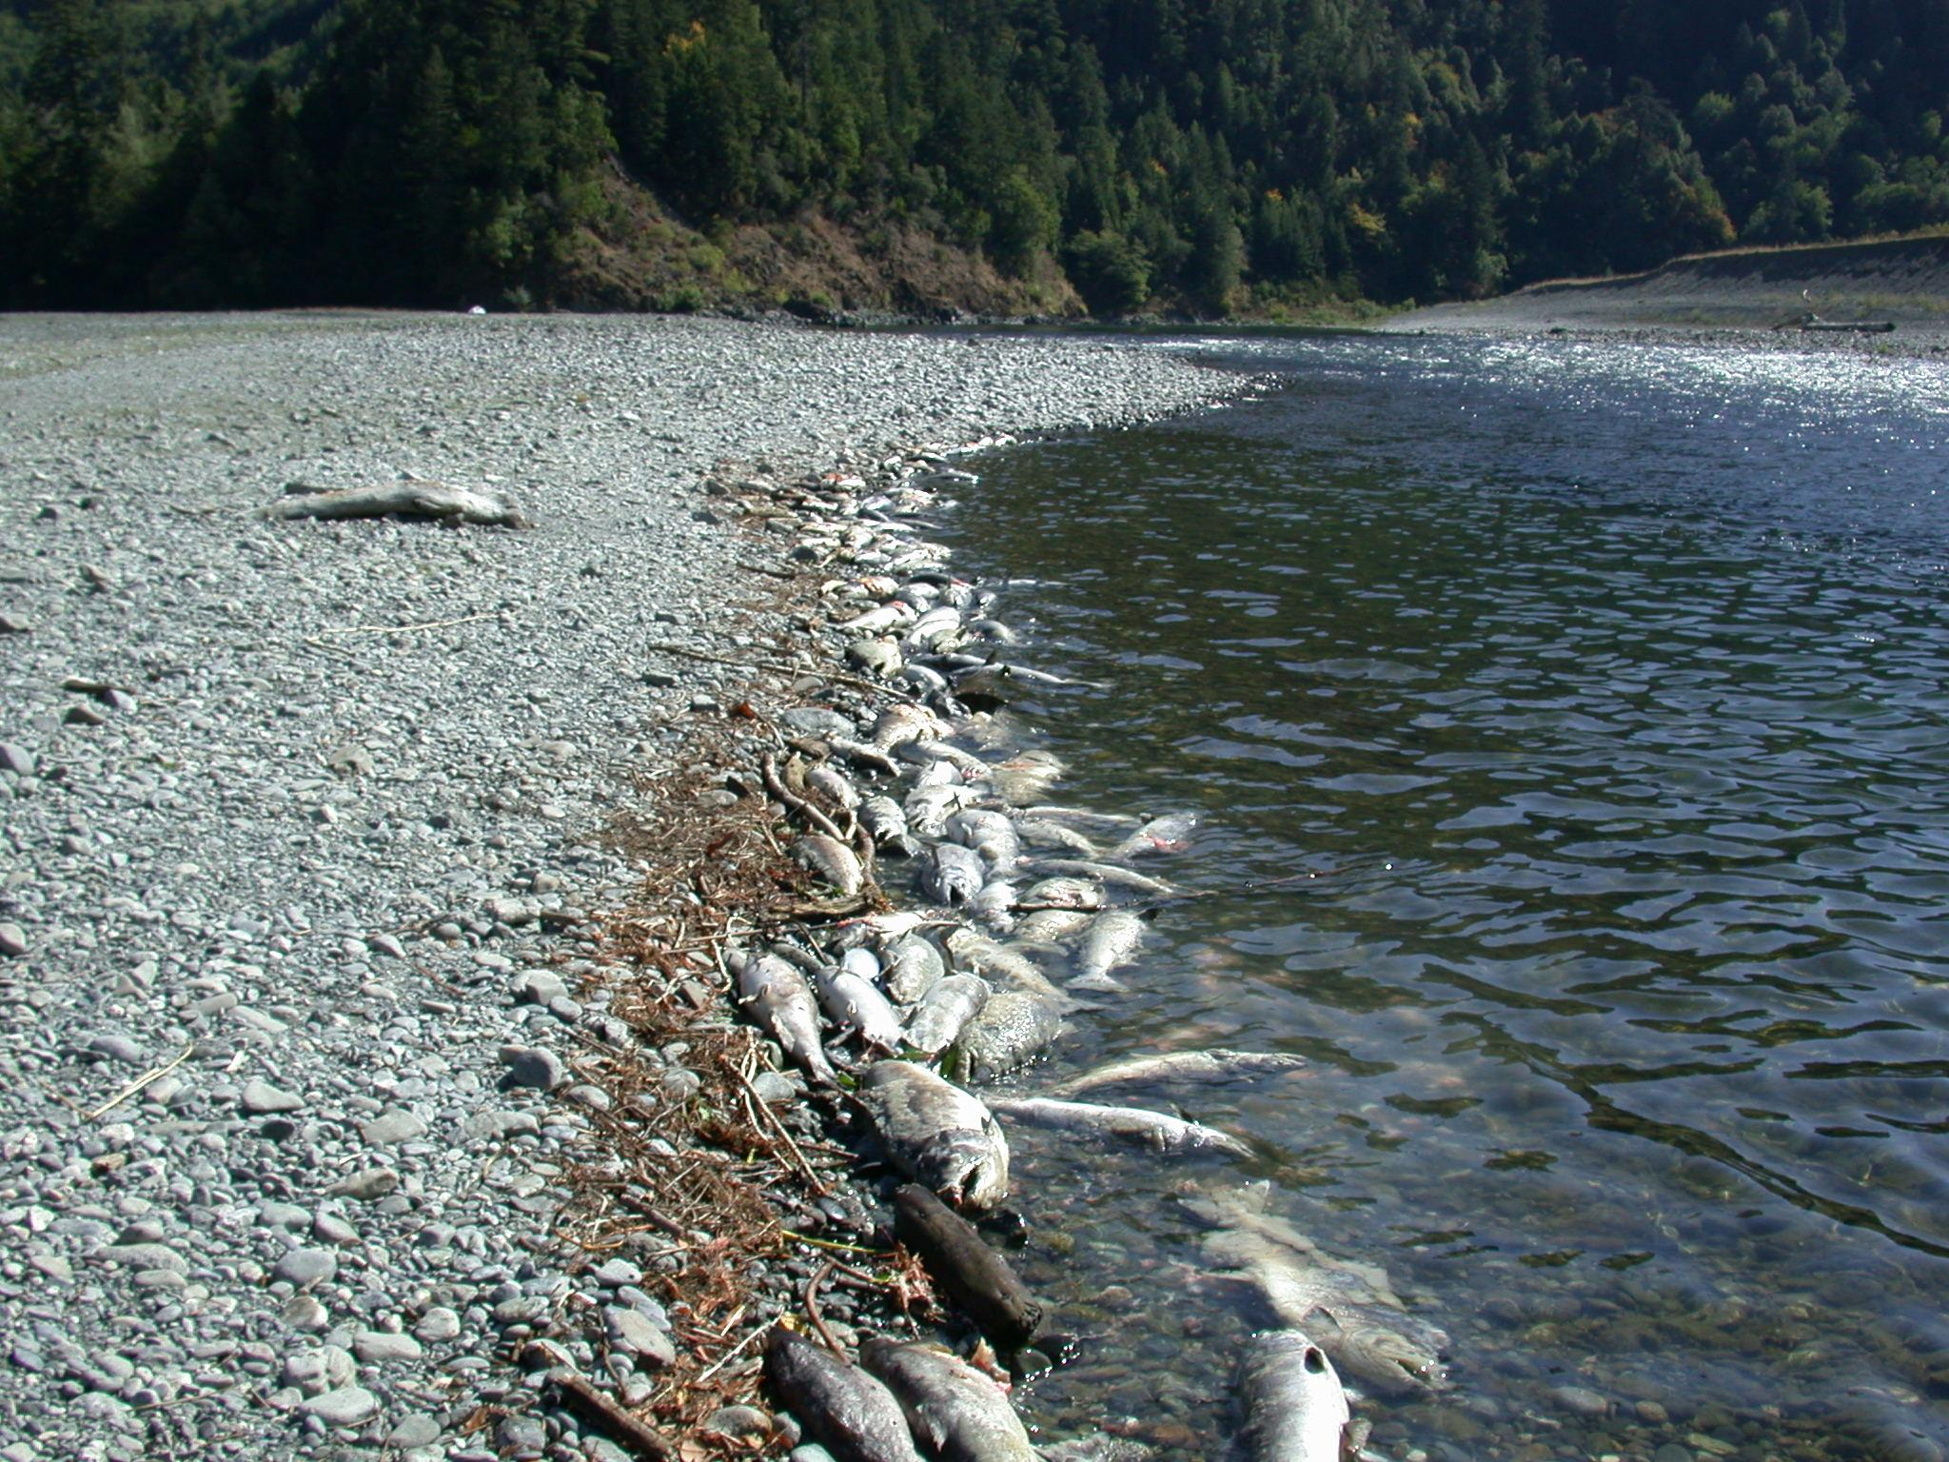
Water quality and flow conditions are now poor enough to cause major fish kills

Slide 8
What Must Be Done?
Dam Removal
Salmon return to their home
The basin: reunited with the salmon and culturally
The right flows
Shasta, Scott, Trinity, Klamath
Fix water quality
Restore
Restore Wetlands

Slide 9
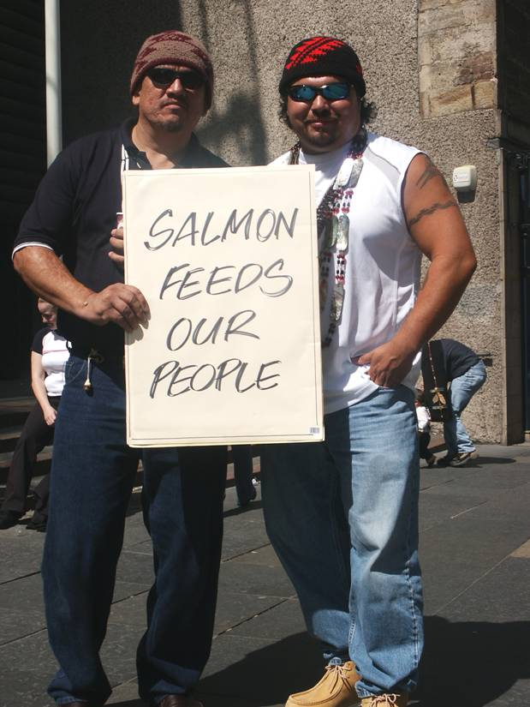
How does it happen?
Culture
Traditional Environmental Knowledge
Science
Litigation
Direct Action
Media
Politics
Policy
Organize!

Slide 10
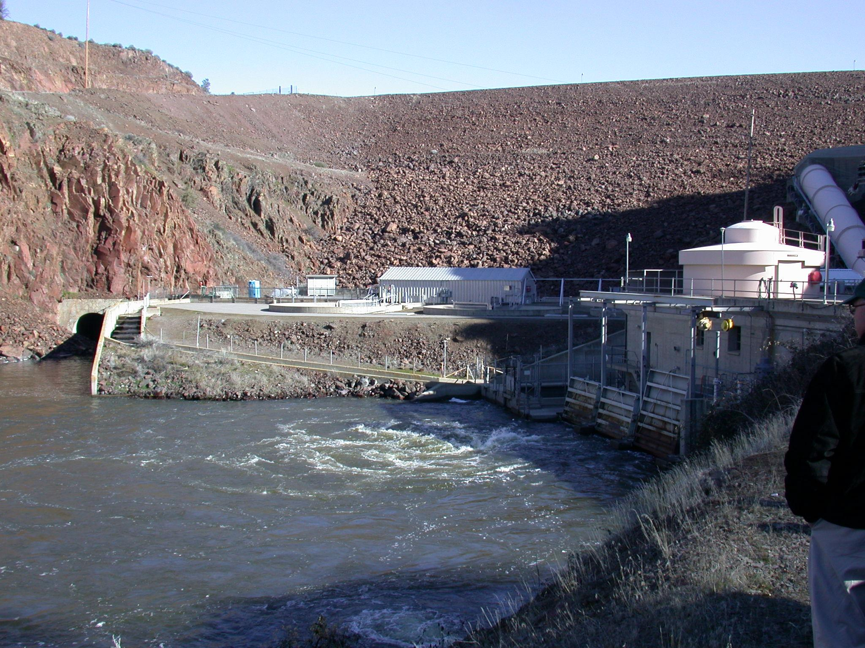
Dam Removal

Slide 13
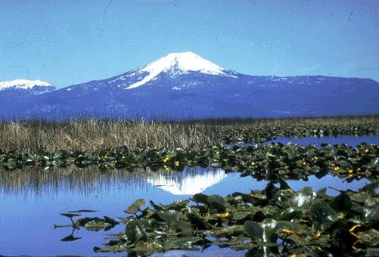
Large-scale wetland restoration

Slide 14
Durable Solutions take dedication and communication.
Clear thinking is required for long-term solutions. The way forward is not always obvious.
Sometimes deciding to fight may mean losing everything
Sometimes, there’s no choice.
Right now, water flows depend on the Endangered Species Act.
Is that the best way to ensure flows moving forward?
How can Tribal Rights become more of a guiding factor in flow and water management decisions?
Rights are never granted, they must be asserted.

